Slide 1
ISY503 Intelligent Systems
Final Group Project

Slide 2
Introduction
01

Slide 3
OUR GROUP
01
02
03
Zhengmin Zhu
Yousuf Agha
Natasha Mathews
A00154491
A00138948
A00136182

Slide 4
OUR GOAL
We aim to build a sophisticated Intelligent System that focuses on Natural Language Processing. This project will allow us to delve into the complexities of language understanding, sentiment analysis, and other NLP applications, sharpening our technical skills in this exciting field.

Slide 5
UNDERSTANDING THE PROBLEM
Negative Reviews
Positive Reviews
Notes:
Dataset Complexity: The Multi-Domain Sentiment Dataset contains product reviews from 4 different domains—Kitchen, Books, DVDs, and Electronics. Each domain includes thousands of reviews, each with varying formats, which introduces challenges in handling a wide variety of data types and ensuring consistency across domains.
Data Structure Issues: The dataset is organized into directories containing positive, negative, and unlabeled reviews. Positive reviews express favorable opinions about the products, while negative reviews highlight dissatisfaction. These reviews are encoded in a pseudo-XML format, which required careful parsing and preprocessing. Moreover, inconsistencies like repeated unique IDs added complexity to the data cleaning process.
Labeling Challenges: The star ratings provided (ranging from 1 to 5 stars) could be converted into binary sentiment labels, categorizing reviews as either positive or negative. However, determining the threshold between positive and negative reviews required careful consideration to avoid introducing bias into the labeling process.
Domain Variability: The differing nature of product reviews from domains like Kitchen or Books presents unique challenges. The language used in positive reviews, such as praising product quality, can be quite different from the language used in negative reviews, which often focuses on faults or disappointments. This variability requires our model to generalize well across different writing styles and terminologies to effectively understand sentiment in each context.

Slide 6
OUR SOLUTION
Time Efficiency
Cost-Effective Model Design
Team Collaboration
Results-Oriented Deployment
Our data preprocessing pipeline was streamlined to minimise delays, including using efficient libraries for tokenisation and stopword removal. This saved significant time in preparing the data for modelling.
We opted for a GRU-based architecture over other complex models to reduce computational resources while maintaining accuracy
Effective teamwork was key to tuning hyperparameters efficiently. We leveraged collective expertise to fine-tune parameters such as learning rates and dropout rates, which led to faster convergence and better model performance.
Our deployment via a Flask web app ensured that users could easily interact with the model. The focus being on delivering quick, accurate sentiment analysis results, providing real-time insights to users.

Slide 7
Model
02

Slide 8
Model Overview
Why GRU?
Model Goal
Model Architecture
Pre-trained Embeddings
Notes:
Model Architecture: Introduce the model architecture, which is based on GRU (Gated Recurrent Unit) layers for sentiment analysis.
Why GRU?: Explain why GRU was chosen over LSTM: GRUs are computationally less intensive and provide similar accuracy, making them an ideal choice for this use case.
Pre-trained Embeddings: Highlight the use of GloVe pre-trained embeddings to leverage semantic understanding of words from the dataset.
Model Goal: Emphasize the goal of the model, which is to efficiently classify product reviews as positive or negative, providing meaningful insights.

Slide 9
Model Layers
Embedding Layer
GRU Layers
Dropout Layer
Batch Normalization
Notes:
Embedding Layer: Discuss how the embedding layer uses GloVe vectors to represent words in a dense space, capturing semantic relationships between words.
GRU Layers: Explain the two GRU layers used in the model. Highlight the role of GRU in capturing temporal relationships in text and why using two layers helps in better feature extraction.
Dropout Layer: Explain the importance of Dropout for preventing overfitting by randomly deactivating neurons during training.
Batch Normalization: Describe how Batch Normalization stabilizes and speeds up the training process by normalizing activations.

Slide 10
MODEL HYPERPARAMETERS
Learning Rate and Optimizer
Callbacks
Batch Size
Epochs
Notes:
Learning Rate and Optimizer: Discuss the choice of the Adam optimizer and how the learning rate impacts model convergence.
Callbacks: Explain the use of EarlyStopping to halt training when performance stops improving and ReduceLROnPlateau to dynamically reduce the learning rate.
Batch Size: Present the reasoning behind selecting a batch size of 16, which balances training stability and computational efficiency.
Epochs: Justify setting the maximum number of epochs to 100, ensuring sufficient training while using callbacks to prevent overfitting.

Slide 11
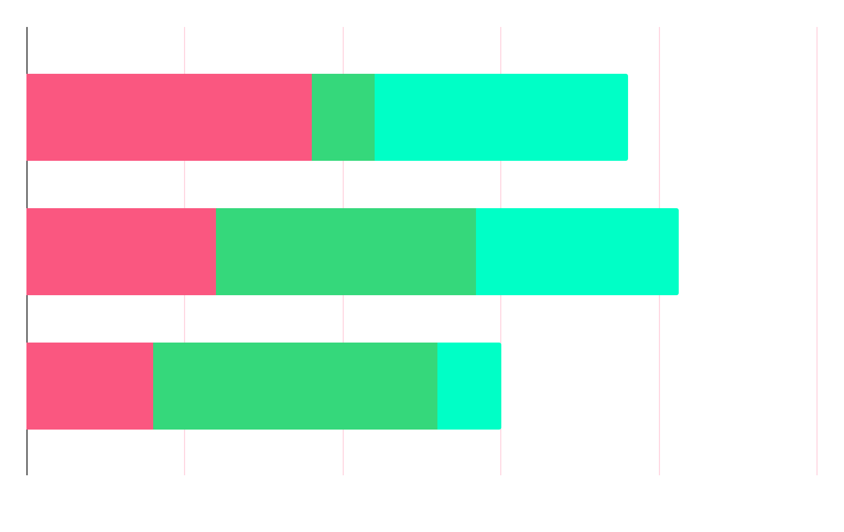
RESEARCH TRAINING AND VALIDATION
Training Dataset Split
Overfitting Prevention
Evaluation Metrics
Notes:
Training Dataset Split: Walk through the training process, including the split between training and validation datasets (80/20 split) to prevent overfitting.
Evaluation Metrics: Explain the metrics used to evaluate the model's performance, such as accuracy, precision, recall, and F1-score, and why they are important.
Overfitting Prevention: Discuss strategies used to prevent overfitting, including Dropout and EarlyStopping.
Handling Class Imbalance: Explain the challenges related to class imbalance and how oversampling techniques were used to ensure balanced learning.

Slide 12
MODEL RESULTS
Examples of Predictions
Insights
Model Performance

Slide 13
FRONT END
03

Slide 14
FLASK INTEGRATION
Purpose of Flask
Web Application Flow
Ease of Use
Notes:
Training Dataset Split: Walk through the training process, including the split between training and validation datasets (80/20 split) to prevent overfitting.
Evaluation Metrics: Explain the metrics used to evaluate the model's performance, such as accuracy, precision, recall, and F1-score, and why they are important.
Overfitting Prevention: Discuss strategies used to prevent overfitting, including Dropout and EarlyStopping.
Handling Class Imbalance: Explain the challenges related to class imbalance and how oversampling techniques were used to ensure balanced learning.

Slide 15
CONCLUSION & FUTURE RECOMMENDATIONS
Notes:
Project Summary: Summarize the key components of the project, including data preprocessing, model design, and deployment.
Key Achievements: Highlight the successful deployment of the sentiment analysis model and the insights gained from the project.
Limitations: Discuss any limitations, such as the model's performance on complex reviews or domain-specific biases.
Future Improvements: Suggest future improvements, such as adding an attention mechanism, expanding to more domains, or deploying on a cloud platform for scalability.

Slide 16

THANK YOU!

