Slide 1
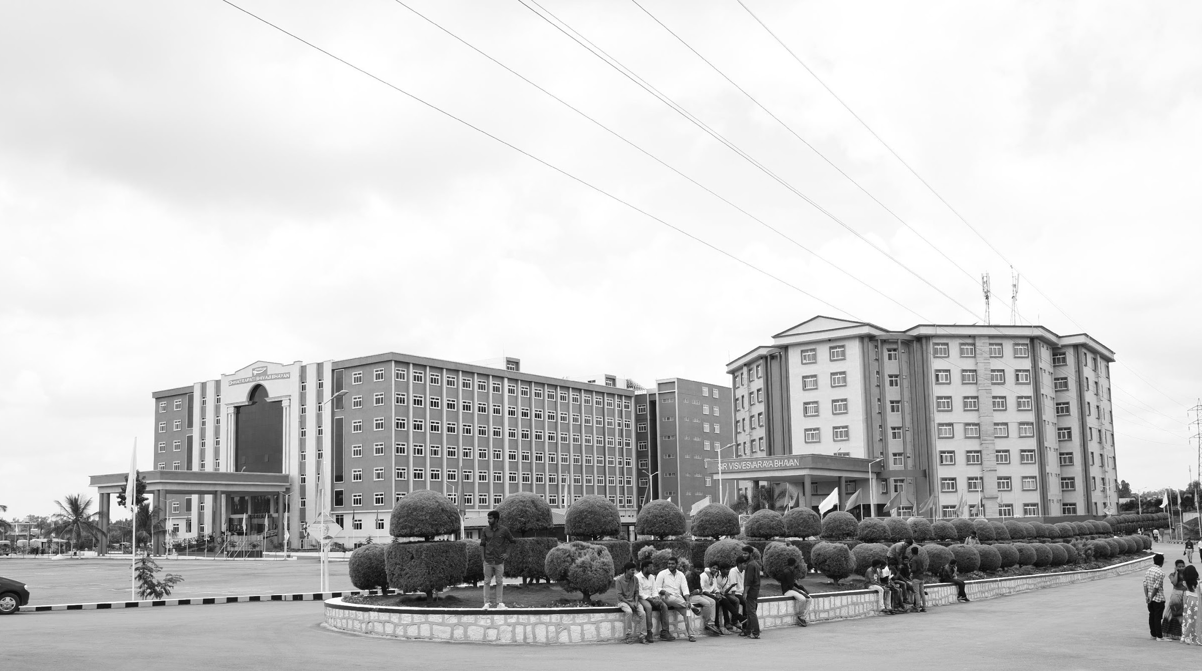

IoT-Powered Smart Helmet(SafeRide)
AY 2021-25
GITAM UNIVERSITY
Major Project
Project ID:
A University should be a place of light, of liberty, and of learning.
Department of Electrical Electronics and Communication Engineering
Project Team:
K STEEV SUSHANTH
T.S.YOUSUF ALI
M.PRAVEEN KUMAR
Project Mentor: DR.SUBHASISH TIWARI
ASSOCIATE PROFESSOR
www.gitamedu.com

Slide 2
ABSTRACT
The Cost-Effective Advanced Automated IoT Smart Helmet project aims to enhance motorcycle rider safety through the use of modern IoT technology. The smart system can be added to existing helmets, allowing riders to retrofit their current helmets with advanced safety features. The system connects wirelessly to the bike's ignition, ensuring that the bike can only start when the rider is wearing the helmet. This feature enforces helmet usage, reducing the risk of head injuries in case of accidents. Additionally, the helmet includes a fall detection sensor, which identifies if the rider has fallen and sends immediate alerts to emergency contacts, ensuring a swift response in the event of an accident.
Designed with cost-efficiency in mind, this add-on system provides a practical solution to improving rider safety without requiring a complete helmet replacement. The system is ideal for various use cases, including daily commuting, long-distance travel, and fleet or rental services. By promoting helmet use and streamlining emergency responses through real-time alerts, the project addresses the growing need for safer road conditions and reduced accident-related injuries and fatalities.

Slide 3




Project Group – Details
Photo
Track
Roll No
Name
EECE AI/ML
BU21EECE0100332
K.STEEV SUSHANTH
Photo
EECE
BU21EECE0100155
T.S.YOUSUF ALI
Photo
EECE AI/ML
BU21EECE0100379
M.PRAVEEN KUMAR

Slide 4
Objective and Goals
Objective
To develop a cost-effective IoT-based smart helmet system that prioritizes rider safety through automated features, ensuring motorcycles operate only when the rider is wearing the helmet, we aim to create a seamless, budget-friendly, and user-friendly safety solution. This system is designed to be an add-on module that can be easily integrated into existing helmets, offering a cost-efficient way to upgrade safety features without requiring a new helmet. By combining affordable technology with convenience, we promote responsible riding habits and enhance road safety standards while keeping production and installation costs low.
Goals
Main Goals:
Ensuring everyone wears a helmet is key to protecting lives and fostering a culture of road safety and responsibility via cost effeciently
Implementing precise accident detection and rapid response to minimize injury and ensure swift assistance.
Additional Goal:
Developing a scalable solution for mass production and integration across diverse motorcycle models.

Slide 5
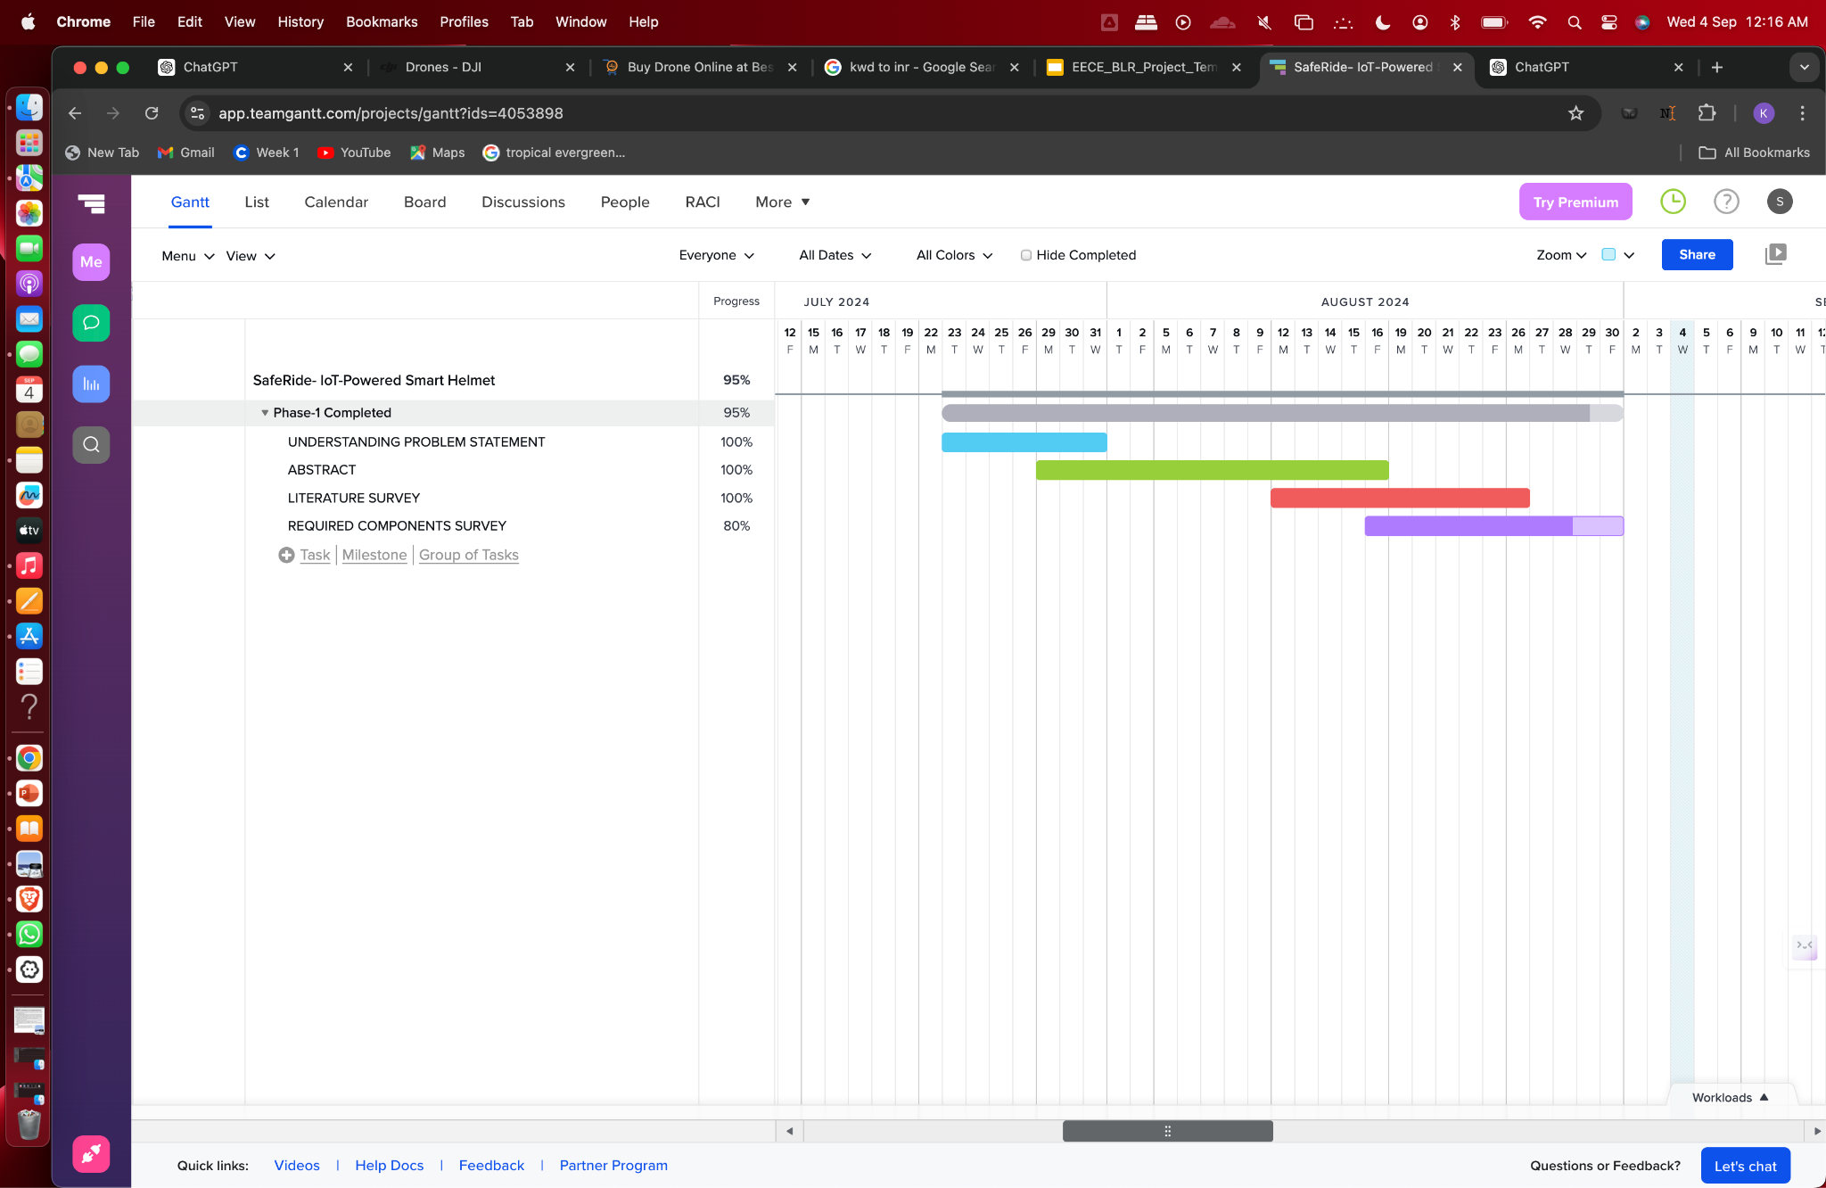
Project Plan

Slide 6
Literature Survey
Key Publications
1. Smart Helmet for Motorcyclists Using IoT Technology
Authors: J. H. Park, H. S. Lee, J. W. Kim
Publication: IEEE Access
Focus: This paper explores the application of Internet of Things (IoT) technology for improving rider safety. The system developed integrates sensors within a helmet, providing real-time alerts to the rider. By utilizing IoT, the helmet can monitor various environmental and user conditions, ensuring the rider's safety during different driving conditions. The real-time alerts allow for immediate action in case of potential accidents or hazardous situations, thus contributing to the overall reduction of injuries and fatalities in motorcycle accidents. The research emphasizes the importance of sensor-based safety mechanisms in reducing road accidents and improving motorcycle safety standards.
2. IoT-Based Safety System for Helmet Detection and Fall Detection
Authors: R. R. Kumar, S. S. Rao
Publication: IEEE Transactions on Industrial Informatics
Focus: This publication focuses on the use of IoT for detecting helmet usage and monitoring falls. The developed system ensures that the motorcycle engine only starts when the helmet is detected, ensuring rider compliance with helmet regulations. Additionally, the helmet is equipped with fall detection technology that can detect a rider’s fall and immediately transmit data for timely response. The IoT system's ability to communicate real-time data to emergency services or family members helps in reducing response time in case of accidents, improving the chances of survival and reducing long-term injuries. The paper provides a detailed analysis of data transmission protocols and sensor integration.

Slide 7
3. Development of a Smart Helmet System with IoT Integration for Safety Enhancement
Authors: M. T. Choi, H. J. Kim, S. H. Yang
Publication: IEEE Transactions on Consumer Electronics
Focus: This paper presents a comprehensive system that integrates IoT technology into smart helmets to enhance safety. The system is designed to detect impacts, such as those from falls or collisions, and provide real-time monitoring of the rider’s condition. The IoT integration enables the helmet to collect data on the rider’s environment and condition, sending alerts if unsafe conditions are detected. The research highlights the benefits of using IoT for continuous monitoring, ensuring that accidents are detected immediately and that the appropriate measures, such as emergency response notifications, are taken. This system also includes the ability to alert nearby vehicles or riders, further enhancing safety.
4. Real-Time Fall Detection System Using Wearable IoT Devices
Authors: K. J. Lee, B. H. Ahn
Publication: IEEE Journal on Selected Areas in Communications
Focus: This paper focuses on the development of a real-time fall detection system using wearable IoT devices, which is directly applicable to smart helmet technology. The system is capable of detecting falls through accelerometers and gyroscopes integrated into the wearable devices, which continuously monitor the rider’s posture and movement. In the event of a fall, the system immediately sends alerts to emergency services or designated contacts. The publication discusses the communication protocols used for this real-time detection and the importance of low-latency transmission to ensure rapid responses in emergencies. This research underscores the critical role wearable IoT devices play in enhancing safety for riders and preventing fatal accidents.
5. Helmet Safety System with Real-Time Monitoring and Fall Detection Using IoT
Authors: L. K. Sharma, P. M. Gupta
Publication: IEEE Transactions on Vehicular Technology
Focus: This paper introduces a smart helmet safety system that combines real-time monitoring and fall detection using IoT. The system not only ensures that riders are wearing helmets before the motorcycle engine starts but also continuously monitors the rider’s condition during the ride. In case of an accident, such as a fall, the system automatically detects the incident and sends real-time alerts to nearby emergency services or contacts. This IoT-based system provides continuous updates on the rider’s status, significantly reducing the response time in emergencies. The research emphasizes how the integration of IoT into helmet safety systems can contribute to improved road safety and accident prevention.

Slide 8
Analysis - SWOT
Weaknesses
Strengths
Technical Failures: Sensor or communication failures could lead to inaccurate helmet or fall detection, affecting performance and safety.
Durability: Electronic components must withstand environmental factors like moisture, temperature changes, and impacts, ensuring helmet safety.
Regulatory Compliance: Adapting to changing regulations requires ongoing updates, adding to costs and maintenance efforts.
Cost Effiicient: Ensures bike engine starts only when the helmet is worn and detects falls, potentially reducing injury and death rates The smart helmet is cost-effective, using affordable components while delivering essential safety
Enhancded safety:Ensures bike engine starts only when the helmet is worn and detects falls, potentially reducing injury and death rates
Innovative Technology: Utilizes IoT and advanced sensors, making it a cutting-edge solution in motorcycle safety.
Opportunities
Threats
Failures: If the technology fails, it could cause customer dissatisfaction or safety risks.
Competition: New competitors may offer similar or better technologies, affecting market share.
Market Demand: Increasing road safety awareness creates a strong market for advanced safety equipment.
Partnerships: Collaborations with motorcycle manufacturers or safety organizations can boost product reach and credibility.
Technological Advancements: Advances in IoT and sensor technology could enhance functionality and lower costs.

Slide 9
Analysis – 4W1H
Why:
Safety: The project aims to decrease death rates and prevent injuries by ensuring riders wear helmets, which is crucial for safety.
Innovation:The add-on can be easily attached to any existing helmet, making it cost-effective and easy for everyone to use. It also improves safety by sending emergency alerts and using smart technology by integrating IoT and automation,
Compliance: It could potentially enforce helmet usage, aligning with road safety regulations.
What:The project creates a cost-effective add-on that turns any helmet into a smart helmet using IoT technology. It ensures the bike starts only when the rider is wearing the helmet and includes a fall detection sensor to send alerts in case of an accident.
Where: The Advanced Automated IoT Smart Helmet connects to a motorcycle’s ignition system, making sure the rider wears the helmet in different settings like city rides and long trips. It provides real-time safety checks, detects accidents, and is useful for fleet operators and bike rental services to improve rider safety and follow safety rules.
When: . The smart helmet to be worn every time the rider uses the bike. The bike's engine will only start if the rider is wearing the helmet, ensuring that it is always worn for safety during rides.
How: We are developing a wireless add-on for existing helmets to make them smart. Using Arduinos and a microprocessor, it connects with the bike's ignition and includes a fall detection sensor to send alerts in case of an accident.
Refined Objective: The objective of the “Advanced Automated IoT Smart Helmet-Safeguard” project is to enhance rider safety by integrating an IoT-enabled add-on system with existing helmets and the bike's ignition system. The system uses proximity sensors to ensure the helmet is worn before allowing the bike engine to start and includes fall detection sensors to identify accidents and trigger alerts. This add-on solution aims to reduce motorcycle accidents and improve emergency response by ensuring helmet usage and providing timely notifications in case of falls.

Slide 10
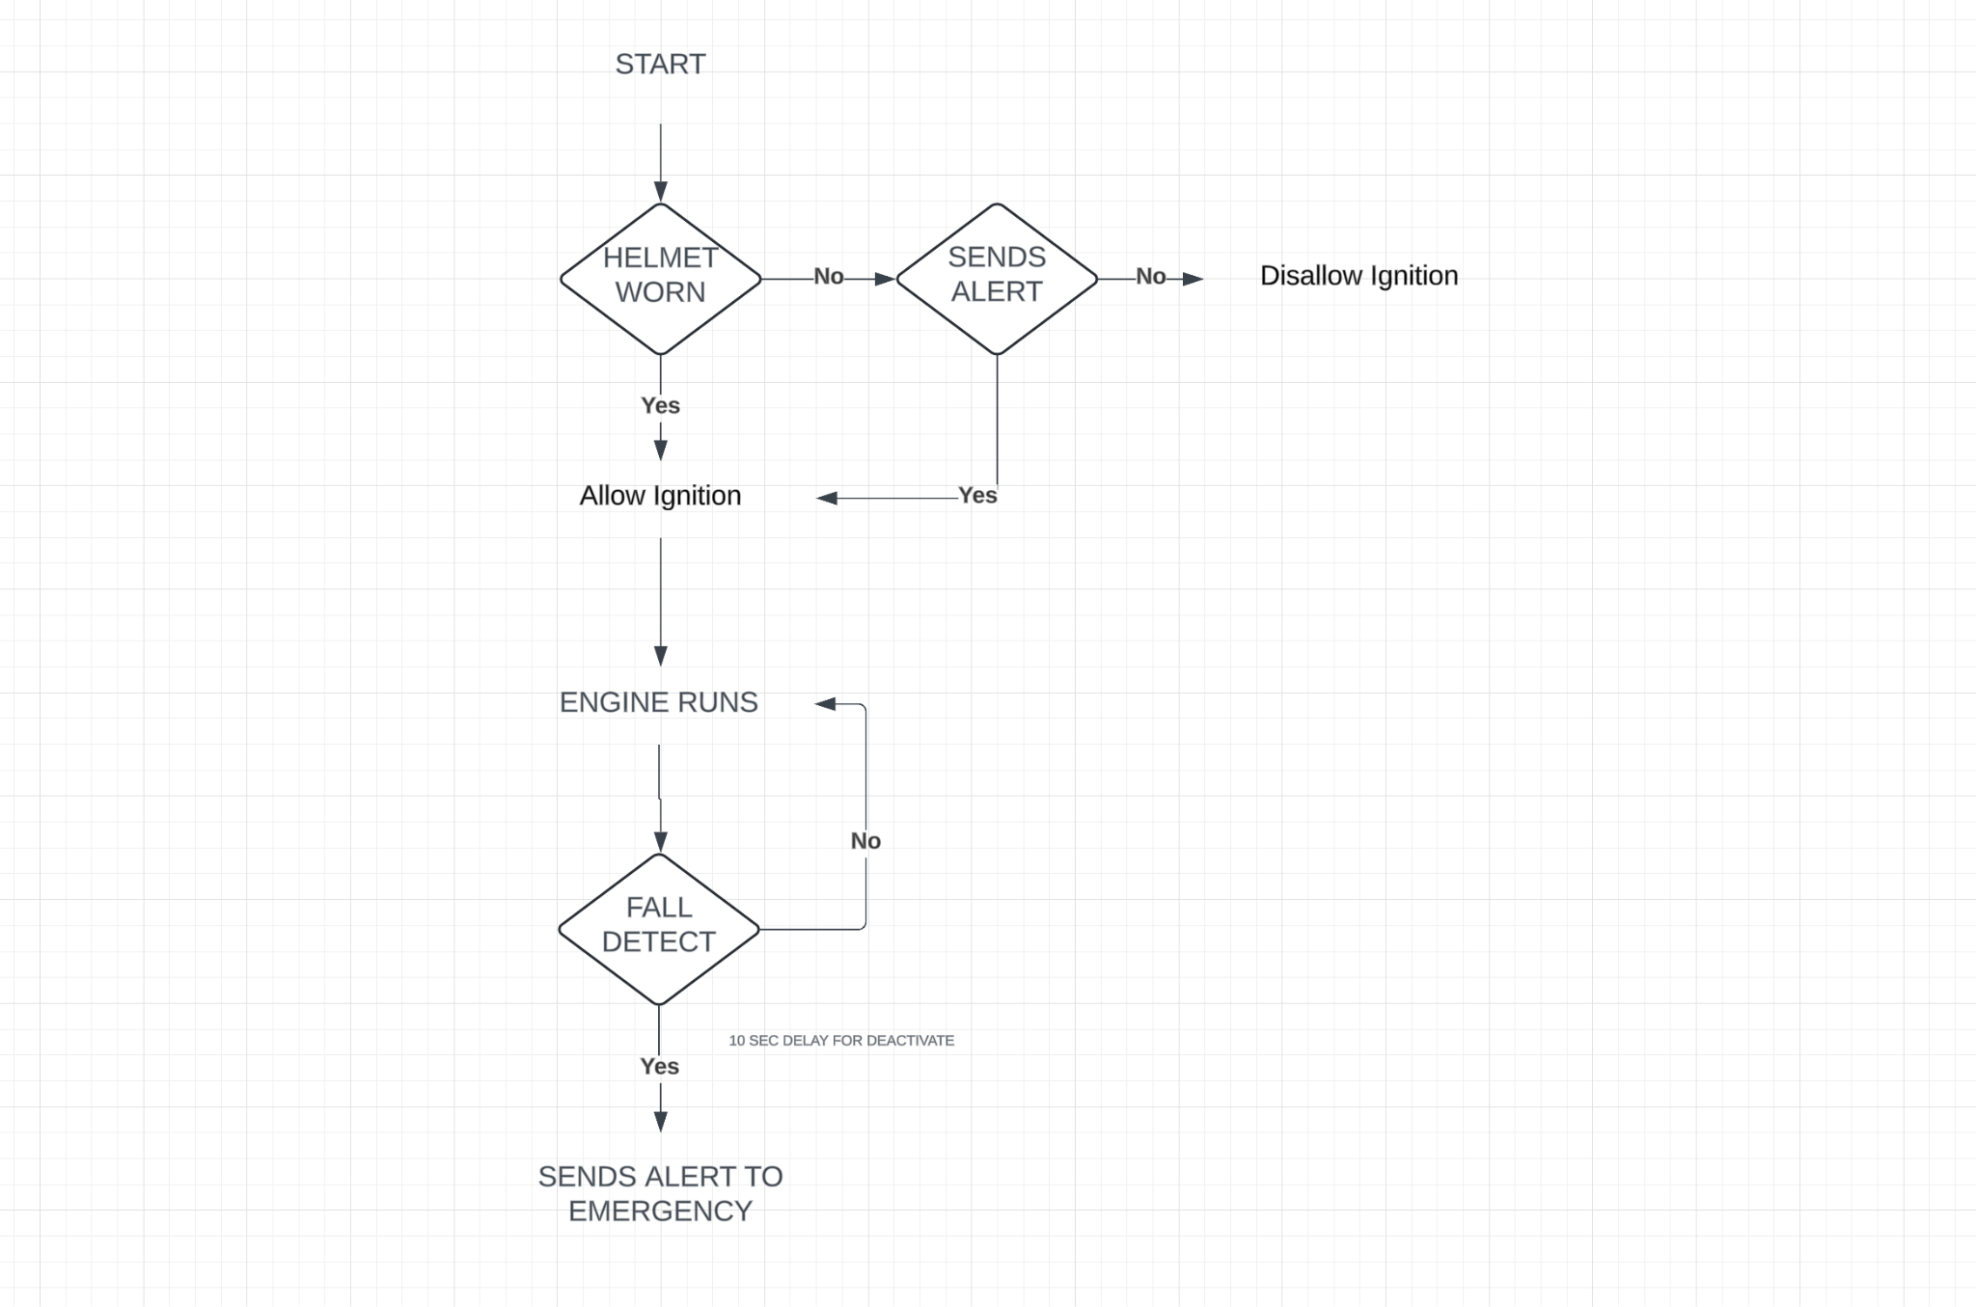
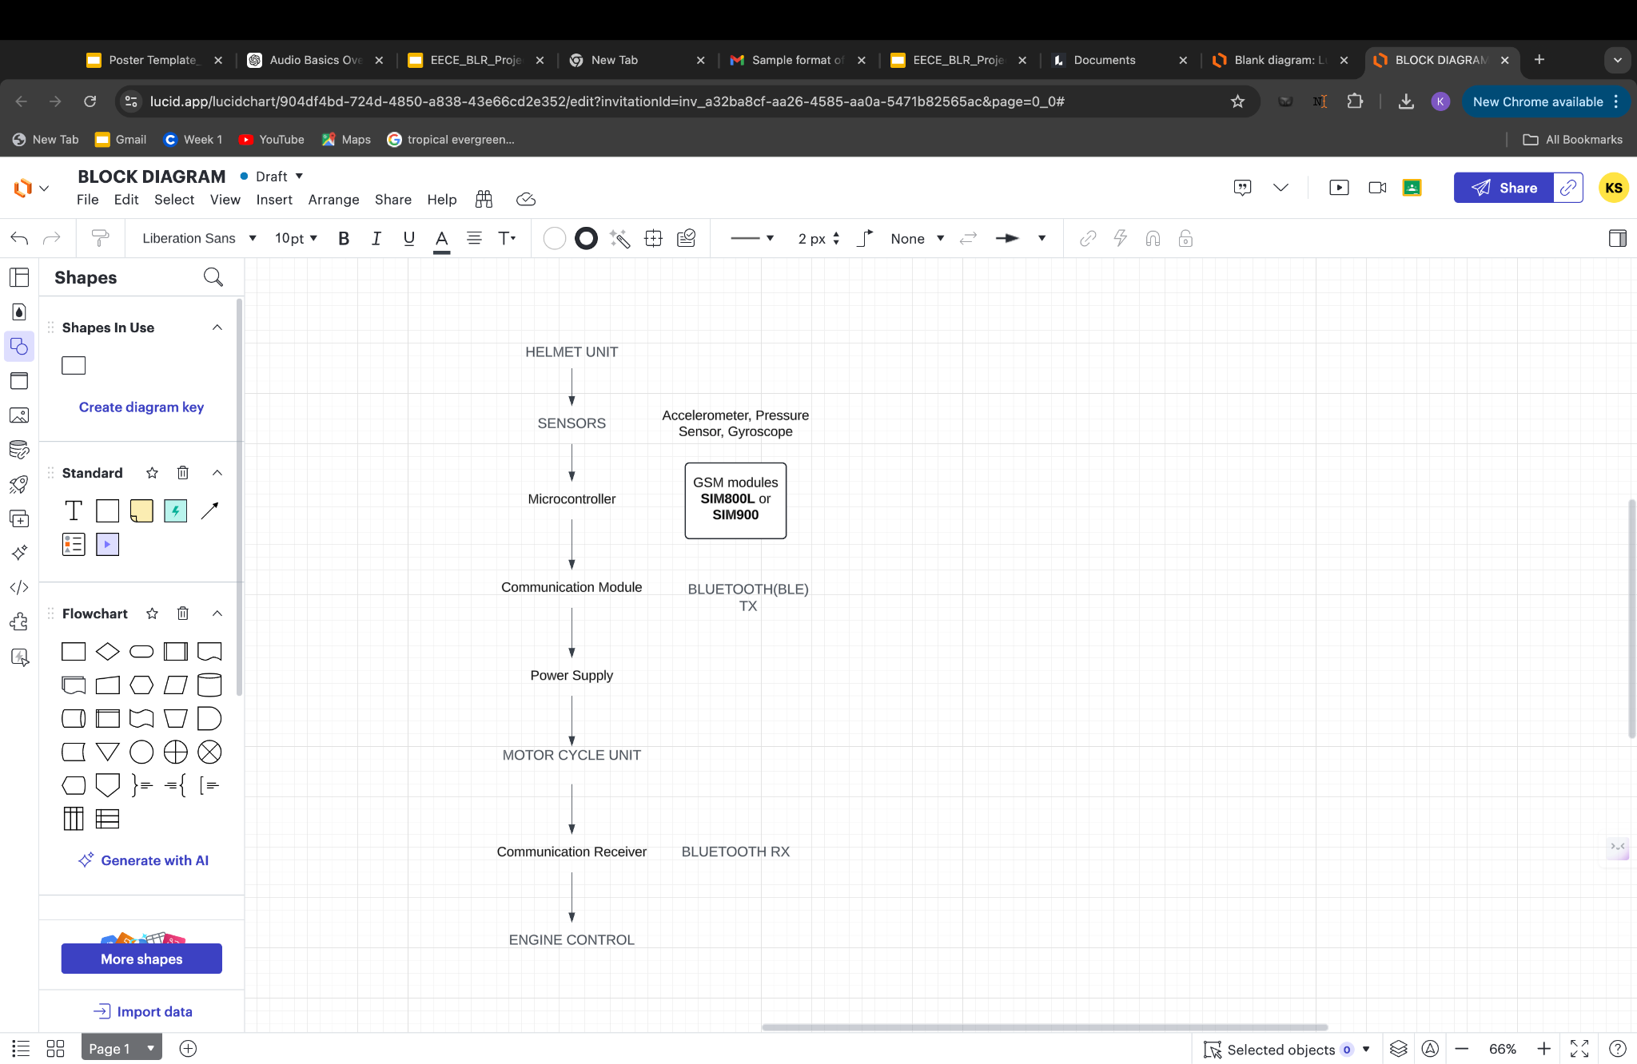
Architecture
Structural Diagram
Behaviour Diagram

Slide 11
Use Cases & Testing
Use Case Of Helmet Detetction
Helmet Worn
Helmet Not Worn
Test Cases
Test Case1: Helmet Worn :
Verifies the system and confirmed that it allows the motorcycle to start and activates a GREEN LED when the helmet is worn properly.
Test Case2: Helmet Not Worn :
Verifies the system and confirmed that it allows the motorcycle to start and activates a RED LED when the helmet is worn properly.

Slide 12
Implementation and Results – Iteration 1
Iteration 1 : Results
In Iteration -1: we focused on the initial setup and testing of the helmet detection system. This included:
Sensor Configuration: Successfully configuring the proximity sensor with the ESP32 to detect the helmet.
LED Integration: Connecting and programming the LED indicators (green, red,) based on detection conditions.
Basic Testing: Conducting preliminary tests to verify that the system responds correctly to helmet detection, non-detection.
Results of Iteration - 1:
The system correctly identified when the helmet was worn, not worn.
The corresponding LED indicators functioned as intended, providing clear feedback to the rider.

Slide 13
Implementation and Results – Iteration 2
Iteration 2: Helmet Detection System with Buzzer as Ignition Control
In this iteration, we improved the helmet detection system to manage the bike's ignition, which we're currently simulating with a Buzzer. The system determines the helmet's status—whether it's worn, not worn —and uses that information to control the ignition.
Key Features:-
1. Helmet States:
Worn: The helmet is properly secured.
Not Worn: There is no helmet present.
.
2. LED Indicators:
Green LED: This lights up when the helmet is worn, allowing the buzzer (ignition) to run.
Red LED: This lights up when no helmet is worn, disabling the ignition.
3. Relay Control:
When the green LED is on (helmet worn), the relay activates, enabling the buzzer (acting as the ignition).
If the red LED is lit (not worn), the relay cuts off power to the buzzer, preventing it from running.

Slide 14
Contribution
Team Progress and Movement
Progress Overview:
Our team has made great strides in the helmet detection project. We’ve successfully developed the initial system using the ESP32 microcontroller and a proximity sensor to check helmet usage.
Prototype Development:
We’ve built and tested the prototype, which works well by detecting when the helmet is worn properly, preventing ignition when no helmet is detected, and stopping the motor if the helmet is not worn.
Testing Phase:
We ran thorough tests to ensure the system is reliable and responsive. This feedback helped us refine its functionality further.
Next Steps:
Looking ahead, we’ll focus on adding fall detection and alert notifications to make the system even more robust and user-friendly. We’ll continue to work closely together to hit our project milestones.
Individual Contribution
Key contributions: Steev Sushanth.
Steev was essential in developing the hardware for the helmet detection system. He led the selection and integration of the ESP32 microcontroller and proximity sensor and handled the Arduino coding and testing to ensure reliable functionality.
Key contributions: Yousuf Ali
Yousuf focused on documentation and testing. He carefully documented the development process and test results, ensuring the system performed well and refining its functionality through thorough testing.
Key contributions: Praveen Kumar
Praveen designed the project poster and contributed to testing. He created an informative poster that highlighted the project’s goals, and his testing efforts ensured the system met all standards and worked properly.

Slide 15
Conclusion & Future Work
Summary and Conclusion :
We created a helmet detection system using an ESP32 microcontroller and a proximity sensor to help improve rider safety. The system checks if the helmet is worn correctly and controls a buzzer based on that status.
In our first iteration, we tested the system and confirmed that it successfully allows the motorcycle to start when the helmet is worn properly, prevents the motorcycle from starting if there’s no helmet,. Overall, this setup lays a great foundation for further improvements in our project.
Future Work :
Moving forward, we want to enhance our helmet detection system by adding *fall detection* and *alert notifications*. We’ll use sensors to track the rider’s movements and determine if a fall has occurred. If a fall is detected, the system will send alerts to emergency contacts through SMS or a mobile app.
We also aim to make this feature compatible with existing helmets, allowing more riders to benefit without needing to buy new gear. This upgrade will significantly improve rider safety and ensure a faster response in emergencies.

Slide 16

THANK YOU

