Slide 1
Video Games Dataset
Yousuf Sadiq Mohammed
ID: 800959514

Slide 2
Dataset
Data includes statistics of various consoles for the years in the range 2004 to 2010 in the United States.
Idea is to analyze the Dataset to improve profits across various regions in the United States.
Dataset Source: https://researchportal.port.ac.uk/portal/files/2366486/Managerial_and_Decision_Economics_2013_Video_Games_Dataset.csv

Slide 3
Tasks
Which Console have the better profits over the years 2004 – 2010 ?
Identify the regions having low reviews across the United States for different consoles.
Identify the games which have better profits.
What category of games has the better sales among different consoles ?

Slide 4
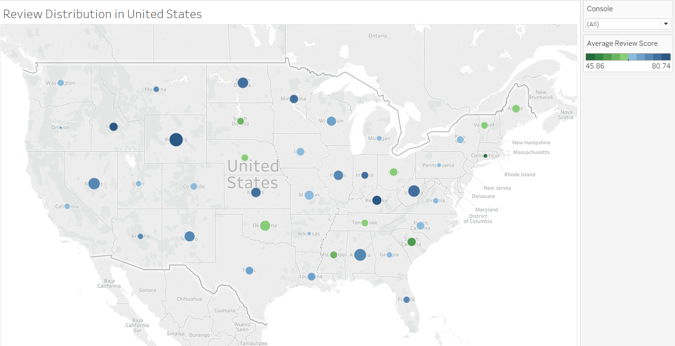
Reviews For Various Consoles Across United States

Slide 5
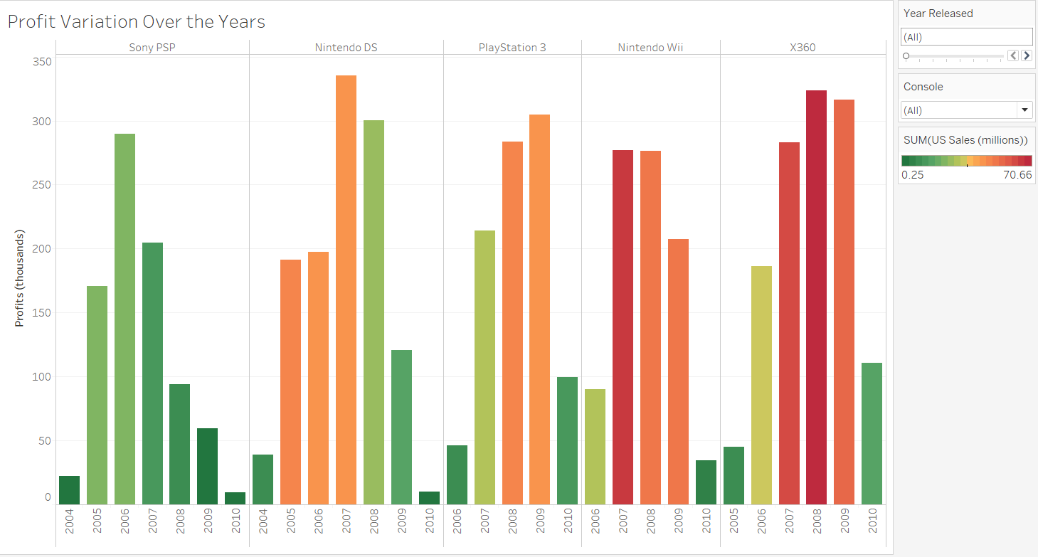
Profits Of Different Consoles Over Various Years

Slide 6
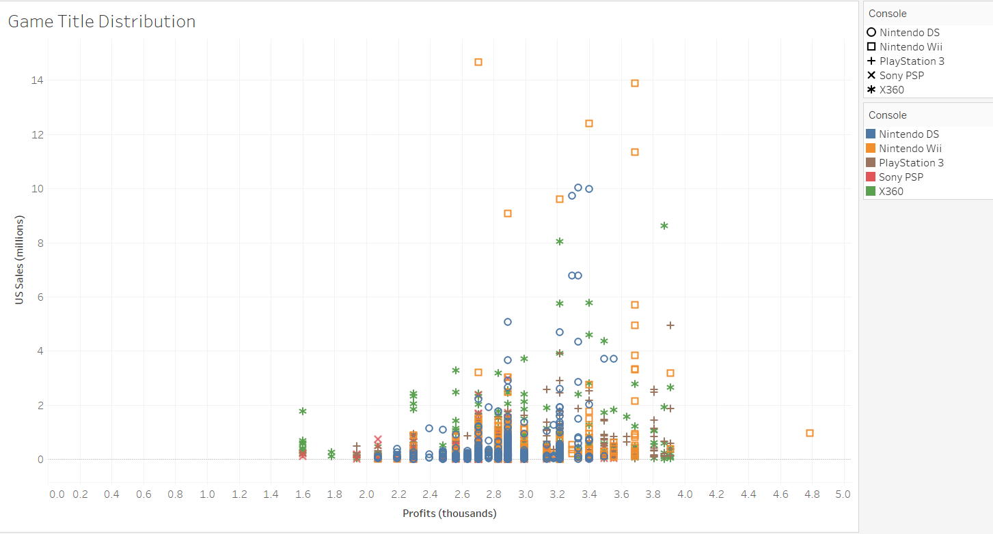
Profits Of Games Across Different Consoles

Slide 7
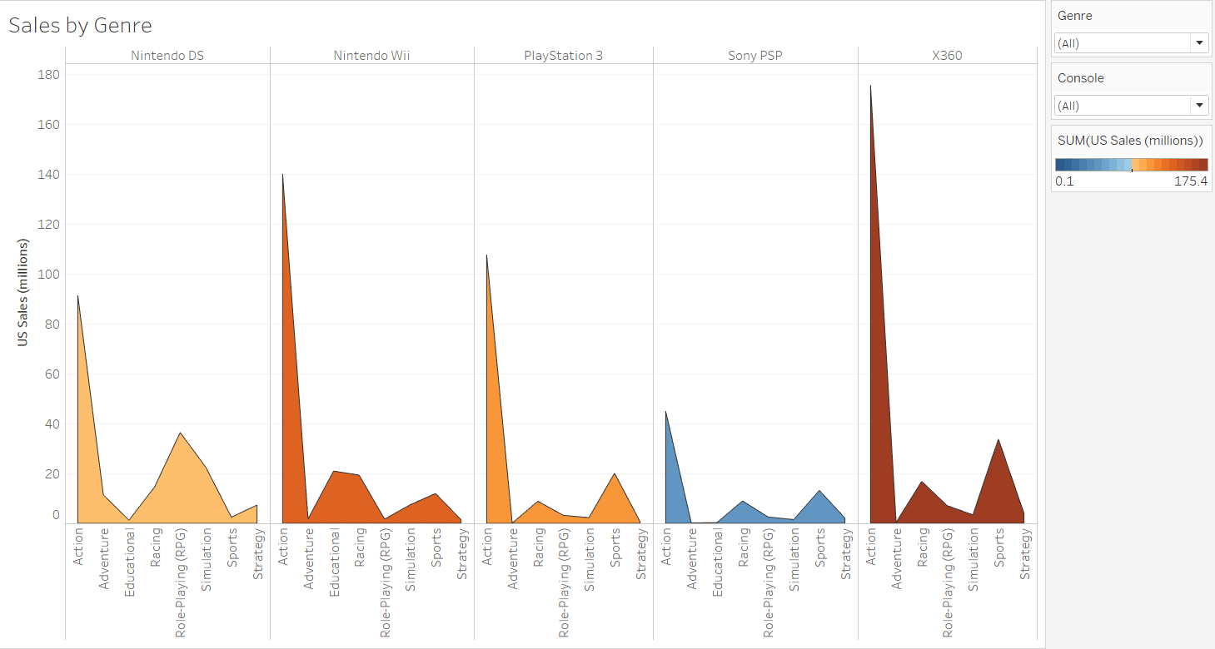
Sales Of Consoles Among Various Genres

Slide 8
Dashboard
https://public.tableau.com/profile/yousuf.sadiq.mohammed#!/vizhome/Video_Games_0/VideoGameDashboard

Slide 9
Thank You

