Slide 1
Power System Fault Detection and Classification
CAPSTONE PROJECT
Presented By:
1. K A YOUSUF ALI-ILAHIA COLLEGE OF ENGINEERING AND TECHNOLOGY-CYBER SECURITY

Slide 2
OUTLINE
Problem Statement
Proposed System/Solution
System Development Approach
Algorithm & Deployment
Result
Conclusion
Future Scope
References

Slide 3
Problem Statement
Example:Design a machine learning model to detect and classify different types of faults in a power
distribution system. Using electrical measurement data (e.g., voltage and current
phasors), the model should be able to distinguish between normal operating conditions
and various fault conditions (such as line-to-ground, line-to-line, or three-phase faults).
The objective is to enable rapid and accurate fault identification, which is crucial for
maintaining power grid stability and reliability..

Slide 4
Proposed Solution
Proposed System
The proposed system aims to accurately detect and classify power distribution system faults using machine learning. By leveraging electrical measurement data such as voltage and current phasors, the system can enhance grid reliability through rapid fault identification and classification. The solution will consist of the following components:
Data Collection:
Gather simulated or real-world power system data, including voltage and current phasors from different points in the grid.
Include various operating conditions: normal, line-to-ground, line-to-line, and three-phase faults.
Data Preprocessing:
Clean and preprocess the collected data to handle missing values, noise, and inconsistencies.
Perform feature engineering to extract critical information like magnitude, phase angle, and derivative features (e.g., rate of change).
Machine Learning Algorithm:
Train a supervised classification model (e.g., Decision Tree, SVM, Random Forest, or Neural Network) to distinguish between fault types.
Use cross-validation to avoid overfitting and ensure generalization.
Deployment:
Develop a user-friendly dashboard or application to display fault status in real-time.
Integrate the model into the SCADA system or a simulated environment to test real-time responses.
Evaluation:
Evaluate model performance using metrics such as Accuracy, Precision, Recall, F1-Score, and Confusion Matrix.
Conduct tests under various scenarios to ensure robustness and reliability.
Result:
A scalable and accurate system that classifies power system faults in real time.
Improves response time for fault detection, reduces downtime, and contributes to overall grid stability and reliability

Slide 5
System Approach
System Approach for Power System Fault Detection and Classification:
Data Acquisition: Collect voltage and current phasor data from sensors, PMUs (Phasor Measurement Units), or simulation tools like MATLAB/Simulink.
Preprocessing: Filter noise, normalize the data, and extract relevant features such as RMS values, phase angles, and sequence components.
Feature Extraction: Calculate statistical and signal-based features (e.g., entropy, harmonics, sequence components) that indicate fault characteristics.
Model Training: Use a supervised machine learning algorithm (e.g., Random Forest) to train the model on labeled fault data.
Fault Classification: Apply the trained model to incoming data to detect and classify the type of fault in real time.
System Response: Trigger automated alerts, isolate the faulted section, and assist operators in taking corrective actions to maintain grid stability.

Slide 6
Algorithm & Deployment
.
.
.
Algorithm Selection:
Random Forest Classifier is chosen for its robustness and high accuracy in multi-class classification tasks. It handles complex, high-dimensional electrical data effectively, making it suitable for identifying various power system faults.
Data Input:
Input features include voltage and current phasors, RMS values, phase angle differences, and sequence components, each labeled with a specific fault type (Normal, LG, LL, DLG, 3Φ).
Training Process:
The model is trained on preprocessed and labeled data using 70/30 train-test split, with hyperparameter tuning and cross-validation to improve accuracy and prevent overfitting.
Prediction Process:
Real-time phasor data is input into the trained model, which predicts the type of fault instantly, enabling rapid detection and response in the power system.

Slide 7
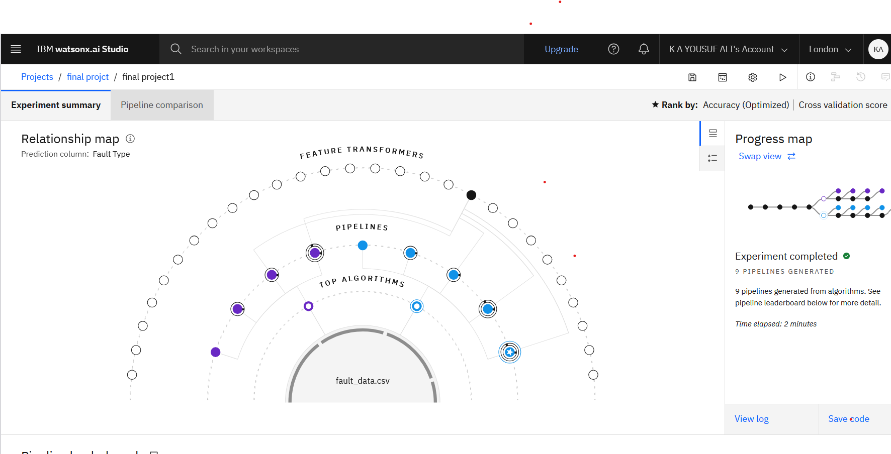
Result
.

Slide 8
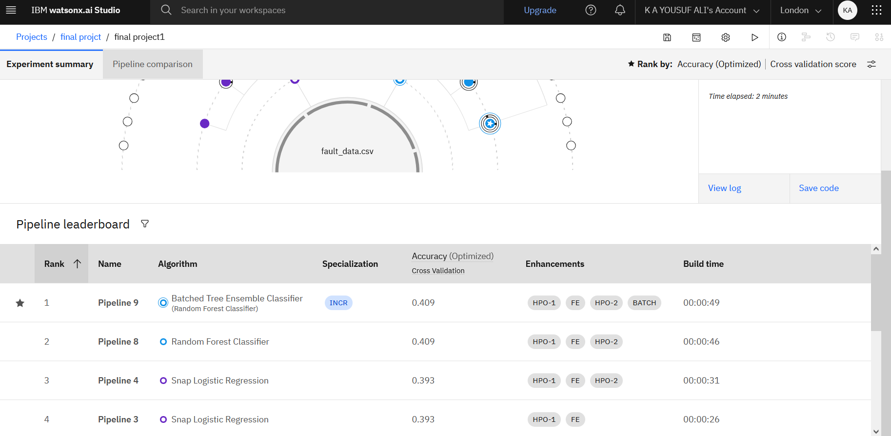

Slide 9
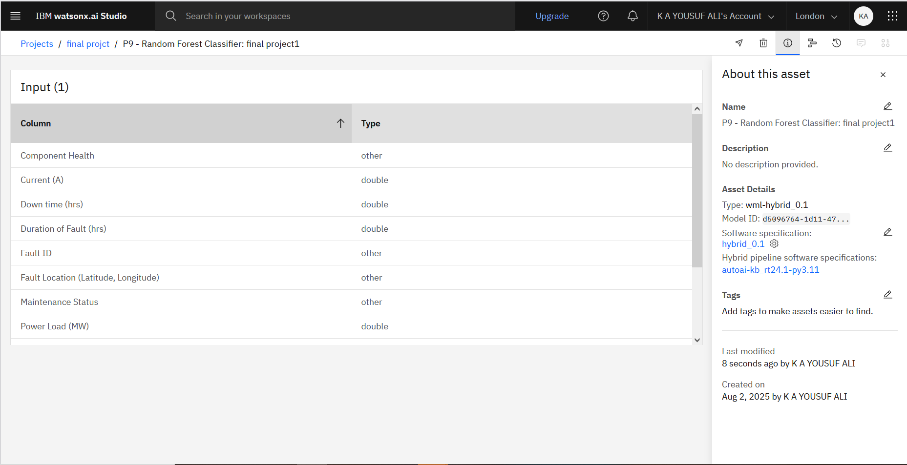

Slide 10
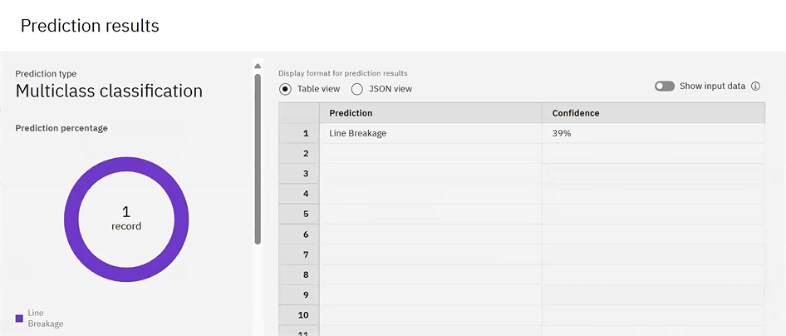

Slide 11
Conclusion
The proposed machine learning-based system for power system fault detection and classification demonstrates a practical and efficient approach to enhancing grid reliability. By analyzing electrical measurement data such as voltage and current phasors, the model can accurately identify and classify fault types including line-to-ground, line-to-line, and three-phase faults.
Through effective data preprocessing, algorithm selection, and model training, the system ensures fast and reliable fault classification. The deployment of the model in a real-time environment further enables proactive fault response, reducing downtime and preventing damage to grid infrastructure.
This project not only contributes to improved power system protection but also showcases the potential of machine learning in addressing critical challenges in the electrical engineering domain. Future enhancements may include integration with live PMU/SCADA systems and the use of advanced deep learning models for better accuracy under complex scenarios.

Slide 12
Future scope
In the future, the model can be enhanced using deep learning techniques like LSTM or CNN for more accurate fault detection from raw waveform data. Real-time integration with SCADA and IoT-enabled devices can enable on-site, edge-based fault diagnosis. The system can also be extended to predict fault severity and suggest preventive actions. Additionally, a visual dashboard with live alerts can support faster decision-making by grid operators.

Slide 13
References
This project was done in IBM cloud with help of knowledge I got from IBM skillsBuild internship
on Ai&cloud Technologies

Slide 14
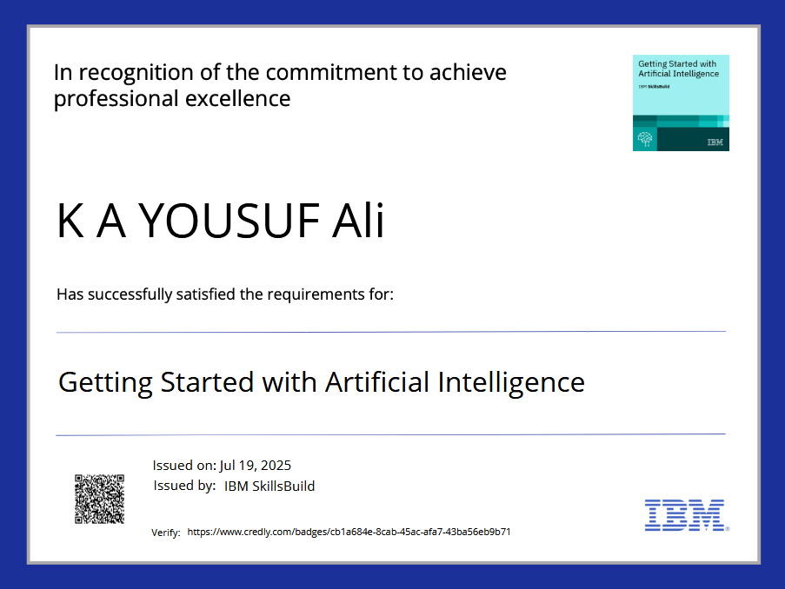
IBM Certifications

Slide 15

IBM Certifications

Slide 16
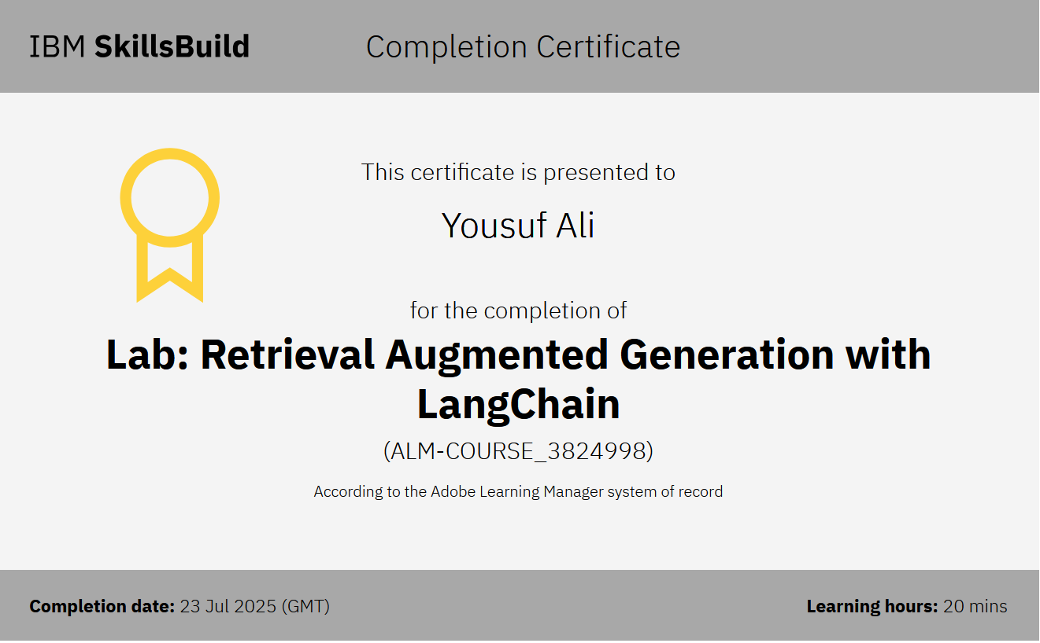
IBM Certifications

Slide 17
THANK YOU

