Slide 1
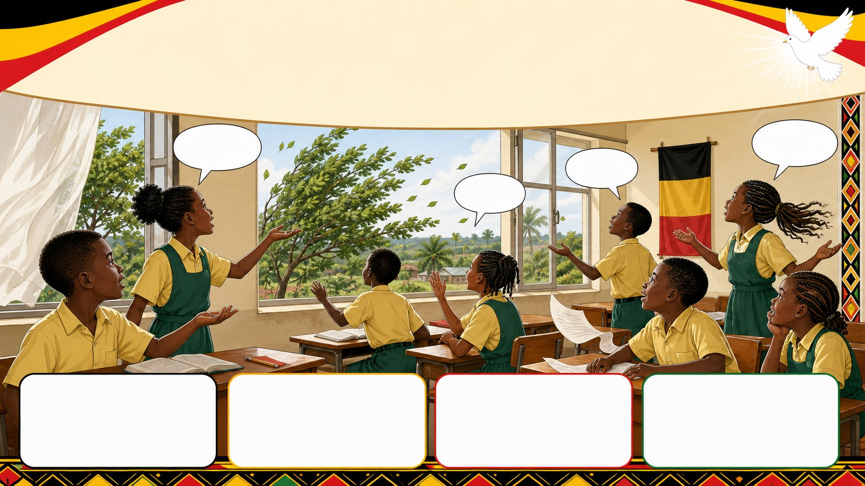
1. HOOK
p7_t1_christian_religious_education_0101
Christians and the Holy Spirit (Topic 1: Enriched in the Spirit)
Can you see the wind?
Think alone
Pair talk
Share one idea
Point to evidence

Slide 2
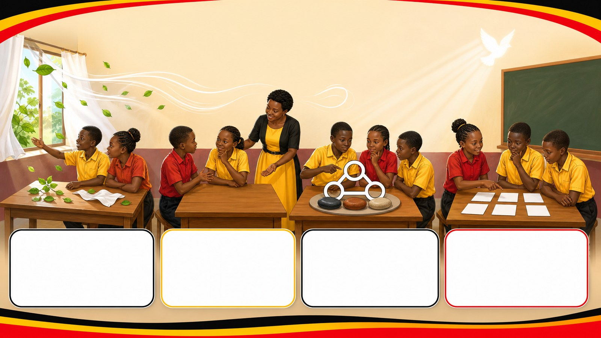
2. MISSION
p7_t1_christian_religious_education_0101
Today's mission
I can define the Holy Spirit and recognize Him
What is a Spirit?, Defining the Holy Spirit
answer with one reason or example
listen, talk, try, explain

Slide 3
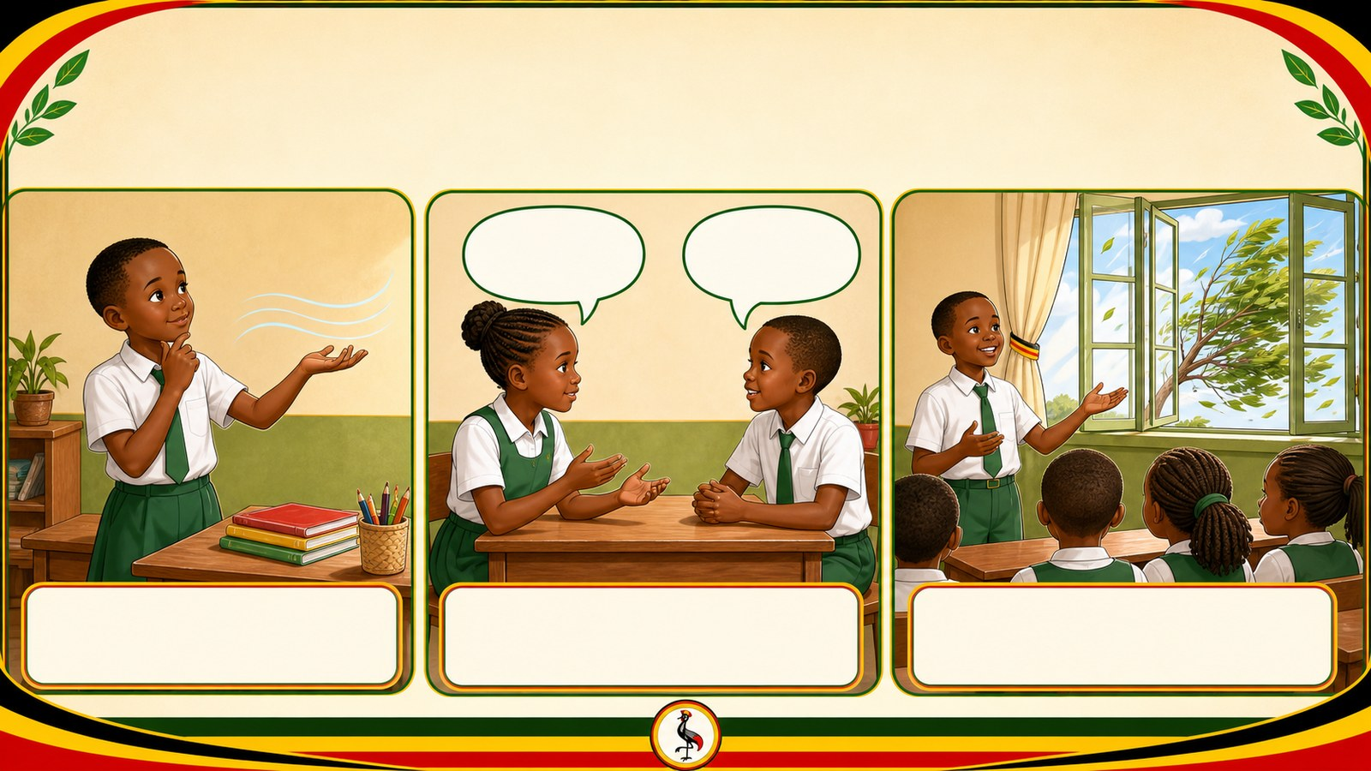
3. STARTER
p7_t1_christian_religious_education_0101
Starter: think first
Can you see the wind?
compare your first answer with a partner
connect your answer to What is a Spirit?

Slide 4
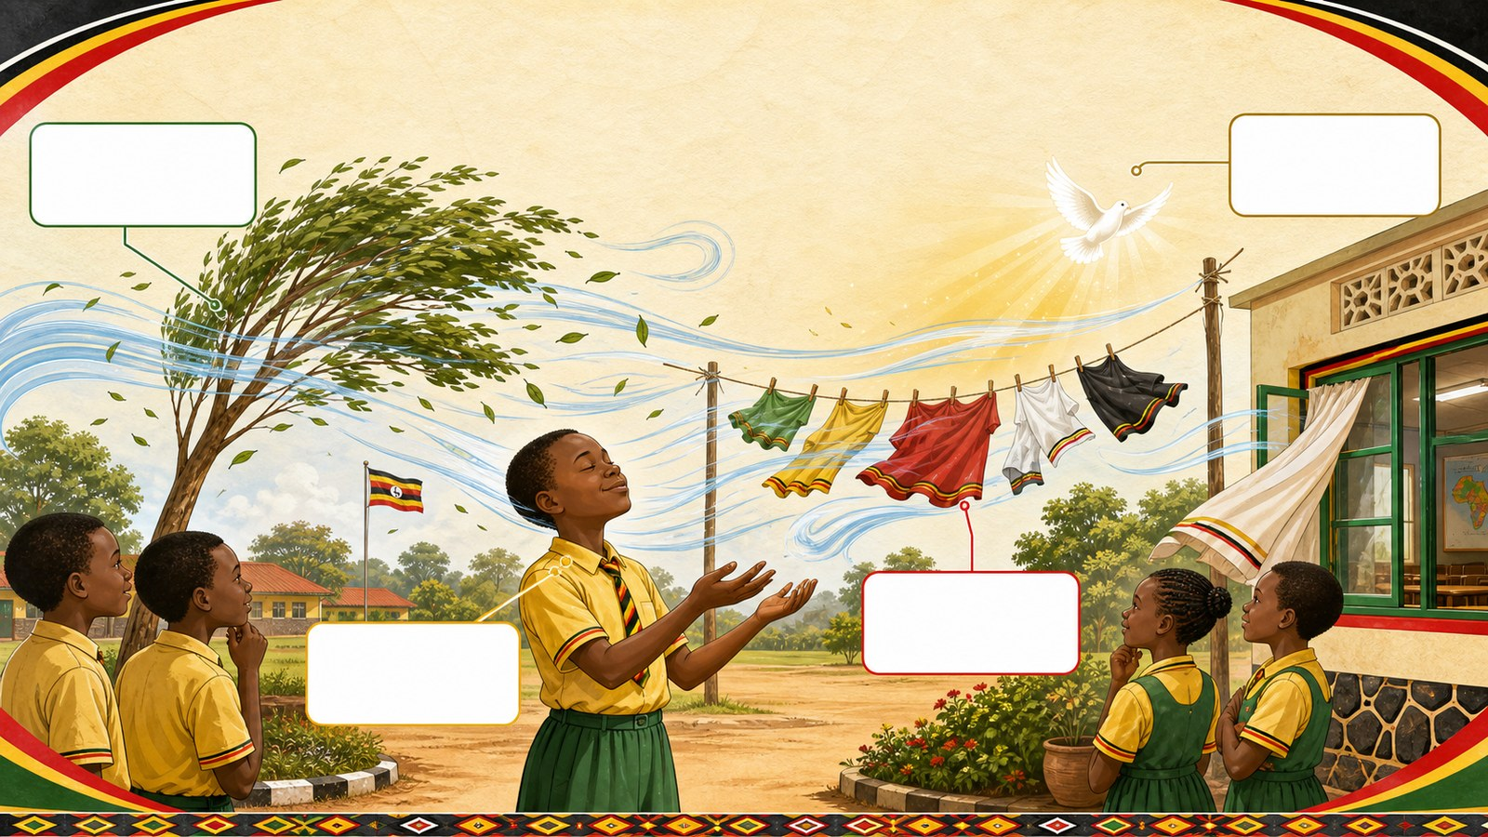
4. CONCEPT
p7_t1_christian_religious_education_0101
What is a Spirit?
Introduction to the "Spirit" concept. Just as wind
A spirit is invisible
We see the effects of a spirit, like we see wind
The Spirit is the "breath" of God

Slide 5

5. MODEL
p7_t1_christian_religious_education_0101
Defining the Holy Spirit
2. The Holy Spirit
He is God's presence in us
He is the "Gift and the Giver."

Slide 6
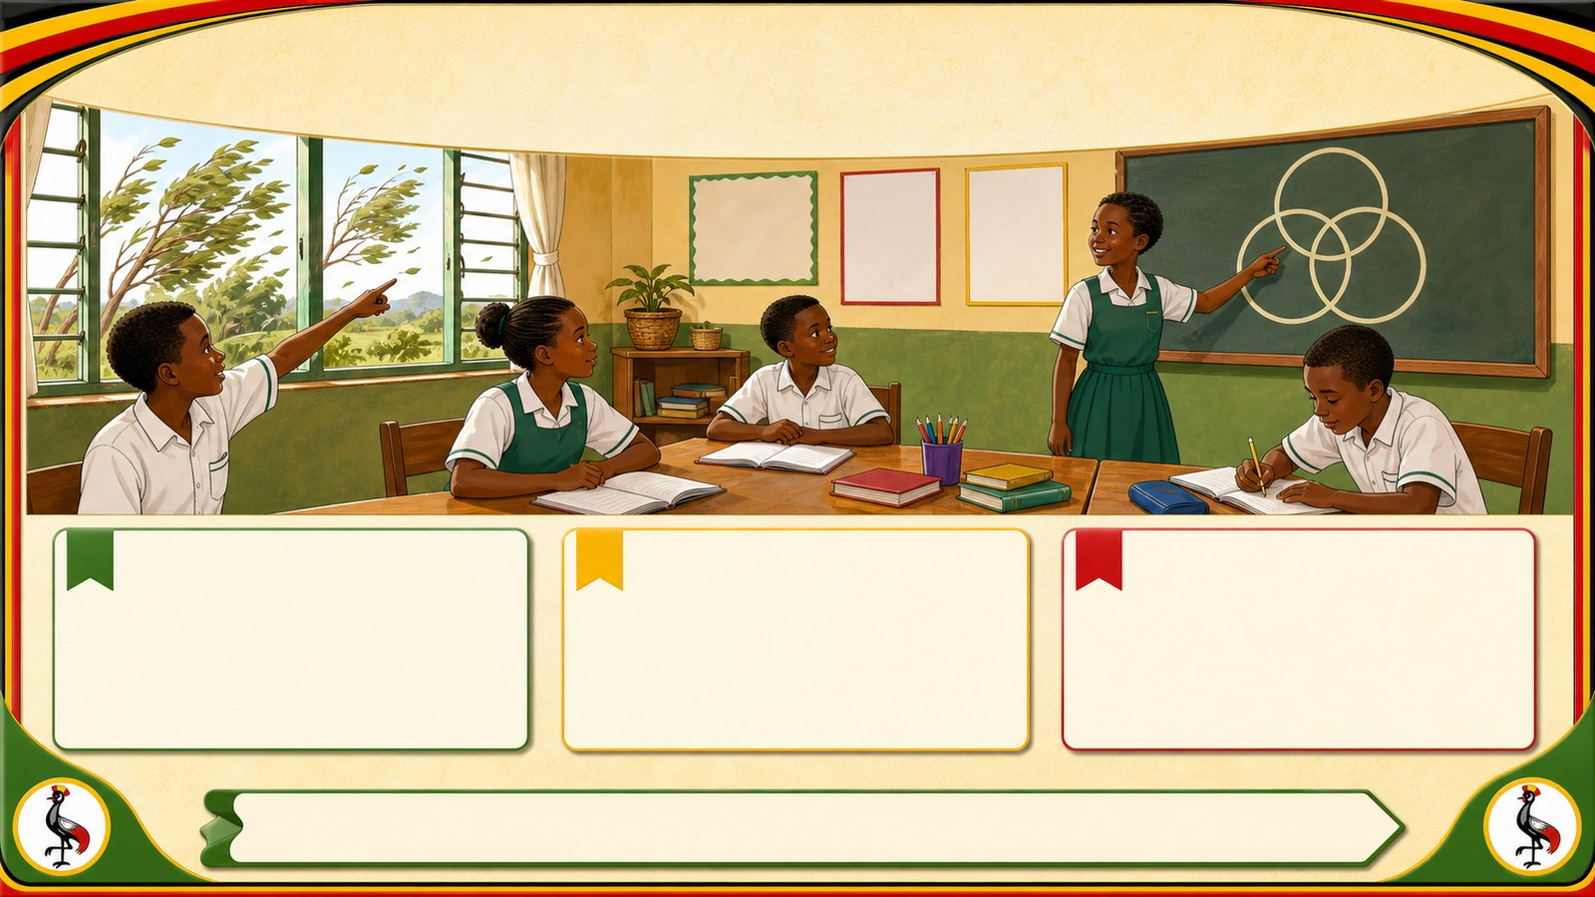
6. PRACTICE
p7_t1_christian_religious_education_0101
Try it together
Answer with evidence:
How do you know the wind is there?
Is God visible to our physical eyes?
Who is the Holy Spirit?

Slide 7
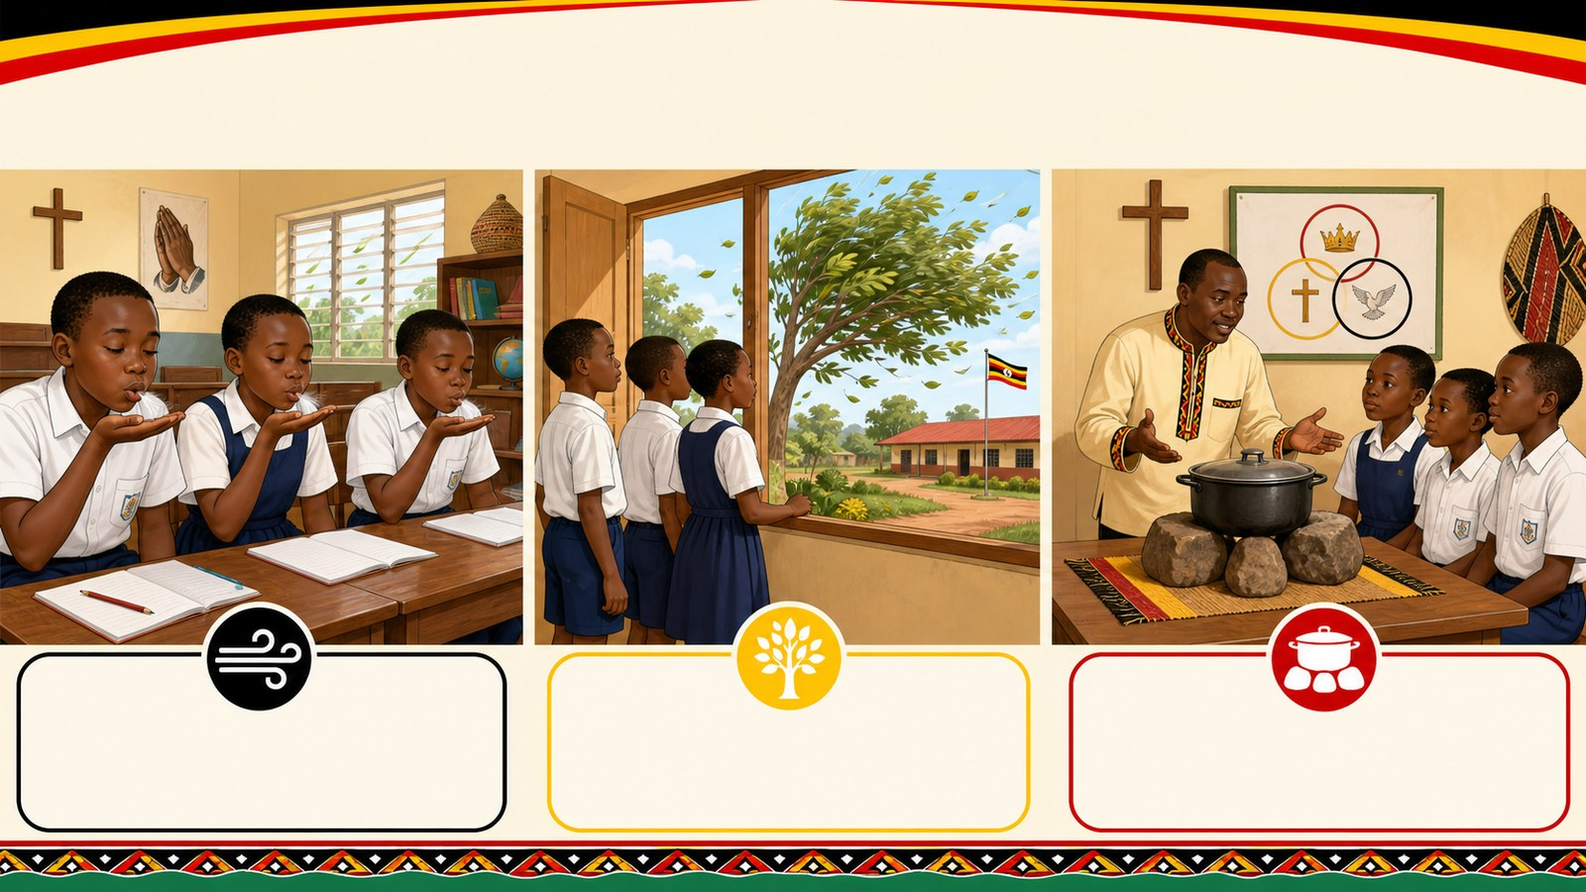
7. ACTIVITY
p7_t1_christian_religious_education_0101
Activity challenge
Blow on their hands and observe trees moving outside to understand
Discuss in pairs what it means to receive a gift that is also the
Teacher demonstrates the Trinity using the three-stone stove

Slide 8

8. EXIT
p7_t1_christian_religious_education_0101
Exit ticket
Can you name the three persons?
Use one complete sentence Use one key word: Spirit Hand in or read your answer aloud
Complete sentence
Use a key word
Read aloud or hand in

