Slide 1
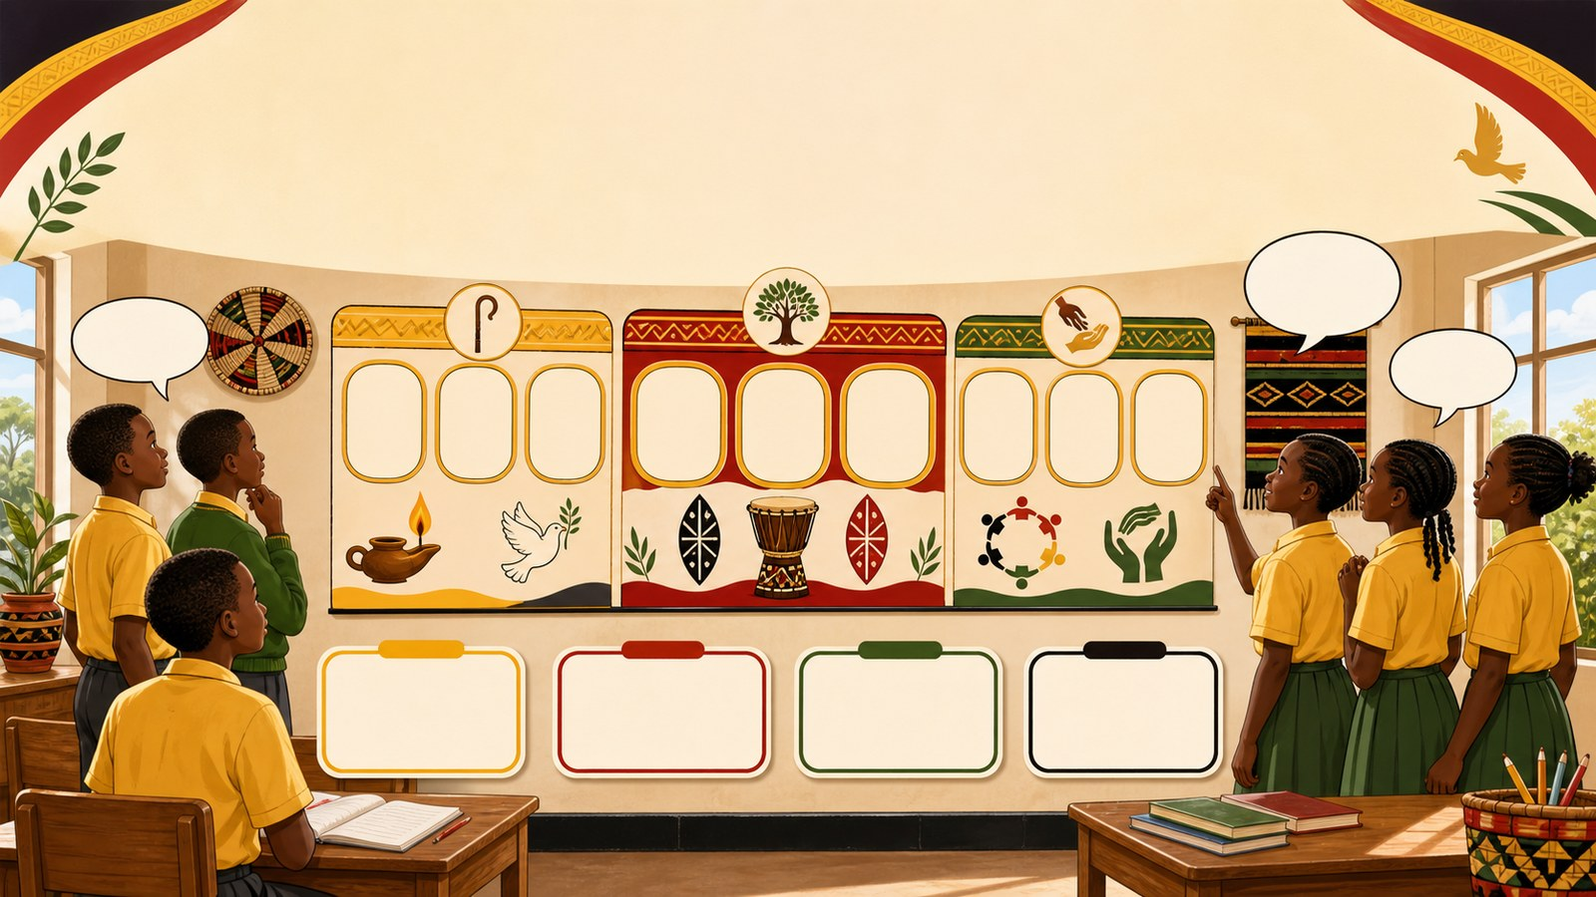
1. HOOK
p7_t1_christian_religious_education_1205
Christians and the Holy Spirit
Name one Biblical hero we studied
Think alone
Pair talk
Share one idea
Point to evidence

Slide 2
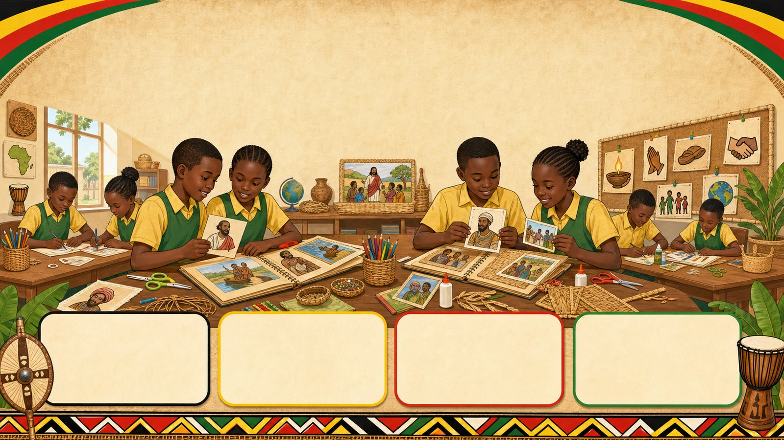
2. MISSION
p7_t1_christian_religious_education_1205
Today's mission
I can synthesize key concepts from Term 1 by
Who are our Heroes of Faith?, Planning Our Scrapbook
answer with one reason or example
listen, talk, try, explain

Slide 3
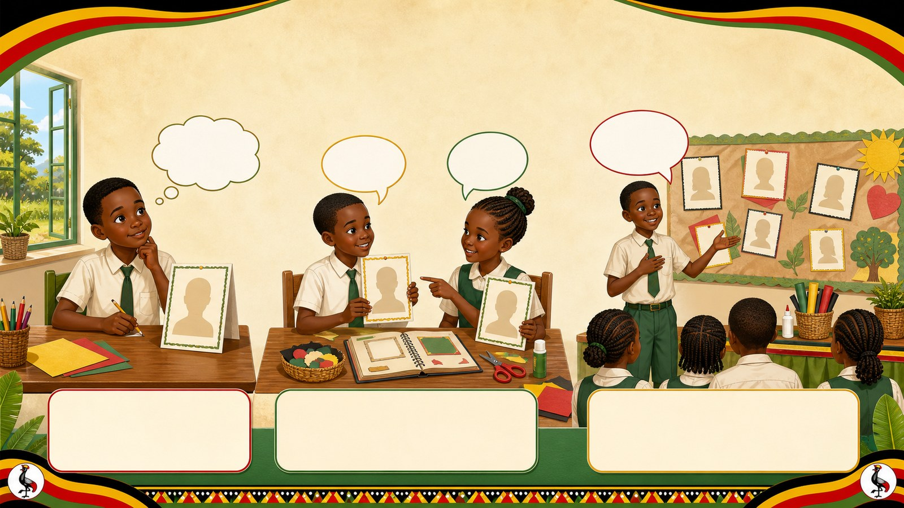
3. STARTER
p7_t1_christian_religious_education_1205
Starter: think first
Name one Biblical hero we studied
compare your first answer with a partner
connect your answer to Who are our Heroes of Faith?

Slide 4
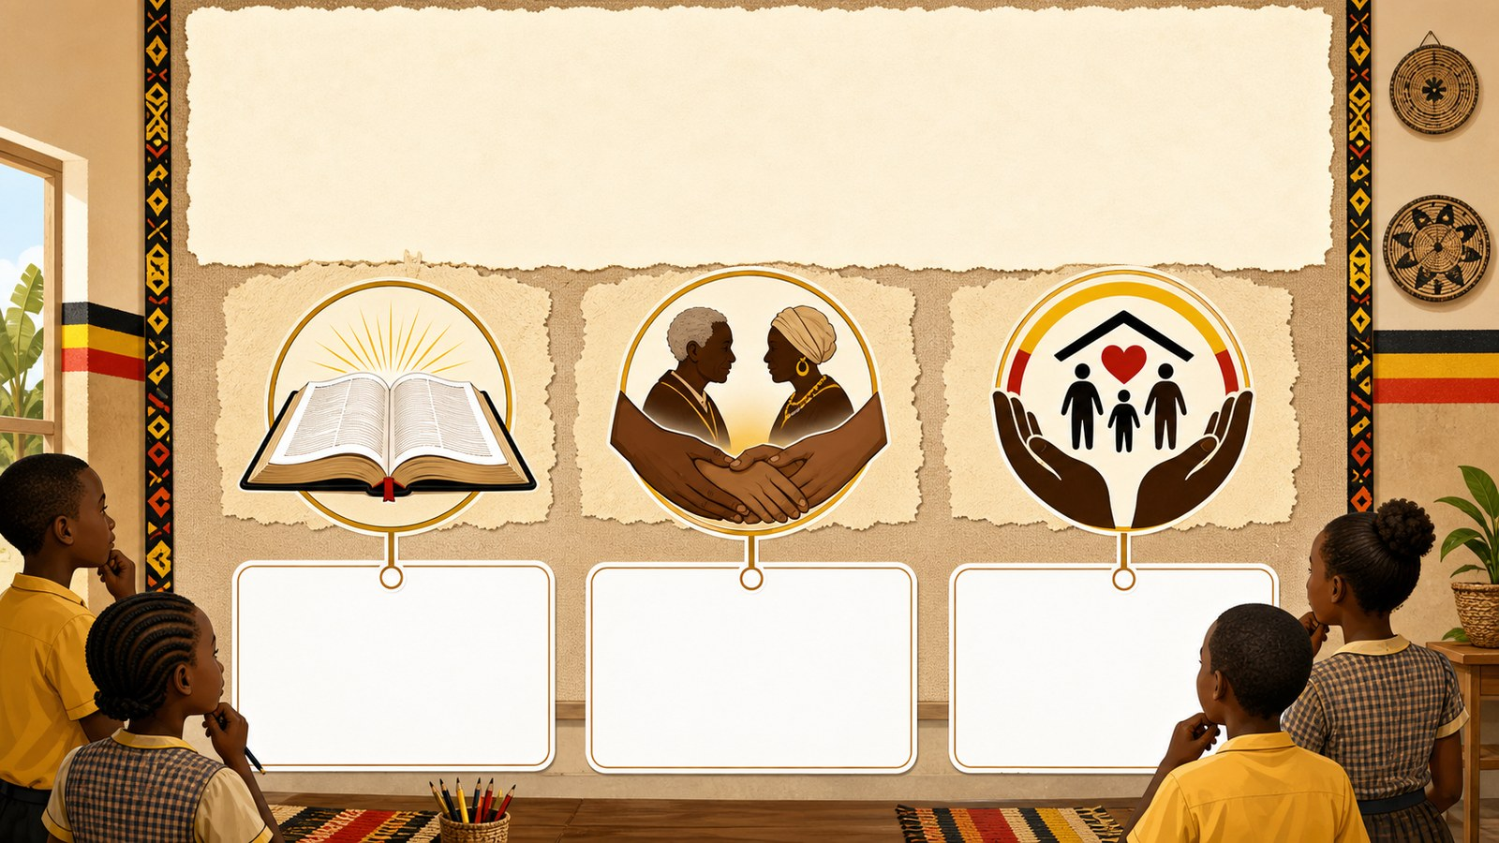
4. CONCEPT
p7_t1_christian_religious_education_1205
Who are our Heroes of Faith?
Brainstorming session to recall "Heroes of Faith"
Reviewing Topic 1: Biblical Heroes
Reviewing Topic 2: Ancestors and Reconciliation
Reviewing Topic 3: Global Organizations of Service

Slide 5
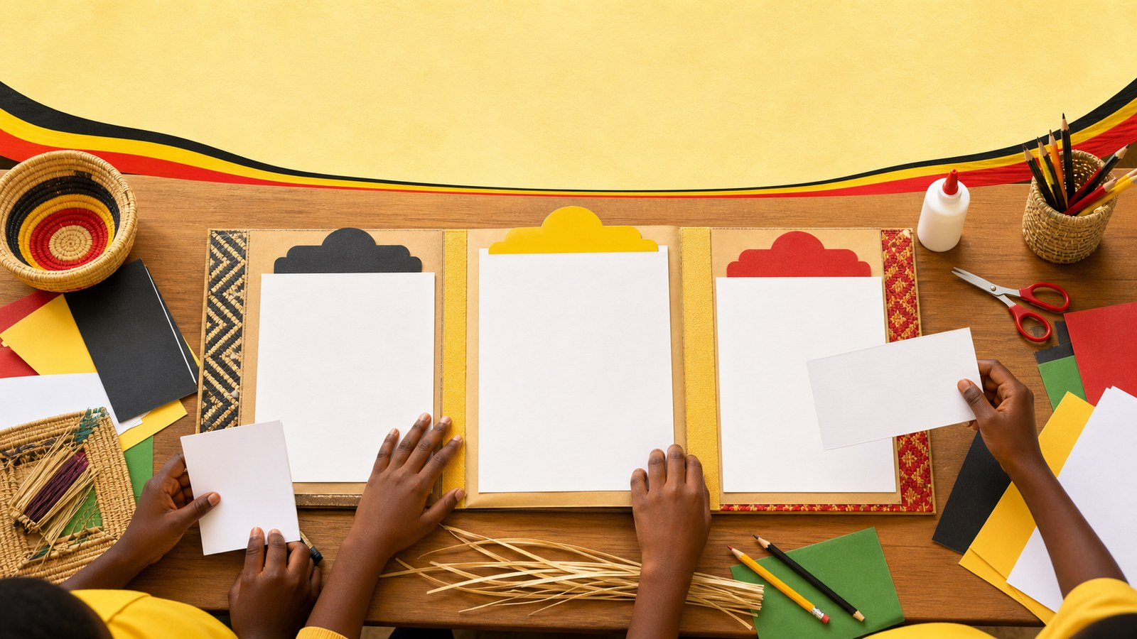
5. MODEL
p7_t1_christian_religious_education_1205
Planning Our Scrapbook
Dividing the scrapbook into three sections
Choosing titles for each page
Preparing local materials (banana fibers, cards)

Slide 6

6. PRACTICE
p7_t1_christian_religious_education_1205
Try it together
Answer with evidence:
What values do our ancestors teach us?
Which organization helps people in times of war?
How many sections will our scrapbook have?

Slide 7
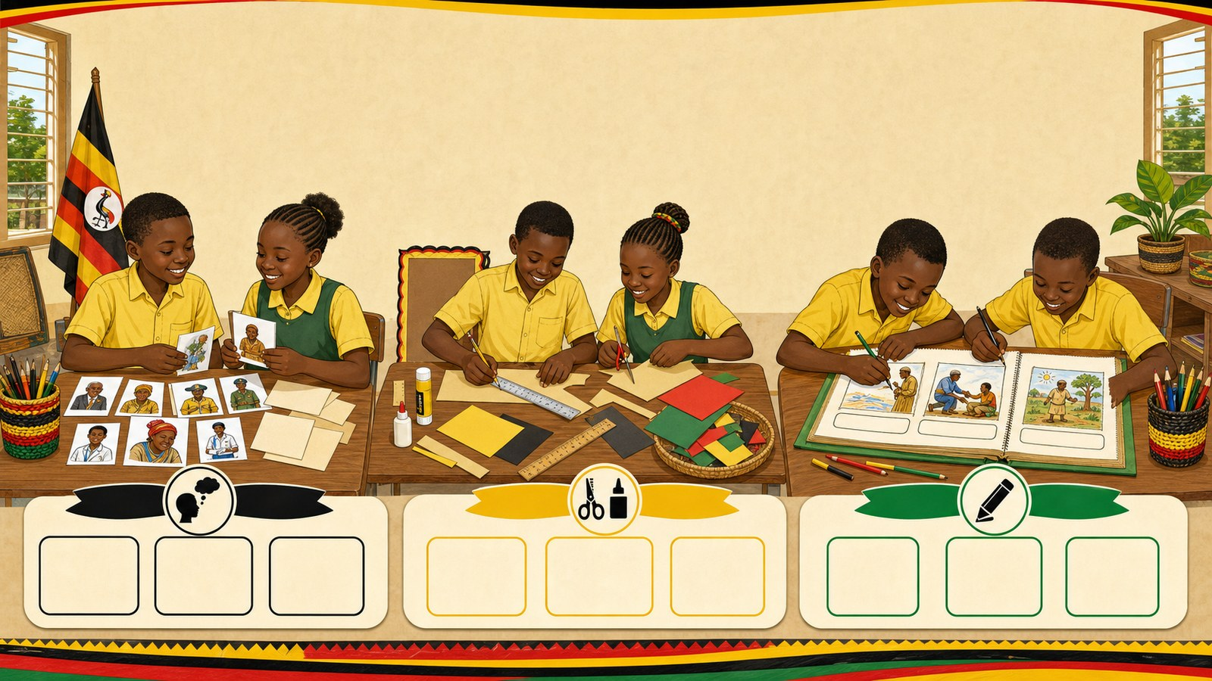
7. ACTIVITY
p7_t1_christian_religious_education_1205
Activity challenge
Work in pairs to list at least two heroes/organizations for each
Measure and cut their manila cards and label the top of each page
Draw illustrations for the first two sections and write brief

Slide 8

8. EXIT
p7_t1_christian_religious_education_1205
Exit ticket
How will you use the Holy Spirit’s help during the holidays?
Use one complete sentence Use one key word: Reviewing names and roles Hand in or read your answer aloud
Complete sentence
Use a key word
Read aloud or hand in

