Slide 1

1. HOOK
p7_t1_english_0101
1.1 School Holidays
Where is Nakato going?
Think alone
Pair talk
Share one idea
Point to evidence

Slide 2

2. MISSION
p7_t1_english_0101
Today's mission
I can listen to a story and identify key plans
Nakato’s Holiday Story, New Holiday Words
answer with one reason or example
listen, talk, try, explain

Slide 3

3. STARTER
p7_t1_english_0101
Starter: think first
Where is Nakato going?
compare your first answer with a partner
connect your answer to Nakato’s Holiday Story

Slide 4
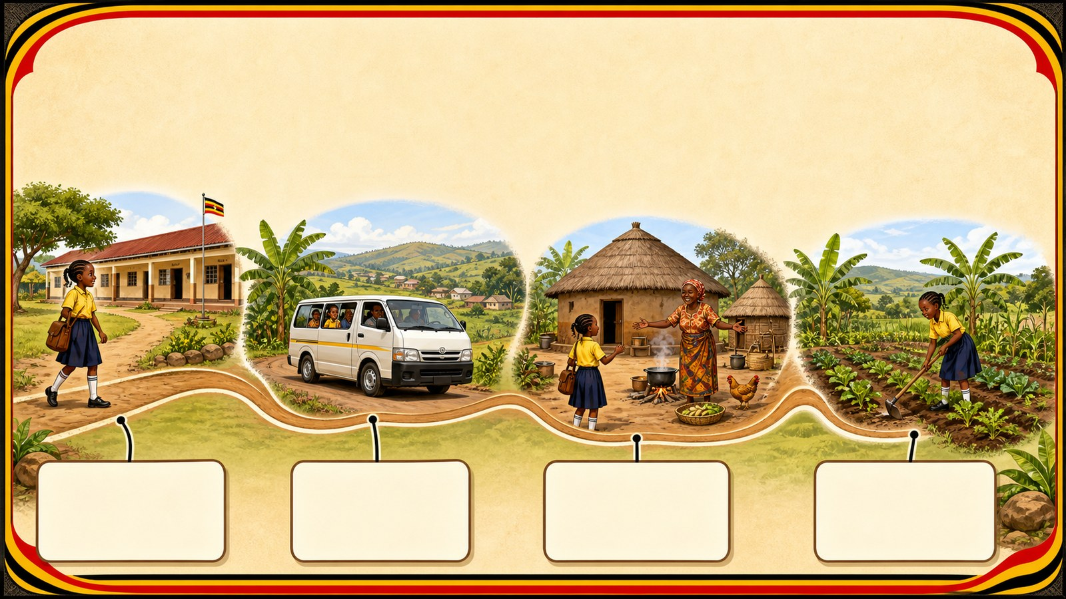
4. CONCEPT
p7_t1_english_0101
Nakato’s Holiday Story
Listen for Nakato’s trip to her grandmother
Listen to the story carefully
Identify the characters
List the places Nakato plans to visit

Slide 5

5. MODEL
p7_t1_english_0101
New Holiday Words
Travel: To go from one place to another
Up-country: Rural areas/the village
Relatives: Family members

Slide 6

6. PRACTICE
p7_t1_english_0101
Try it together
Answer with evidence:
What will she do in the village?
Who is she going to visit?
What is another word for 'start'?

Slide 7

7. ACTIVITY
p7_t1_english_0101
Activity challenge
Listen to the story; whisper two Nakato plans
Copy the words and definitions neatly
Repeat together, then do a pronoun substitution drill

Slide 8

8. EXIT
p7_t1_english_0101
Exit ticket
Where will you be in three weeks?
Use one complete sentence Use one key word: Listening for detail Hand in or read your answer aloud
Complete sentence
Use a key word
Read aloud or hand in

