Slide 1
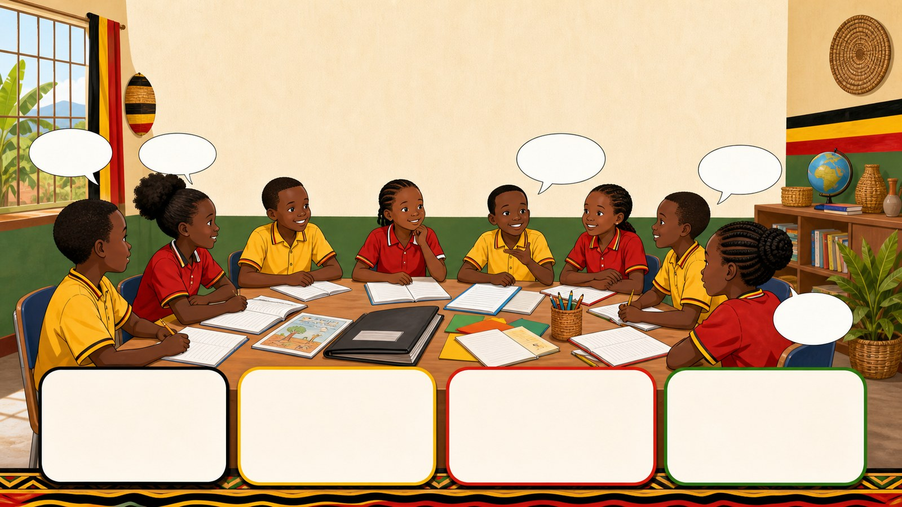
1. HOOK
p7_t1_english_1205
3.4 Final Review and Assessment
What are the three main topics we studied this term?
Think alone
Pair talk
Share one idea
Point to evidence

Slide 2
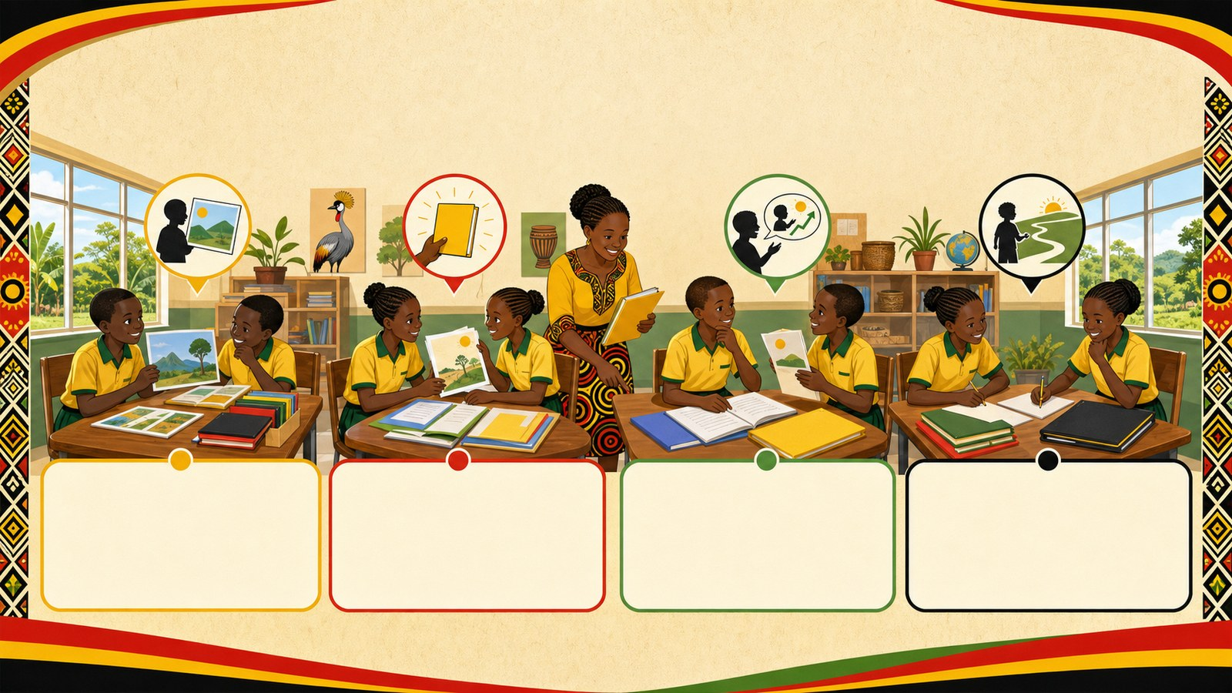
2. MISSION
p7_t1_english_1205
Today's mission
I can reflect on personal progress in English from
Looking Back at Term 1, What is a Portfolio?
answer with one reason or example
listen, talk, try, explain

Slide 3
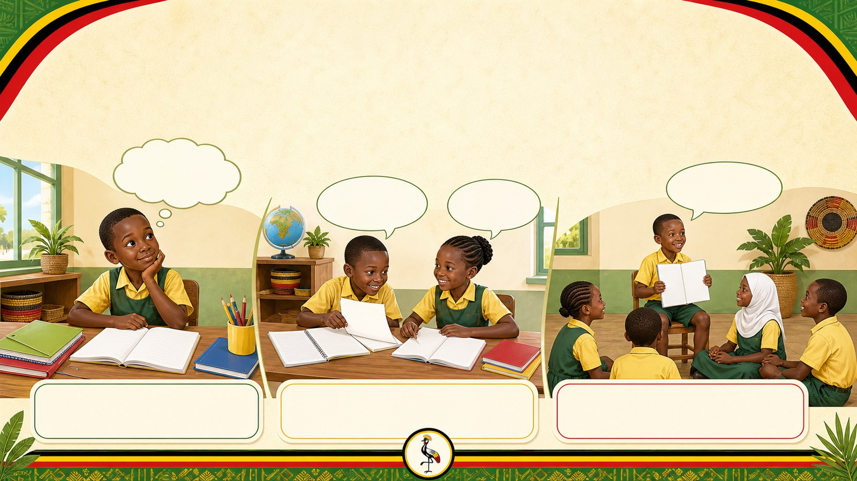
3. STARTER
p7_t1_english_1205
Starter: think first
What are the three main topics we studied this term?
compare your first answer with a partner
connect your answer to Looking Back at Term 1

Slide 4

4. CONCEPT
p7_t1_english_1205
Looking Back at Term 1
Oral reflection on the three main topics of Term 1
Review the topics we covered
Share our favorite English activities
Discuss how our writing has improved

Slide 5
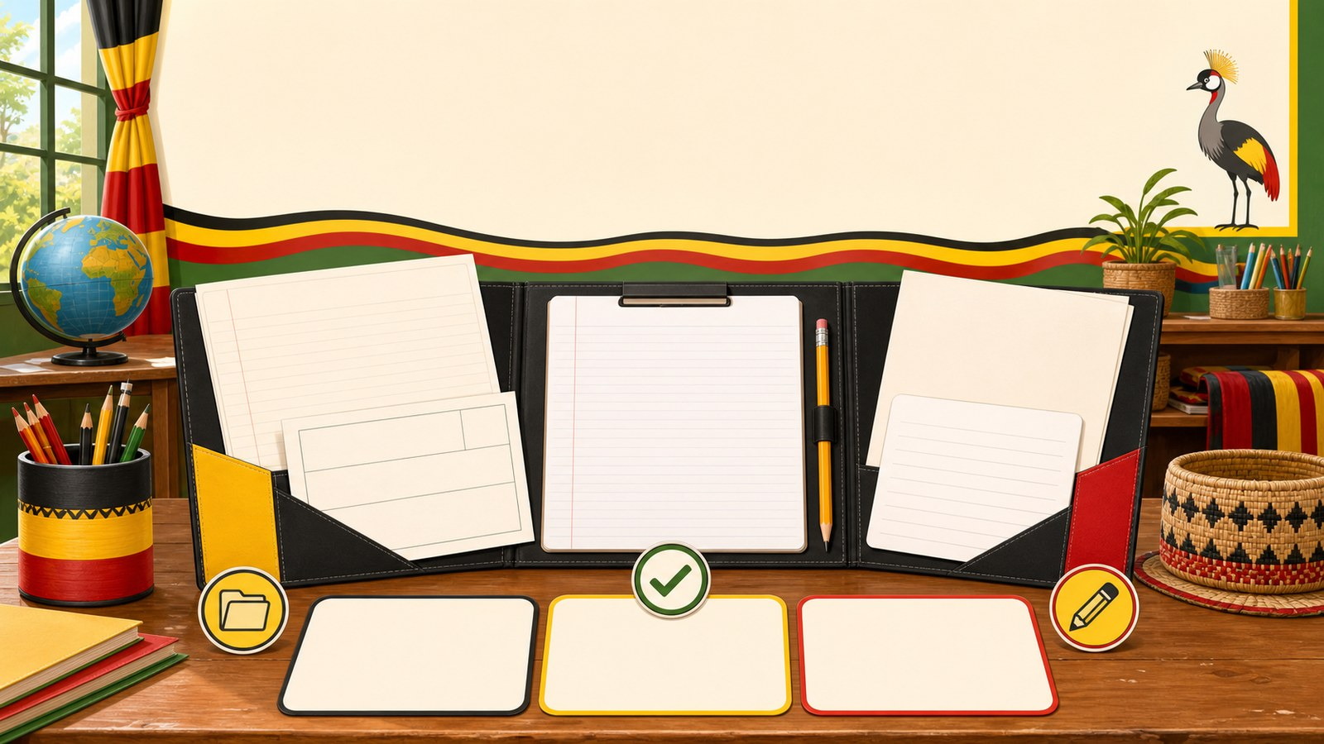
5. MODEL
p7_t1_english_1205
What is a Portfolio?
NEW VOCABULARY
Pair talk
Share evidence

Slide 6

6. PRACTICE
p7_t1_english_1205
Try it together
Answer with evidence:
Which activity helped you improve your English most?
Why is it important to review our work?
What is a portfolio?

Slide 7
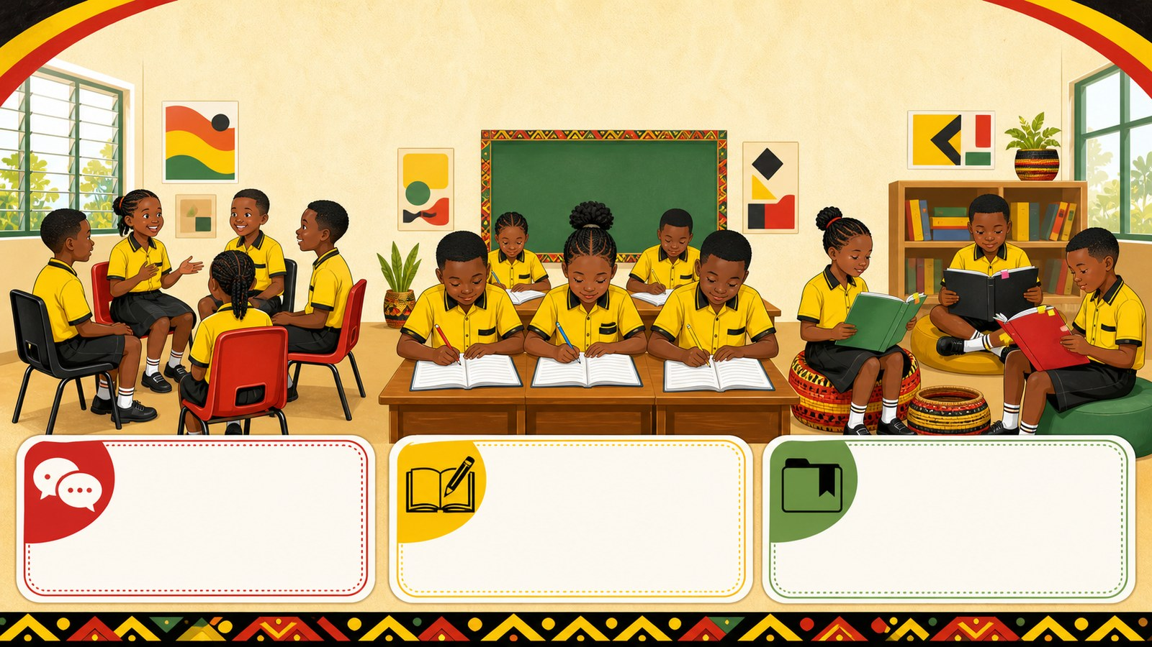
7. ACTIVITY
p7_t1_english_1205
Activity challenge
Sit in a circle and participate in a "Turn and Talk" session to
Write the new vocabulary in their exercise books and work in pairs
Individual activity: Learners silently read through their term's

Slide 8

8. EXIT
p7_t1_english_1205
Exit ticket
How will you make your work even better in Term 2?
Use one complete sentence Use one key word: Past simple tense for Hand in or read your answer aloud
Complete sentence
Use a key word
Read aloud or hand in

