Slide 1
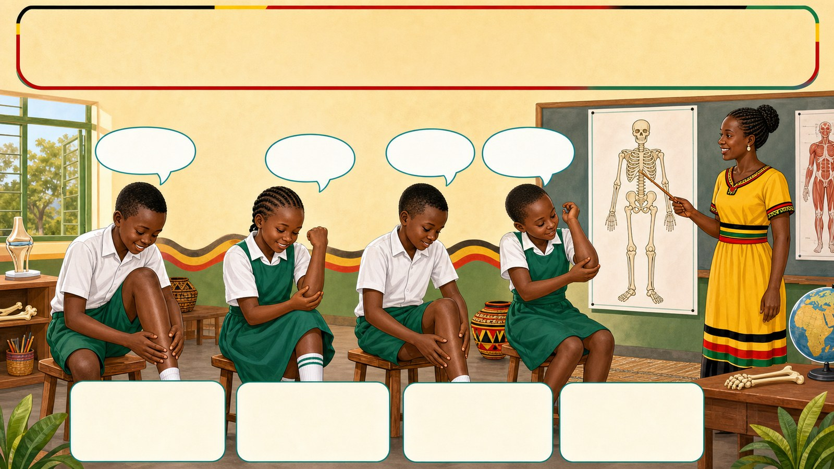
1. HOOK
p7_t1_integrated_science_0101
The Human Body: Muscular-Skeletal System
What do you feel when you touch your shin?
Think alone
Pair talk
Share one idea
Point to evidence

Slide 2
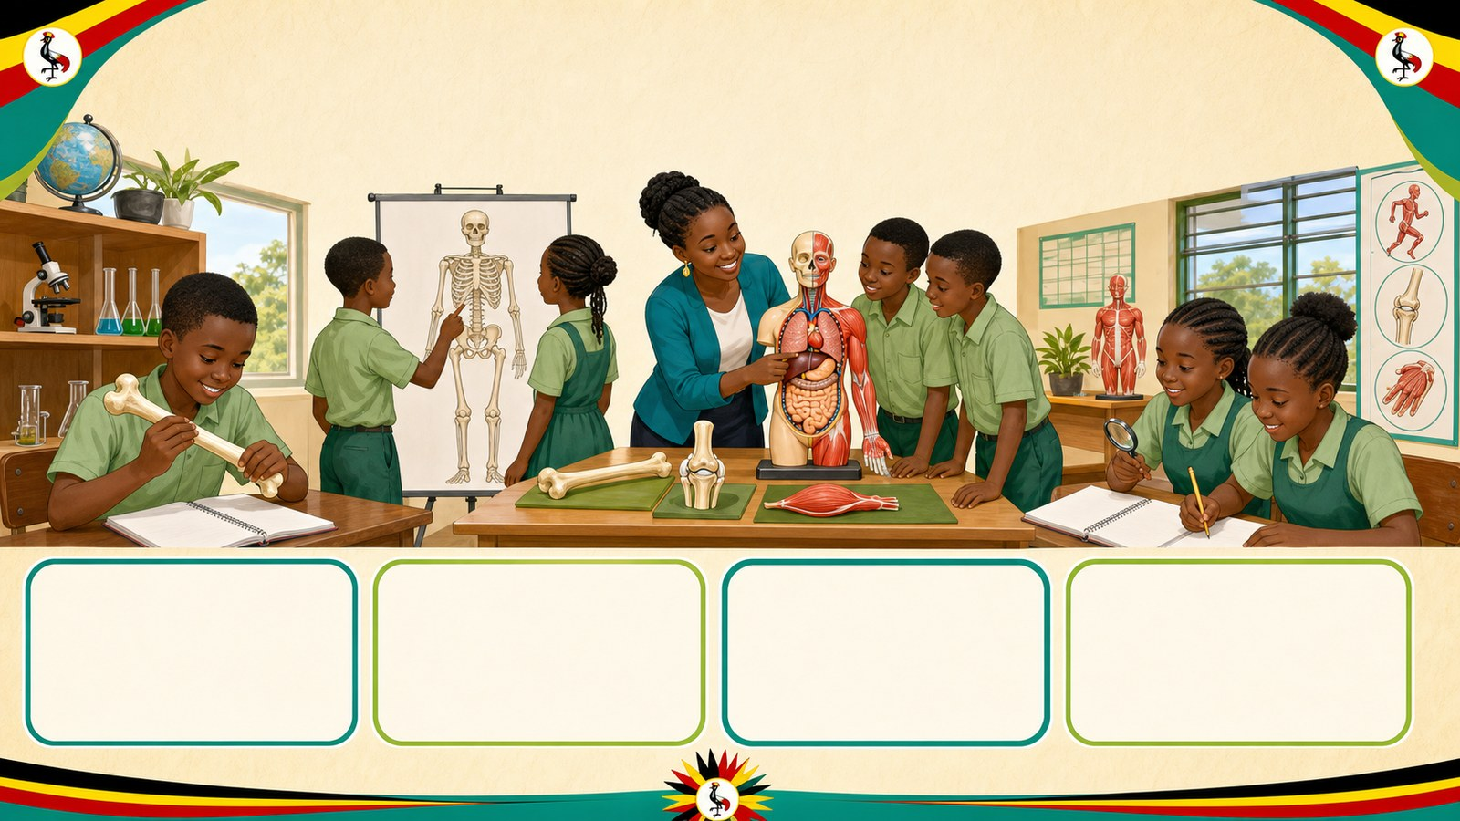
2. MISSION
p7_t1_integrated_science_0101
Today's mission
I can identify and name the main components of the
Why Do We Have a Shape?, Exploring the Skeleton
answer with one reason or example
listen, talk, try, explain

Slide 3
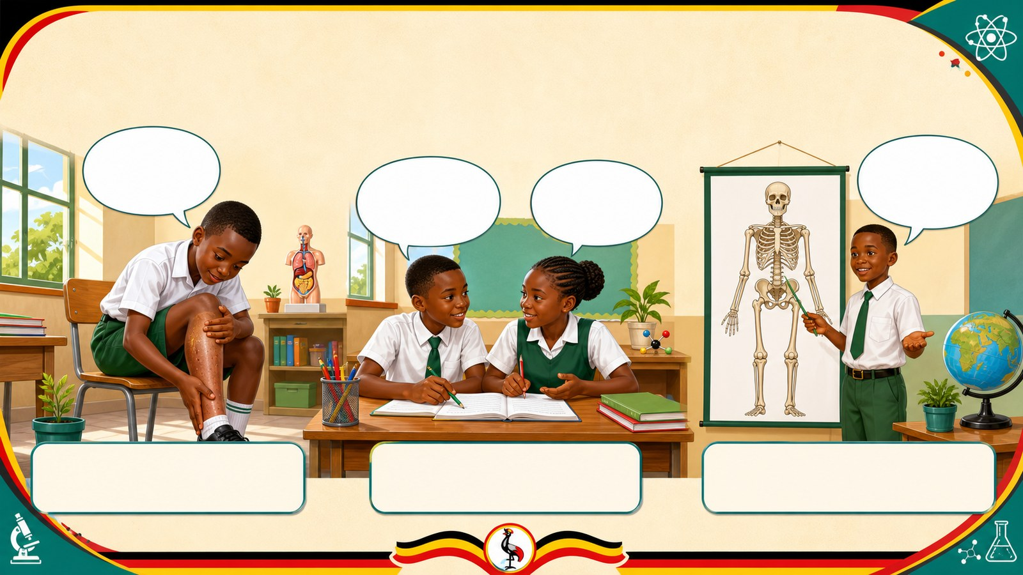
3. STARTER
p7_t1_integrated_science_0101
Starter: think first
What do you feel when you touch your shin?
compare your first answer with a partner
connect your answer to Why Do We Have a Shape?

Slide 4
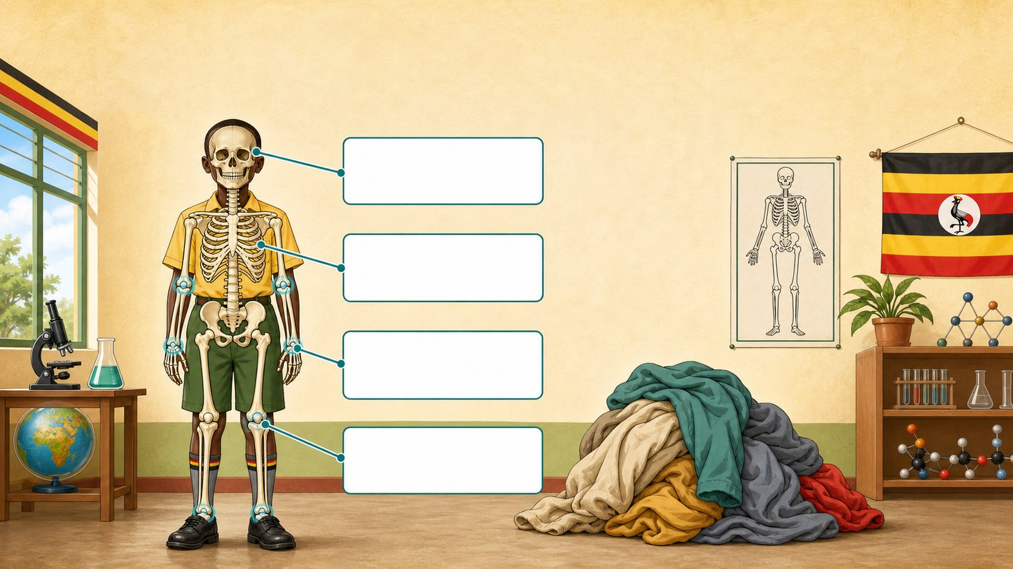
4. CONCEPT
p7_t1_integrated_science_0101
Why Do We Have a Shape?
Prior knowledge activation: Discussing why the body
The body has a firm framework
This framework allows us to stand and move
Without it, we would be like a heap of cloth

Slide 5
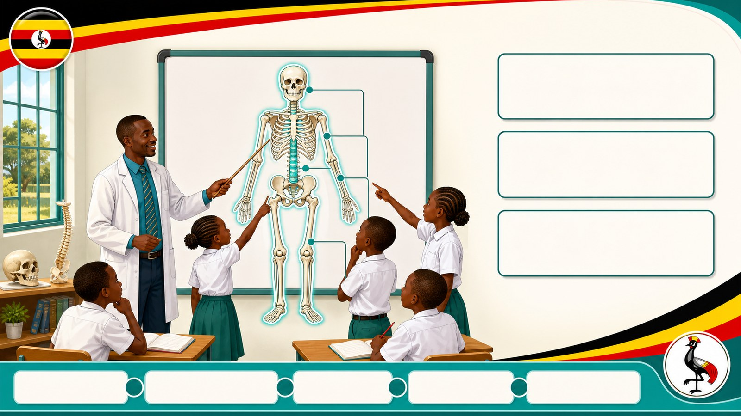
5. MODEL
p7_t1_integrated_science_0101
Exploring the Skeleton
THE SKELETON
A framework of bones in the body
Share evidence

Slide 6
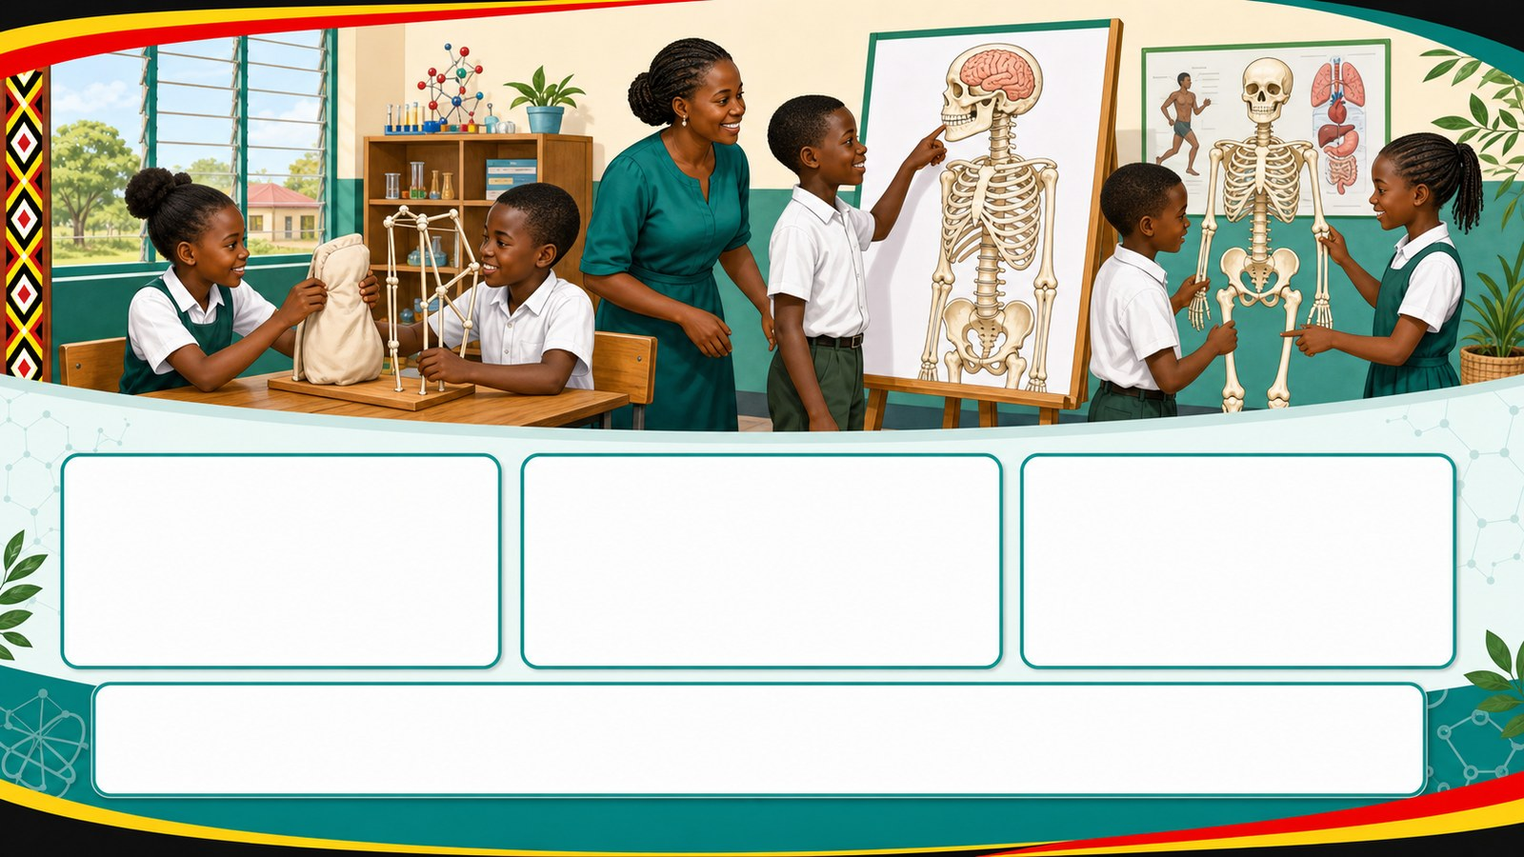
6. PRACTICE
p7_t1_integrated_science_0101
Try it together
Answer with evidence:
Why can't a piece of cloth stand up on its own?
What is the name of the bone protecting the brain?
Where are the longest bones found in the skeleton?

Slide 7
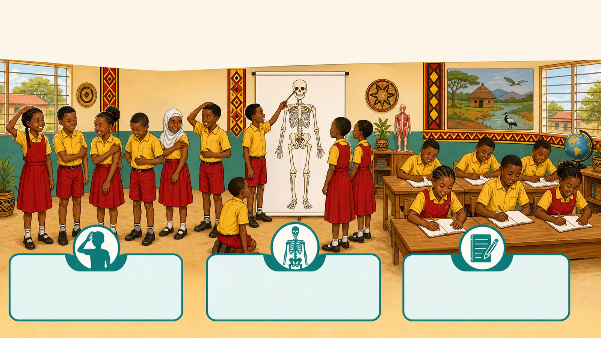
7. ACTIVITY
p7_t1_integrated_science_0101
Activity challenge
Touch various parts of their bodies (head, arm, ribs) to identify
In groups, observe the skeleton chart and point out the skull
Write the definitions of bones, muscles, and joints in their

Slide 8
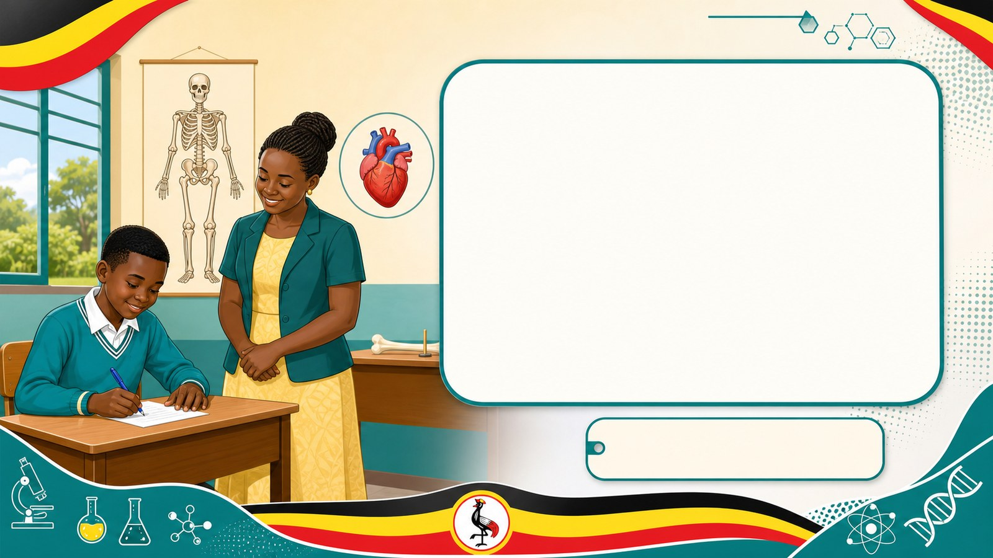
8. EXIT
p7_t1_integrated_science_0101
Exit ticket
Is the heart part of the muscular-skeletal system?
Use one complete sentence Hand in or read your answer aloud
Complete sentence
Use a key word
Read aloud or hand in

