Slide 1
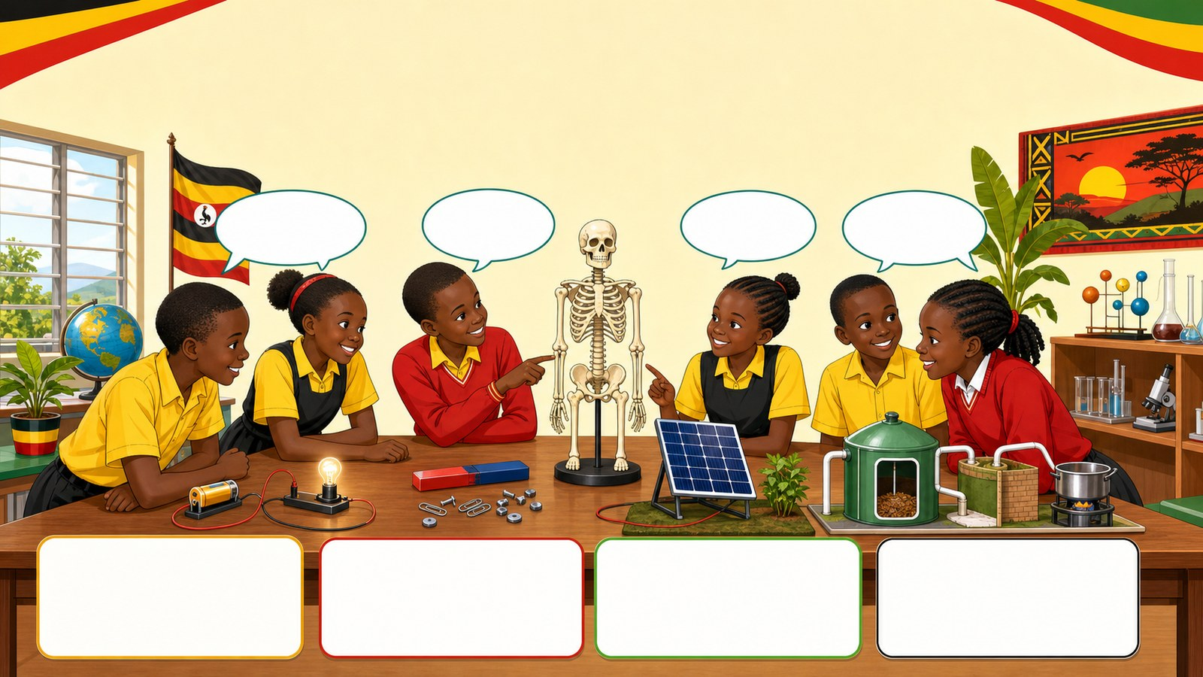
1. HOOK
p7_t1_integrated_science_1205
3.4 Energy Resources in the Environment
Which experiment did you find most challenging?
Think alone
Pair talk
Share one idea
Point to evidence

Slide 2
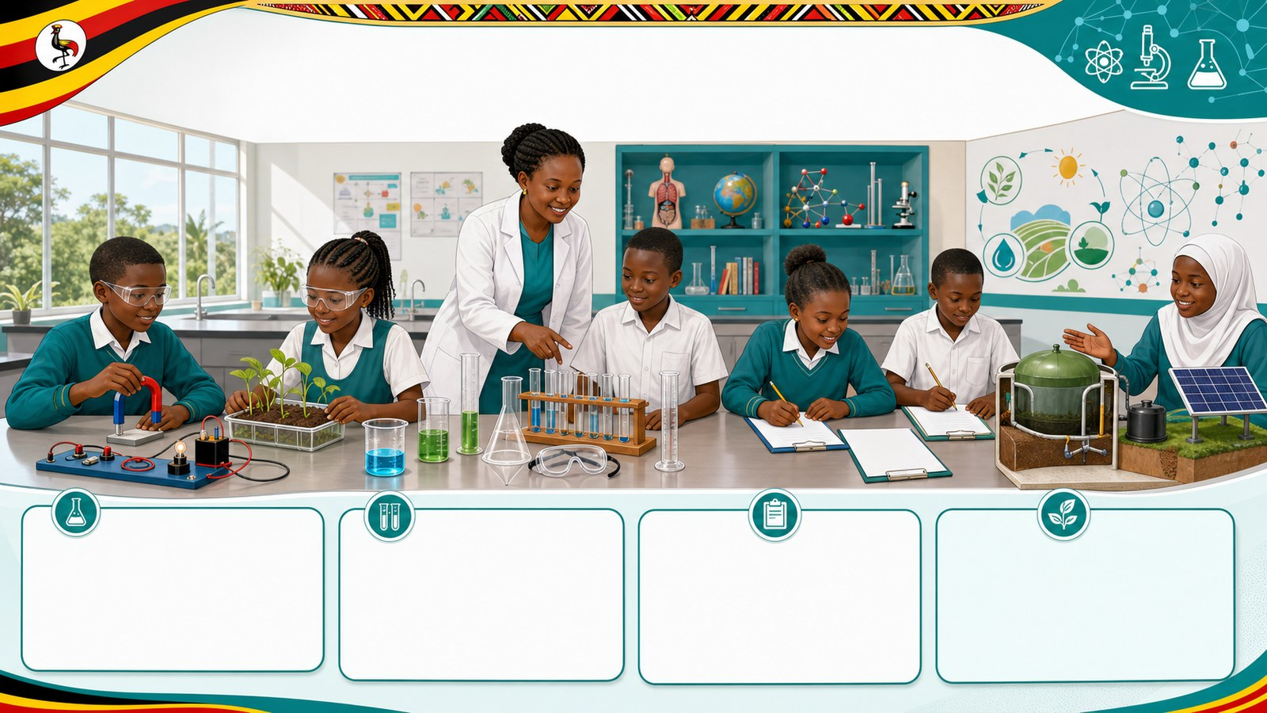
2. MISSION
p7_t1_integrated_science_1205
Today's mission
Recalls and identify key experiments conducted from
Looking Back at Our Experiments, How to Write a
answer with one reason or example
listen, talk, try, explain

Slide 3
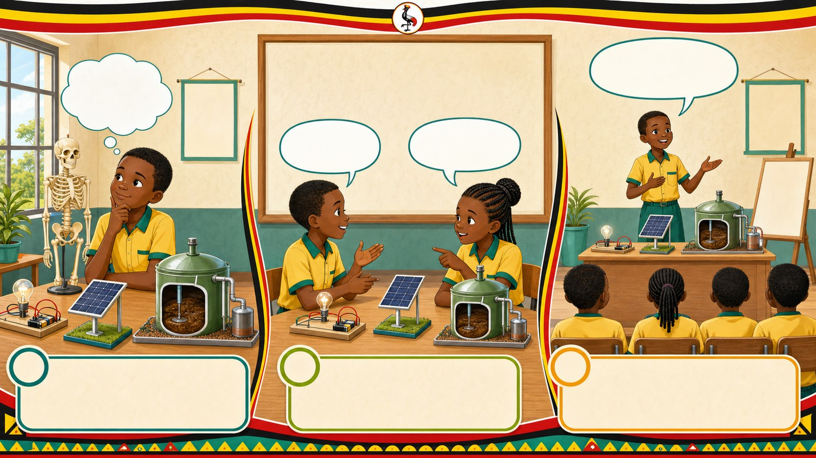
3. STARTER
p7_t1_integrated_science_1205
Starter: think first
Which experiment did you find most challenging?
compare your first answer with a partner
connect your answer to Looking Back at Our Experiments

Slide 4
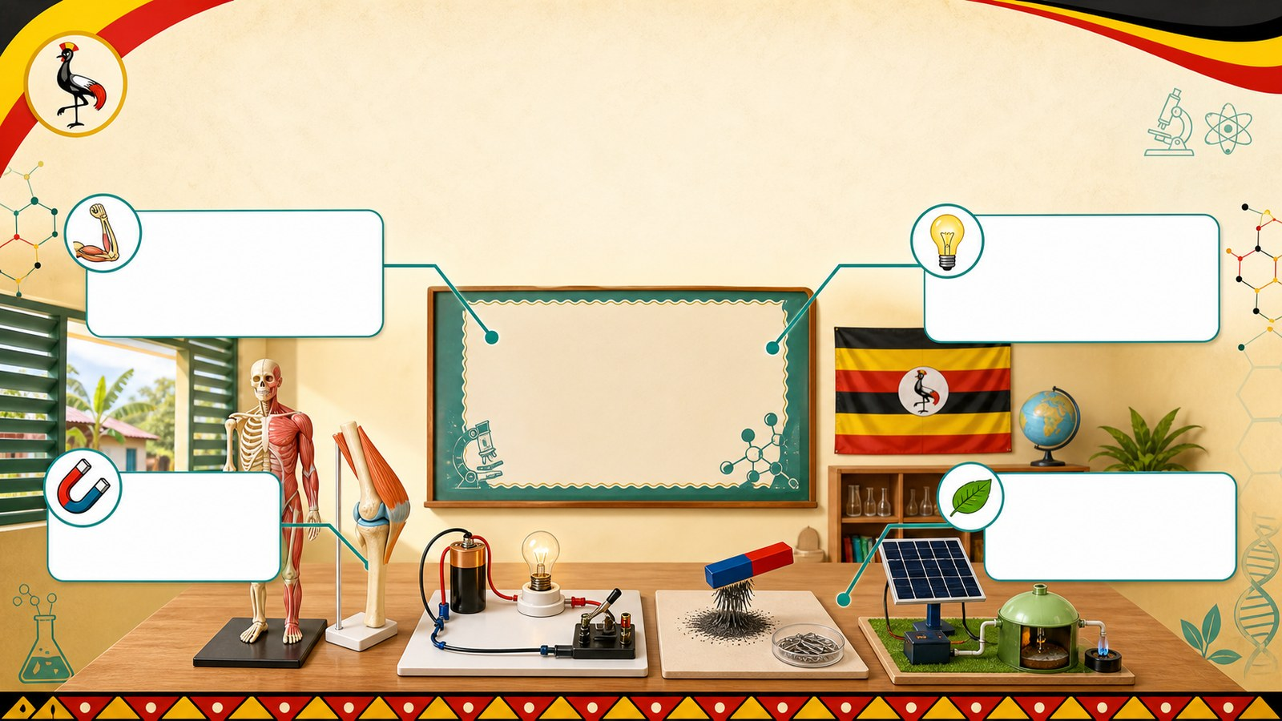
4. CONCEPT
p7_t1_integrated_science_1205
Looking Back at Our Experiments
Prior knowledge activation regarding Term 1 Science
Reviewing the Muscular-Skeletal model
Recalling the Electricity and Magnetism circuit
Remembering the Energy Resources (biogas/solar)

Slide 5
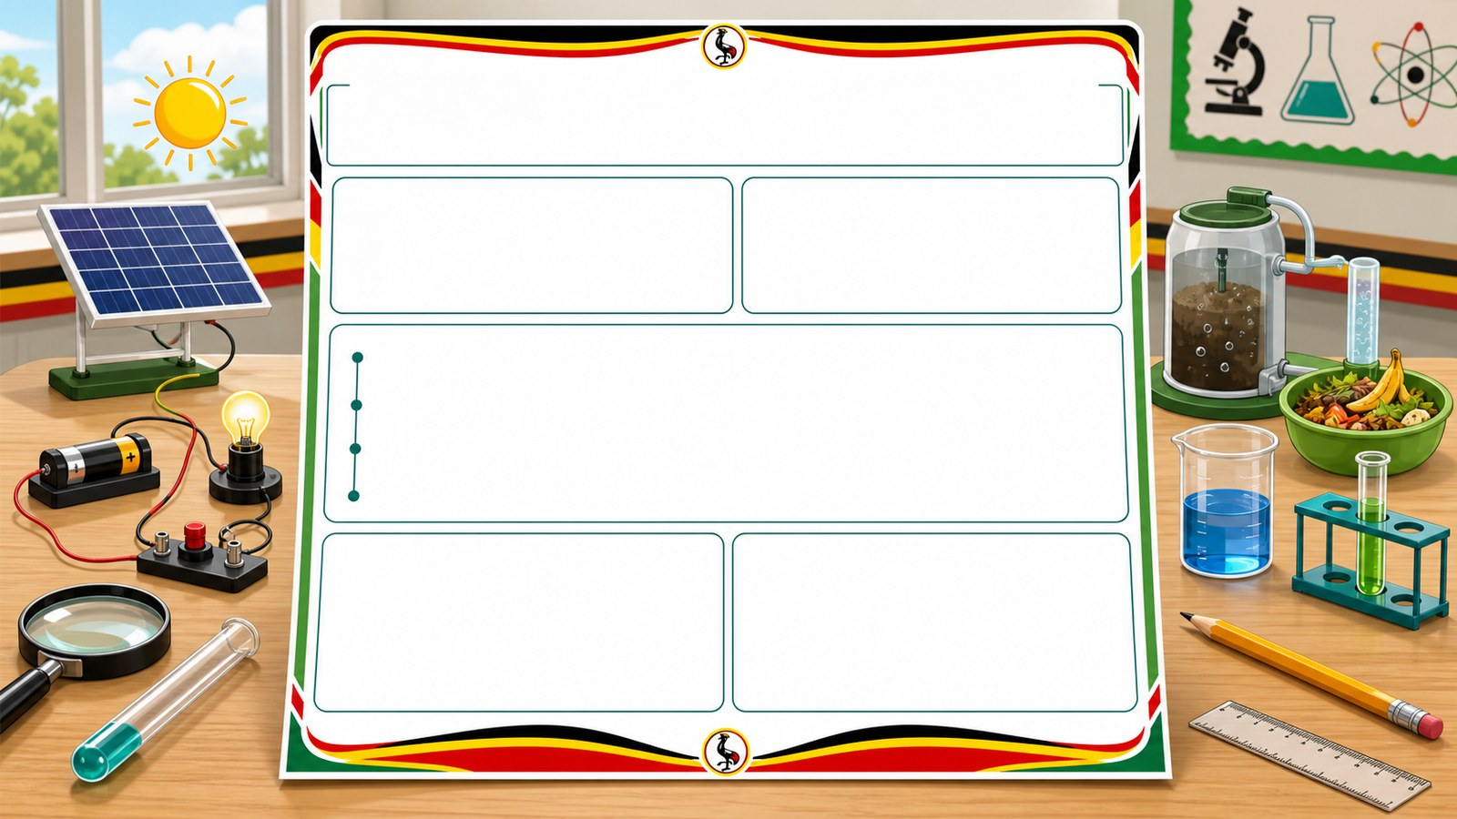
5. MODEL
p7_t1_integrated_science_1205
How to Write a Science Report
Title and Aim (What and Why)
Apparatus/Materials (The tools)
Procedure (The steps)

Slide 6

6. PRACTICE
p7_t1_integrated_science_1205
Try it together
Answer with evidence:
What materials did we use to represent the backbone in our model?
What is the difference between apparatus and procedure?
Why do we need an 'Aim' in our report?

Slide 7
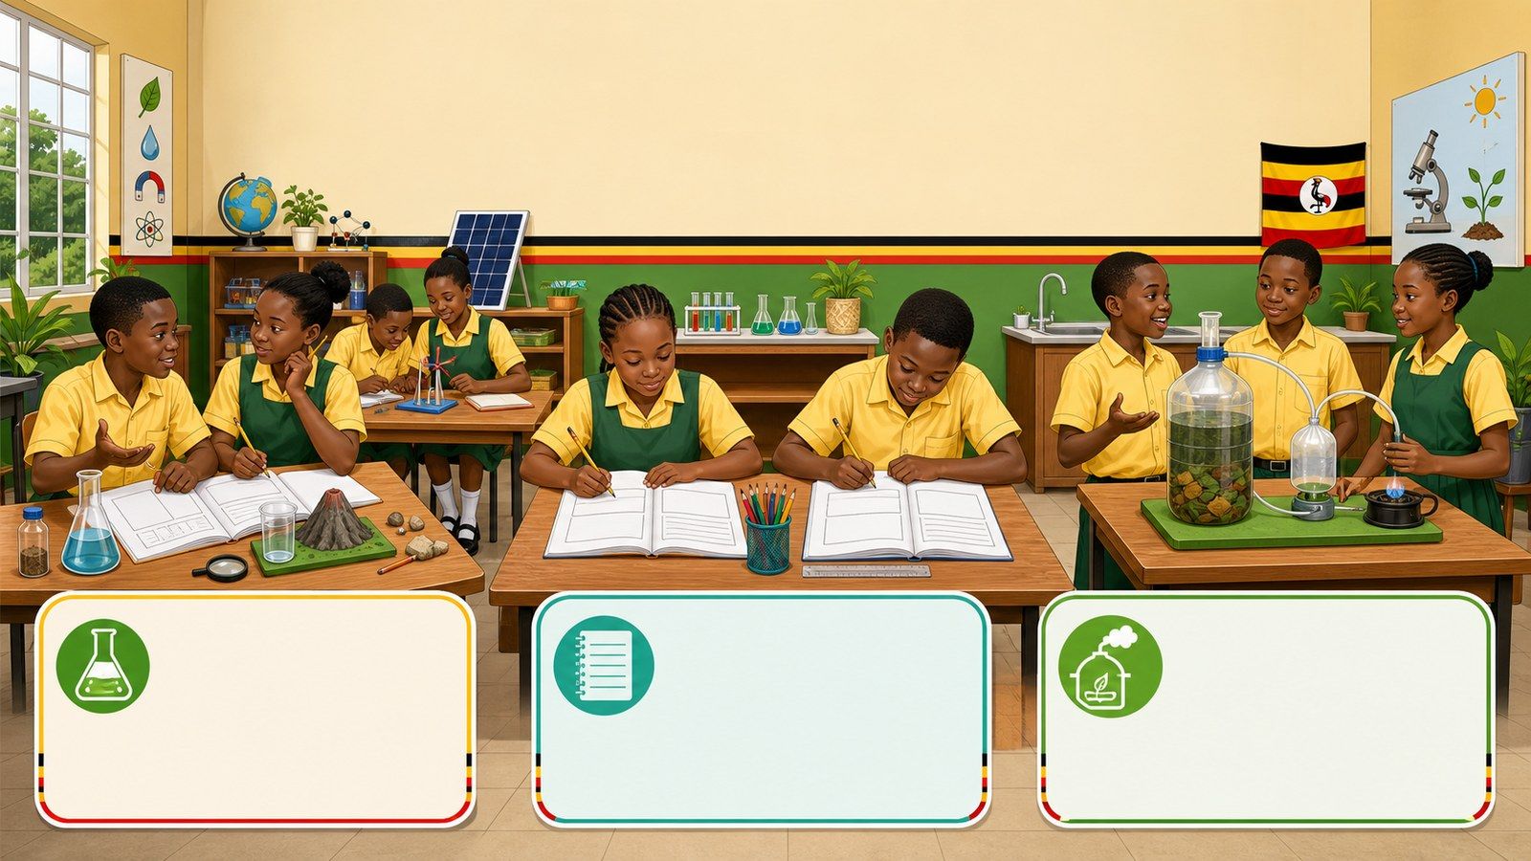
7. ACTIVITY
p7_t1_integrated_science_1205
Activity challenge
Brainstorm in pairs and list all the scientific experiments and
Copy the report structure into their notebooks and label each part
Participate in a whole-class exercise to verbally summarize the

Slide 8
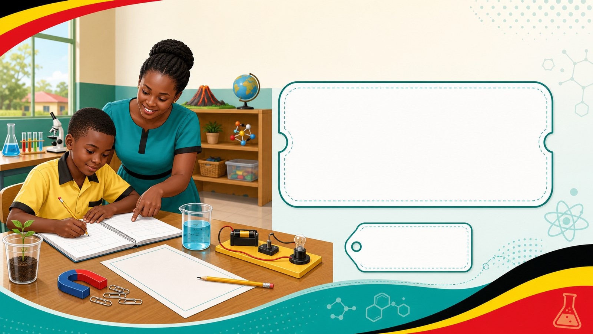
8. EXIT
p7_t1_integrated_science_1205
Exit ticket
How does writing a report help you remember the experiment?
Use one complete sentence Hand in or read your answer aloud
Complete sentence
Use a key word
Read aloud or hand in

