Slide 1
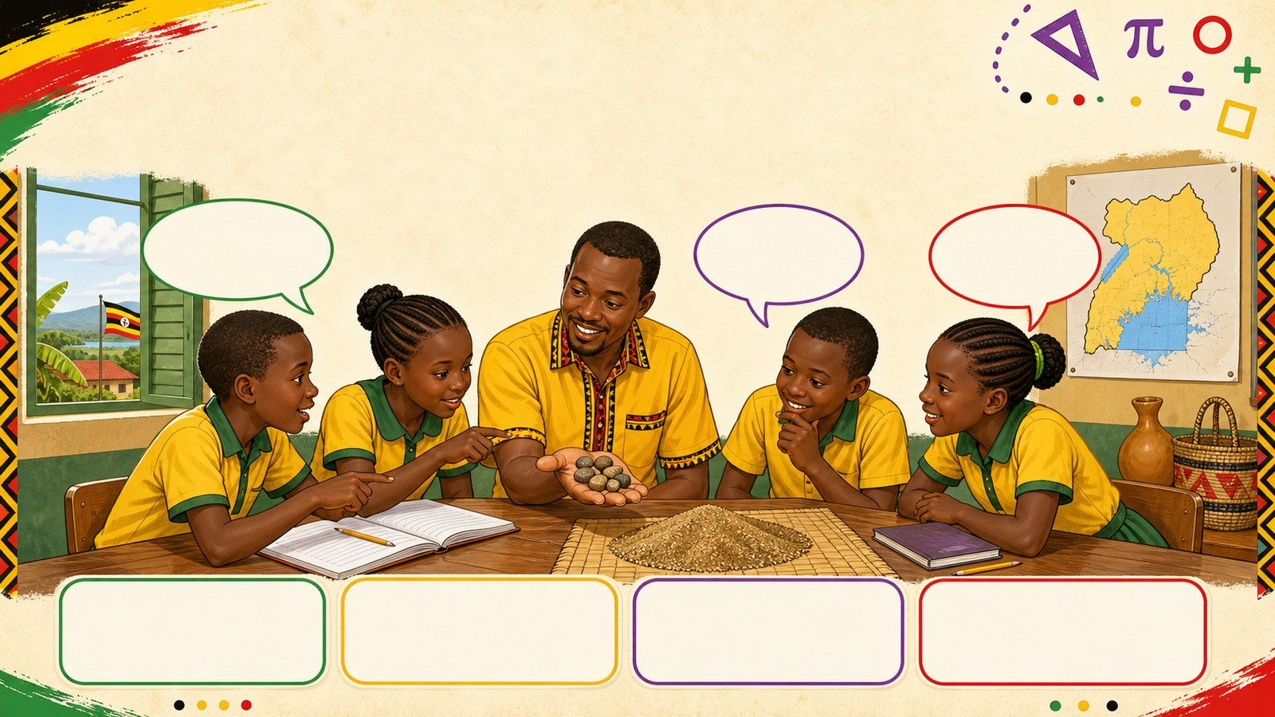
1. HOOK
p7_t1_mathematics_0101
01 Sets (Set Concepts)
How many stones are in my hand?
Think alone
Pair talk
Share one idea
Point to evidence

Slide 2
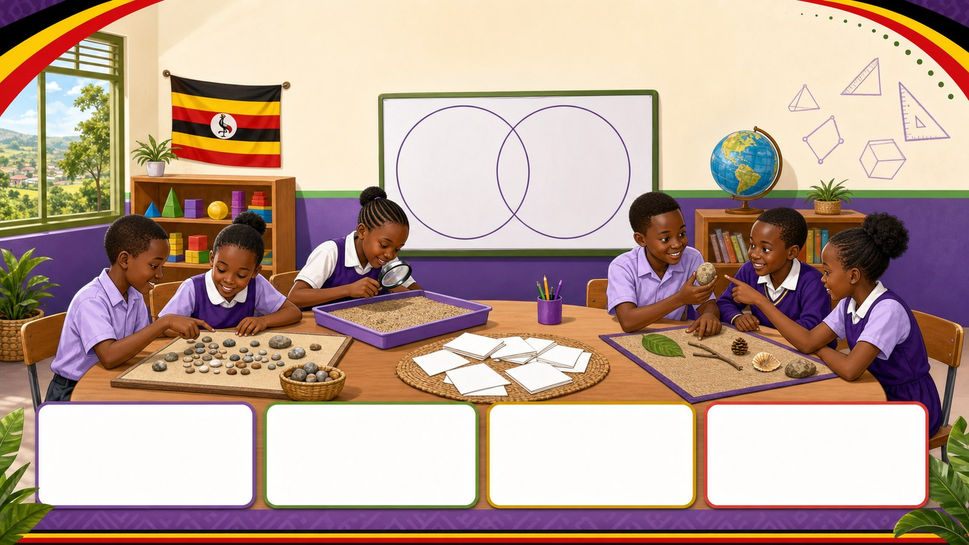
2. MISSION
p7_t1_mathematics_0101
Today's mission
I can distinguish between finite and infinite sets
Can We Count Everything?, Defining Our Sets
answer with one reason or example
listen, talk, try, explain

Slide 3
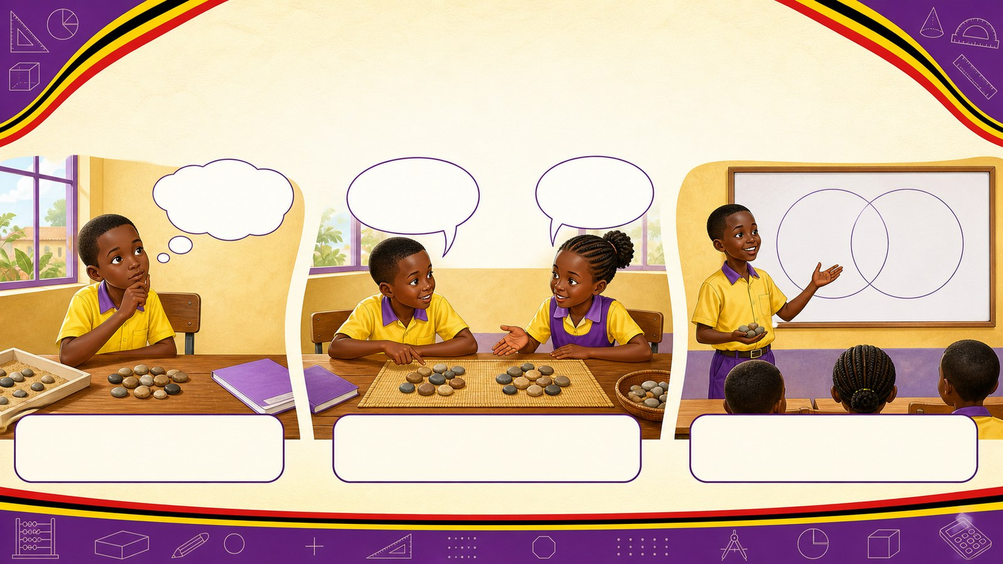
3. STARTER
p7_t1_mathematics_0101
Starter: think first
How many stones are in my hand?
compare your first answer with a partner
connect your answer to Can We Count Everything?

Slide 4
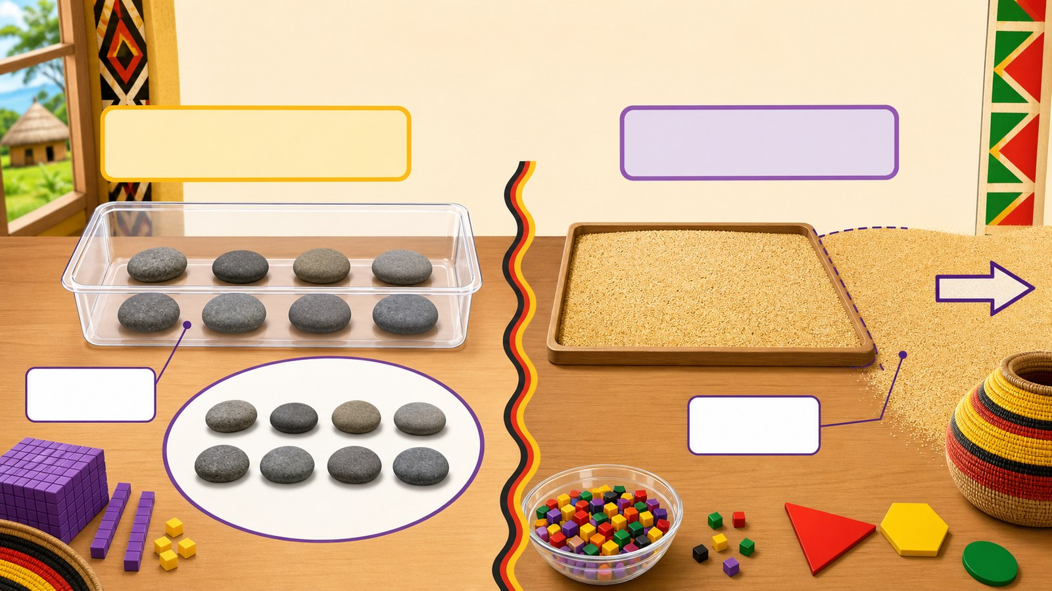
4. CONCEPT
p7_t1_mathematics_0101
Can We Count Everything?
Concrete exploration of countable objects (stones)
Practical counting of stones
Attempting to count grains of sand
Identifying which count can be finished

Slide 5
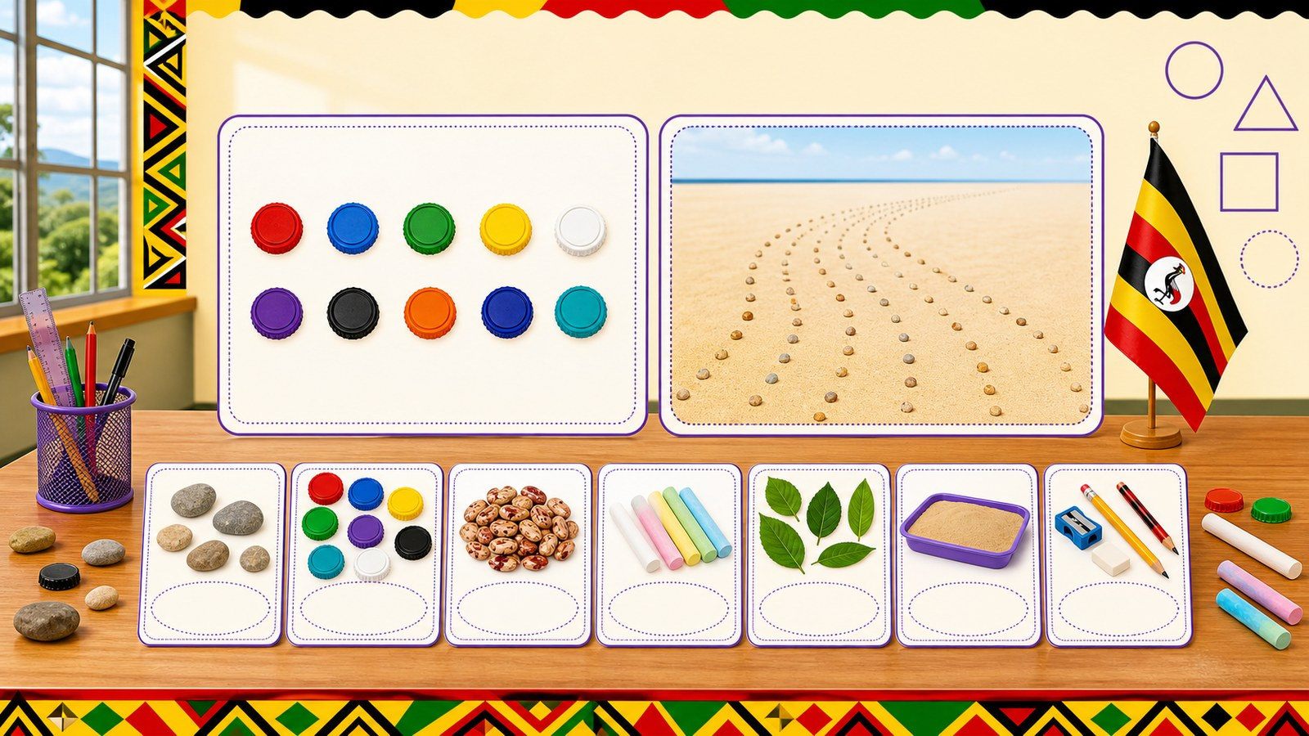
5. MODEL
p7_t1_mathematics_0101
Defining Our Sets
Finite Set: Has a countable number of members
Infinite Set: Has members that go on forever
Examples from daily life

Slide 6
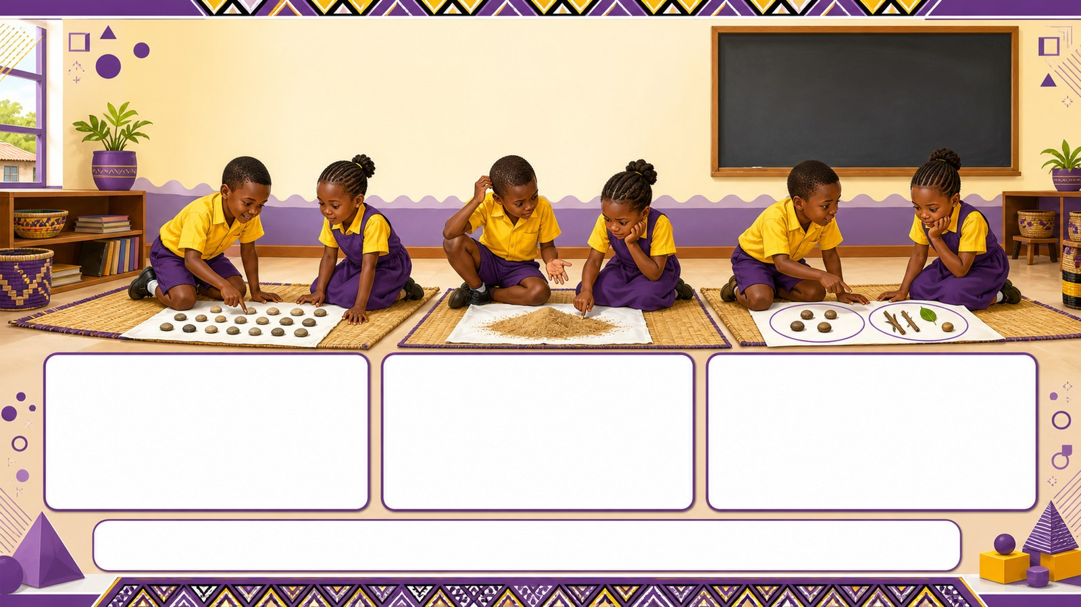
6. PRACTICE
p7_t1_mathematics_0101
Try it together
Answer with evidence:
Can you tell me exactly how many grains are in that pile of sand?
Which count was easier to finish?
What is a finite set?

Slide 7
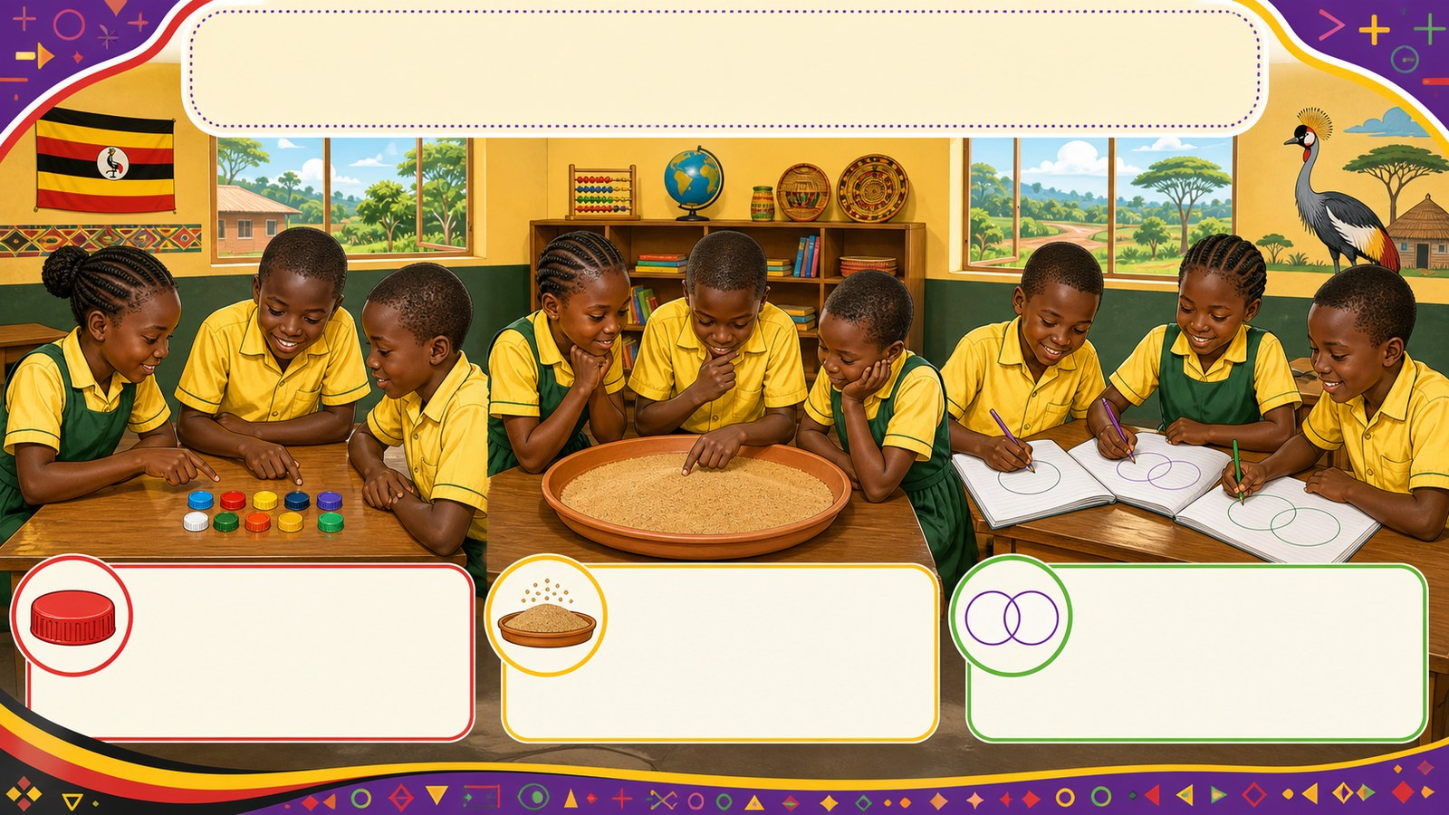
7. ACTIVITY
p7_t1_mathematics_0101
Activity challenge
In groups of five, learners count a pile of 10 bottle caps and
Write the definitions of finite and infinite sets in their
Draw two Venn diagrams. In the first, they represent

Slide 8
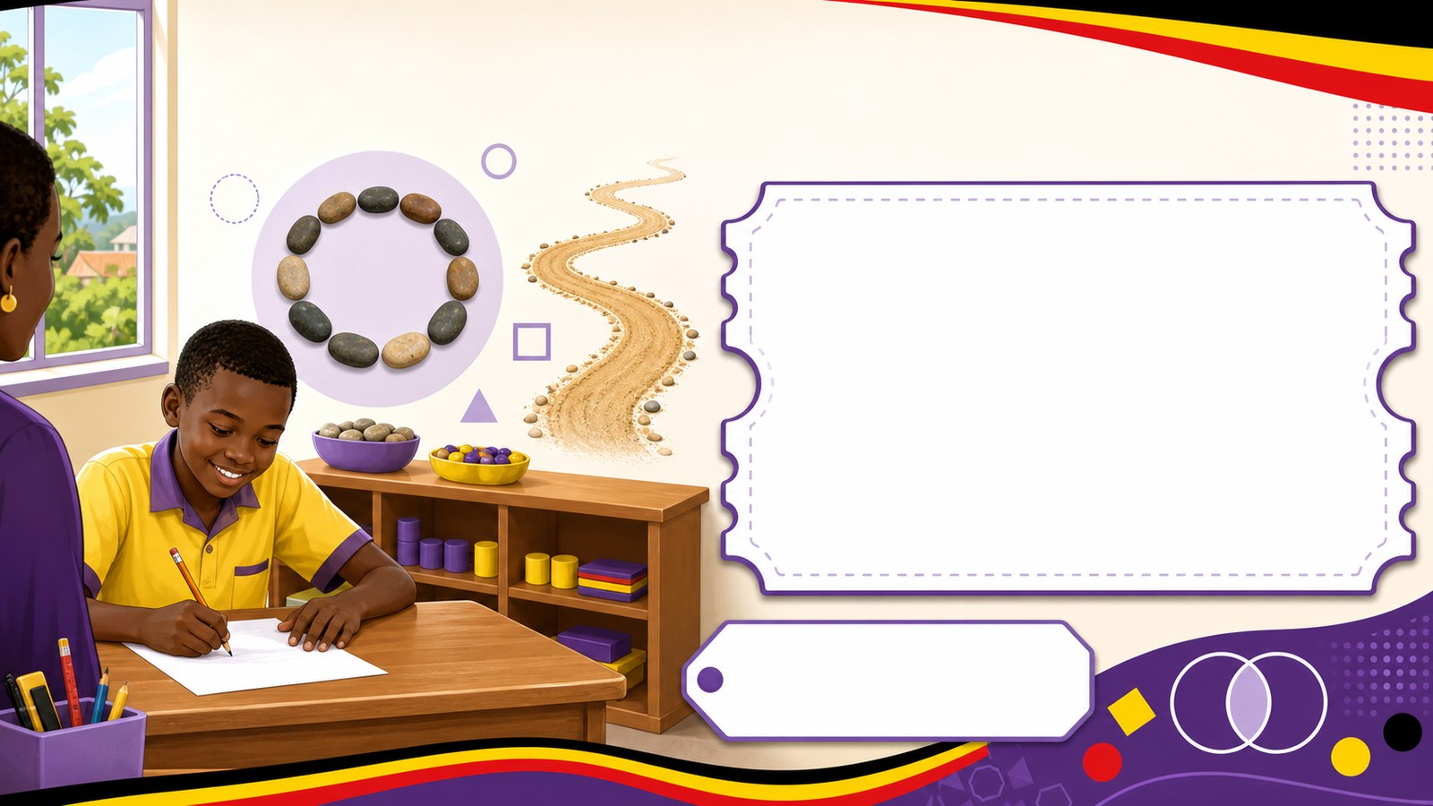
8. EXIT
p7_t1_mathematics_0101
Exit ticket
Can a very large set still be finite? (Yes, if it has an end)
Use one complete sentence Use one key word: Set Hand in or read your answer aloud
Complete sentence
Use a key word
Read aloud or hand in

