Slide 1
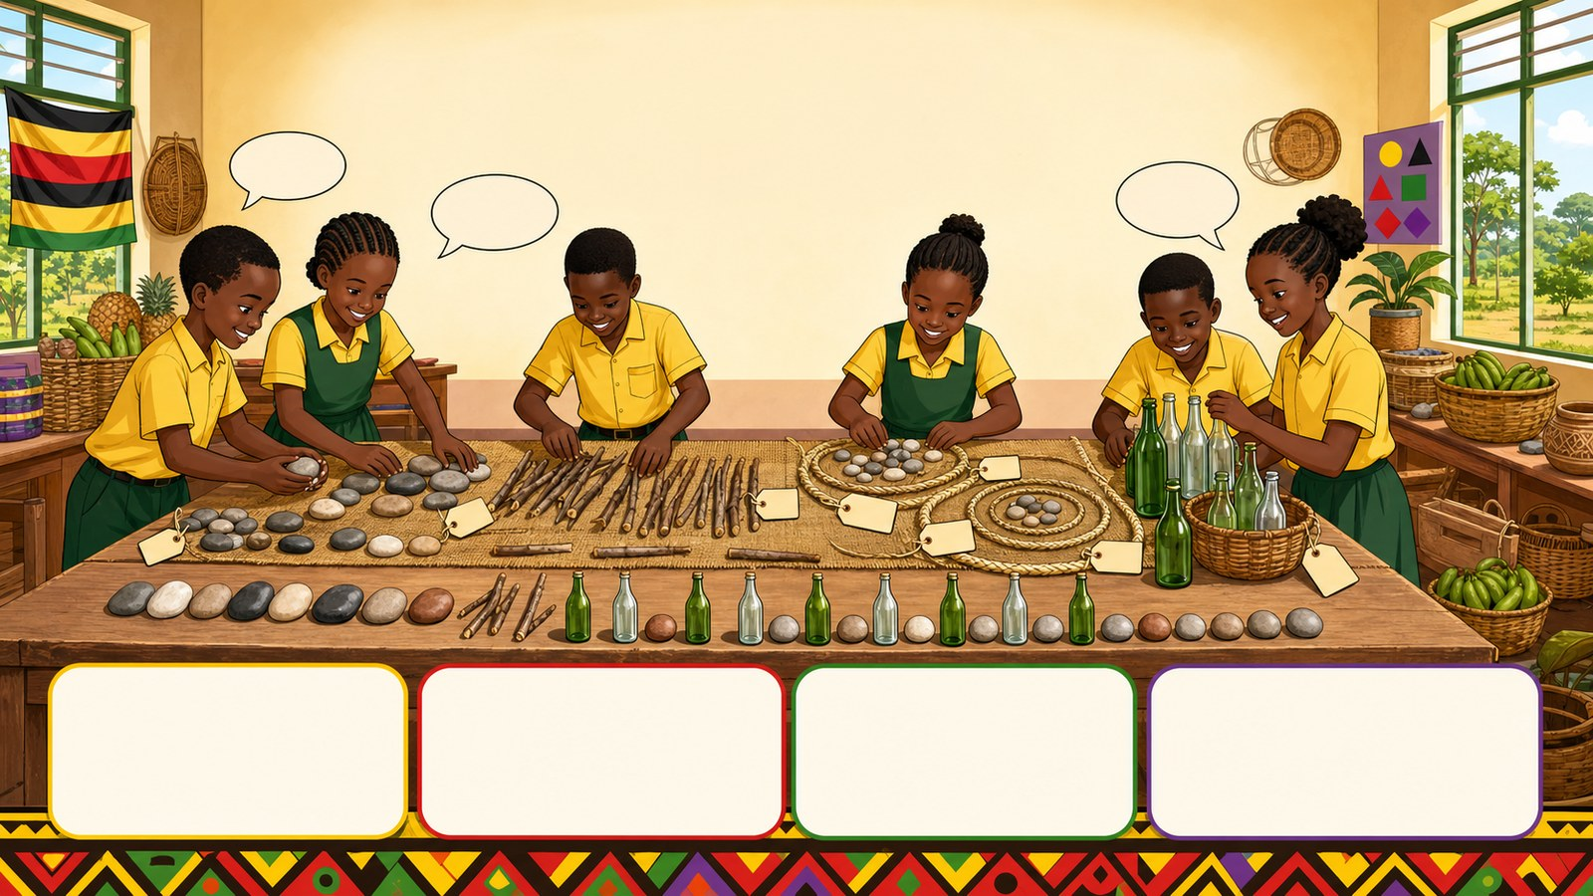
1. HOOK
p7_t1_mathematics_1205
4.0 Patterns and Sequences (Final Review)
What is a subset?
Think alone
Pair talk
Share one idea
Point to evidence

Slide 2
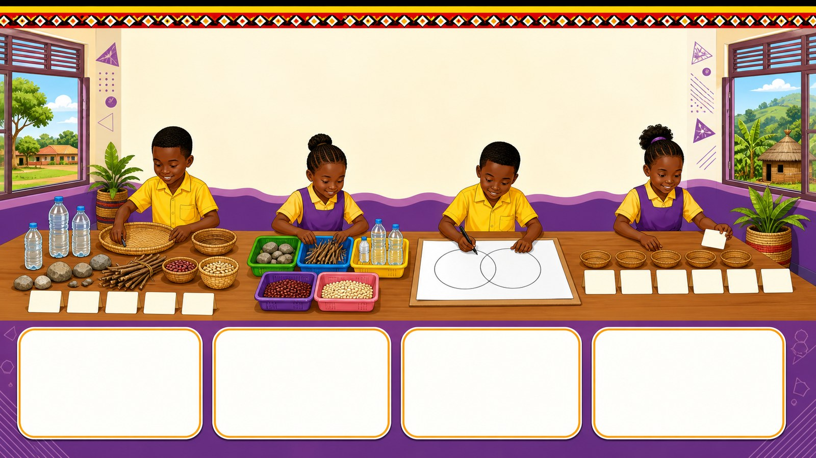
2. MISSION
p7_t1_mathematics_1205
Today's mission
I can apply all Term 1 math ideas (Sets, Whole
Setting Up Our Math Market, Mapping the Market Data
answer with one reason or example
listen, talk, try, explain

Slide 3
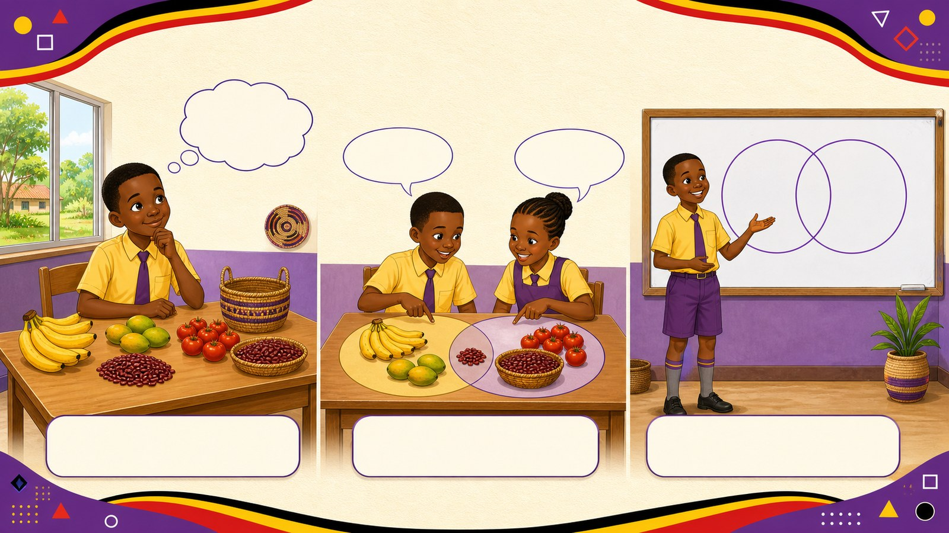
3. STARTER
p7_t1_mathematics_1205
Starter: think first
What is a subset?
compare your first answer with a partner
connect your answer to Setting Up Our Math Market

Slide 4
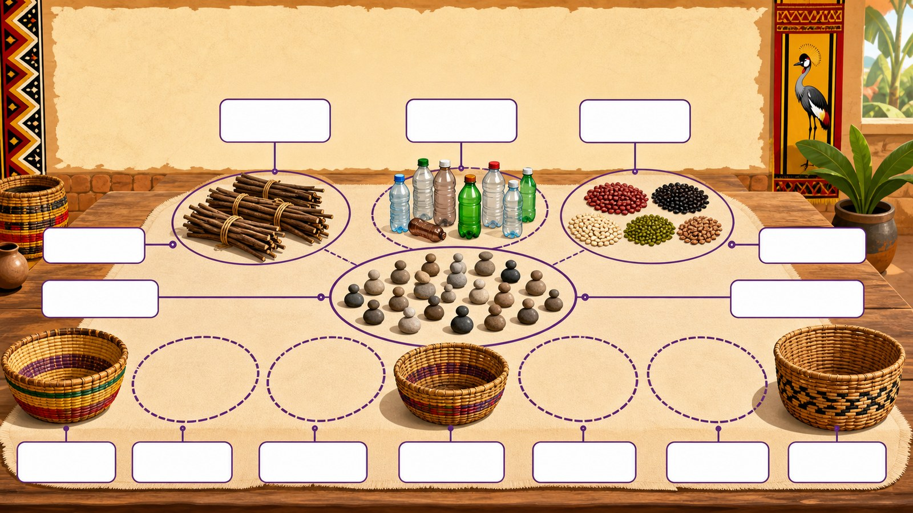
4. CONCEPT
p7_t1_mathematics_1205
Setting Up Our Math Market
Concrete Stage: Organizing market items into sets
Use stones to represent customers
Group local items into Sets
Identify subsets within the market

Slide 5
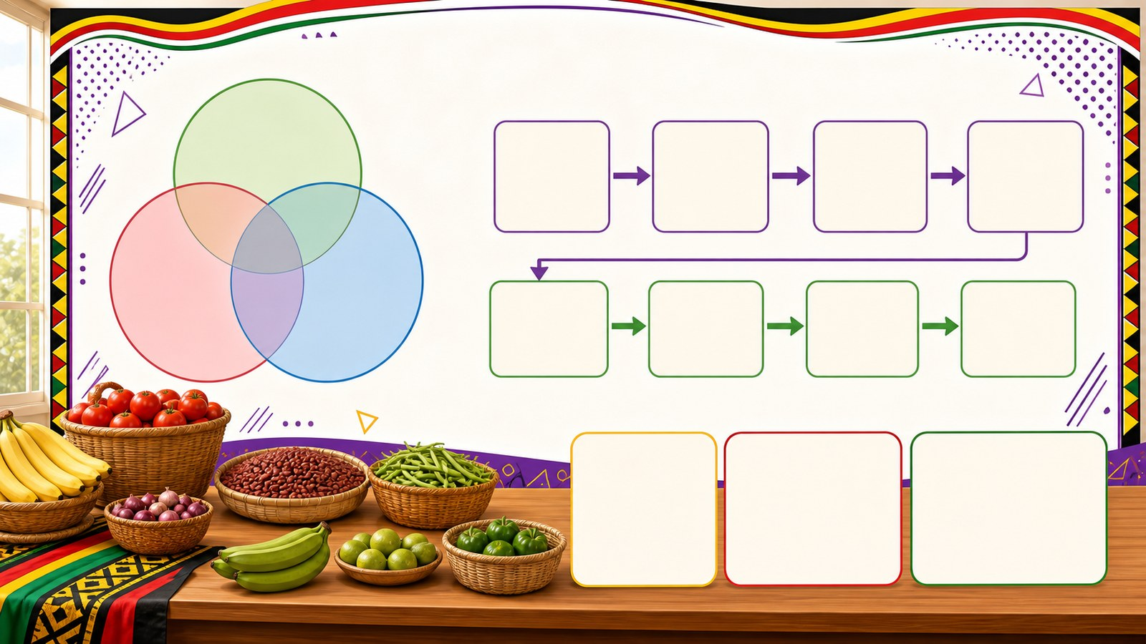
5. MODEL
p7_t1_mathematics_1205
Mapping the Market Data
Draw a Venn diagram of the inventory
Create a price sequence for items
Identify the rule of the sequence

Slide 6
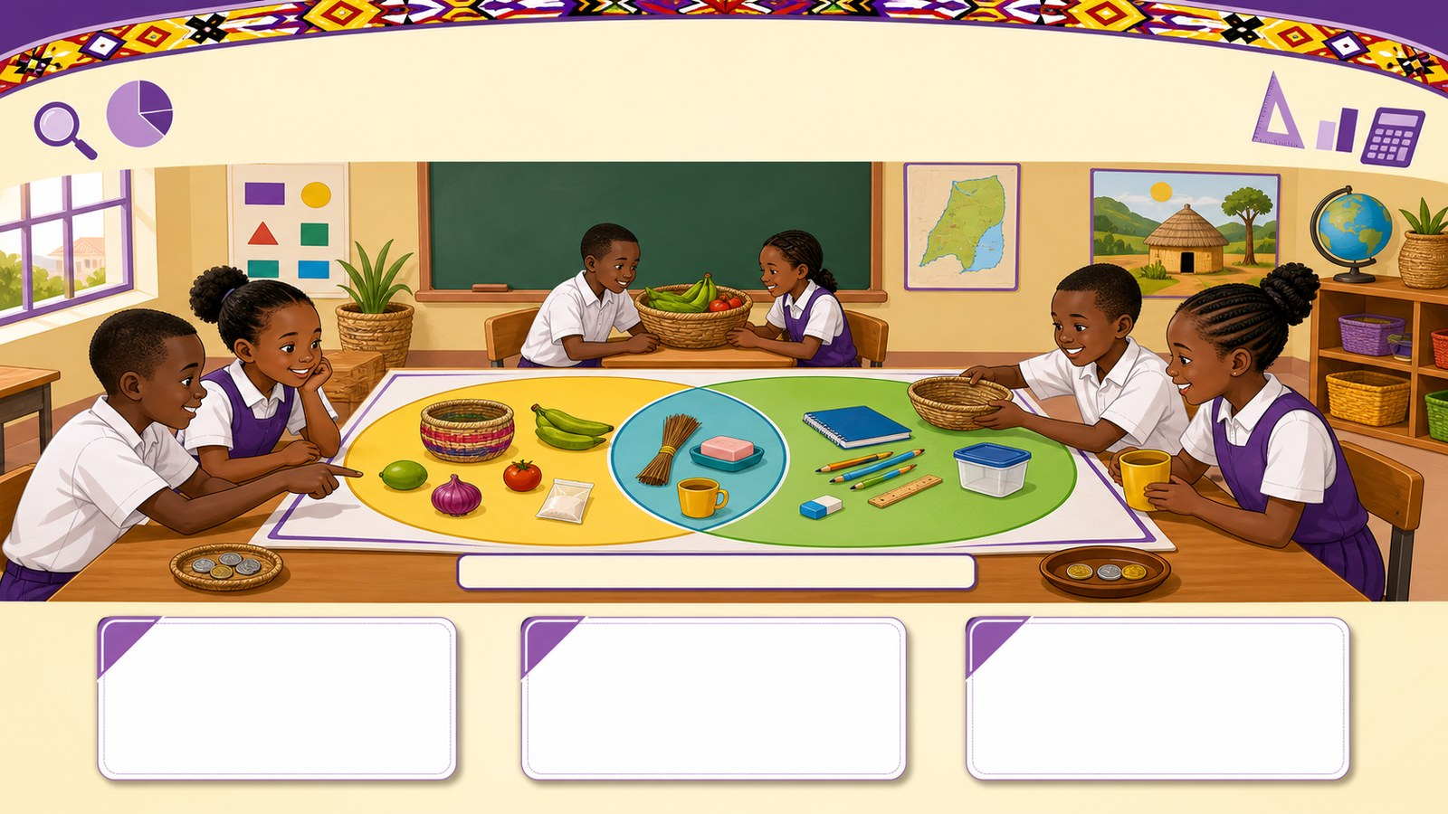
6. PRACTICE
p7_t1_mathematics_1205
Try it together
Answer with evidence:
How many items are in our Universal Set?
Can an item belong to two sets at once?
Where do we put items that are both cheap and useful?

Slide 7
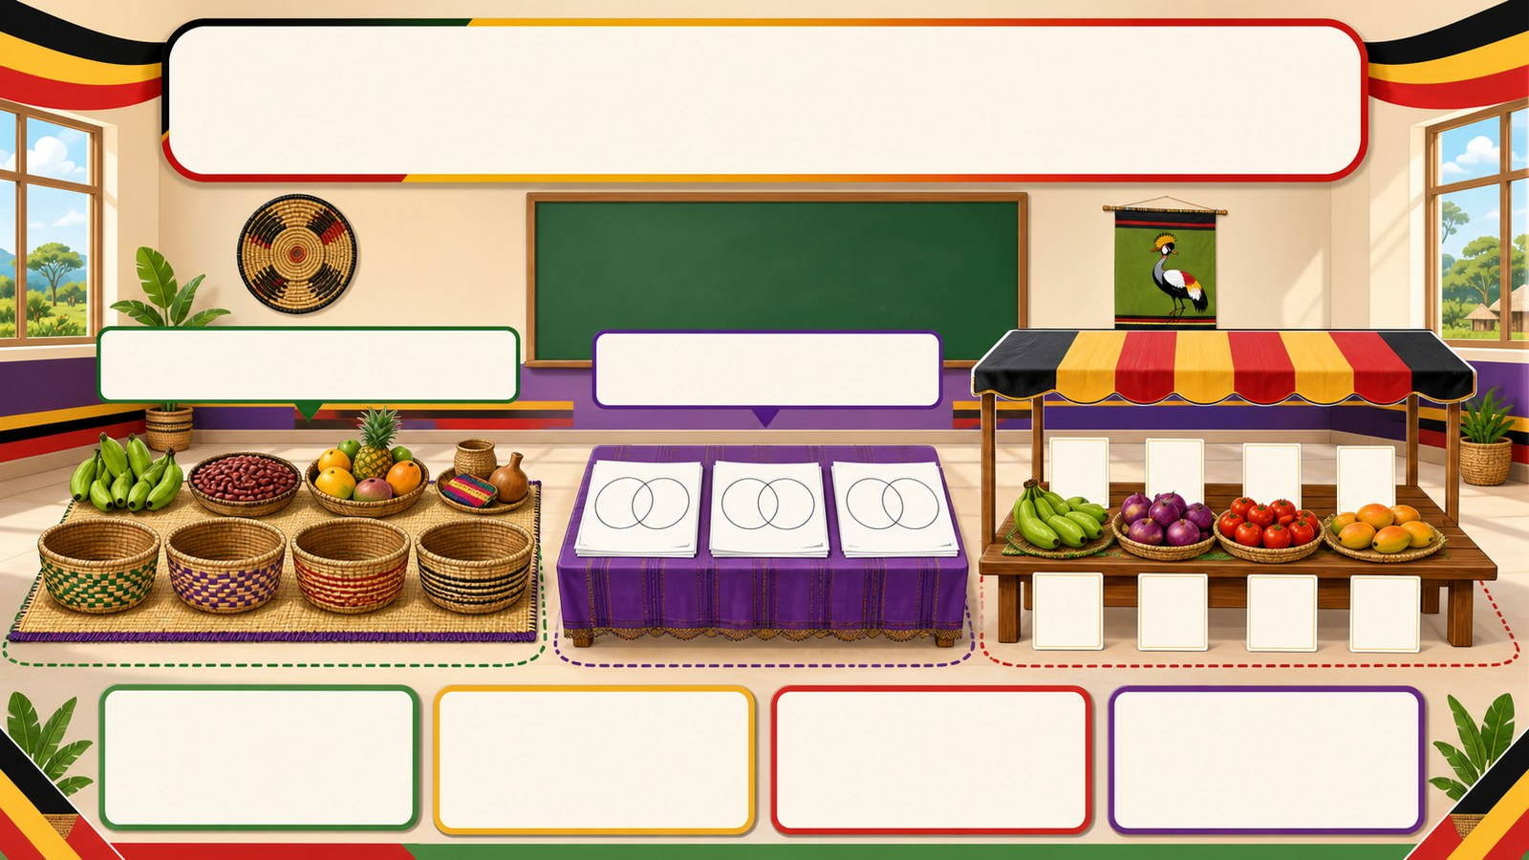
7. ACTIVITY
p7_t1_mathematics_1205
Activity challenge
Work in groups of five to sort physical objects (stones, sticks
Draw Venn diagrams on paper to represent their sorted sets and
Individual learners solve multi-digit multiplication and addition

Slide 8
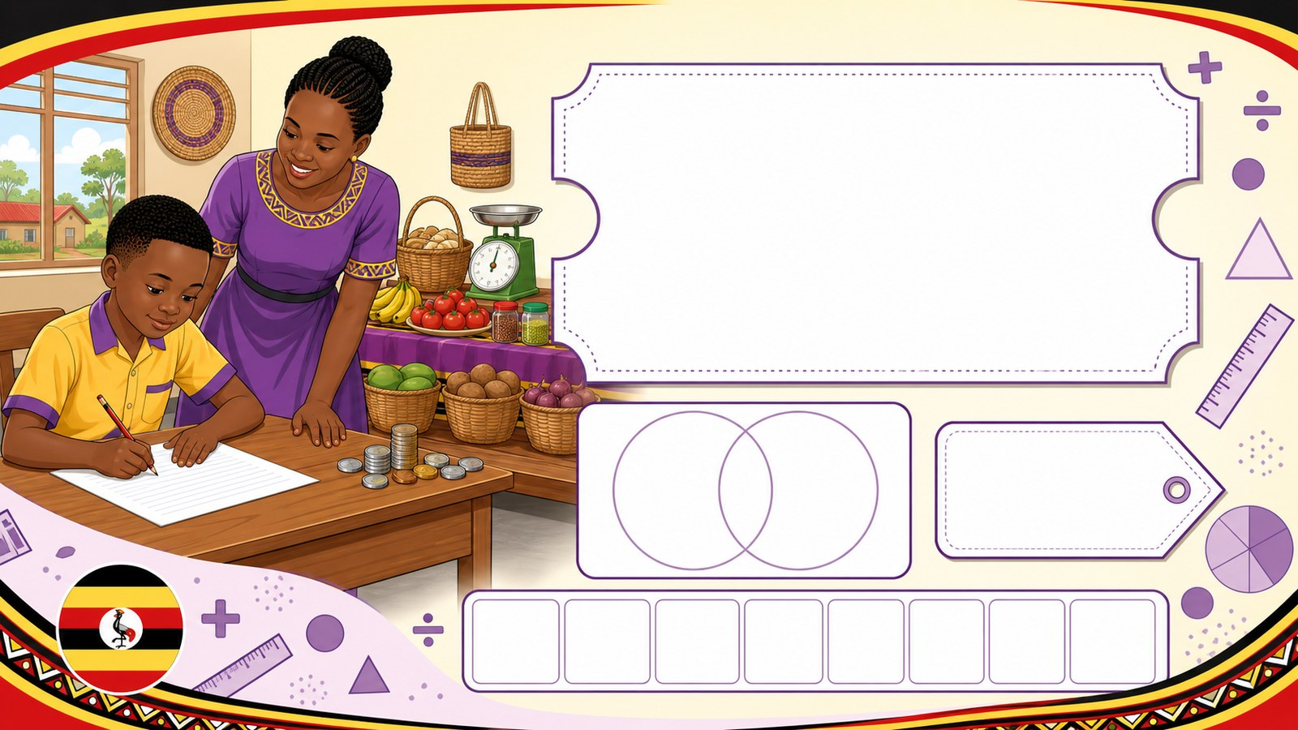
8. EXIT
p7_t1_mathematics_1205
Exit ticket
How does math help a market seller in Uganda?
Use one complete sentence Hand in or read your answer aloud
Complete sentence
Use a key word
Read aloud or hand in

