Slide 1
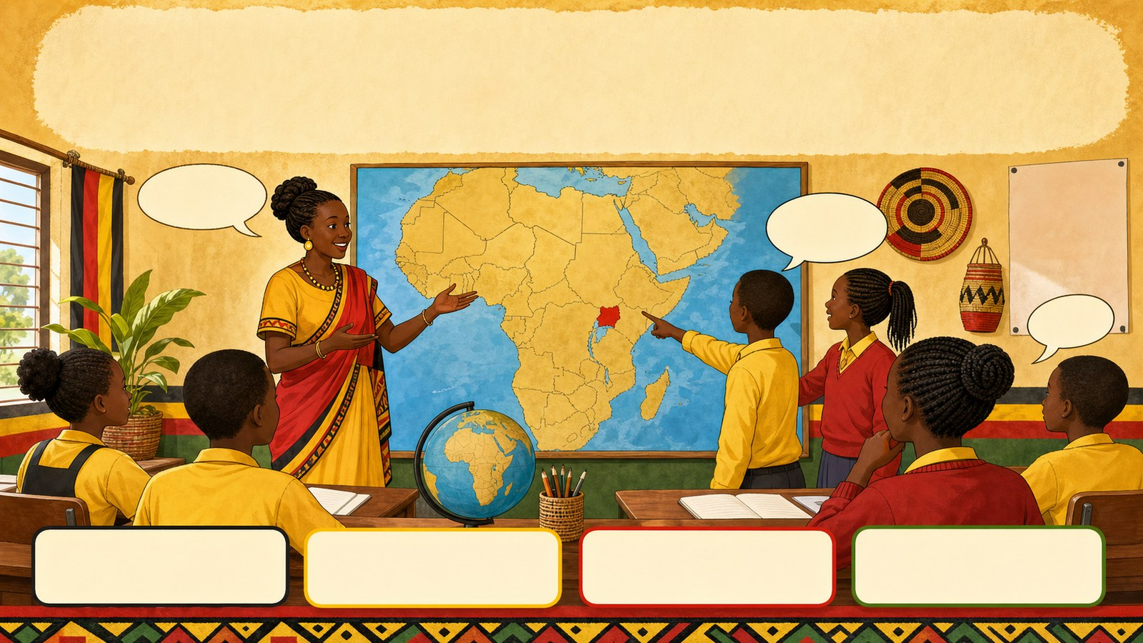
1. HOOK
p7_t1_social_studies_0101
1.0 Living Together in Africa
What is the name of our country?
Think alone
Pair talk
Share one idea
Point to evidence

Slide 2
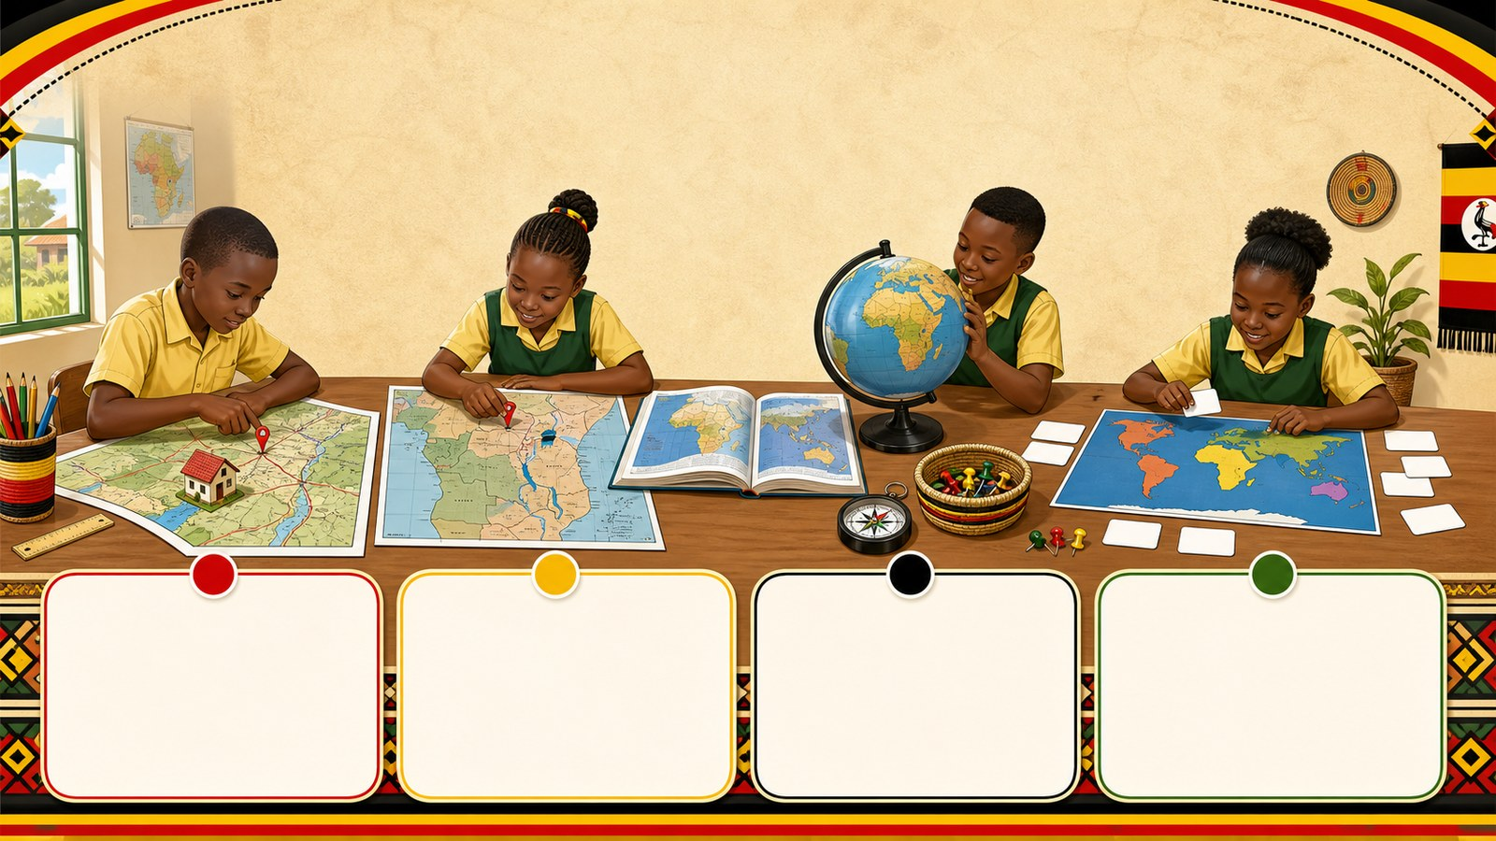
2. MISSION
p7_t1_social_studies_0101
Today's mission
Students will identify the location of Africa in
Where is Our Home?, The Seven Continents
answer with one reason or example
listen, talk, try, explain

Slide 3
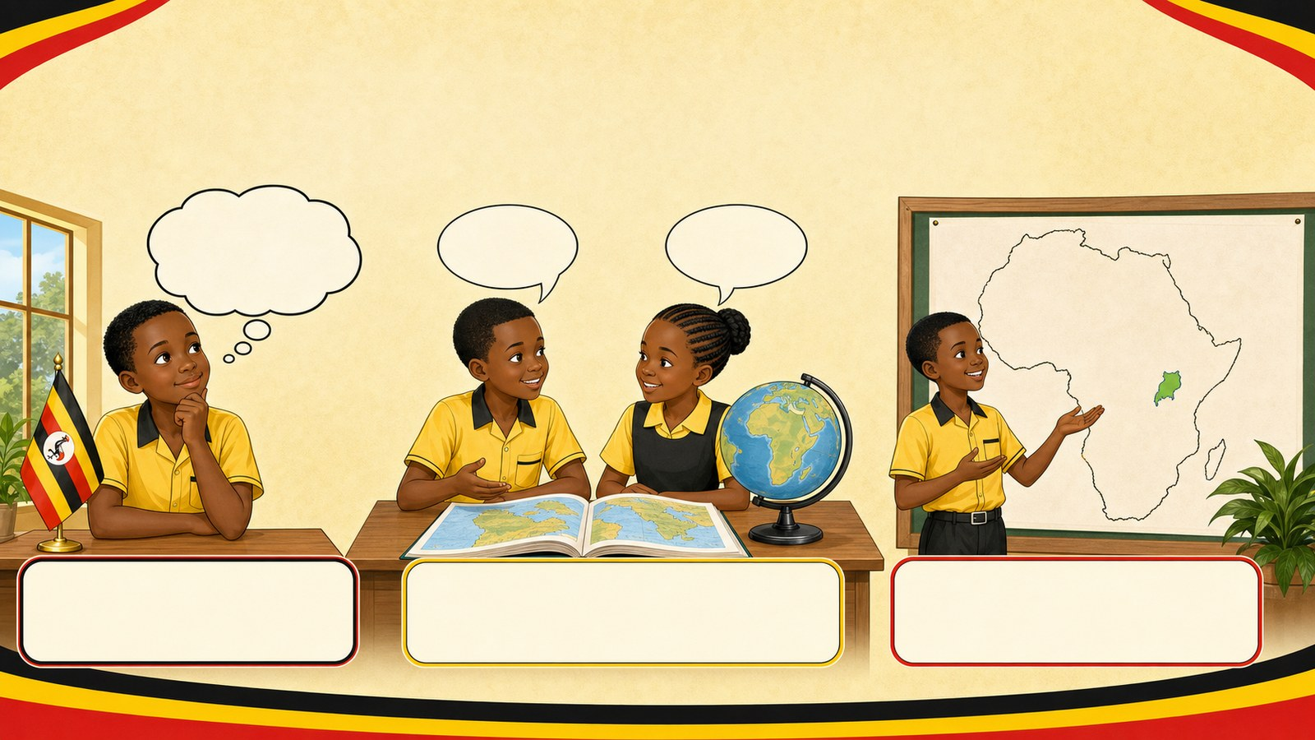
3. STARTER
p7_t1_social_studies_0101
Starter: think first
What is the name of our country?
compare your first answer with a partner
connect your answer to Where is Our Home?

Slide 4
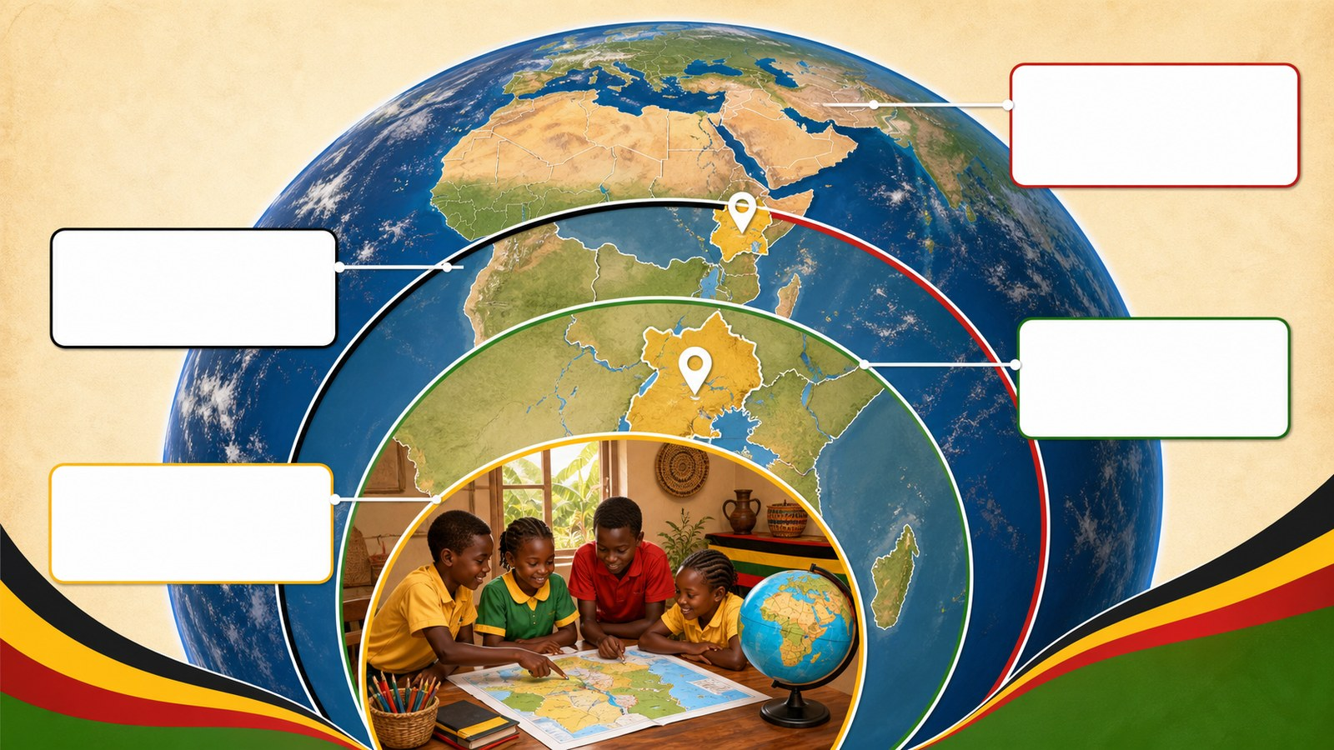
4. CONCEPT
p7_t1_social_studies_0101
Where is Our Home?
Connecting personal knowledge of local location to
We live in Uganda
Uganda is a country in East Africa
Africa is a large continent on the Earth

Slide 5
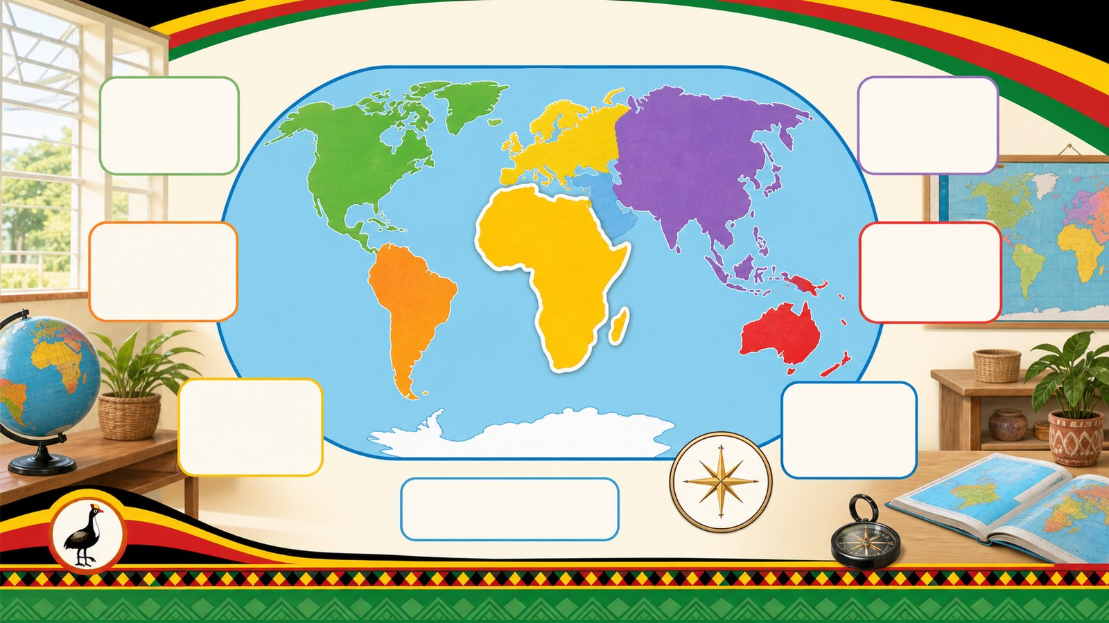
5. MODEL
p7_t1_social_studies_0101
The Seven Continents
THE 7 CONTINENTS (By Size):
1. Asia (Largest)
2. AFRICA (2nd Largest)

Slide 6
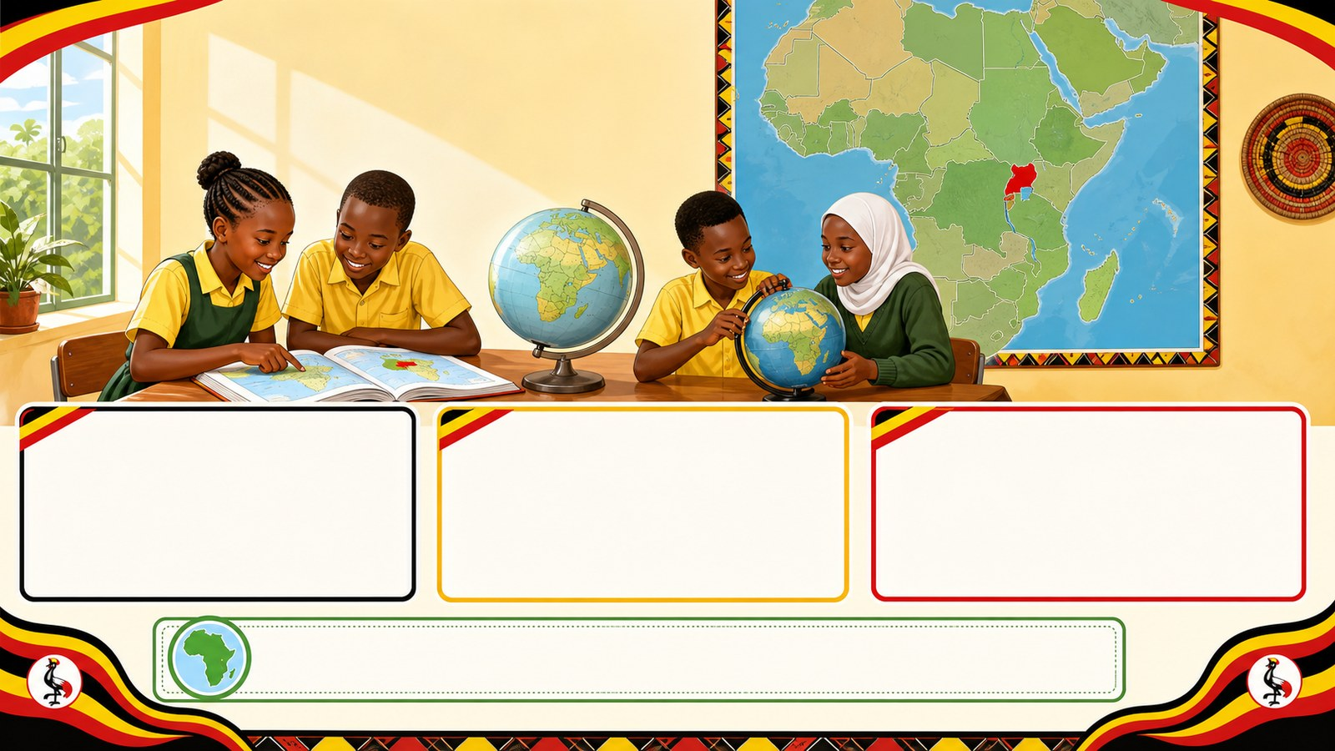
6. PRACTICE
p7_t1_social_studies_0101
Try it together
Answer with evidence:
In which continent is Uganda found?
Is Africa a country or a continent?
How many continents are there in the world?

Slide 7
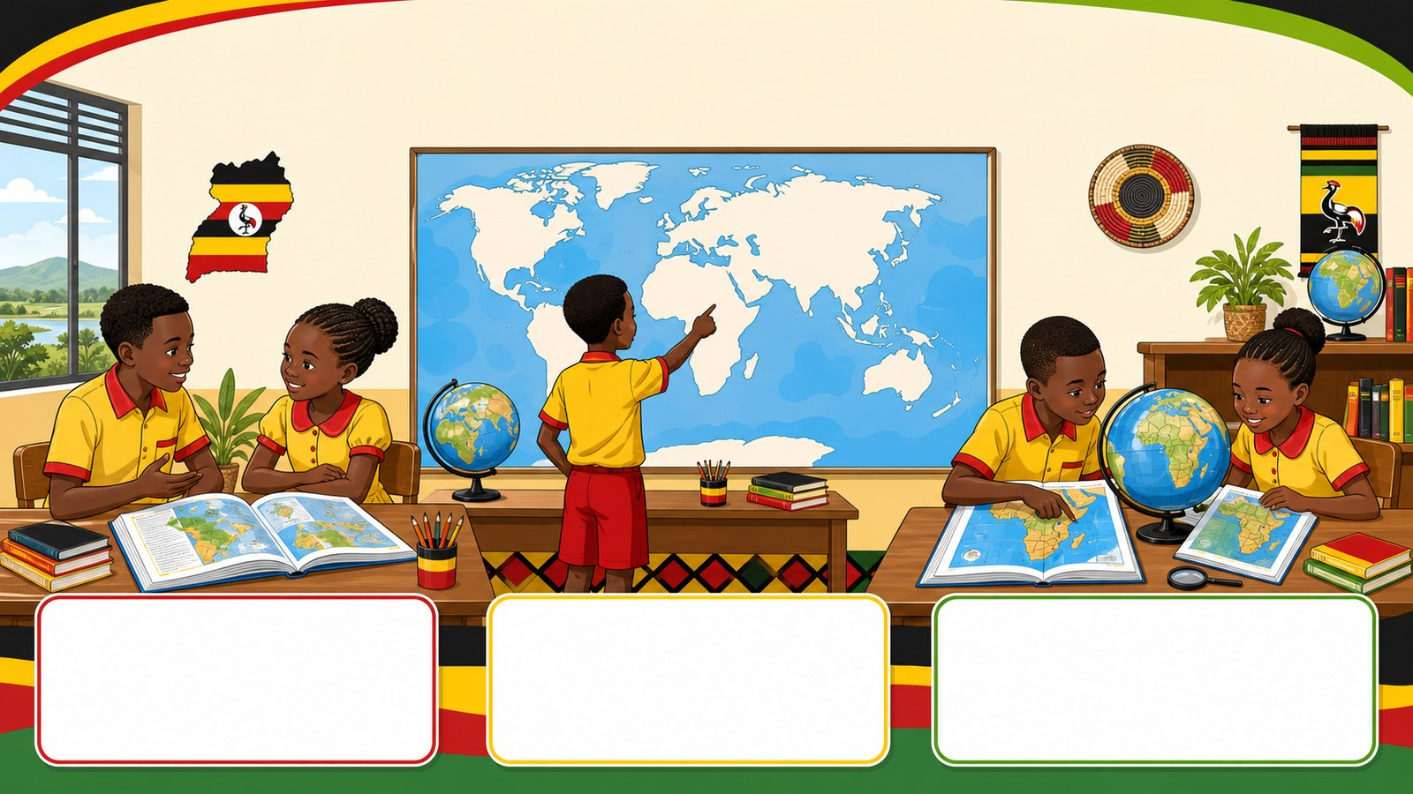
7. ACTIVITY
p7_t1_social_studies_0101
Activity challenge
Turn to a partner and discuss if they have ever seen a map of the
Look at the wall map and point to each continent as the teacher
Use atlases in groups to list the four water

Slide 8

8. EXIT
p7_t1_social_studies_0101
Exit ticket
Which ocean did you put to the East?
Use one complete sentence Hand in or read your answer aloud
Complete sentence
Use a key word
Read aloud or hand in

