Slide 1
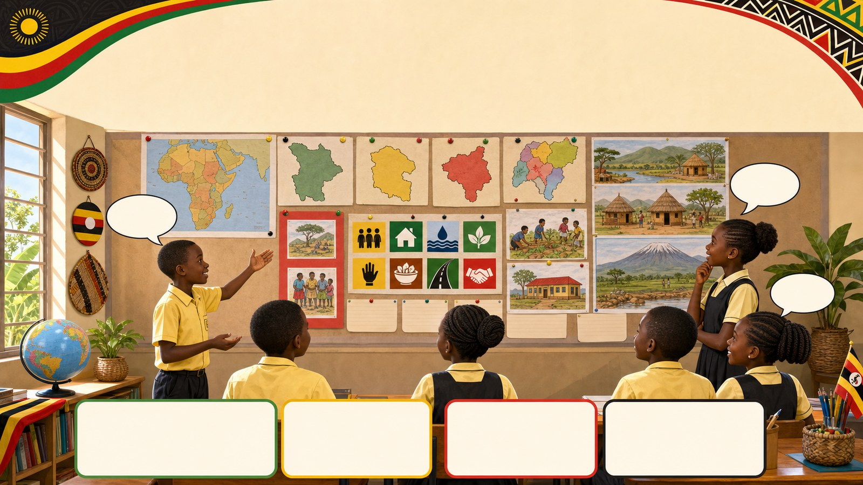
1. HOOK
p7_t1_social_studies_1205
Living Together in Africa
What is the most interesting thing you learned about Africa
Think alone
Pair talk
Share one idea
Point to evidence

Slide 2
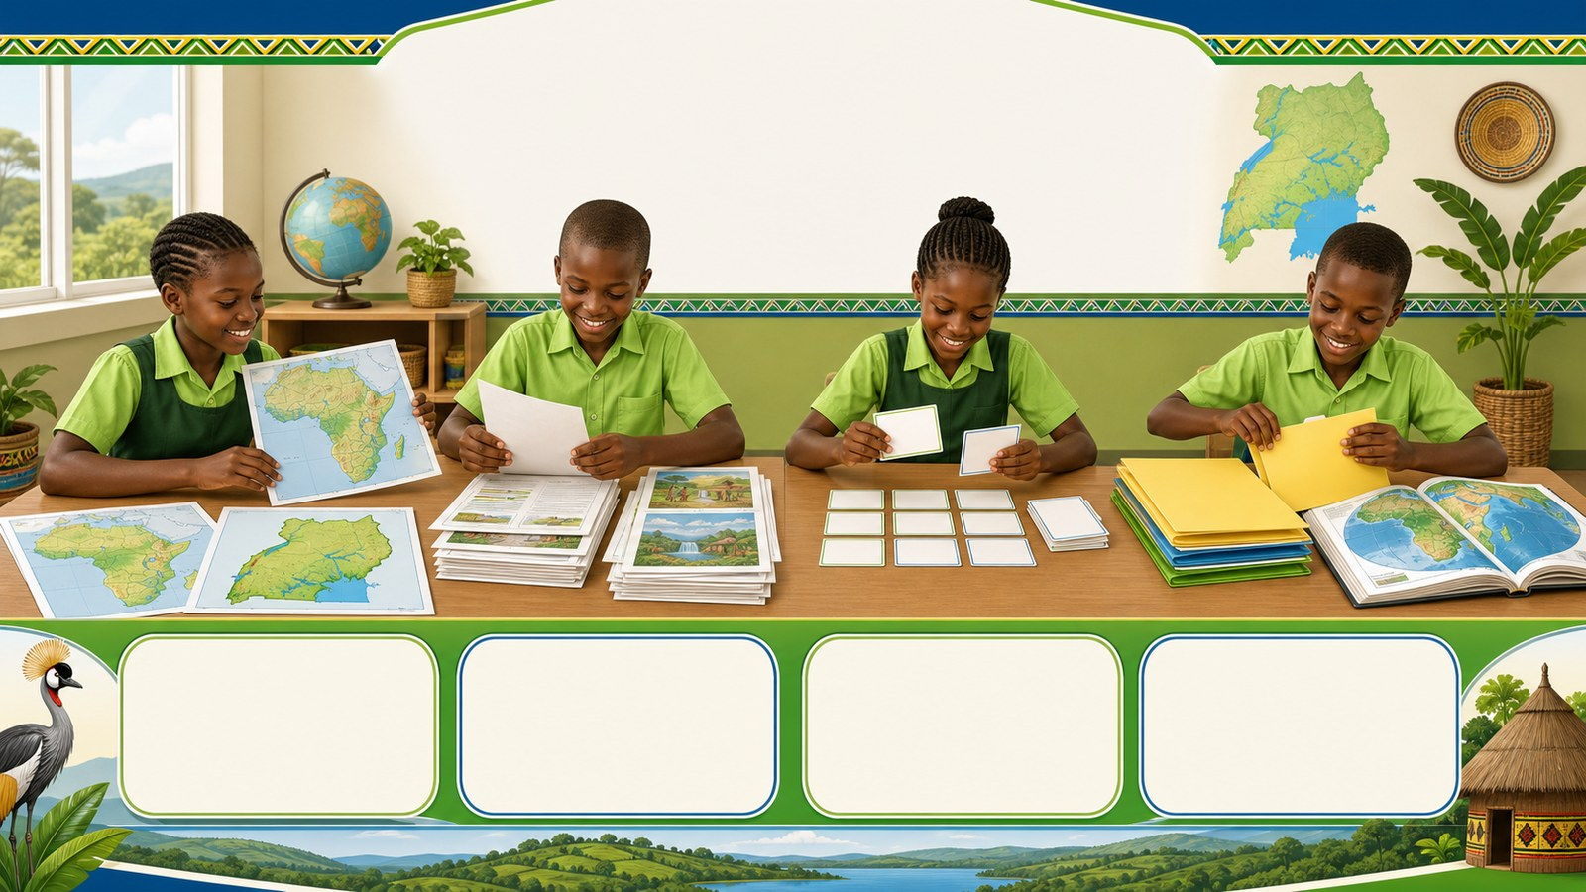
2. MISSION
p7_t1_social_studies_1205
Today's mission
I can organize and compile their Term 1 Social
Our Term 1 SST Journey, Organizing Our Work
answer with one reason or example
listen, talk, try, explain

Slide 3
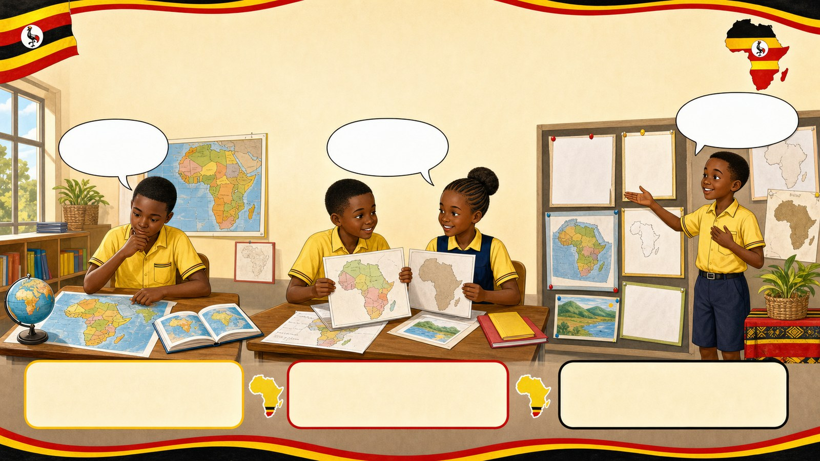
3. STARTER
p7_t1_social_studies_1205
Starter: think first
What is the most interesting thing you learned about Africa this
compare your first answer with a partner
connect your answer to Our Term 1 SST Journey

Slide 4
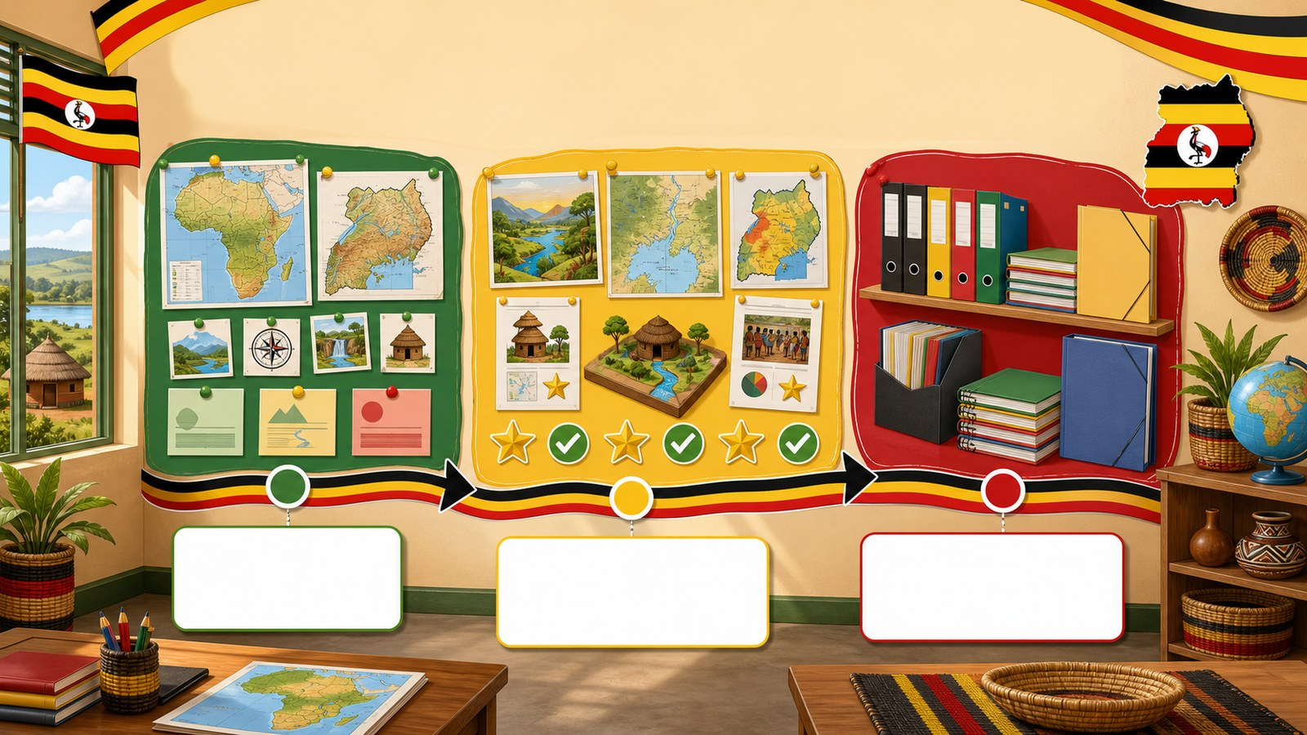
4. CONCEPT
p7_t1_social_studies_1205
Our Term 1 SST Journey
Introduction to the final review process and
Reviewing major themes
Celebrating our work
Preparing for compilation

Slide 5
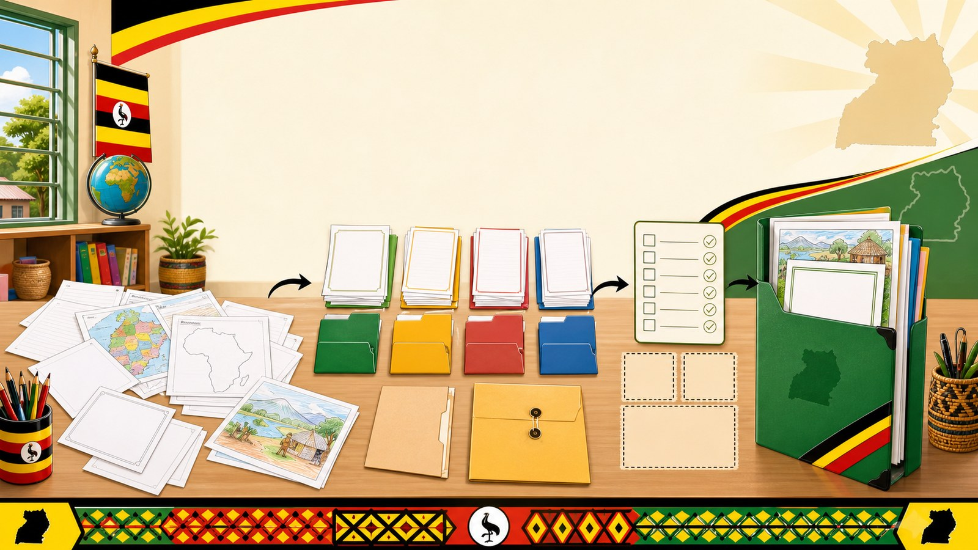
5. MODEL
p7_t1_social_studies_1205
Organizing Our Work
Collecting all Term 1 work
Sorting by topic
Checking for missing items

Slide 6
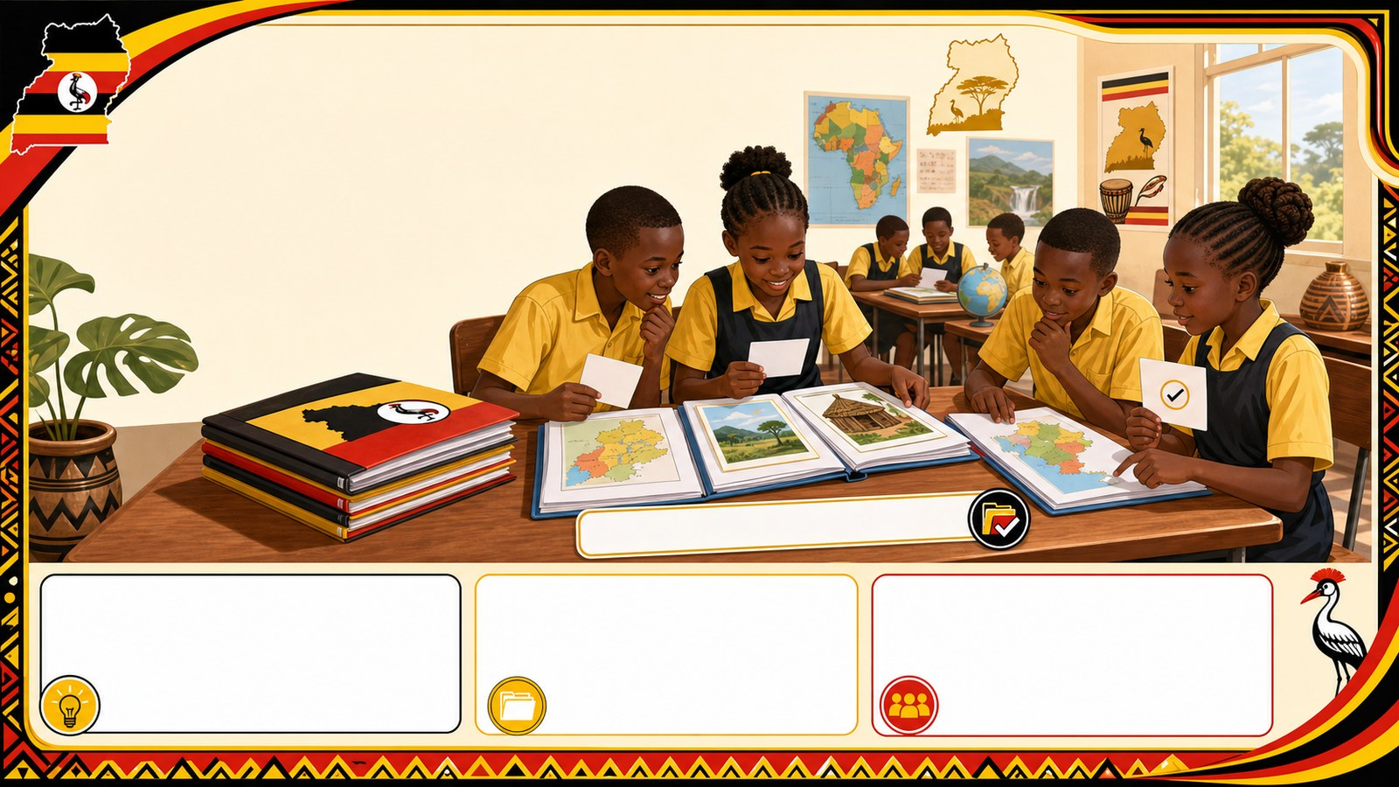
6. PRACTICE
p7_t1_social_studies_1205
Try it together
Answer with evidence:
Why is it important to keep our maps and projects organized?
Do you have all four major projects?
Which work needs to be at the very front of your pile?

Slide 7
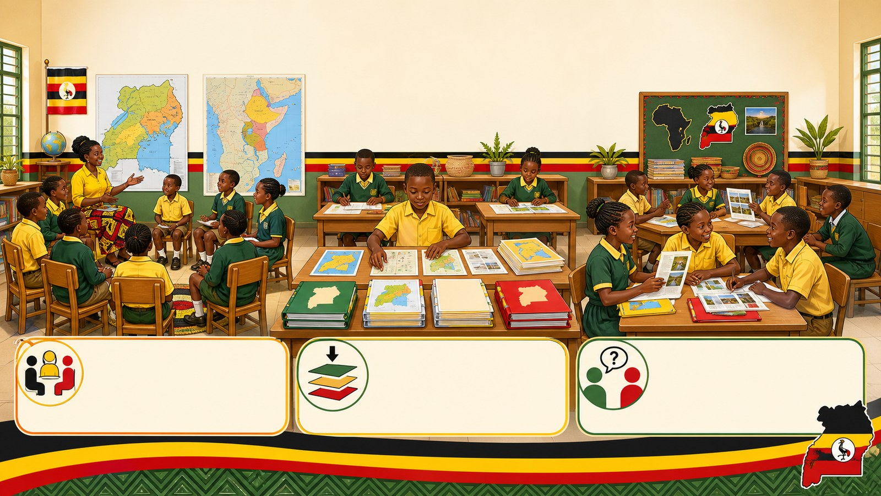
7. ACTIVITY
p7_t1_social_studies_1205
Activity challenge
Participate in a whole-class discussion, sharing their most
Individually sort their maps and written projects according to the
In small groups, learners quiz each other on the key facts

Slide 8
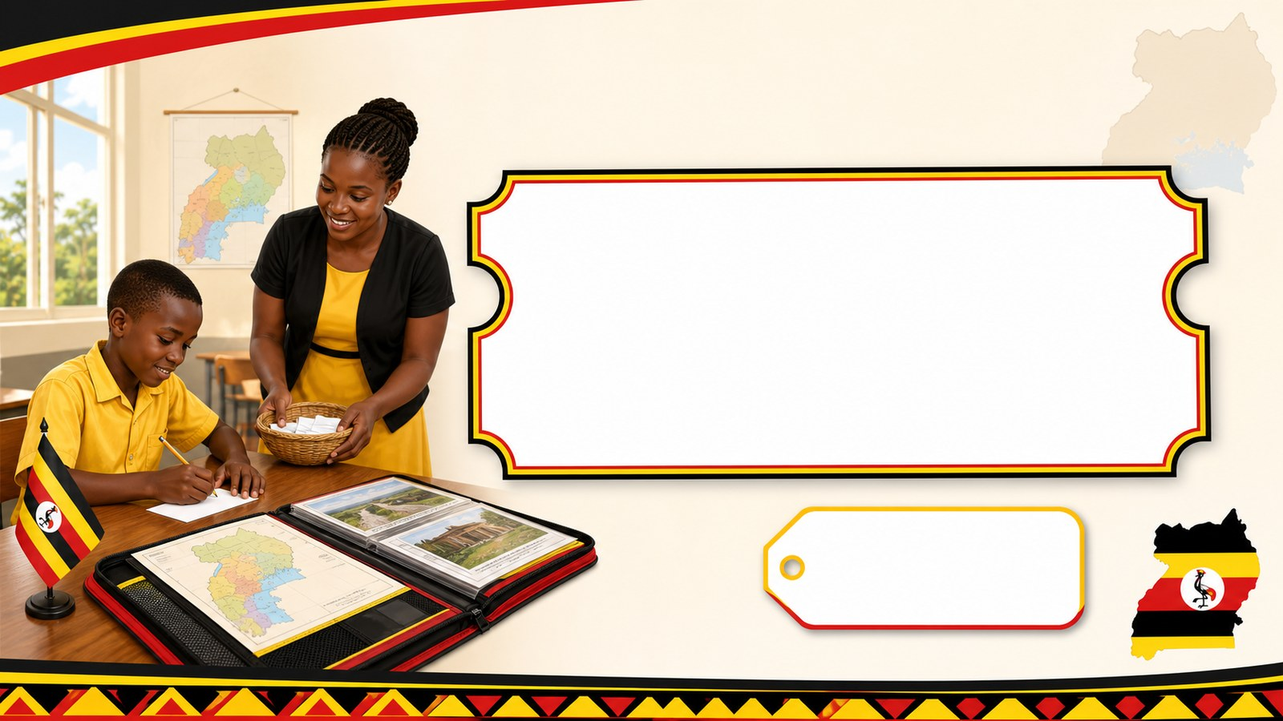
8. EXIT
p7_t1_social_studies_1205
Exit ticket
Where will you keep this portfolio for revision?
Use one complete sentence Hand in or read your answer aloud
Complete sentence
Use a key word
Read aloud or hand in

