Slide 1

1. HOOK
p7_t1_english_0101
1.1 School Holidays
Where is Nakato going?
Think alone
Pair talk
Share evidence
Feature
Evidence
Explain
generated visual insert
Teacher note: ask for first ideas; do not give the answer yet.

Slide 2

2. MISSION
p7_t1_english_0101
Today's mission
I can listen to a story and identify key plans.
1
Nakato’s Holiday Story, New Holiday Words
2
answer with one reason or example.
3
listen, talk, try, explain.
generated visual insert
Teacher note: make the success criteria visible before activity.

Slide 3

3. STARTER
p7_t1_english_0101
Starter: think first
Where is Nakato going?
compare your first answer with a partner.
connect your answer to Nakato’s Holiday
Feature
Evidence
Explain
generated visual insert
Teacher note: cold-call after pair talk; accept partial answers.

Slide 4
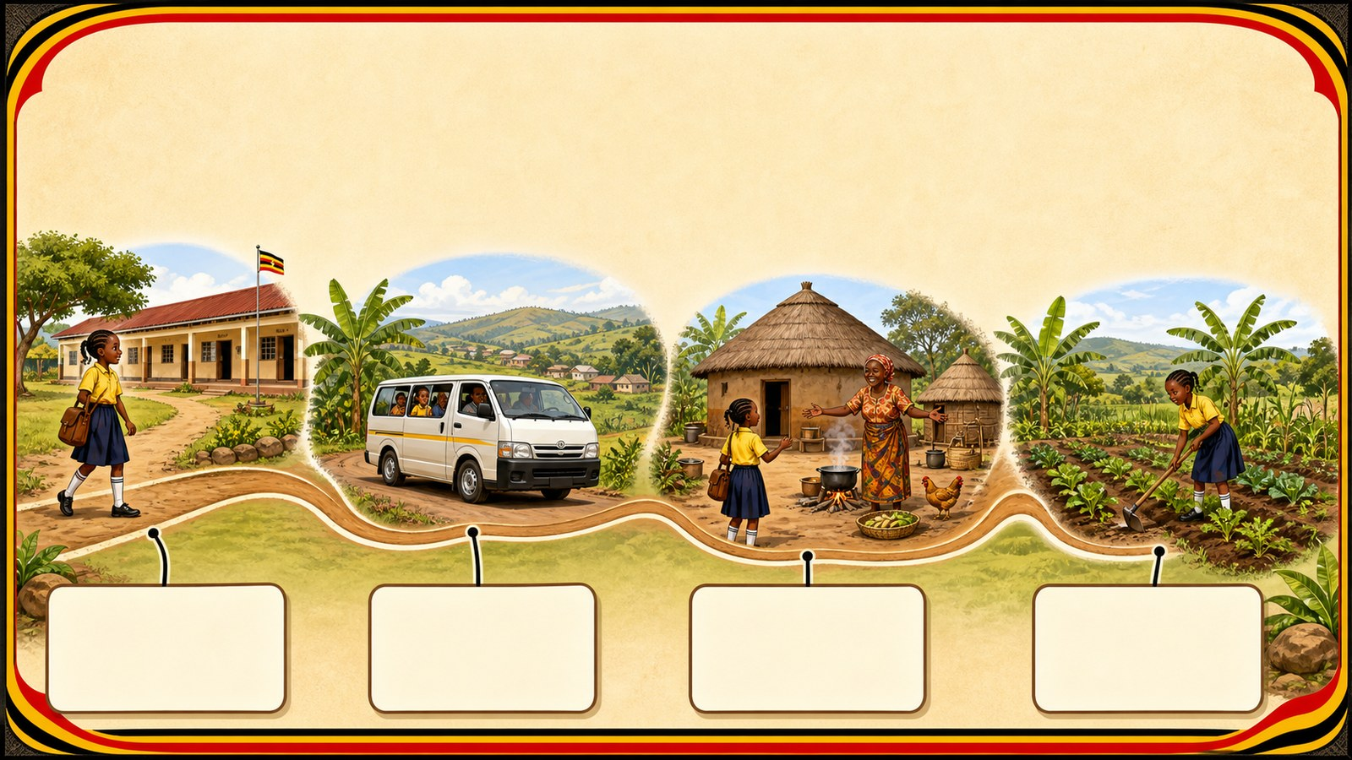
4. CONCEPT
p7_t1_english_0101
Nakato’s Holiday Story
Listen for Nakato’s trip to her grandmother up-country.
Feature
Evidence
Explain
1
Listen to the story carefully.
generated visual insert
Identify the characters.
2
Teacher note: point to the generated visual, then require evidence.

Slide 5

5. MODEL
p7_t1_english_0101
New Holiday Words
Worked example:
Feature
Evidence
Explain
1
Travel: To go from one place to another.
generated visual insert
Up-country: Rural areas/the village.
2
Teacher note: model one answer aloud before learners try.

Slide 6

6. PRACTICE
p7_t1_english_0101
Try it together
Answer with evidence:
?
What will she do in the village?
?
Who is she going to visit?
?
What is another word for 'start'?
generated visual insert
Teacher note: check answer + reason, not answer only.

Slide 7

7. ACTIVITY
p7_t1_english_0101
Activity challenge
Listen to the story; whisper two Nakato
Copy the words and definitions neatly.
Repeat together, then do a pronoun
Feature
Evidence
Explain
generated visual insert
Teacher note: circulate, listen, and improve one group response.

Slide 8

8. EXIT
p7_t1_english_0101
Exit ticket
Where will you be in three weeks?
EXIT TICKET ____________________________ ____________________________
generated visual insert
Use one complete sentence.
Use one key word: Listening for detail
Hand in or read your answer aloud.
Teacher note: collect one complete sentence as evidence.

