Slide 1
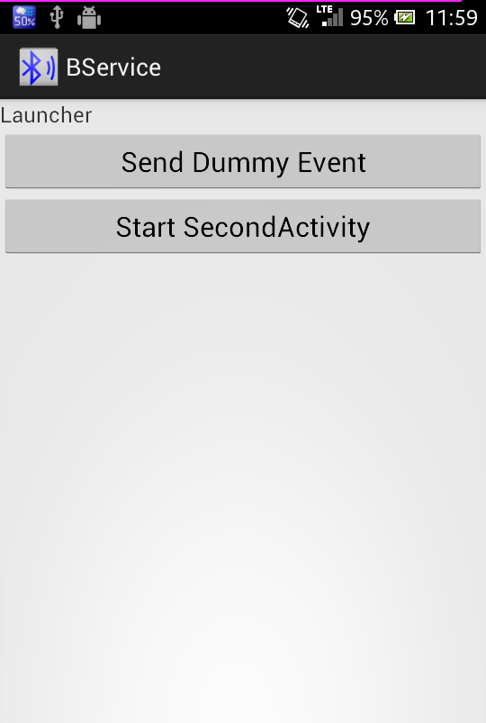
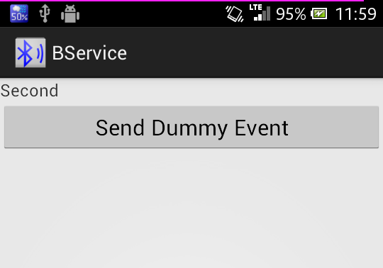
Launcher Activity
BService
bindService
onServiceConnected
registerListener
onServiceEvent
sendEvent
unregisterListener
unbindService
Second Activity

