Slide 1
Arduino
Overview about Arduino and how to use it immediately

Slide 2
Outline
Introduce
Hardware
Software
Examples
Reference

Slide 3
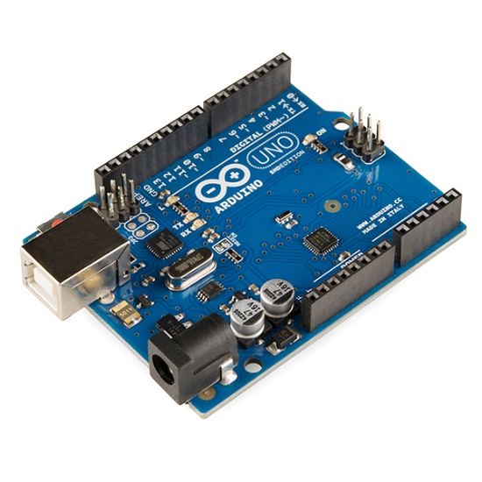
Introduce
Arduino is an open-source electronics platform based on easy-to-use hardware and software
Cre: arduino.cc
What is Arduino?
Why Arduino
Types of Arduino
Compiler for Arduino

Slide 4
Introduce
Main purposes in this workshop
For school subjects
For scientific projects
Provide a fundamental platform for students to participate in major competitions both within and outside of the school.
User purposes
Inexpensive
Cross-platforms
Simple, clear programming environment
Open source and extensible software
What is Arduino?
Why Arduino
Types of Arduino
Compiler for Arduino

Slide 5
Introduce
What is Arduino?
Arduino uno
Arduino mega
Arduino nano
Arduino Leonardo
Arduino mini
Arduino Due
...
Why Arduino
Types of Arduino
Compiler for Arduino

Slide 6
Introduce
What is Arduino?
Why Arduino
Types of Arduino
Compiler for Arduino
Arduino uno

Slide 7
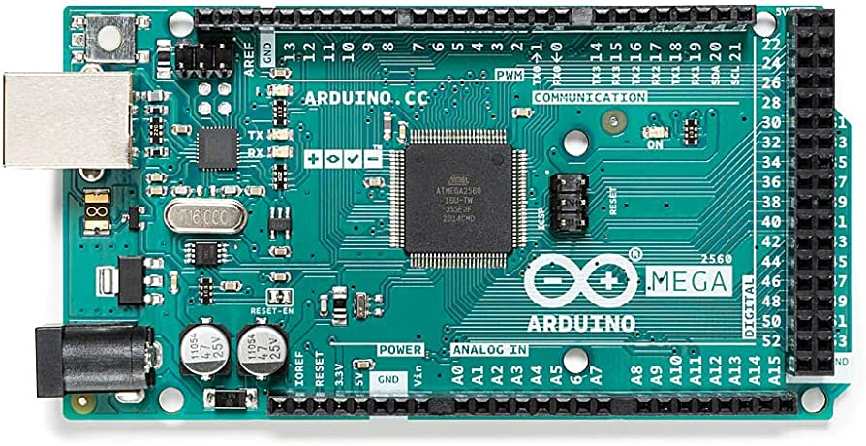
Introduce
What is Arduino?
Why Arduino
Types of Arduino
Compiler for Arduino
Arduino mega

Slide 8
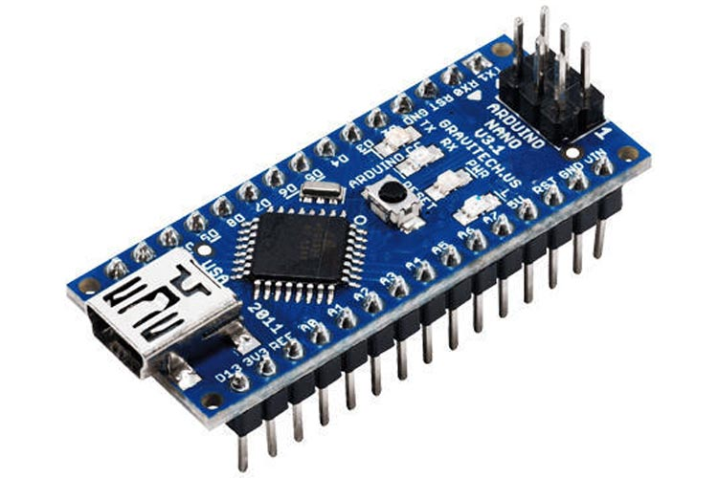
Introduce
What is Arduino?
Why Arduino
Types of Arduino
Compiler for Arduino
Arduino nano

Slide 9
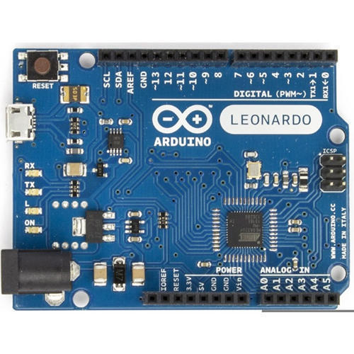
Introduce
What is Arduino?
Why Arduino
Types of Arduino
Compiler for Arduino
Arduino Leonardo

Slide 10
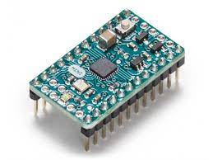
Introduce
What is Arduino?
Why Arduino
Types of Arduino
Compiler for Arduino
Arduino mini

Slide 11
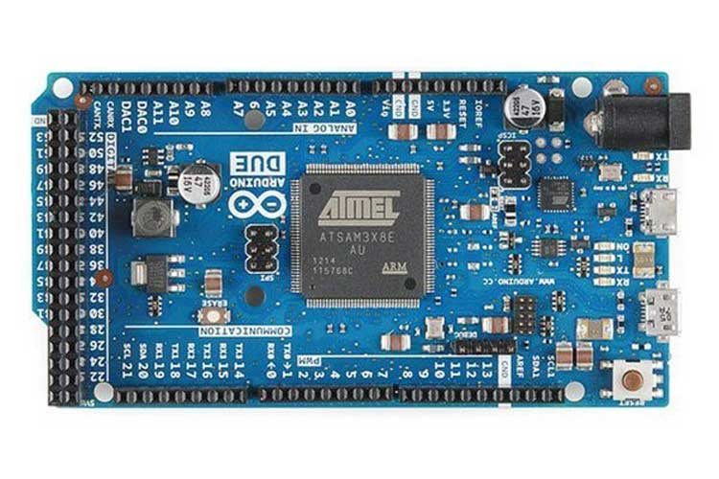
Introduce
What is Arduino?
Why Arduino
Types of Arduino
Compiler for Arduino
Arduino Due

Slide 12


Introduce
What is Arduino?
Why Arduino
Types of Arduino
Compiler for Arduino

Slide 13
Hardware (All in one)

Slide 14
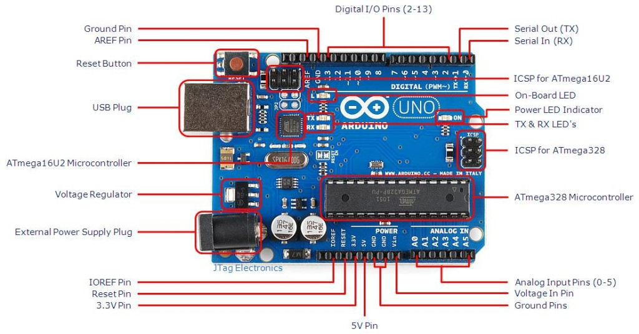

Slide 15


Software (All in one)
Local simulation
Arduino IDE
Online simulation

Slide 16
Examples
From chapter 2 -> chapter 7 folders

Slide 17

Reference
Cộng đồng Arduino Việt Nam | Tôi yêu Việt Nam

