Slide 1
Vote with your feet!
Spend a few minutes thinking about these issues, what is your opinion?
People possessing drugs for personal use should NOT be sent to prison.
People should be charged for healthcare if they smoke.
There should be more Grammar schools in the UK (schools that have better education for students who pass an exam at age 11).
The government should do more to help young people to buy houses or afford to rent their own home.
The minimum wage should be the same for 18 year olds as it is for 25 year olds, and it should be higher.
The UK should leave the EU.

Slide 2
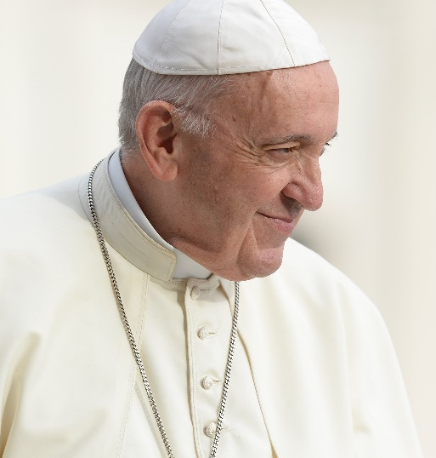
Catholic teaching: Ted Talk by Pope Francis 2017
‘The more powerful you are, the more your actions will have an impact on people, the more responsible you are to act humbly.
If you don’t your power will ruin you, and you will ruin others…if you don’t connect your power with humility and tenderness.’
Watch me
What does he mean? Do you agree?
Who has the power to decide things about your future like university fees? Affordable housing? Minimum wage rate? How much you will pay in tax? The NHS? Immigration policies?
If you could choose who had this power …would you?
Notes:
Which model of relationship is PF suggesting? Conflict, compatible or independent?

Slide 3
On Thursday 12th December there will be a General Election in the UK.
If you will be 18 or over on 12th December you can vote…but you must register by Tuesday 26th November!
Do you want your voice to be heard?

Slide 4
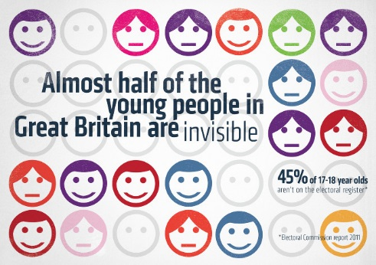
Aims & Outcomes
Why we should vote…
To understand how being registered to vote makes your opinion more valued.
To explore different issues that are currently being debated by parties in the run up to the election, and develop your own opinion on them.
To consider the religious responsibilities of engaging in politics.

Slide 5
Vote with your feet
Ask the person next to you why they are standing there. Do you agree with their reason?
Agree
Disagree
If you have a sticky note …
Sit Down
You are not registered to vote…you do not get to decide!!
There should be more Grammar schools in the UK (schools that have better education for students who pass an exam at age 11).
The government should do more to help young people to buy houses or afford to rent their own home.
The minimum wage should be the same for 18 year olds as it is for 25 year olds, and it should be higher.
The UK should leave the EU.
People should be charged for healthcare if they smoke.
People possessing drugs for personal use should NOT be sent to prison.

Slide 6
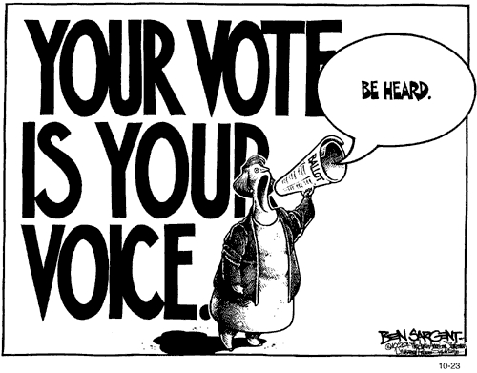

Vote with your feet
The whole class represents the amount of 18-19 year olds in the UK today.
Only around 30% are registered to vote at the moment, and 70% are not.
In the 2017 general election, only 57% of 18-19 year olds actually voted.
Roughly how many is 57% of this class? Get 57% to stand up.
Is this enough people to represent what YOU want?

Slide 7
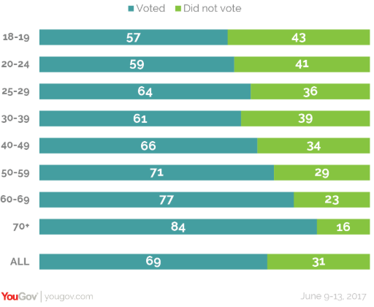
You are an MP in the run up to the current general election…
You need votes!
Look at the issues below. Which ones are you going to focus on to get votes? Why?
Making university accessible for everyone.
Protecting pensions for old people.
Making sure people do not have to work longer before they retire.
Keeping good links with the EU to improve job prospects
Making the minimum wage for 18 year olds the same as for 25 year olds.
Putting money into affordable housing for young people.
Making sure people earning high incomes do not pay more tax.

Slide 8
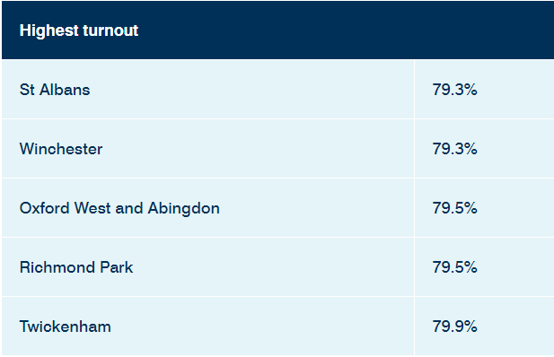
Not only that…look at this: In the last election in 2017 the overall turnout was 69% of all adults (this means that for every 100 people, 31 did not vote at all!)
Here are the statistics for the 5 places in the UK where the turnout to vote was highest in the last election.
In these areas hundreds of thousands more people had a say in the running of our country!
What do these places all have in common? …anyone know?
Who is deciding your future??

Slide 9
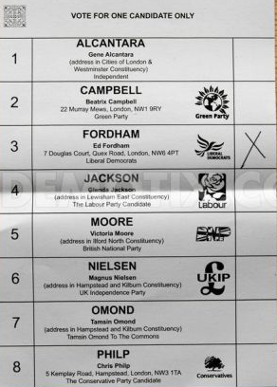
Why should we vote?
In your group or pair discuss this.
Think of 3 good reasons why you should vote.
Which is the strongest reason?
It only takes a couple of minutes to register to vote. Follow the link on SFX Moodle page or go to the website https://www.gov.uk/register-to-vote
Watch Me

Slide 10
Why should we vote?
We live in a globally respected democracy, we need to protect it
Voting gives you the power to choose how the UK is run, it gives the government legitimacy to act
The more young people vote, the more likely politicians are to introduce policies that benefit young people
Your local MP can help fight important issues for you (e.g. housing)
People in different times and places have spent years campaigning for the right to vote.
If you have lost trust in politicians or in the political process you can choose to leave your ballot paper blank or spoil it. That way your ‘protest’ voice is heard.
It only takes a couple of minutes to register to vote. Follow the link on SFX Moodle page or go to the website https://www.gov.uk/register-to-vote

Slide 11
A religious responsibility…
Seeking justice (referred to in both religion and politics as The Common Good) is embedded in all the World’s religions. For Christians, Muslims, and Jews, there is clear instruction to do so within our sacred texts.
What implications do the words of Pope Francis have on election issues such as: the living wage, welfare, NHS, university fees, and affordable housing?
An authentic faith – which is never comfortable or completely personal – always involves a deep desire to leave this earth somehow better that we found it.
None of us can say, “I have nothing to do with politics”.
No, we must say “I have a responsibility and I have to do my best by participating in politics according to my ability”. This is one of the highest forms of charity, because politics serves the common good. I cannot wash my hands of it? We all have to give something!
~ Pope Francis

Slide 12

Do you know who you would vote for?
You do not need to tell us!
If you are not sure….join the club! There are a lot of adults who are not sure too ☺
Not sure which party you agree with the most? One way to check is online quizzes:
If 18-24 years old registered and voted in force, they would become “powerfully unignorable”, rather than “mostly forgotten”.
Click here
Shorter version
Click here
Longer version

Slide 13
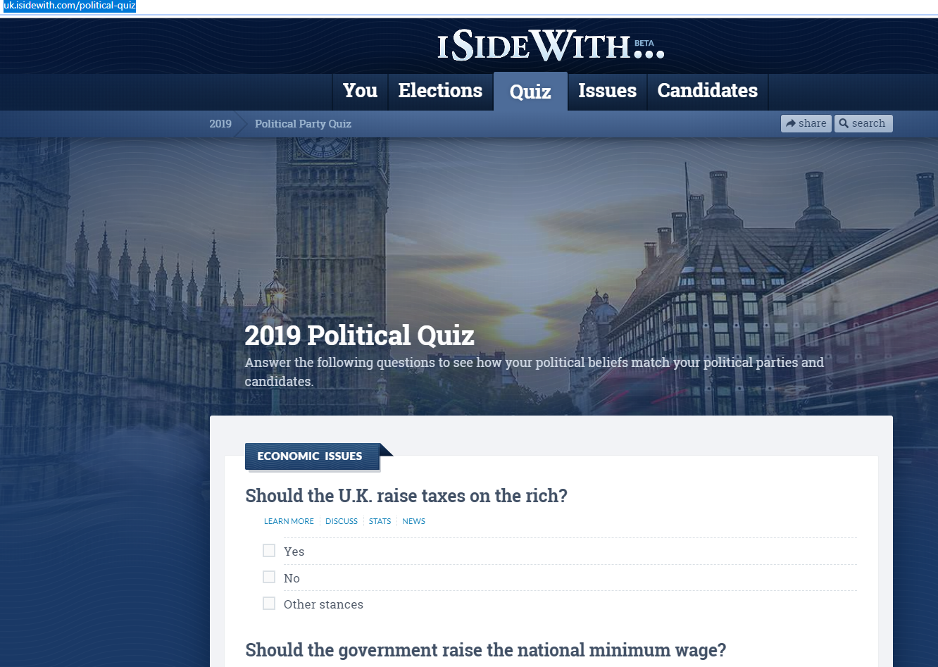
On your phone or on a computer….
Log onto uk.isidewith.com
Work in pairs and take the take the test.
You must agree an answer between you.

Slide 14
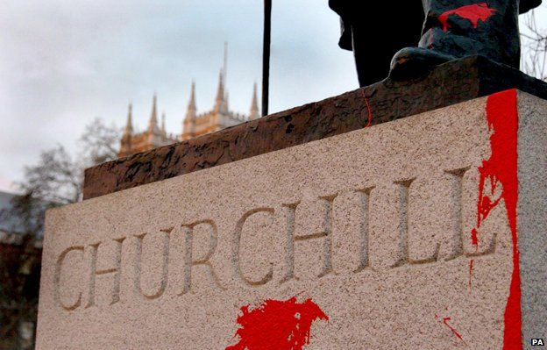
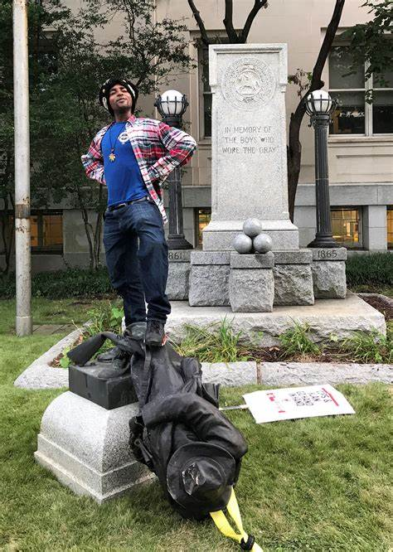
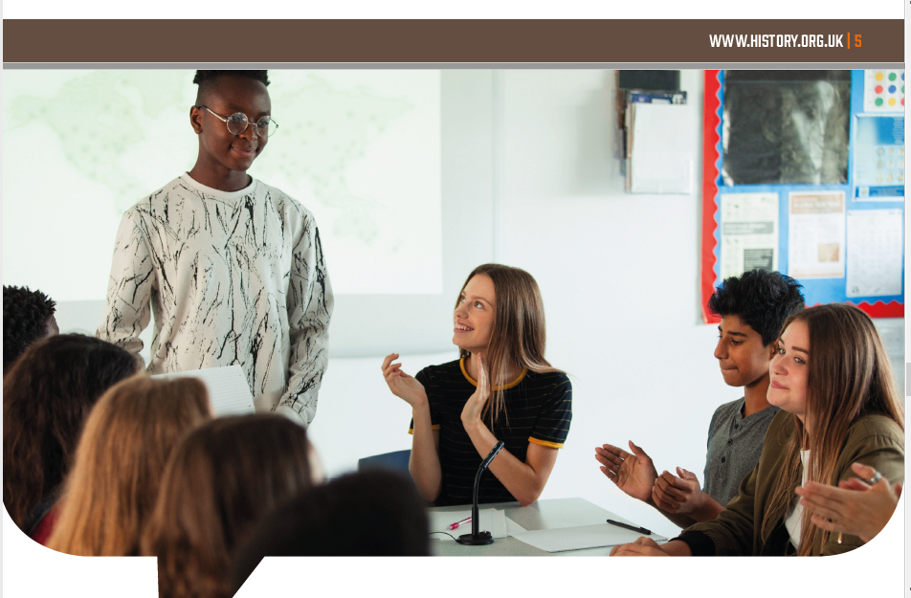
Are you ready for the Great Debate?
The Great Debate is a national public speaking competition for 16-19 year olds run by the Historical Association.
Do you have what it takes to be SFX’s representative in the London heat at UCL on 10th December?
This year’s topic is “Should we judge historical figures by the morals of today?”
If you would like to find out more come to room 215 at 12.30pm on Wednesday 6th November or email a.stone@sfx.ac.uk
Further info and advice at: https://www.history.org.uk/secondary/categories/926/news/3762/the-great-debate-2020

