Slide 1
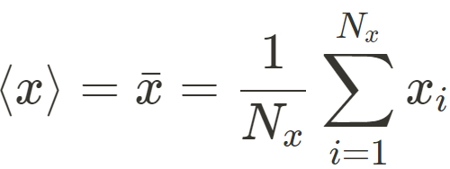
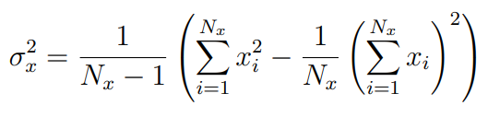
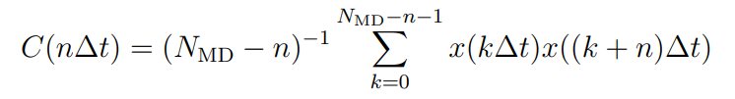
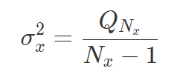
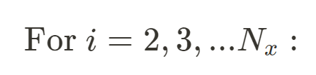
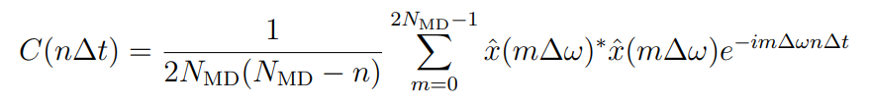
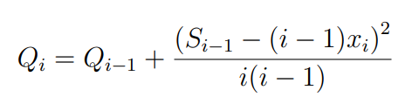


Project Overview
Goal: analyzing macroscopic properties of atoms in a system using MD trajectories
Task 1: Computing the fluctuations
Sought: replace the ensemble average by a time average
Based on: Ergodic theory
Implementation: compute the averages and the fluctuations during each time step while running the MD program
Algorithm 1.1: Inaccurate computation [formula 42]
Algorithm 1.2: accurate computation [formula 43, 45]
Task 2: Computation of correlation functions
Sought: discretization of the correlation function
Based on: Convolution theorem, linearity of FFT
Implementation: obtain the correlations calculated at each time frame by post-processing the wanted property (i.e. velocity)
Algorithm 2.1: Direct method [formula 49]
Algorithm 2.2: FFT method with zero padding [formula 53, 54]

Slide 2
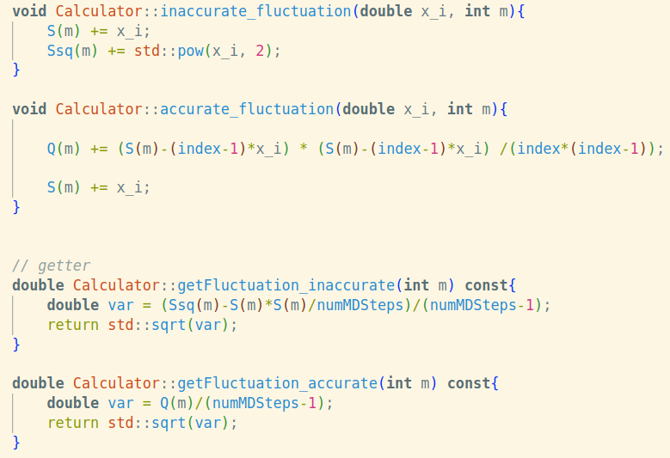
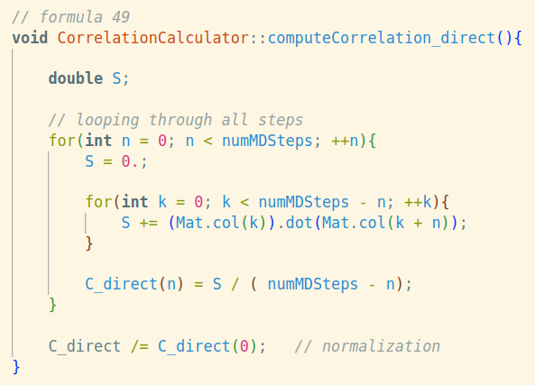
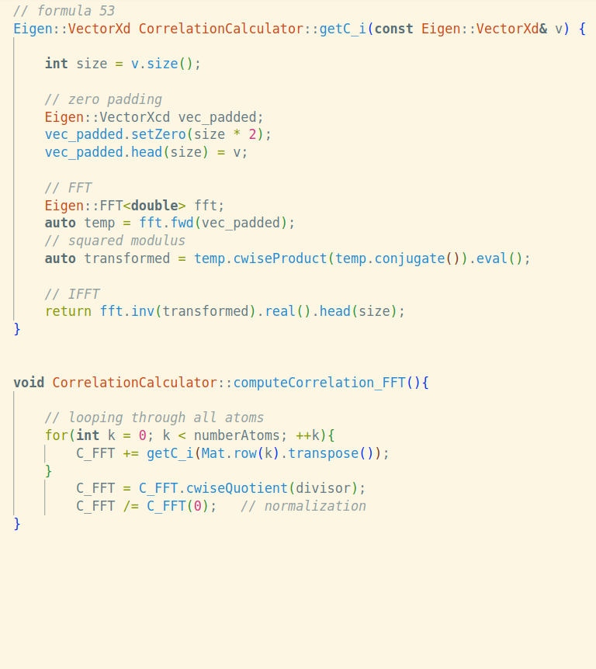
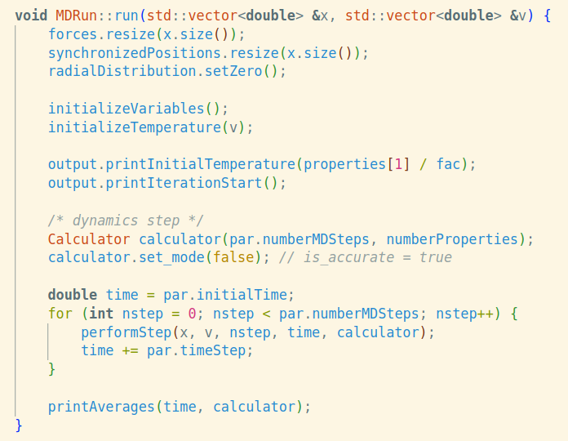
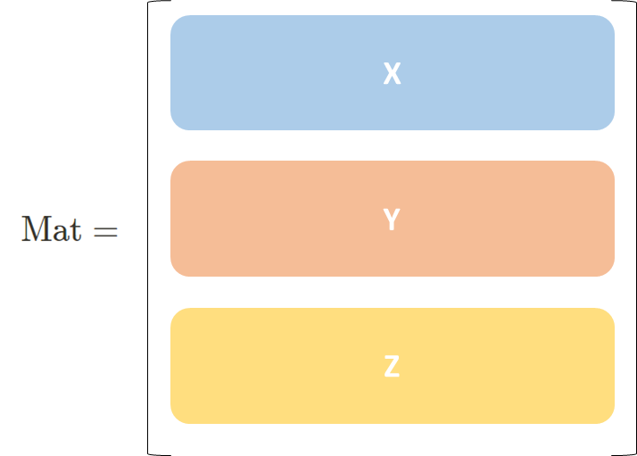


Implementation
Task 1: Computing the fluctuations
Task 2: Computation of correlation functions
Data structure used for storing velocities from the MDprogram

Slide 3
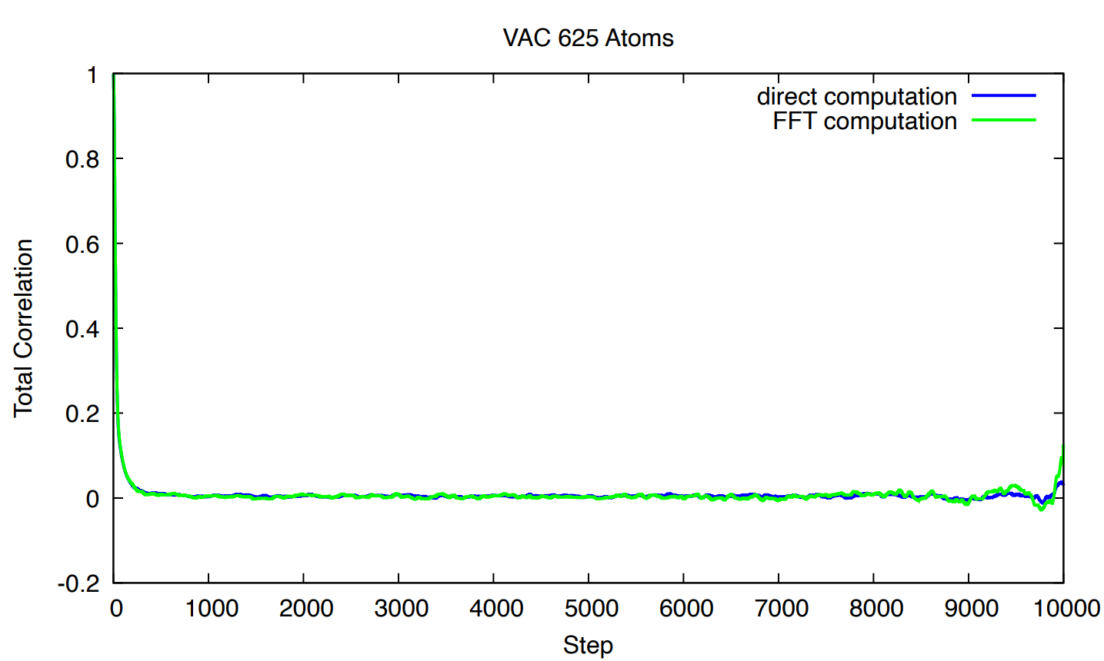
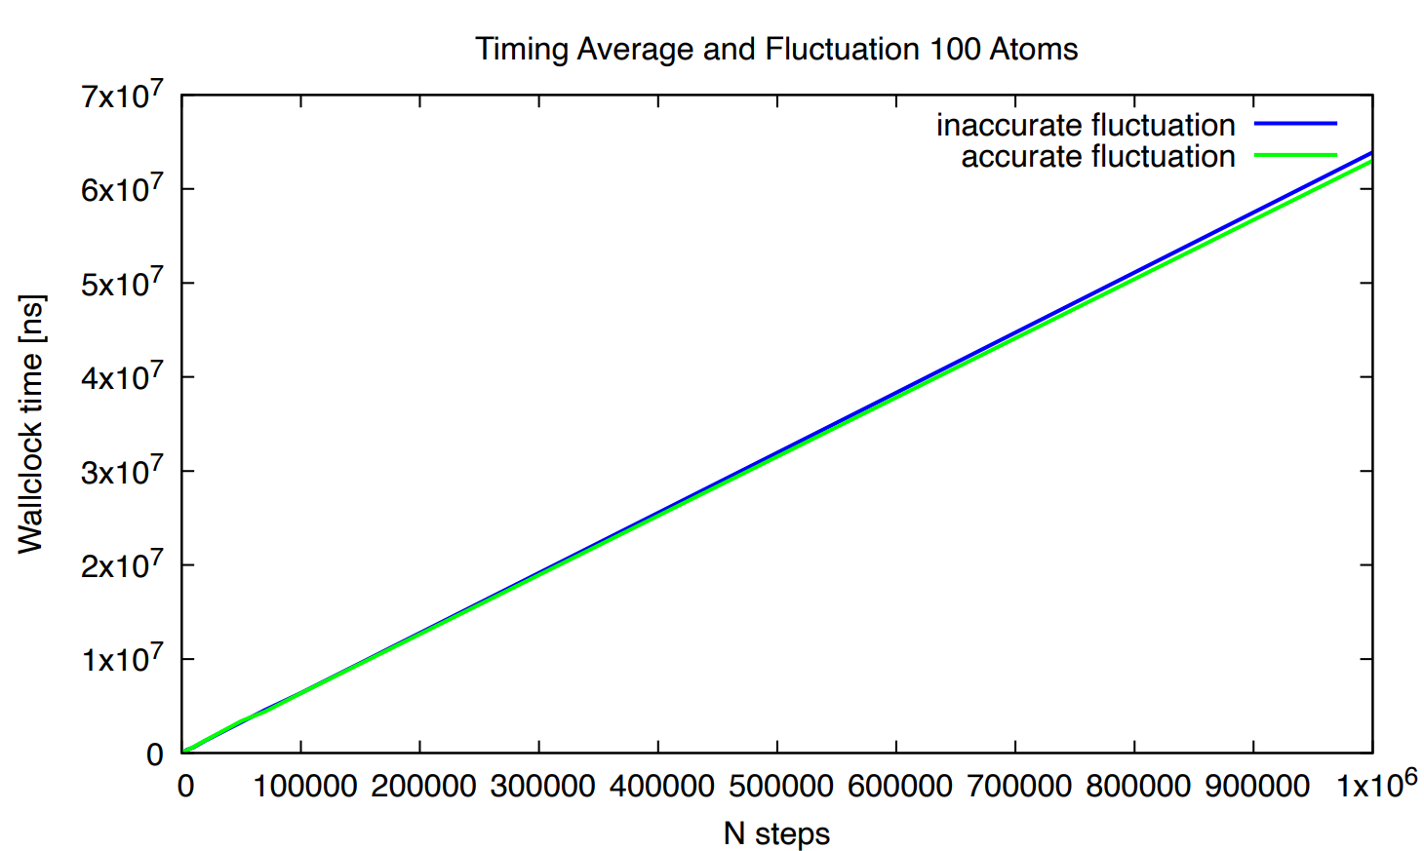
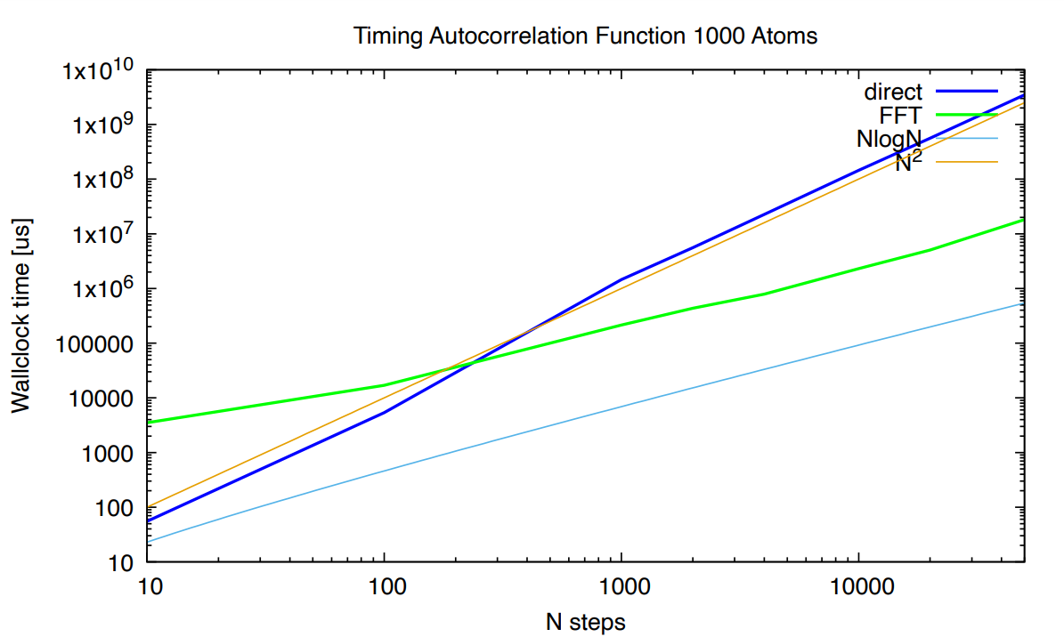
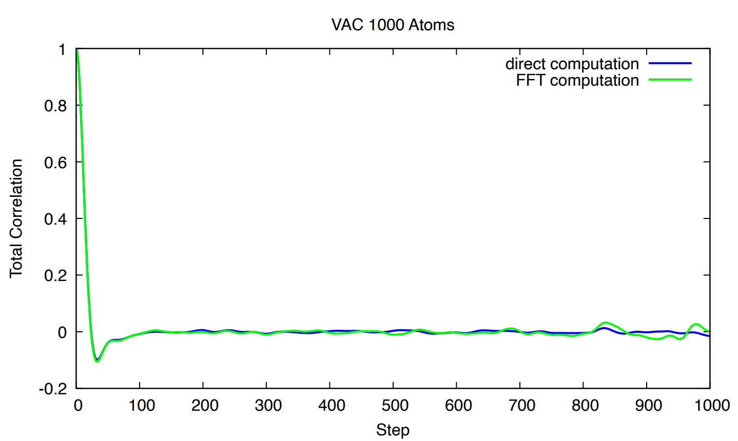
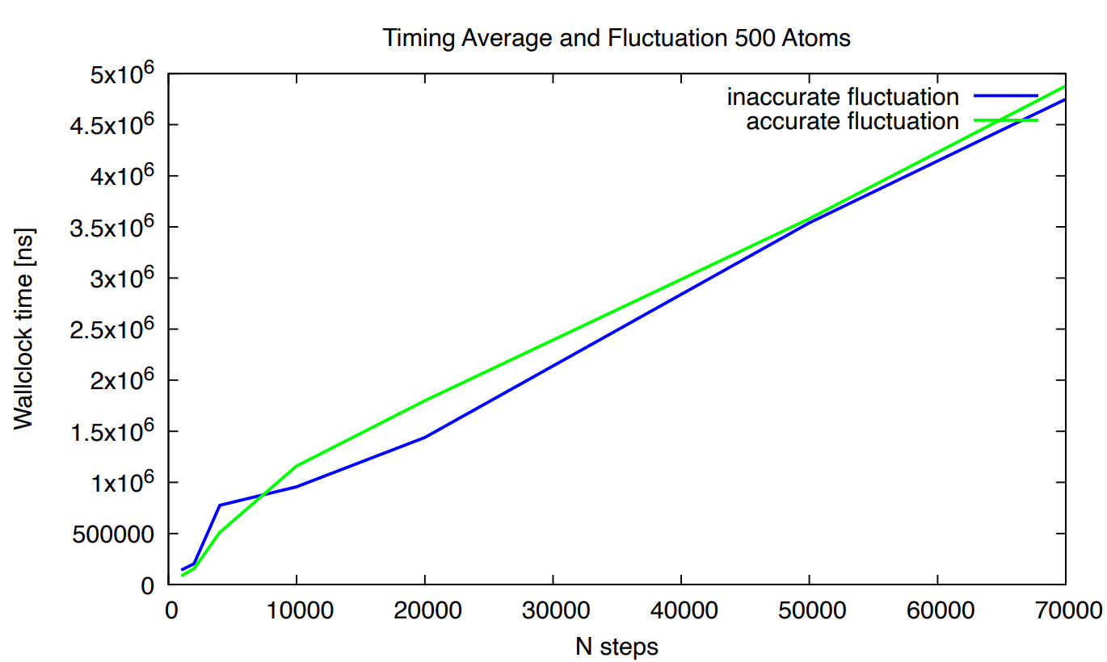
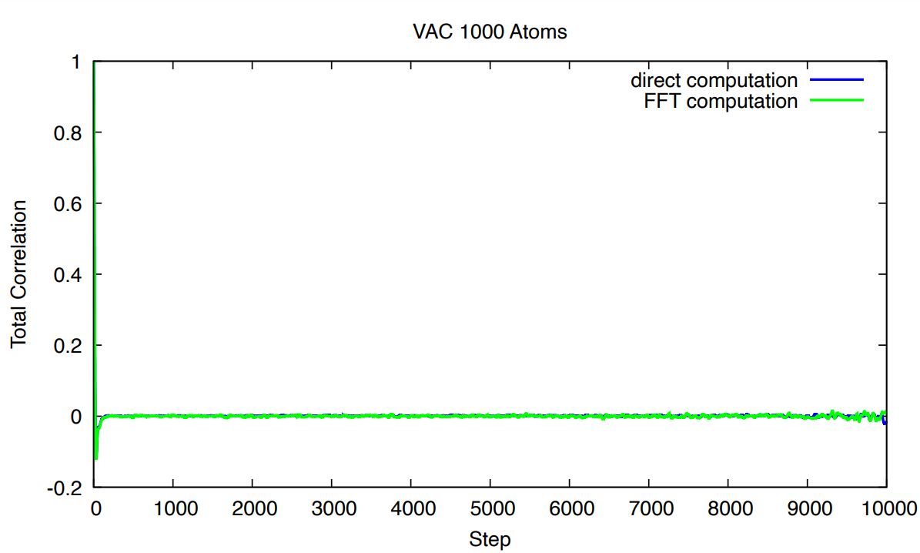
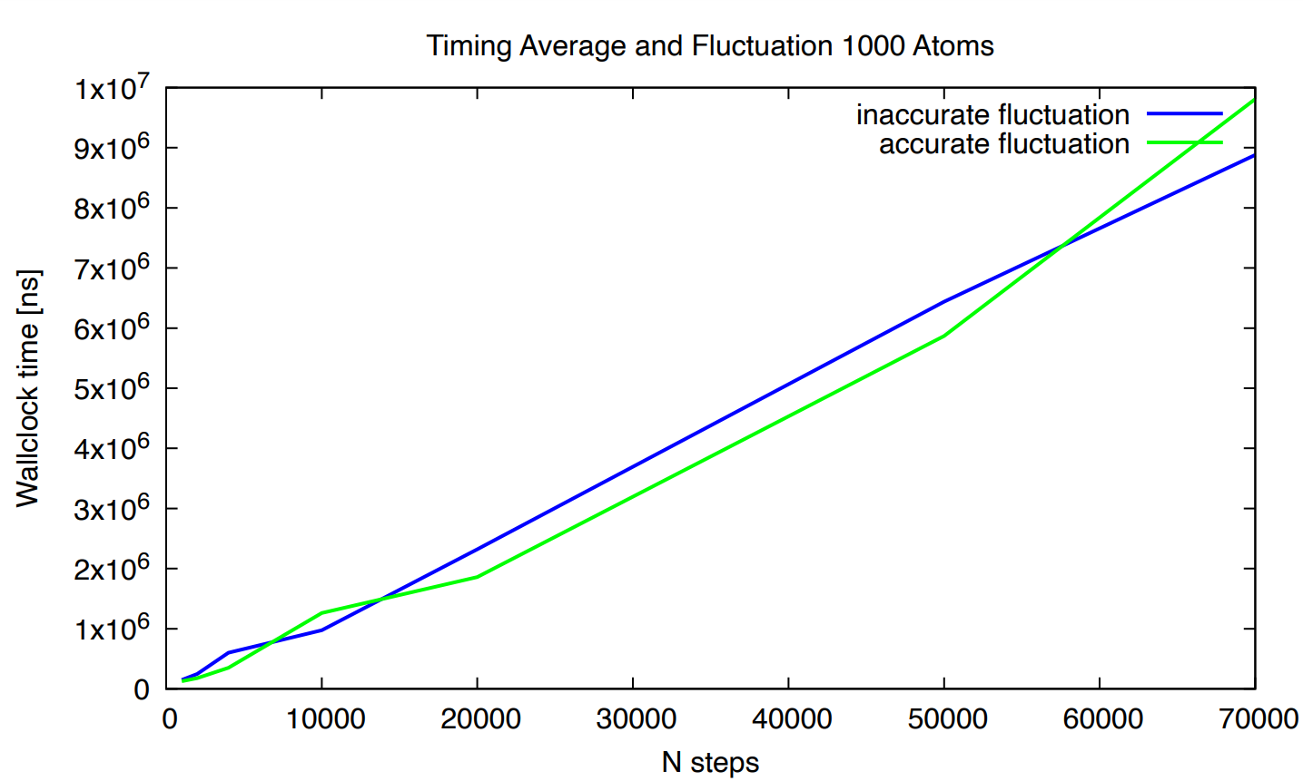
Results & Conclusion
Results of VAC:
Performance of fluctuation computation:
Performance of VAC:

