Slide 1
Computation of the Character Table of the Symmetric Group
Xingyou Zhou
Advisor: Stavros Garoufalidis
2022-05-19

Slide 2
Contents
Introduction
How To Compute
Examples
Optimization
Results

Slide 3
Introduction

Slide 4
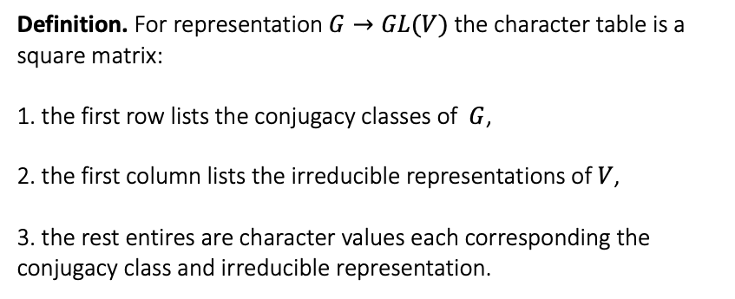
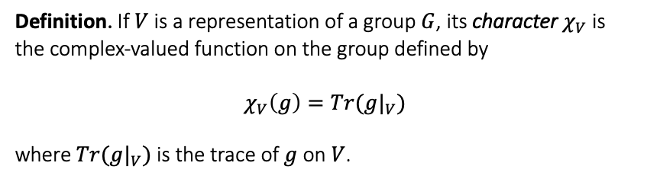
Introduction
Character Table
Definition. If $V$ is a representation of a group $G$, its character $χ_{V}$ is the complex-valued function on the group defined by
$$χ_{V}\left(g\right)=Tr({g|}_{V})$$
where $Tr({g|}_{V})$is the trace of $g$ on $V$.
Character Table
Background
Definition. For representation $G→GL(V)$ the character table is a square matrix:
1. the first row lists the conjugacy classes of $G$,
2. the first column lists the irreducible representations of $V$,
3. the rest entires are character values each corresponding the conjugacy class and irreducible representation.

Slide 5

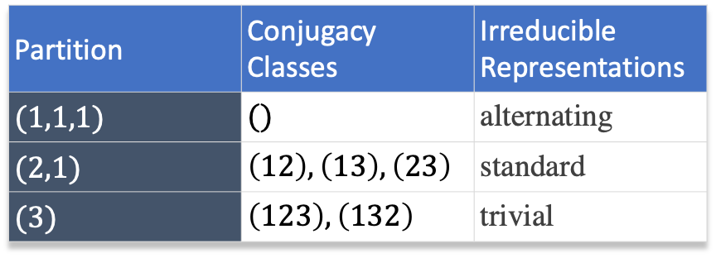
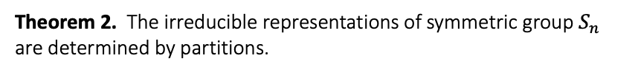

Introduction
Character Table
Theorem 1. The conjugacy classes of symmetric group $S_{n}$ are determined by partitions.
Character Table
Background
Theorem 2. The irreducible representations of symmetric group $S_{n}$ are determined by partitions.
Example. $S_{3}$ : $\{$ (123),(132),(12),(13),(23),() $\}$
Partition | Conjugacy Classes | Irreducible Representations
$(1,1,1)$ | $()$ | alternating
$(2,1)$ | $\left(12\right), \left(13\right), \left(23\right)$ | standard
$(3)$ | $\left(123\right), \left(132\right)$ | trivial

Slide 6
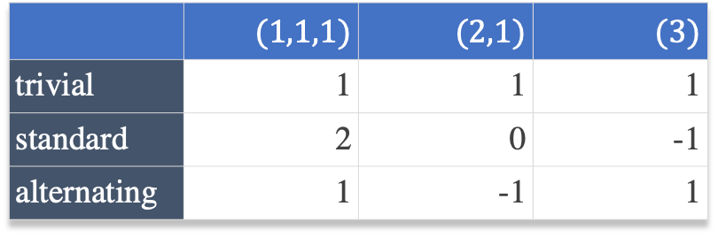

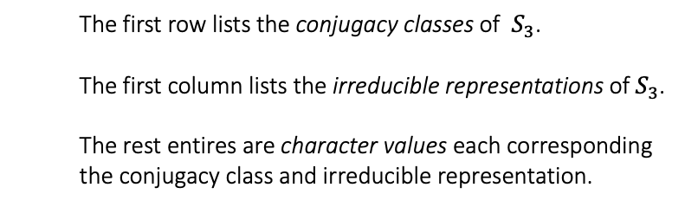

Introduction
Character Table
Example.
The character table of symmetric group $S_{3}$
Character Table
Background
 | $(1,1,1)$ | $(2,1)$ | $(3)$
trivial | 1 | 1 | 1
standard | 2 | 0 | -1
alternating | 1 | -1 | 1
Character Table of $S_{3}$
The first row lists the conjugacy classes of $S_{3}$.
The first column lists the irreducible representations of $S_{3}$.
The rest entires are character values each corresponding the conjugacy class and irreducible representation.

Slide 7
Introduction
Background
Character Table is very useful!
In chemistry, crystallography, and spectroscopy, character tables of point groups are used to classify e.g. molecular vibrations according to their symmetry, and to predict whether a transition between two states is forbidden for symmetry reasons.
Many university level textbooks on physical chemistry, quantum chemistry, spectroscopy and inorganic chemistry devote a chapter to the use of symmetry group character tables.
---- Wikipedia
Character Table
Background
Problem
Sagemath, GAP, etc., are too slow to compute the table.
We need a specific algorithm to reduce computation time.

Slide 8
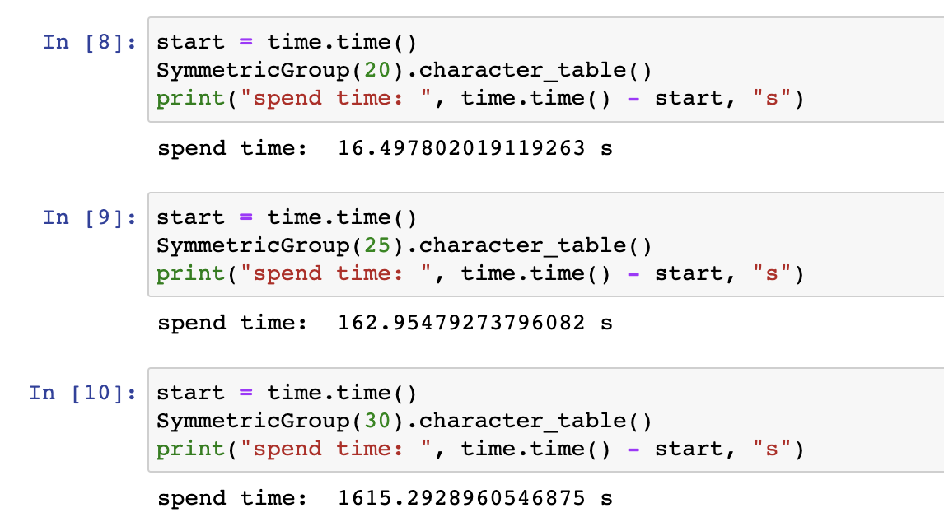

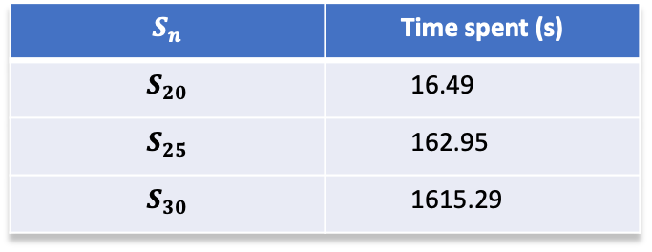
Introduction
Background
Test Results for Sagemath
Symmetric Group $S_{n}$ ($n=20, 25, 30$)
Character Table
Background
$$S_{n}$$ | Time spent (s)
$$S_{20}$$ | 16.49
$$S_{25}$$ | 162.95
$$S_{30}$$ | 1615.29

Slide 9
How To Compute

Slide 10
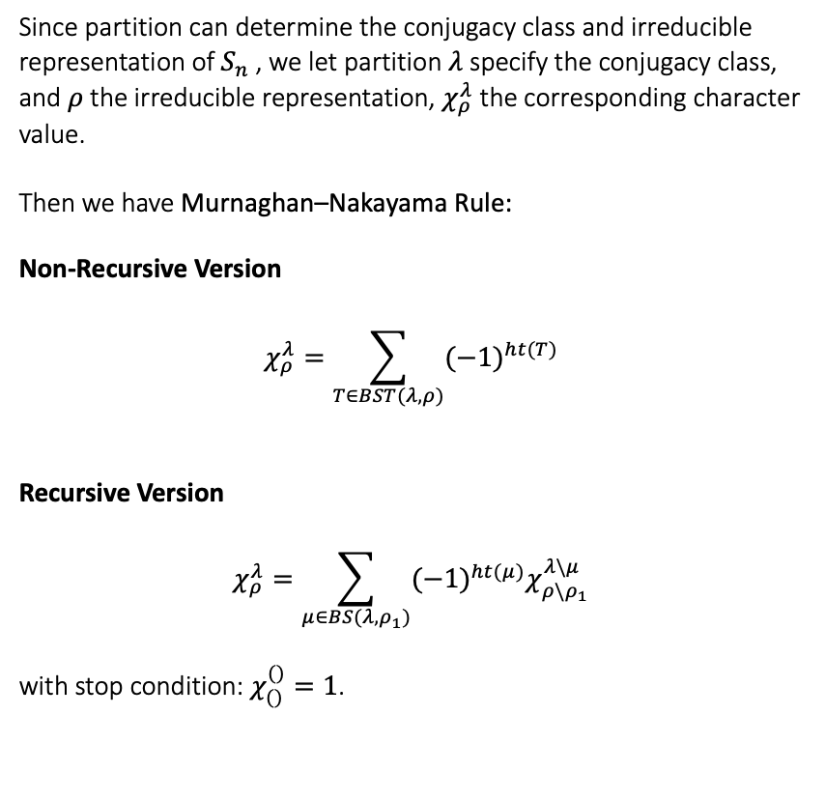
How To Compute
Murnaghan–Nakayama Rule
Since partition can determine the conjugacy class and irreducible representation of $S_{n}$ , we let partition $λ$ specify the conjugacy class, and $ρ$ the irreducible representation, $χ_{ρ}^{λ}$ the corresponding character value.
Then we have Murnaghan–Nakayama Rule:
Non-Recursive Version
$$χ_{ρ}^{λ}=\sum_{T∈BST(λ,ρ)}{{(−1)}^{ht(T)}}$$
Recursive Version
$$χ_{ρ}^{λ}=\sum_{μ∈BS(λ,ρ_{1})}{{(−1)}^{ht(μ)}χ_{ρ\backslash ρ_{1}}^{λ\backslash μ}}$$
with stop condition: $χ_{()}^{()}=1$.
Nakayama’s rule
Young Diagram
Young Tableau
Border Strip
Border Strip Tableau

Slide 11
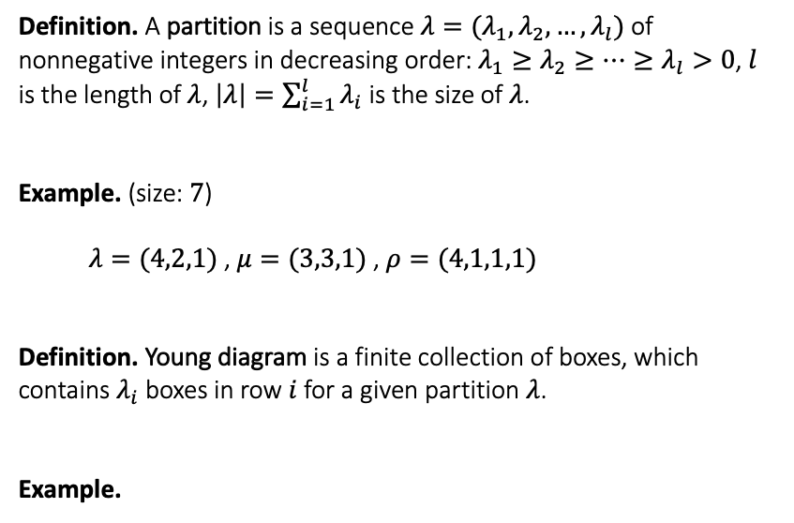




How To Compute
Young Diagram
Nakayama’s rule
Young Diagram
Young Tableau
Border Strip
Border Strip Tableau
Definition. A partition is a sequence $λ=(λ_{1},λ_{2},…, λ_{l})$ of nonnegative integers in decreasing order: $λ_{1}≥λ_{2}≥⋯≥λ_{l}>0$, $l$ is the length of $λ$, $\left|λ\right|=\sum_{i=1}^{l}{λ_{i}}$ is the size of $λ$.
Example. (size: $7$)
$λ=(4,2,1)$ , $μ=(3,3,1)$ , $ρ=(4,1,1,1)$
Definition. Young diagram is a finite collection of boxes, which contains $λ_{i}$ boxes in row $i$ for a given partition $λ$.
Example.
Murnaghan–Nakayama Rule
Non-Recursive Version
$$χ_{ρ}^{λ}=\sum_{T∈BST(λ,ρ)}{{(−1)}^{ht(T)}}$$
Recursive Version
$$χ_{ρ}^{λ}=\sum_{μ∈BS(λ,ρ_{1})}{{(−1)}^{ht(μ)}χ_{ρ\backslash ρ_{1}}^{λ\backslash μ}}$$
stop condition: $χ_{()}^{()}=1$
$(4,2,1)$
$(3,3,1)$
$(4,1,1,1)$

Slide 12



How To Compute
Young Tableau
Nakayama’s rule
Young Diagram
Young Tableau
Border Strip
Border Strip Tableau
Definition. A Young tableau is obtained by filling in the boxes of the Young diagram with symbols taken from some ordered alphabet. We say it is standard (SYT) if the entries in each row and each column are increasing.
Example.
1
5
6
7
2
1
3
4
1
2
3
Murnaghan–Nakayama Rule
Non-Recursive Version
$$χ_{ρ}^{λ}=\sum_{T∈BST(λ,ρ)}{{(−1)}^{ht(T)}}$$
Recursive Version
$$χ_{ρ}^{λ}=\sum_{μ∈BS(λ,ρ_{1})}{{(−1)}^{ht(μ)}χ_{ρ\backslash ρ_{1}}^{λ\backslash μ}}$$
stop condition: $χ_{()}^{()}=1$
2
7
5
4
5
6
3
6
7
4
$(4,2,1)$
$(3,3,1)$
$(4,1,1,1)$

Slide 13
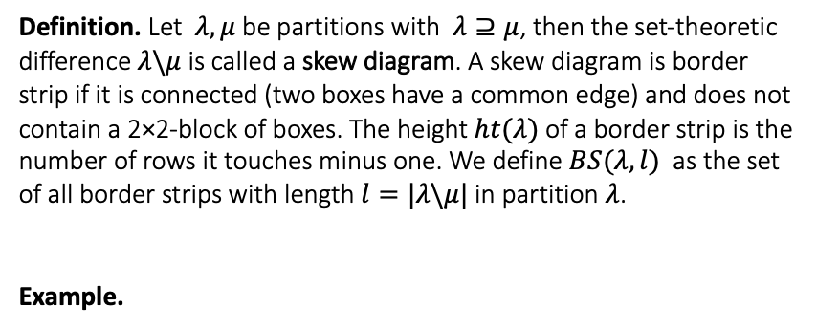



How To Compute
Border Strip (BS)
Nakayama’s rule
Young Diagram
Young Tableau
Border Strip
Border Strip Tableau
Definition. Let $λ, μ$ be partitions with $λ⊇μ$, then the set-theoretic difference $λ\backslash μ$ is called a skew diagram. A skew diagram is border strip if it is connected (two boxes have a common edge) and does not contain a 2×2-block of boxes. The height $ht(λ)$of a border strip is the number of rows it touches minus one. We define $BS(λ,l)$ as the set of all border strips with length $l=|λ\backslash μ|$ in partition $λ$.
Example.
Murnaghan–Nakayama Rule
Non-Recursive Version
$$χ_{ρ}^{λ}=\sum_{T∈BST(λ,ρ)}{{(−1)}^{ht(T)}}$$
Recursive Version
$$χ_{ρ}^{λ}=\sum_{μ∈BS(λ,ρ_{1})}{{(−1)}^{ht(μ)}χ_{ρ\backslash ρ_{1}}^{λ\backslash μ}}$$
stop condition: $χ_{()}^{()}=1$
$\left(5,4,4,1\right)\backslash (4,3,2)$
$\left(5,4,4,1\right)\backslash (3,3,3,1)$
The height of border strip $ρ=\left(5,4,4,1\right)\backslash (3,3,3,1)$
$$ht\left(ρ\right)=3−1=2$$

Slide 14
How To Compute
Border Strip (BS)
Nakayama’s rule
Young Diagram
Young Tableau
Border Strip
Border Strip Tableau
Definition. Let $λ, μ$ be partitions with $λ⊇μ$, then the set-theoretic difference $λ\backslash μ$ is called a skew diagram. A skew diagram is border strip if it is connected (two boxes have a common edge) and does not contain a 2×2-block of boxes. The height $ht(λ)$of a border strip is the number of rows it touches minus one. We define $BS(λ,l)$ as the set of all border strips with length $l=|λ\backslash μ|$ in partition $λ$.
Example.
Murnaghan–Nakayama Rule
Non-Recursive Version
$$χ_{ρ}^{λ}=\sum_{T∈BST(λ,ρ)}{{(−1)}^{ht(T)}}$$
Recursive Version
$$χ_{ρ}^{λ}=\sum_{μ∈BS(λ,ρ_{1})}{{(−1)}^{ht(μ)}χ_{ρ\backslash ρ_{1}}^{λ\backslash μ}}$$
stop condition: $χ_{()}^{()}=1$
$\left(5,4,4,1\right)\backslash (4,3,2)$
$\left(5,4,4,1\right)\backslash (3,3,3,1)$
The height of border strip $ρ=\left(5,4,4,1\right)\backslash (3,3,3,1)$
$$ht\left(ρ\right)=3−1=2$$

Slide 15

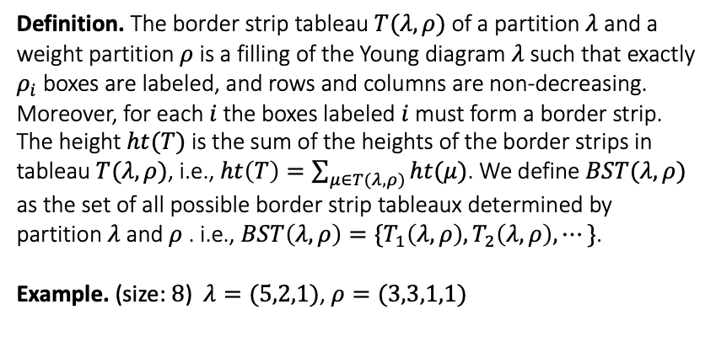






How To Compute
Border Strip Tableau (BST)
Nakayama’s rule
Young Diagram
Young Tableau
Border Strip
Border Strip Tableau
Definition. The border strip tableau $T(λ,ρ)$ of a partition $λ$ and a weight partition $ρ$ is a filling of the Young diagram $λ$ such that exactly $ρ_{i}$ boxes are labeled, and rows and columns are non-decreasing. Moreover, for each $i$ the boxes labeled $i$ must form a border strip. The height $ht(T)$ is the sum of the heights of the border strips in tableau $T(λ,ρ)$, i.e., $ht\left(T\right)=\sum_{μ∈T(λ,ρ)}{ht(μ)}$. We define $BST(λ,ρ)$ as the set of all possible border strip tableaux determined by partition $λ$ and $ρ$ . i.e., $BST\left(λ,ρ\right)=\{T_{1}\left(λ,ρ\right),T_{2}\left(λ,ρ\right),⋯\}$.
Example. (size: $8$) $λ=(5,2,1)$, $ρ=(3,3,1,1)$
Murnaghan–Nakayama Rule
Non-Recursive Version
$$χ_{ρ}^{λ}=\sum_{T∈BST(λ,ρ)}{{(−1)}^{ht(T)}}$$
Recursive Version
$$χ_{ρ}^{λ}=\sum_{μ∈BS(λ,ρ_{1})}{{(−1)}^{ht(μ)}χ_{ρ\backslash ρ_{1}}^{λ\backslash μ}}$$
stop condition: $χ_{()}^{()}=1$
1
1
1
3
4
1
1
2
2
2
1
1
2
2
2
2
2
1
3
1
4
2
4
3
$T_{1}$
$T_{2}$
$T_{3}$
1
2
2
3
4
1
2
2
2
4
1
2
2
2
3
1
2
1
3
1
4
1
1
1
$T_{4}$
$T_{5}$
$T_{6}$
The height of $T_{1}$: $ht\left(T_{1}\right)=\sum_{μ∈T_{1}(λ,ρ)}{ht(μ)}=0+1+0+0=1$

Slide 16
How To Compute
Border Strip Tableau (BST)
Nakayama’s rule
Young Diagram
Young Tableau
Border Strip
Border Strip Tableau
Definition. The border strip tableau $T(λ,ρ)$ of a partition $λ$ and a weight partition $ρ$ is a filling of the Young diagram $λ$ such that exactly $ρ_{i}$ boxes are labeled, and rows and columns are non-decreasing. Moreover, for each $i$ the boxes labeled $i$ must form a border strip. The height $ht(T)$ is the sum of the heights of the border strips in tableau $T(λ,ρ)$, i.e., $ht\left(T\right)=\sum_{μ∈T(λ,ρ)}{ht(μ)}$. We define $BST(λ,ρ)$ as the set of all possible border strip tableaux determined by partition $λ$ and $ρ$ . i.e., $BST\left(λ,ρ\right)=\{T_{1}\left(λ,ρ\right),T_{2}\left(λ,ρ\right),⋯\}$.
Example. (size: $8$) $λ=(5,2,1)$, $ρ=(3,3,1,1)$
Murnaghan–Nakayama Rule
Non-Recursive Version
$$χ_{ρ}^{λ}=\sum_{T∈BST(λ,ρ)}{{(−1)}^{ht(T)}}$$
Recursive Version
$$χ_{ρ}^{λ}=\sum_{μ∈BS(λ,ρ_{1})}{{(−1)}^{ht(μ)}χ_{ρ\backslash ρ_{1}}^{λ\backslash μ}}$$
stop condition: $χ_{()}^{()}=1$
1
1
1
3
4
1
1
2
2
2
1
1
2
2
2
2
2
1
3
1
4
2
4
3
$T_{1}$
$T_{2}$
$T_{3}$
1
2
2
3
4
1
2
2
2
4
1
2
2
2
3
1
2
1
3
1
4
1
1
1
$T_{4}$
$T_{5}$
$T_{6}$
The height of $T_{1}$: $ht\left(T_{1}\right)=\sum_{μ∈T_{1}(λ,ρ)}{ht(μ)}=0+1+0+0=1$

Slide 17
Examples

Slide 18






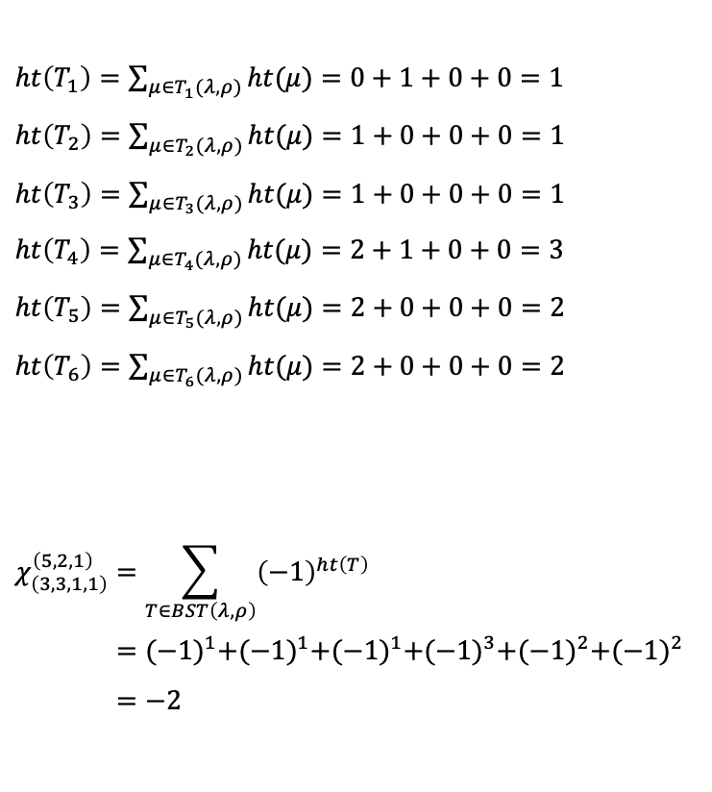
Example
Non-Recursive Version: (size: $8$) $λ=(5,2,1)$, $ρ=(3,3,1,1)$
$ht\left(T_{1}\right)=\sum_{μ∈T_{1}(λ,ρ)}{ht(μ)}=0+1+0+0=1$
$ht\left(T_{2}\right)=\sum_{μ∈T_{2}(λ,ρ)}{ht(μ)}=1+0+0+0=1$
$ht\left(T_{3}\right)=\sum_{μ∈T_{3}(λ,ρ)}{ht(μ)}=1+0+0+0=1$
$ht\left(T_{4}\right)=\sum_{μ∈T_{4}(λ,ρ)}{ht(μ)}=2+1+0+0=3$
$ht\left(T_{5}\right)=\sum_{μ∈T_{5}(λ,ρ)}{ht(μ)}=2+0+0+0=2$
$ht\left(T_{6}\right)=\sum_{μ∈T_{6}(λ,ρ)}{ht(μ)}=2+0+0+0=2$
$$χ_{\left(3,3,1,1\right)}^{\left(5,2,1\right)}=\sum_{T∈BST\left(λ,ρ\right)}{{\left(−1\right)}^{ht\left(T\right)}} \\ ={(−1)}^{1}+{(−1)}^{1}+{(−1)}^{1}+{(−1)}^{3}+{(−1)}^{2}+{(−1)}^{2} \\ =−2$$
1
1
1
3
4
1
1
2
2
2
2
2
1
3
2
4
$T_{1}$
$T_{2}$
1
1
2
2
2
1
2
2
3
4
1
4
1
2
3
1
$T_{3}$
$T_{4}$
1
2
2
2
4
1
2
2
2
3
1
3
1
4
1
1
$T_{5}$
$T_{6}$

Slide 19
Example
Recursive Version: (size: $9$) $λ=(6,2,1)$, $ρ=(3,3,2,1)$

Slide 20
Example
Recursive Version: (size: $9$) $λ=(6,2,1)$, $ρ=(3,3,2,1)$

Slide 21
Example
Recursive Version: (size: $9$) $λ=(6,2,1)$, $ρ=(3,3,2,1)$

Slide 22
Example
Recursive Version: (size: $9$) $λ=(6,2,1)$, $ρ=(3,3,2,1)$

Slide 23
Example
Recursive Version: (size: $9$) $λ=(6,2,1)$, $ρ=(3,3,2,1)$

Slide 24
Example
Recursive Version: (size: $9$) $λ=(6,2,1)$, $ρ=(3,3,2,1)$

Slide 25
Example
Recursive Version: (size: $9$) $λ=(6,2,1)$, $ρ=(3,3,2,1)$

Slide 26
Example
Recursive Version: (size: $9$) $λ=(6,2,1)$, $ρ=(3,3,2,1)$

Slide 27
Example
Recursive Version: (size: $9$) $λ=(6,2,1)$, $ρ=(3,3,2,1)$

Slide 28
Example
Recursive Version: (size: $9$) $λ=(6,2,1)$, $ρ=(3,3,2,1)$

Slide 29
Example
Recursive Version: (size: $9$) $λ=(6,2,1)$, $ρ=(3,3,2,1)$

Slide 30
Example
Recursive Version: (size: $9$) $λ=(6,2,1)$, $ρ=(3,3,2,1)$
$$χ_{(3,3,2,1)}^{(6,2,1)} ={{ (−1)}^{0}χ}_{(3,2,1)}^{(3,2,1)} + {(−1)}^{1}χ_{(3,2,1)}^{(5)}$$

Slide 31
Example
Recursive Version: (size: $9$) $λ=(6,2,1)$, $ρ=(3,3,2,1)$
$$χ_{(3,3,2,1)}^{(6,2,1)} ={{ (−1)}^{0}χ}_{(3,2,1)}^{(3,2,1)} + {(−1)}^{1}χ_{(3,2,1)}^{(5)}$$

Slide 32
Example
Recursive Version: (size: $9$) $λ=(6,2,1)$, $ρ=(3,3,2,1)$
$$χ_{(3,3,2,1)}^{(6,2,1)} ={{ (−1)}^{0}χ}_{(3,2,1)}^{(3,2,1)} + {(−1)}^{1}χ_{(3,2,1)}^{(5)}$$

Slide 33
Example
Recursive Version: (size: $9$) $λ=(6,2,1)$, $ρ=(3,3,2,1)$
$$χ_{(3,3,2,1)}^{(6,2,1)} ={{ (−1)}^{0}χ}_{(3,2,1)}^{(3,2,1)} + {(−1)}^{1}χ_{(3,2,1)}^{(5)}$$

Slide 34
Example
Recursive Version: (size: $9$) $λ=(6,2,1)$, $ρ=(3,3,2,1)$
$$χ_{(3,3,2,1)}^{(6,2,1)} ={{ (−1)}^{0}χ}_{(3,2,1)}^{(3,2,1)} + {(−1)}^{1}χ_{(3,2,1)}^{(5)}$$

Slide 35
Example
Recursive Version: (size: $9$) $λ=(6,2,1)$, $ρ=(3,3,2,1)$
$$χ_{(3,3,2,1)}^{(6,2,1)} ={{ (−1)}^{0}χ}_{(3,2,1)}^{(3,2,1)} + {(−1)}^{1}χ_{(3,2,1)}^{(5)}$$

Slide 36
Example
Recursive Version: (size: $9$) $λ=(6,2,1)$, $ρ=(3,3,2,1)$
$$χ_{(3,3,2,1)}^{(6,2,1)} ={{ (−1)}^{0}χ}_{(3,2,1)}^{(3,2,1)} + {(−1)}^{1}χ_{(3,2,1)}^{(5)}$$

Slide 37
Example
Recursive Version: (size: $9$) $λ=(6,2,1)$, $ρ=(3,3,2,1)$
$$χ_{(3,3,2,1)}^{(6,2,1)} ={{ (−1)}^{0}χ}_{(3,2,1)}^{(3,2,1)} + {(−1)}^{1}χ_{(3,2,1)}^{(5)}$$

Slide 38
Example
Recursive Version: (size: $9$) $λ=(6,2,1)$, $ρ=(3,3,2,1)$
$$χ_{(3,3,2,1)}^{(6,2,1)} ={{ (−1)}^{0}χ}_{(3,2,1)}^{(3,2,1)} + {(−1)}^{1}χ_{(3,2,1)}^{(5)}$$

Slide 39
Example
Recursive Version: (size: $9$) $λ=(6,2,1)$, $ρ=(3,3,2,1)$
$$χ_{(3,3,2,1)}^{(6,2,1)} ={{ (−1)}^{0}χ}_{(3,2,1)}^{(3,2,1)} + {(−1)}^{1}χ_{(3,2,1)}^{(5)}$$

Slide 40
Example
Recursive Version: (size: $9$) $λ=(6,2,1)$, $ρ=(3,3,2,1)$
$$χ_{(3,3,2,1)}^{(6,2,1)} ={{ (−1)}^{0}χ}_{(3,2,1)}^{(3,2,1)} + {(−1)}^{1}χ_{(3,2,1)}^{(5)}$$
$$χ_{(3,3,2,1)}^{(6,2,1)}={{ (−1)}^{0}[{ (−1)}^{1}χ}_{(2,1)}^{(1,1,1)}+{(−1)}^{1}χ_{(2,1)}^{(3)} ] + {(−1)}^{1}{[(−1)}^{0}χ_{(2,1)}^{(3)}]$$

Slide 41
Example
Recursive Version: (size: $9$) $λ=(6,2,1)$, $ρ=(3,3,2,1)$
$$χ_{(3,3,2,1)}^{(6,2,1)} ={{ (−1)}^{0}χ}_{(3,2,1)}^{(3,2,1)} + {(−1)}^{1}χ_{(3,2,1)}^{(5)}$$
$$χ_{(3,3,2,1)}^{(6,2,1)}={{ (−1)}^{0}[{ (−1)}^{1}χ}_{(2,1)}^{(1,1,1)}+{(−1)}^{1}χ_{(2,1)}^{(3)} ] + {(−1)}^{1}{[(−1)}^{0}χ_{(2,1)}^{(3)}]$$

Slide 42
Example
Recursive Version: (size: $9$) $λ=(6,2,1)$, $ρ=(3,3,2,1)$
$$χ_{(3,3,2,1)}^{(6,2,1)} ={{ (−1)}^{0}χ}_{(3,2,1)}^{(3,2,1)} + {(−1)}^{1}χ_{(3,2,1)}^{(5)}$$
$$χ_{(3,3,2,1)}^{(6,2,1)}={{ (−1)}^{0}[{ (−1)}^{1}χ}_{(2,1)}^{(1,1,1)}+{(−1)}^{1}χ_{(2,1)}^{(3)} ] + {(−1)}^{1}{[(−1)}^{0}χ_{(2,1)}^{(3)}]$$

Slide 43
Example
Recursive Version: (size: $9$) $λ=(6,2,1)$, $ρ=(3,3,2,1)$
$$χ_{(3,3,2,1)}^{(6,2,1)} ={{ (−1)}^{0}χ}_{(3,2,1)}^{(3,2,1)} + {(−1)}^{1}χ_{(3,2,1)}^{(5)}$$
$$χ_{(3,3,2,1)}^{(6,2,1)}={{ (−1)}^{0}[{ (−1)}^{1}χ}_{(2,1)}^{(1,1,1)}+{(−1)}^{1}χ_{(2,1)}^{(3)} ] + {(−1)}^{1}{[(−1)}^{0}χ_{(2,1)}^{(3)}]$$

Slide 44
Example
Recursive Version: (size: $9$) $λ=(6,2,1)$, $ρ=(3,3,2,1)$
$$χ_{(3,3,2,1)}^{(6,2,1)} ={{ (−1)}^{0}χ}_{(3,2,1)}^{(3,2,1)} + {(−1)}^{1}χ_{(3,2,1)}^{(5)}$$
$$χ_{(3,3,2,1)}^{(6,2,1)}={{ (−1)}^{0}[{ (−1)}^{1}χ}_{(2,1)}^{(1,1,1)}+{(−1)}^{1}χ_{(2,1)}^{(3)} ] + {(−1)}^{1}{[(−1)}^{0}χ_{(2,1)}^{(3)}]$$

Slide 45
Example
Recursive Version: (size: $9$) $λ=(6,2,1)$, $ρ=(3,3,2,1)$
$$χ_{(3,3,2,1)}^{(6,2,1)} ={{ (−1)}^{0}χ}_{(3,2,1)}^{(3,2,1)} + {(−1)}^{1}χ_{(3,2,1)}^{(5)}$$
$$χ_{(3,3,2,1)}^{(6,2,1)}={{ (−1)}^{0}[{ (−1)}^{1}χ}_{(2,1)}^{(1,1,1)}+{(−1)}^{1}χ_{(2,1)}^{(3)} ] + {(−1)}^{1}{[(−1)}^{0}χ_{(2,1)}^{(3)}]$$

Slide 46
Example
Recursive Version: (size: $9$) $λ=(6,2,1)$, $ρ=(3,3,2,1)$
$$χ_{(3,3,2,1)}^{(6,2,1)} ={{ (−1)}^{0}χ}_{(3,2,1)}^{(3,2,1)} + {(−1)}^{1}χ_{(3,2,1)}^{(5)}$$
$$χ_{(3,3,2,1)}^{(6,2,1)}={{ (−1)}^{0}[{ (−1)}^{1}χ}_{(2,1)}^{(1,1,1)}+{(−1)}^{1}χ_{(2,1)}^{(3)} ] + {(−1)}^{1}{[(−1)}^{0}χ_{(2,1)}^{(3)}]$$

Slide 47
Example
Recursive Version: (size: $9$) $λ=(6,2,1)$, $ρ=(3,3,2,1)$
$$χ_{(3,3,2,1)}^{(6,2,1)} ={{ (−1)}^{0}χ}_{(3,2,1)}^{(3,2,1)} + {(−1)}^{1}χ_{(3,2,1)}^{(5)}$$
$$χ_{(3,3,2,1)}^{(6,2,1)}={{ (−1)}^{0}[{ (−1)}^{1}χ}_{(2,1)}^{(1,1,1)}+{(−1)}^{1}χ_{(2,1)}^{(3)} ] + {(−1)}^{1}{[(−1)}^{0}χ_{(2,1)}^{(3)}]$$

Slide 48
Example
Recursive Version: (size: $9$) $λ=(6,2,1)$, $ρ=(3,3,2,1)$
$$χ_{(3,3,2,1)}^{(6,2,1)} ={{ (−1)}^{0}χ}_{(3,2,1)}^{(3,2,1)} + {(−1)}^{1}χ_{(3,2,1)}^{(5)}$$
$$χ_{(3,3,2,1)}^{(6,2,1)}={{ (−1)}^{0}[{ (−1)}^{1}χ}_{(2,1)}^{(1,1,1)}+{(−1)}^{1}χ_{(2,1)}^{(3)} ] + {(−1)}^{1}{[(−1)}^{0}χ_{(2,1)}^{(3)}]$$

Slide 49
Example
Recursive Version: (size: $9$) $λ=(6,2,1)$, $ρ=(3,3,2,1)$
$$χ_{(3,3,2,1)}^{(6,2,1)} ={{ (−1)}^{0}χ}_{(3,2,1)}^{(3,2,1)} + {(−1)}^{1}χ_{(3,2,1)}^{(5)}$$
$$χ_{(3,3,2,1)}^{(6,2,1)}={{ (−1)}^{0}[{ (−1)}^{1}χ}_{(2,1)}^{(1,1,1)}+{(−1)}^{1}χ_{(2,1)}^{(3)} ] + {(−1)}^{1}{[(−1)}^{0}χ_{(2,1)}^{(3)}]$$

Slide 50
Example
Recursive Version: (size: $9$) $λ=(6,2,1)$, $ρ=(3,3,2,1)$
$$χ_{(3,3,2,1)}^{(6,2,1)} ={{ (−1)}^{0}χ}_{(3,2,1)}^{(3,2,1)} + {(−1)}^{1}χ_{(3,2,1)}^{(5)}$$
$$χ_{(3,3,2,1)}^{(6,2,1)}={{ (−1)}^{0}[{ (−1)}^{1}χ}_{(2,1)}^{(1,1,1)}+{(−1)}^{1}χ_{(2,1)}^{(3)} ] + {(−1)}^{1}{[(−1)}^{0}χ_{(2,1)}^{(3)}]$$

Slide 51

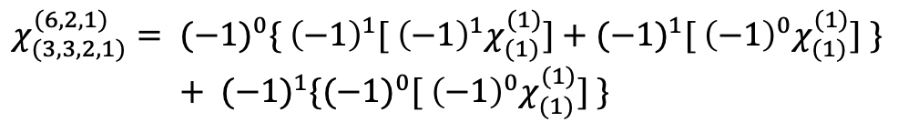
$$χ_{(3,3,2,1)}^{(6,2,1)} ={{ (−1)}^{0}χ}_{(3,2,1)}^{(3,2,1)} + {(−1)}^{1}χ_{(3,2,1)}^{(5)}$$
$$χ_{(3,3,2,1)}^{(6,2,1)}={{ (−1)}^{0}[{ (−1)}^{1}χ}_{(2,1)}^{(1,1,1)}+{(−1)}^{1}χ_{(2,1)}^{(3)} ] + {(−1)}^{1}{[(−1)}^{0}χ_{(2,1)}^{(3)}]$$
$$χ_{(3,3,2,1)}^{(6,2,1)}={{ (−1)}^{0}\{{ \left(−1\right)}^{1}[{ \left(−1\right)}^{1}χ}_{(1)}^{(1)}]+{(−1)}^{1}{[{ \left(−1\right)}^{0}χ}_{(1)}^{(1)}] \}$$
$+ {(−1)}^{1}{\{(−1)}^{0}{[{ \left(−1\right)}^{0}χ}_{(1)}^{(1)}] \}$

Slide 52
$$χ_{(3,3,2,1)}^{(6,2,1)} ={{ (−1)}^{0}χ}_{(3,2,1)}^{(3,2,1)} + {(−1)}^{1}χ_{(3,2,1)}^{(5)}$$
$$χ_{(3,3,2,1)}^{(6,2,1)}={{ (−1)}^{0}[{ (−1)}^{1}χ}_{(2,1)}^{(1,1,1)}+{(−1)}^{1}χ_{(2,1)}^{(3)} ] + {(−1)}^{1}{[(−1)}^{0}χ_{(2,1)}^{(3)}]$$
$$χ_{(3,3,2,1)}^{(6,2,1)}={{ (−1)}^{0}\{{ \left(−1\right)}^{1}[{ \left(−1\right)}^{1}χ}_{(1)}^{(1)}]+{(−1)}^{1}{[{ \left(−1\right)}^{0}χ}_{(1)}^{(1)}] \}$$
$+ {(−1)}^{1}{\{(−1)}^{0}{[{ \left(−1\right)}^{0}χ}_{(1)}^{(1)}] \}$

Slide 53
$$χ_{(3,3,2,1)}^{(6,2,1)} ={{ (−1)}^{0}χ}_{(3,2,1)}^{(3,2,1)} + {(−1)}^{1}χ_{(3,2,1)}^{(5)}$$
$$χ_{(3,3,2,1)}^{(6,2,1)}={{ (−1)}^{0}[{ (−1)}^{1}χ}_{(2,1)}^{(1,1,1)}+{(−1)}^{1}χ_{(2,1)}^{(3)} ] + {(−1)}^{1}{[(−1)}^{0}χ_{(2,1)}^{(3)}]$$
$$χ_{(3,3,2,1)}^{(6,2,1)}={{ (−1)}^{0}\{{ \left(−1\right)}^{1}[{ \left(−1\right)}^{1}χ}_{(1)}^{(1)}]+{(−1)}^{1}{[{ \left(−1\right)}^{0}χ}_{(1)}^{(1)}] \}$$
$+ {(−1)}^{1}{\{(−1)}^{0}{[{ \left(−1\right)}^{0}χ}_{(1)}^{(1)}] \}$

Slide 54
$$χ_{(3,3,2,1)}^{(6,2,1)} ={{ (−1)}^{0}χ}_{(3,2,1)}^{(3,2,1)} + {(−1)}^{1}χ_{(3,2,1)}^{(5)}$$
$$χ_{(3,3,2,1)}^{(6,2,1)}={{ (−1)}^{0}[{ (−1)}^{1}χ}_{(2,1)}^{(1,1,1)}+{(−1)}^{1}χ_{(2,1)}^{(3)} ] + {(−1)}^{1}{[(−1)}^{0}χ_{(2,1)}^{(3)}]$$
$$χ_{(3,3,2,1)}^{(6,2,1)}={{ (−1)}^{0}\{{ \left(−1\right)}^{1}[{ \left(−1\right)}^{1}χ}_{(1)}^{(1)}]+{(−1)}^{1}{[{ \left(−1\right)}^{0}χ}_{(1)}^{(1)}] \}$$
$+ {(−1)}^{1}{\{(−1)}^{0}{[{ \left(−1\right)}^{0}χ}_{(1)}^{(1)}] \}$

Slide 55
$$χ_{(3,3,2,1)}^{(6,2,1)} ={{ (−1)}^{0}χ}_{(3,2,1)}^{(3,2,1)} + {(−1)}^{1}χ_{(3,2,1)}^{(5)}$$
$$χ_{(3,3,2,1)}^{(6,2,1)}={{ (−1)}^{0}[{ (−1)}^{1}χ}_{(2,1)}^{(1,1,1)}+{(−1)}^{1}χ_{(2,1)}^{(3)} ] + {(−1)}^{1}{[(−1)}^{0}χ_{(2,1)}^{(3)}]$$
$$χ_{(3,3,2,1)}^{(6,2,1)}={{ (−1)}^{0}\{{ \left(−1\right)}^{1}[{ \left(−1\right)}^{1}χ}_{(1)}^{(1)}]+{(−1)}^{1}{[{ \left(−1\right)}^{0}χ}_{(1)}^{(1)}] \}$$
$+ {(−1)}^{1}{\{(−1)}^{0}{[{ \left(−1\right)}^{0}χ}_{(1)}^{(1)}] \}$

Slide 56
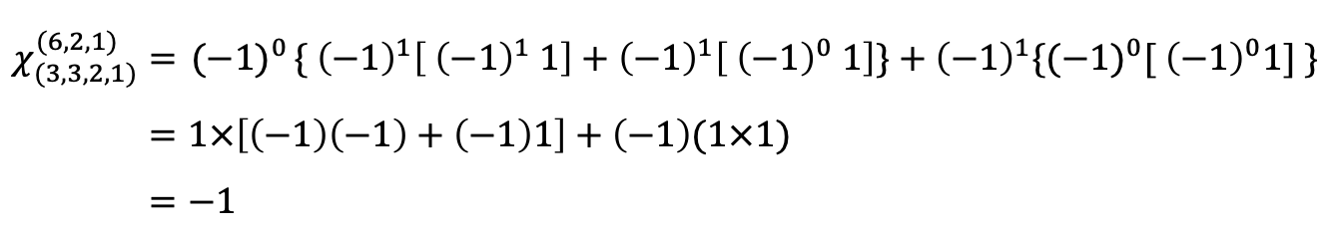
$$χ_{(3,3,2,1)}^{(6,2,1)}={ (−1)}^{0}\{{ \left(−1\right)}^{1}\left[{ \left(−1\right)}^{1} 1\right]+{\left(−1\right)}^{1}\left[{ \left(−1\right)}^{0} 1\right]\}+{\left(−1\right)}^{1}{\{(−1)}^{0}[{ \left(−1\right)}^{0}1] \} \\ =1×\left[\left(−1\right)\left(−1\right)+\left(−1\right)1\right]+\left(−1\right)(1×1) \\ =−1$$

Slide 57
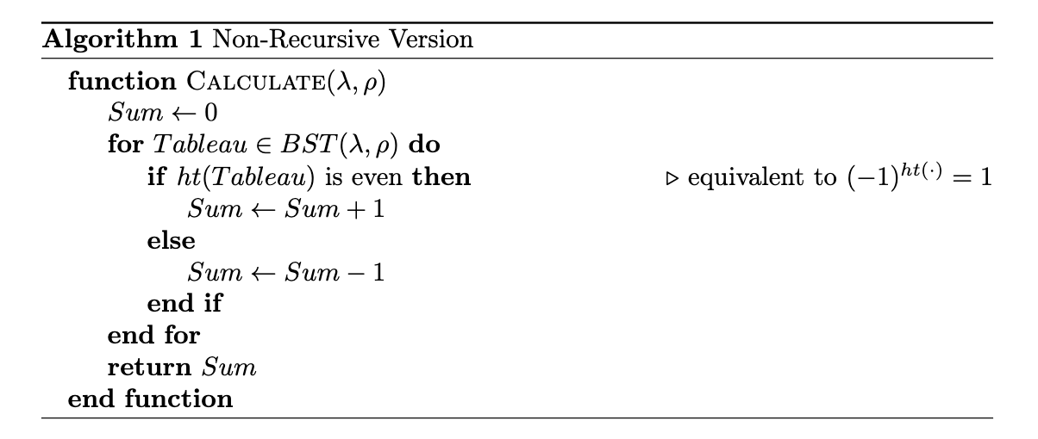
Algorithm

Slide 58
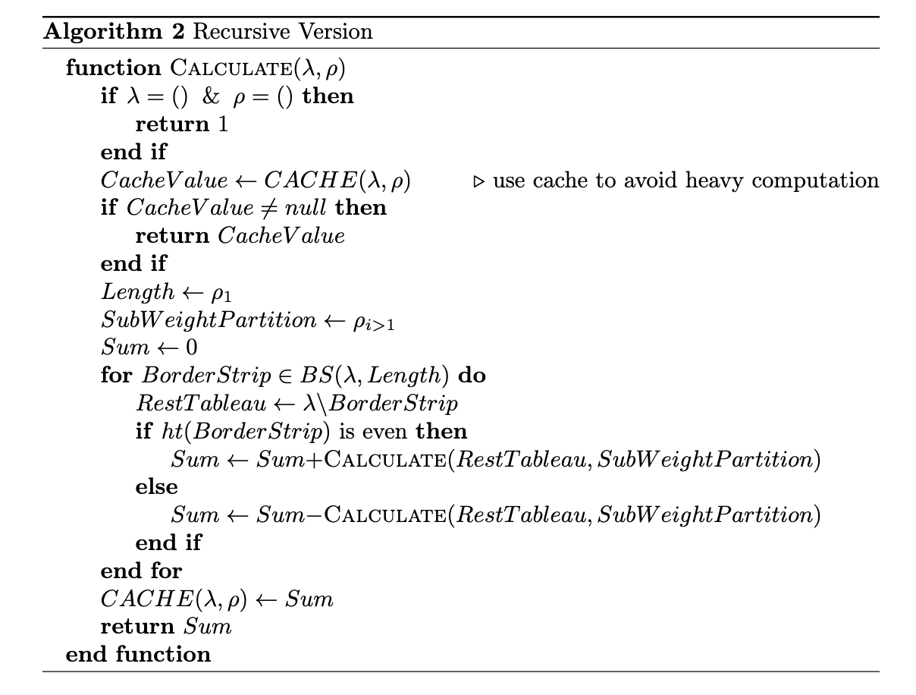
Algorithm

Slide 59
Optimization

Slide 60
Optimization
Problem
We developed several versions…
Problem
Partition Map
Version | Language | Problem
1 | Python | Slow (when n>25)
2 | Java | java.lang.OutOfMemoryError (when n>30)
3 | Golang | Hashmap does not work well
4 # final | Golang | -

Slide 61
Optimization
Problem
We developed several versions…
Problem
Partition Map
Version | Language | Problem
1 | Python | Slow (when n>25)
2 | Java | java.lang.OutOfMemoryError (when n>30)
3 | Golang | Hashmap does not work well
4 # final | Golang | -
Since we can not use partition directly as the key of the map in Golang, and using string as the key is very inefficient even though we can easily turn a partition into a string.
We then need to construct an injection or bijection from partition to integer.

Slide 62
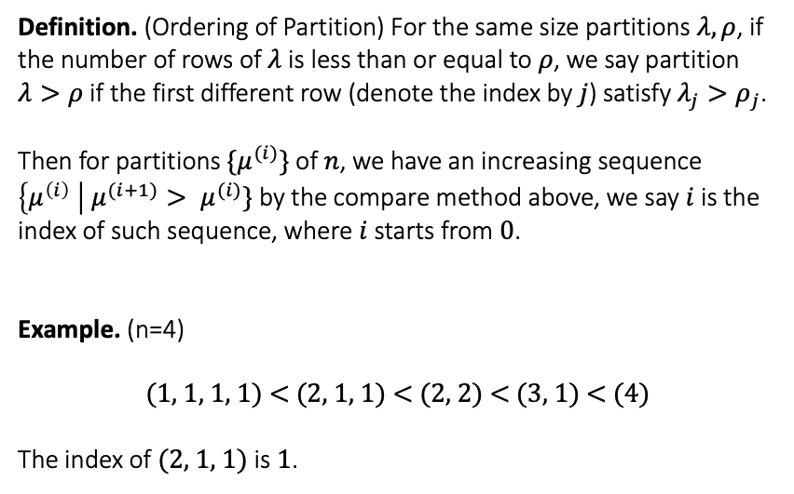
Optimization
Partition Map
Definition. (Ordering of Partition) For the same size partitions $λ,ρ$, if the number of rows of $λ$ is less than or equal to $ρ$, we say partition $λ>ρ$ if the first different row (denote the index by $j$) satisfy $λ_{j}>ρ_{j}$.
Then for partitions $\{μ^{(i)}\}$ of $n$, we have an increasing sequence $\left\{μ^{\left(i\right)} \right| μ^{(i+1)}> μ^{(i)}\}$by the compare method above, we say $i$ is the index of such sequence, where$i$starts from $0$.
Example. (n=4)
$$\text{(1, 1, 1, 1) < (2, 1, 1) < (2, 2) < (3, 1) < (4)}$$
The index of (2, 1, 1) is 1.
Problem
Partition Map

Slide 63
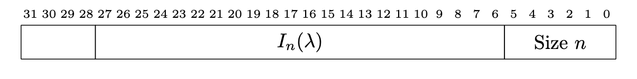
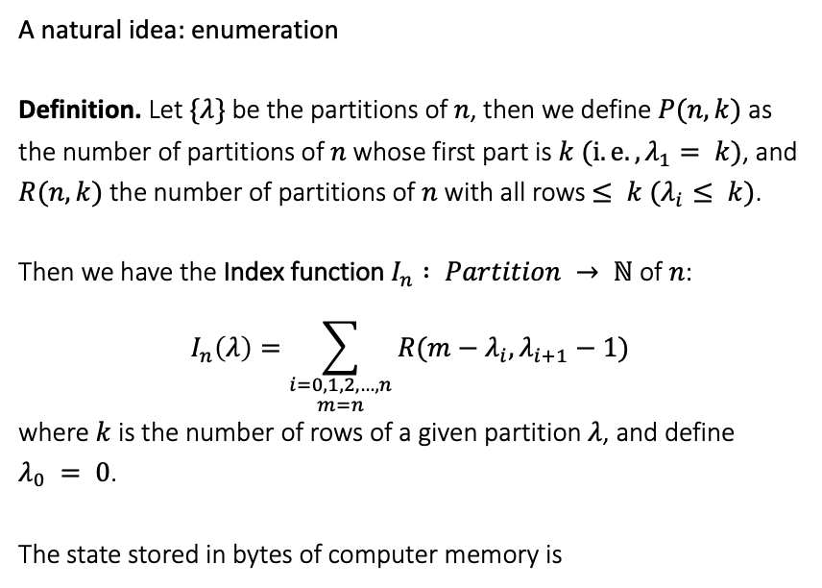
Optimization
Partition Map
A natural idea: enumeration
Definition. Let $\{λ\}$be the partitions of$n$, then we define $P(n, k)$as the number of partitions of $n$ whose first part is $k ({i.e., λ}_{1}= k)$, and $R(n, k)$the number of partitions of $n$ with all rows $≤ k (λ_{i}≤ k)$.
Then we have the Index function $I_{n} : Partition → ℕ$ of $n$: $$I_{n}\left(λ\right)=\sum_{\begin{aligned}i=0,1,2,…,n \\ m=n\end{aligned}}{R(m−λ_{i}, λ_{i+1}−1)}$$ where $k$ is the number of rows of a given partition$λ$, and define $λ_{0} = 0$.
The state stored in bytes of computer memory is
Problem
Partition Map

Slide 64
Results

Slide 65
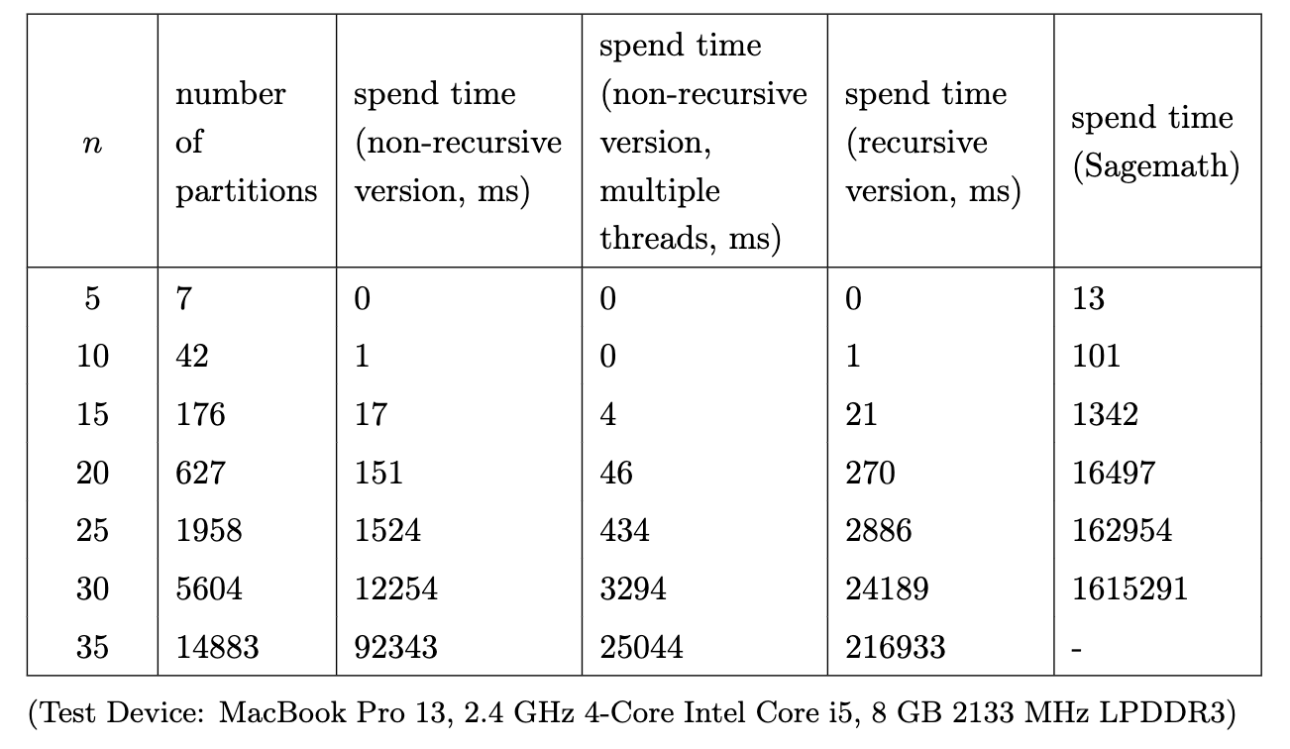
Test Results
Up to 400 times faster than Sagemath!

Slide 66
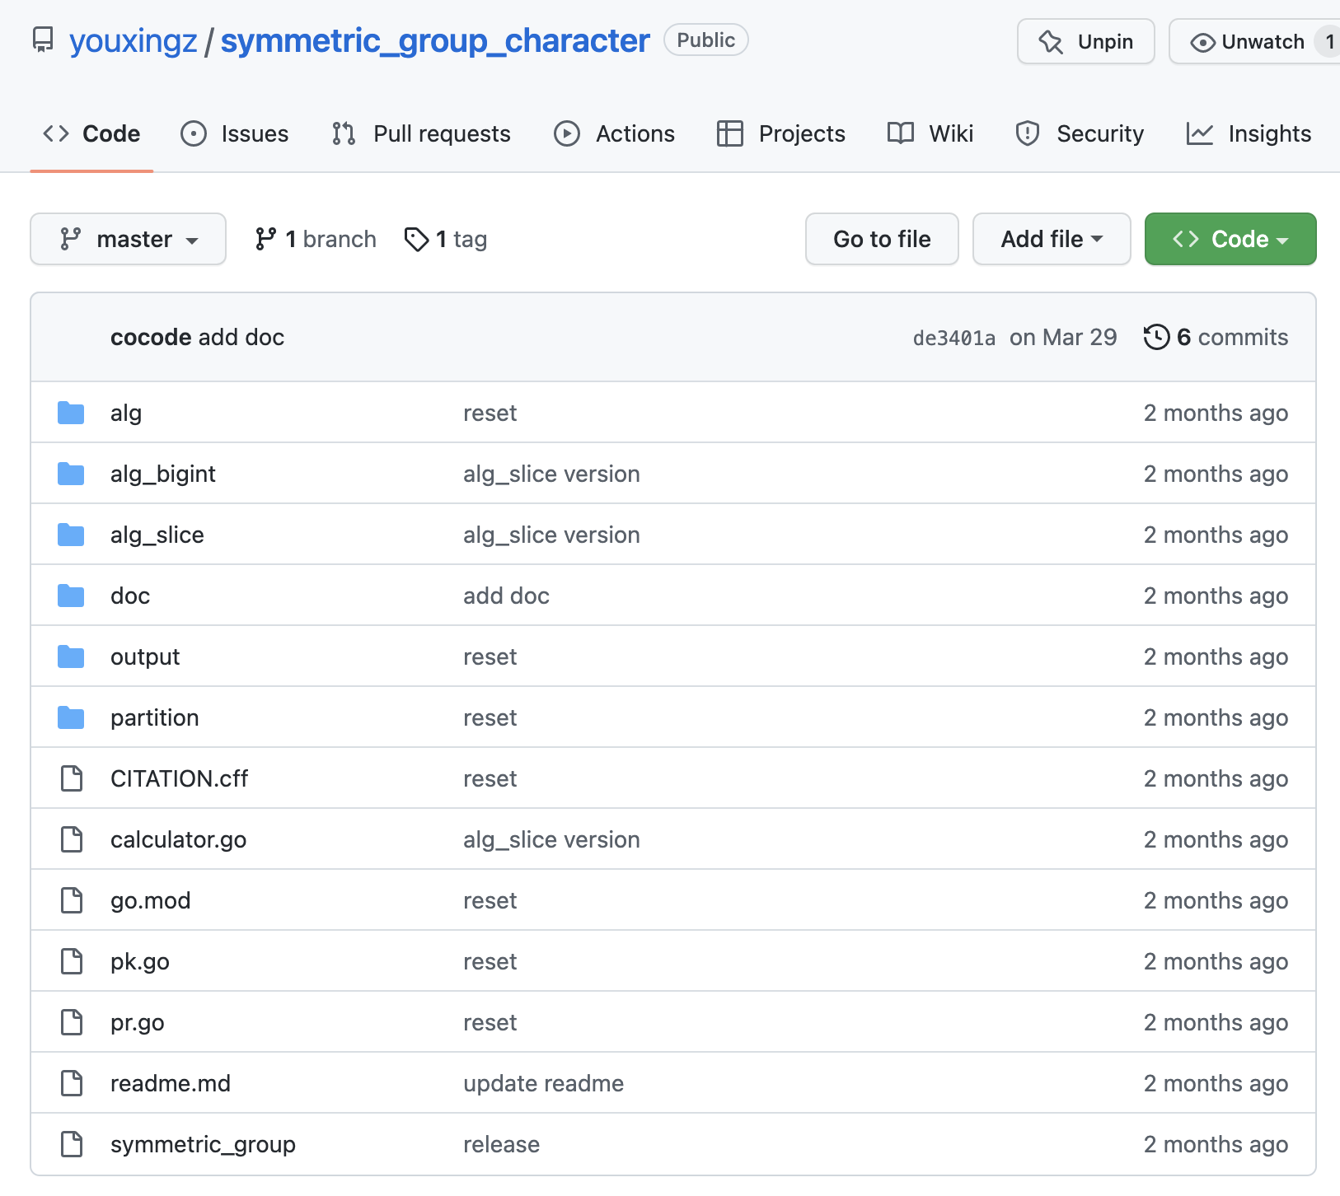
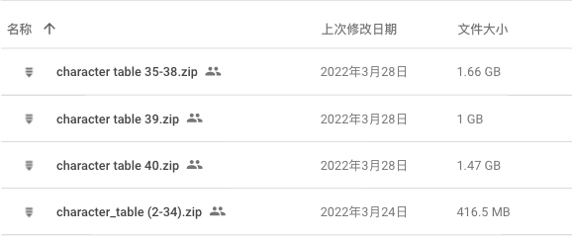
Codes & Tables

Slide 67
Next
Use GPU to speed up (50 times faster than current)
Merge code into Sagemath

Slide 68

Refrence

Slide 69
Thank you! Q&A

