Slide 1
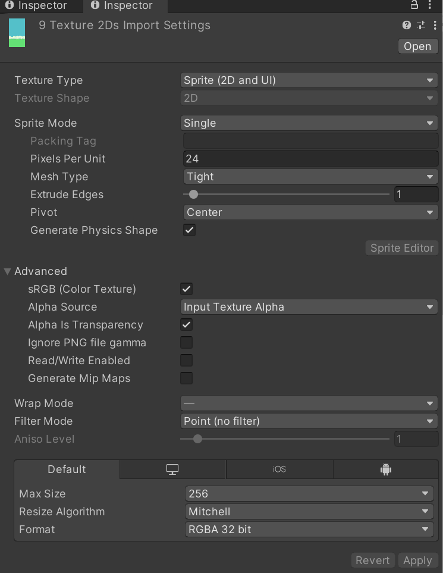
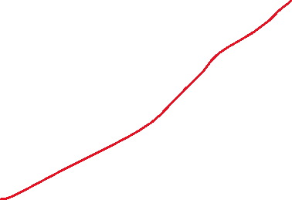





Sprites: 存放一些素材图片
图片的设计是：每单位24像素
修改Filtr Mode为Point，让sprite maintain the pixel style graphics that we want
因为精灵图都不是很大
Pixels Per Unit：The number of pixels of width/height in the Sprite image that correspond to one distance unit in world space.
Filter Mode：Specifies how Unity filters the texture when the texture stretches during 3D transformations.
* Point (no filter)：The texture appears blocky up close.
* Bilinear：The texture appears blurry up close.
* Trilinear：Like Bilinear, but the texture also blurs between the different MIP levels.
Notes:
https://docs.unity3d.com/Manual/texture-type-sprite.html

Slide 2
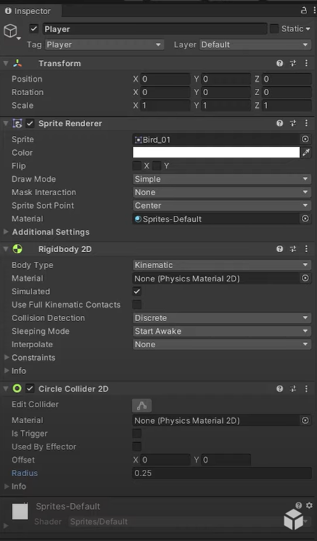


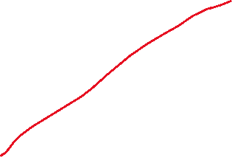


Player的Inspector设置
不能对这个物体模拟出物理特性，但可以实现碰撞collision；
Kinematic game objects are entirely driven by scripts, so you have to manually handle the the motion part:MovePosition, MoveRotation
Kinematic game objects only process collisions with Dynamic game objects, i.e. bouncing away, and cause OnCollisionEnter event to be sent
Use case: you want the character move with more flexibility
Dynamic game objects are entirely driven by game engine (physical engine)
The motion of Dynamic game objects are affected by force, velocity and etc
The physics engine takes responsibility for resolving their collisions with static, kinematic, and other dynamic objects and rebounding them as needed
Use case: game characters, moving game objects, etc
Body Type：Select to set the movement behavior and Collider 2D interaction of this Rigidbody 2D’s component settings.
Dynamic：Select to set this Rigidbody 2D to the Dynamic Body Type, which is designed to move under simulation and has all Rigidbody 2D properties available. This is the default Body Type for a Rigidbody 2D
Kinematic：Select to set this Rigidbody 2D to the Kinematic Body Type, which is designed to move under simulation but only under very explicit user control.
Static：Select to set this Rigidbody 2D to the Static Body Type, which is designed to not move under simulation at all and behaves like an immovable object with infinite mass. Refer to Body Type: Static for more information.
Notes:
https://docs.unity3d.com/Manual/Rigidbody2D-Kinematic.html
https://needoneapp.medium.com/unity-should-i-choose-kinematic-static-or-dynamic-for-rigidbody-2d-body-type-191ce65fa35f

Slide 3
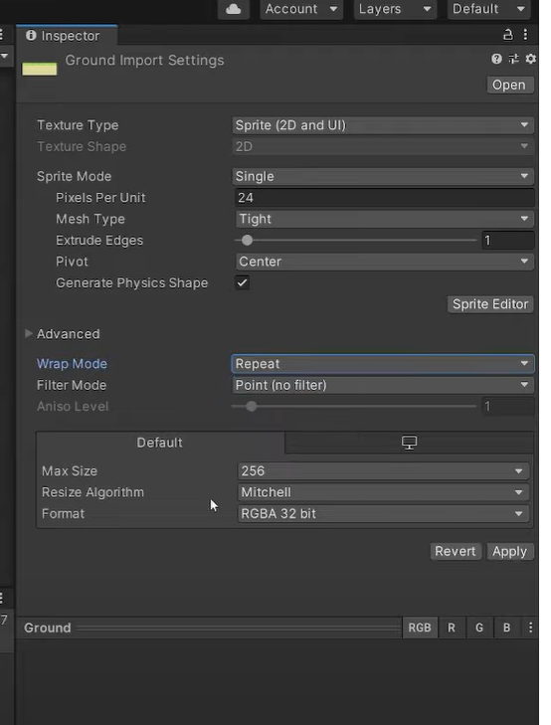
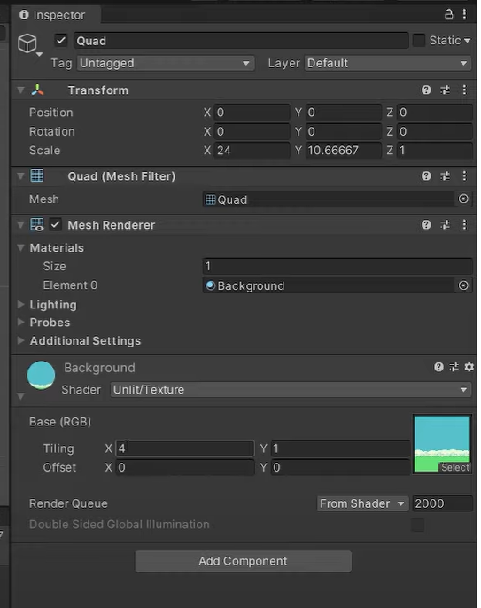


ground的组件里面不需要mesh collider, 因为bird是不会和Quad有发生碰撞这种事情的；
Ground的贴图设置里面需要设置为repeat，这样对quad选择unit/Texture的组件后，设置了Tiling表示重复图片了4次
设置offset可以形成背景图片在移动的效果

Slide 4
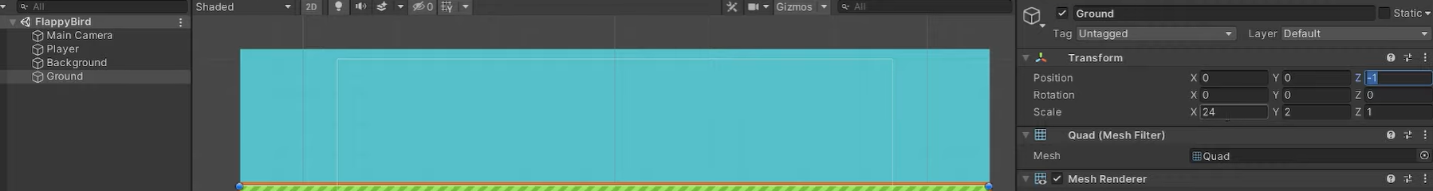
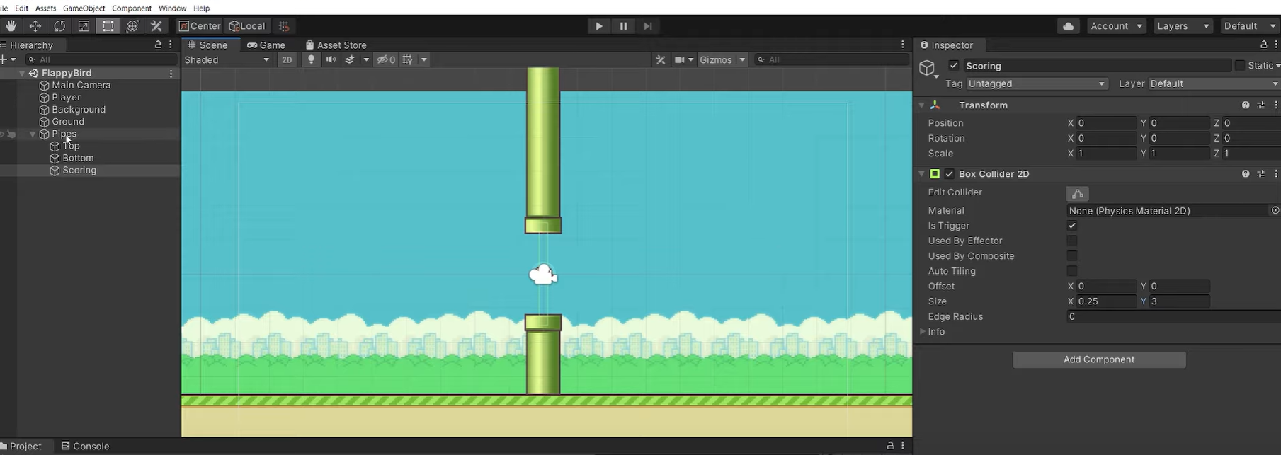
通过调整Z的大小，实现不同物体的显示顺序，这样ground就在background的前面了
1、碰撞器是触发器的载体，而触发器只是碰撞器身上的一个属性。2、当IsTrigger=false时，碰撞器根据物理引擎引发碰撞，产生碰撞的效果，可以调用OnCollisionEnter/Stay/Exit函数；3、当IsTrigger=true时，碰撞器被物理引擎所忽略，没有碰撞效果，可以调用OnTriggerEnter/Stay/Exit函数。4、如果既要检测到物体的接触又不想让碰撞检测影响物体移动或要检测一个物件是否经过空间中的某个区域这时就可以用到触发器。
————————————————
版权声明：本文为CSDN博主「xianhua7877」的原创文章，遵循CC 4.0 BY-SA版权协议，转载请附上原文出处链接及本声明。
原文链接：https://blog.csdn.net/xianhua7877/article/details/81557855
两个柱子，中间一个空物体，碰到柱子表示结束，碰到空物体进行加分；三个物体都设置了Box Collider 2D, 并且选择了Is Trigger

Slide 5
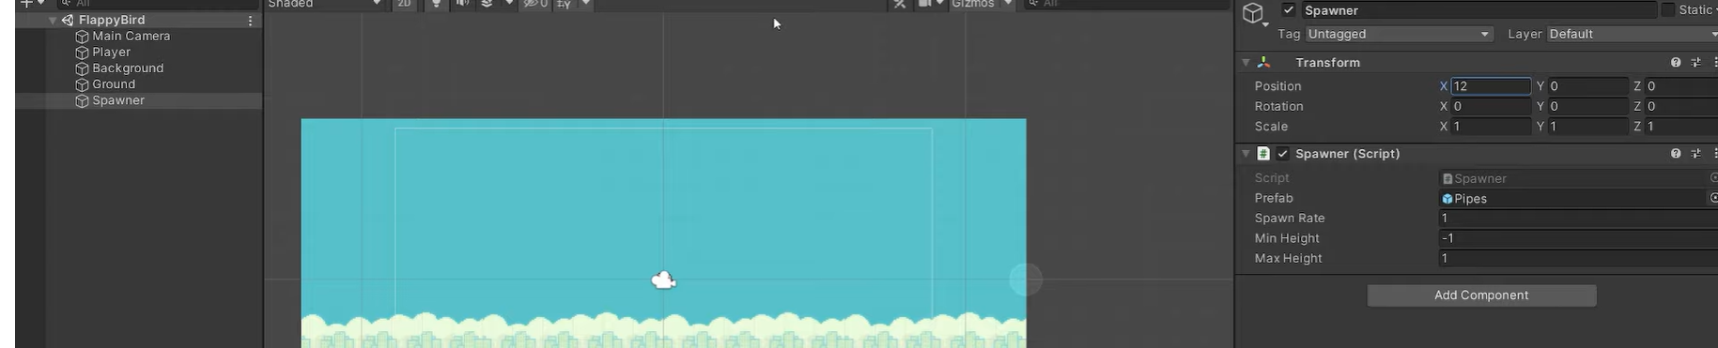
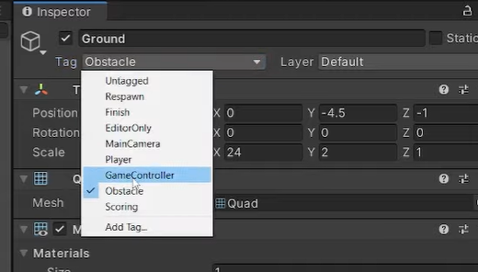


新建一个空物体，放在了右边画面外面；把做好的prefab传给脚本
对pipe和ground设置相应的标签，表示Obstacle或者Scoring

Slide 6
对象池
变量》》》》
cachedPipes 存储所有的对象
函数》》》》
CachePipes(clone): 传入gameobject，构造对象池里的对象的格式：.gameObject, .top, .bottom
Spawn()：GetPipes里没有东西的话，生成pipes，并用CachePipes构造cachedPipes；有东西的话，GetPipes获取到一个激活一个，同时要把参数进行初始化（移到最右边，设置随机高度）
GetPipes()：cachedPipes里存了对象，获取到里面未激活的对象，找到一个就返回一个
Update() 》》》》
获取到所有对象cachedPipes，遍历，激活状态则修改位置和状态
OnEnalbe()》》》》
构造dotween序列，循环调用Spawn

Slide 7
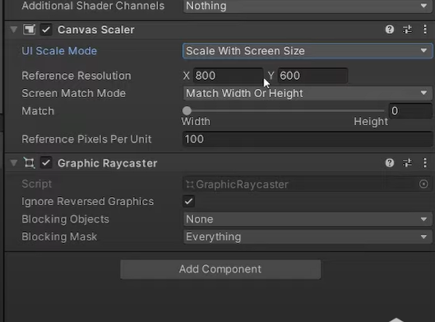
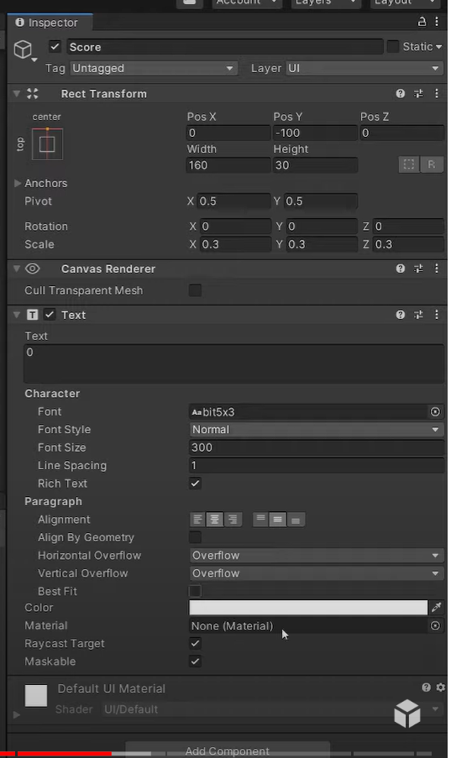
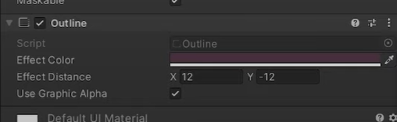









设置表示得分的Text属性，让它位于顶部中央，然后调整Y的位置使得在上方；
先设置很大的字体，然后再调整缩放，字体会很清晰；
添加一个Outline的组件，选择图片中的同色系；
设置UI上级的Canvas，随屏幕大小缩放，可以调整分辨率，此外根据情况设置根据高度进行匹配，这个项目里匹配高度调整到1

Slide 8
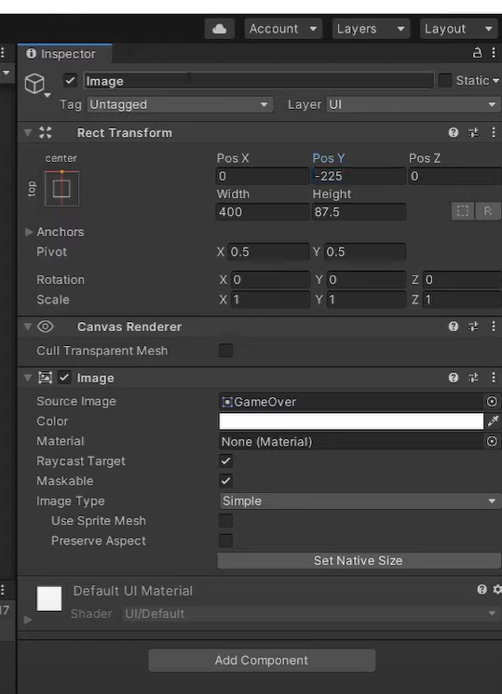



设置Game Over：
添加一个Image的UI组件，而不是直接拖入图片

