Slide 1

NYC Taxi Data Exploration Capital One Data Challenge
By C914994 YL

Slide 2
Data Summary
Trip Distance Exploration
Hourly Trip Distance Distribution and Airport Trips
Predictive Model on Tip Percentage
Speed

Slide 3
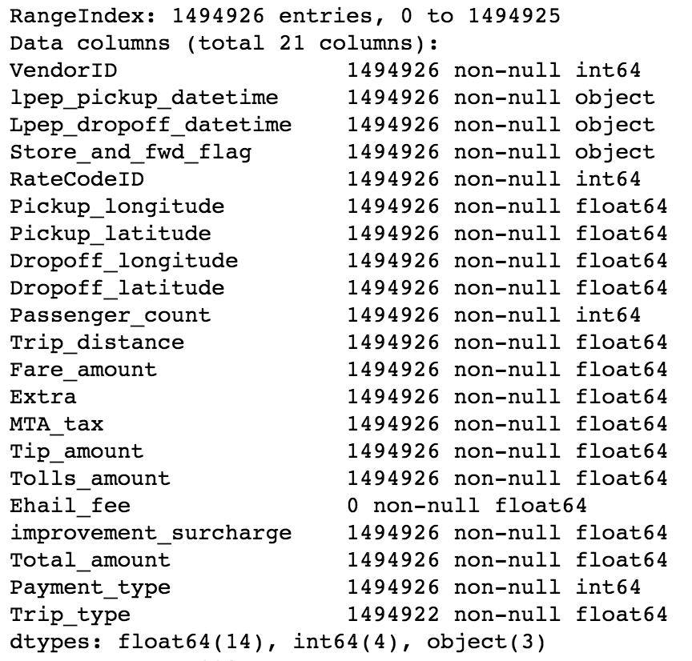
Data Summary
There are 1492926 transactions with 21 features in our data set.
Features are 2 time series data, 4 location data, 5 categorical data and 10 numerical data
Values in feature ‘Ehail_fee’ are totally missing.
4 transactions have no ‘Trip_type’

Slide 4
Data Summary
Trip Distance Exploration
Histogram of Trip Distance
Hypothesis on Trip Distance
Hourly Trip Distance Distribution and Airport Trips
Predictive Model on Tip Percentage
Speed

Slide 5
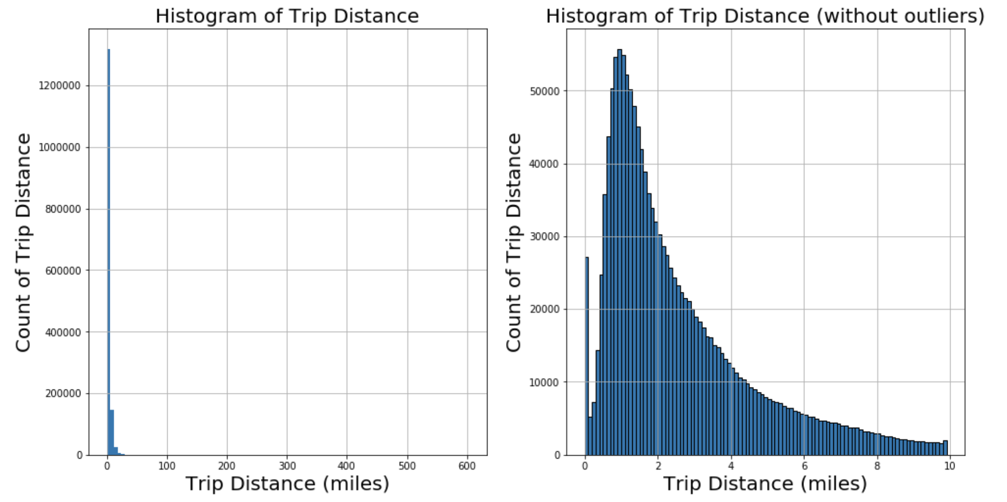
Trip Distance Exploration: Histogram

Slide 6
Trip Distance Exploration: Histogram
Trip Distance Exploration: Histogram
It's right-skewed data. The data's median is smaller than the mean.
It's long tail distribution. Majority trip distance is between 1-3 miles. So we assume that there would be larger amount of needs in short distance trips due to some specific purposes, like rush hour ride, for work or for study.
It looks like gamma distribution(we will explore later).
There is a peak around 0. It might because some rounding issue or take the missing data to 0.

Slide 7
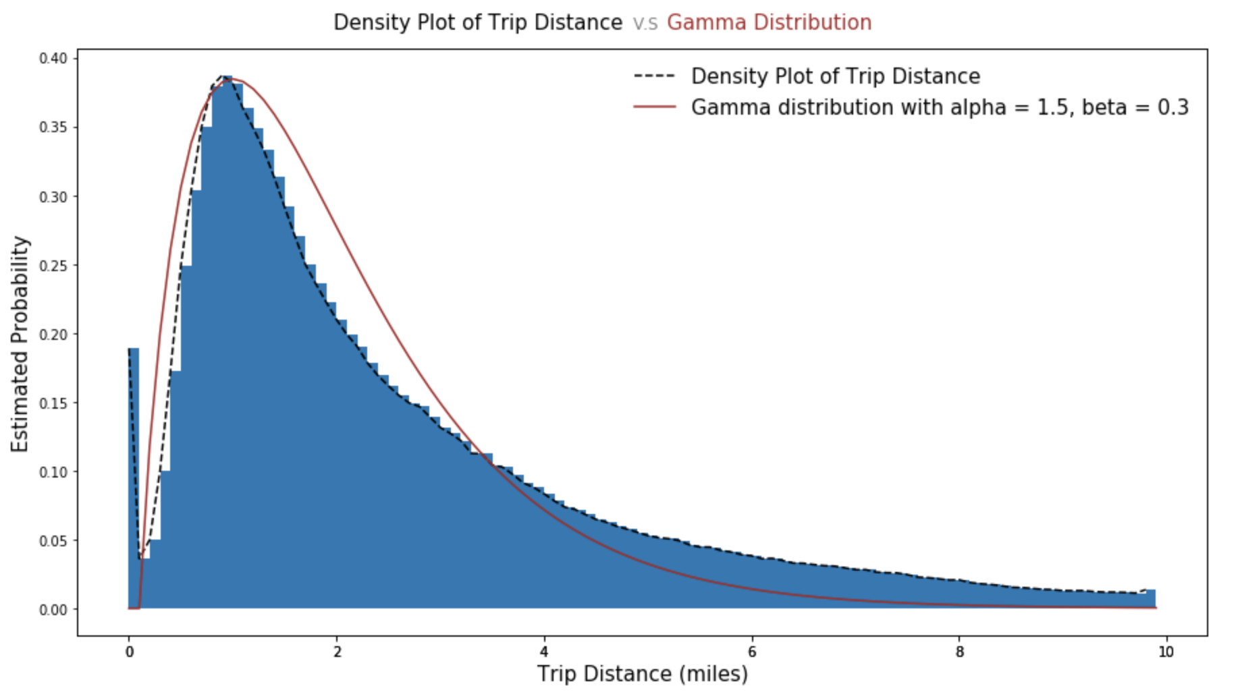
Trip Distance Exploration: Hypothesis
Hypothesis 1: Gamma Distribution
It right-skewed and long tailed, so we assume it is Gamma distribution. It turns out two density curves are pretty similar.

Slide 8
Trip Distance Exploration: Hypothesis
Hypothesis 2: Missing data assigned to 0
There is a peak around 0. The count of value 0 is much larger than nearby values. So we assume that there might be some missing values in trip distance and they were assigned to 0. We explore the data with trip distance = 0 to check their fare amount, pickup & dropoff time and location.
And we find above 53% of them have more than 5 dollars fare amount. We assume these trip may have missing value in Trip_distance.

Slide 9
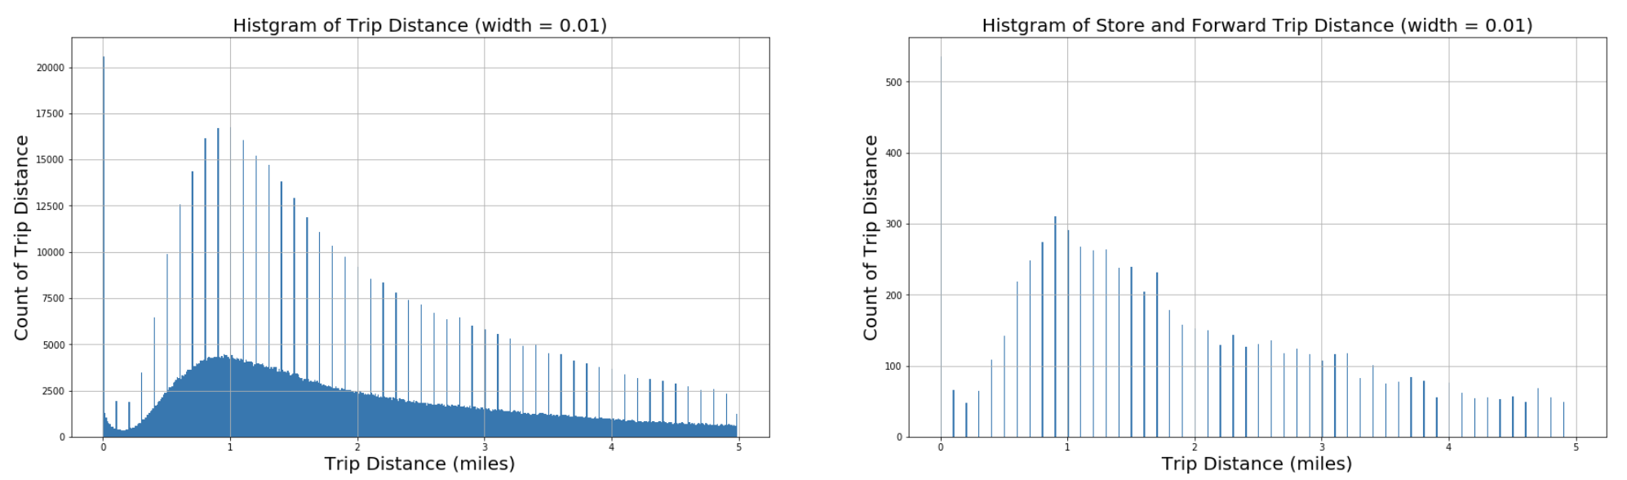
Trip Distance Exploration: Hypothesis
Hypothesis 3: Rounding around 1 decimals in store and forward trips
As we look into data those are not outlier, we notice the number of trip distance at each 1 decimals would be relatively high, we think there might be rounding around each 1 decimals.
One of the possible reason might be different methods to record trip distance. So we look into store and forward trip feature. It turns out that store and forward trip record only record 1 decimals distance. It might because of some memory issue.

Slide 10
Data Summary
Hourly Trip Distance Distribution and Airport Trips
Predictive Model on Tip Percentage
Trip Distance Exploration
Speed Hypothesis
Mean and Median trip distance grouped by hour of day
Airport Trips
Identifying trips to/from one of NYC airports
Interesting Characteristics of Airport Trips

Slide 11
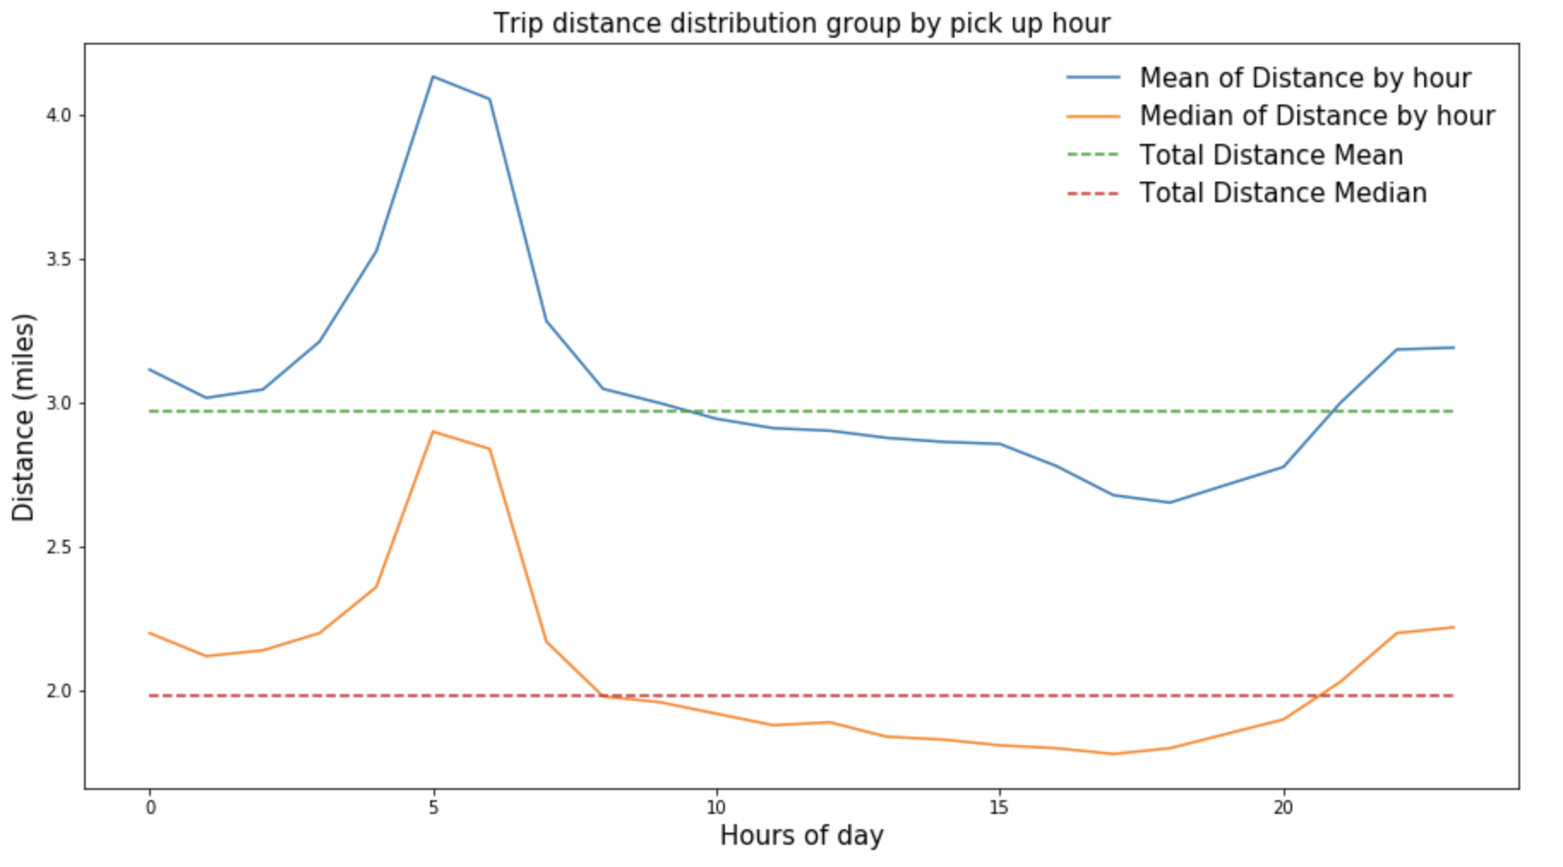
Hourly Trip Distance Distribution: Mean and Median trip distance grouped by hour of day
Trip distance is relatively high in morning and evening. We assume that people prefer to take taxi due to some difficulties in taking long time public transportation that time, like less shuttles and safety problems.
There is peak of distance around 5-6am. The long distance peak around 5-6am might because people are in a rush and want to save time, like catch a flight or a meeting during that day.

Slide 12
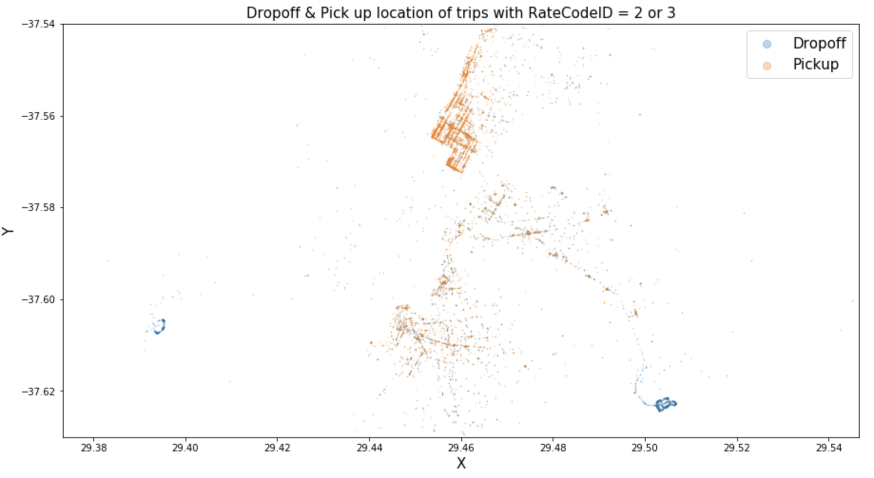
Airport Trips: Identifying trips to/from one of NYC airports
Method 1: Select trips with RateCodeID 2 or 3
Trips with RateCodeID 2(JFK) and 3(Newark) means they drop off at airports(the blue points clustered in 2 places which are airports in google map). It's not full airport transactions. We will try method 2.
In this method, airport trip number is 5552

Slide 13
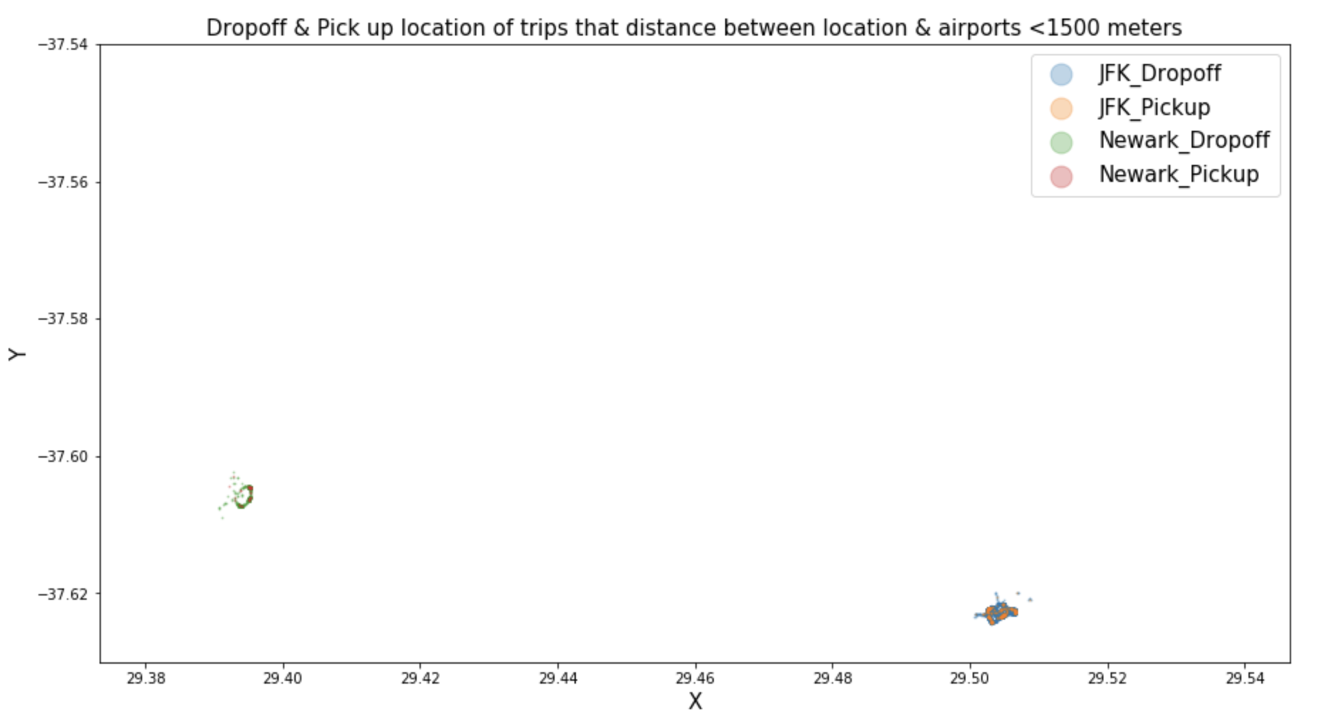
Airport Trips: Identifying trips to/from one of NYC airports
Method 2: Select trips by calculated distance
We find 3 airports latitude & longtitude in google map: JFK(40.6413111, -73.7803278), Newark(40.6895314, -74.1766511), LGA(40.8651848, -73.7299953)
We select trips whose distance between pickup/dropoff locations and airports is within 1500m.
Plot shows that pickup/dropoff locations are clustered in airports location. So we believe this method is convincing.
In this method, the number of trips to/from airports is 13658

Slide 14
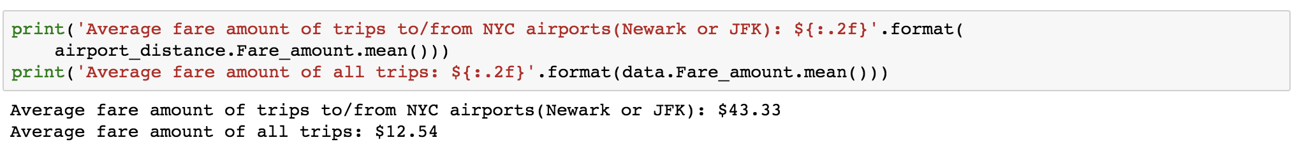
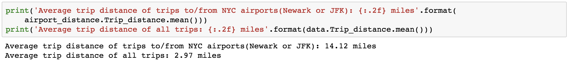
Airport Trips: Interesting Characteristics of Airport Trips
Characteristic 1: Higher average fare
Characteristic 2: Higher average trip distance & duration
Since the average fare amount is relatively high, so we assume those trips might be long trips which means the trip distance and duration(calculated by dropoff time - pickup time) are relatively high too.

Slide 15
Airport Trips: Interesting Characteristics of Airport Trips
Characteristic 2: Higher average trip distance & duration
We find 3 airports latitude & longtitude in google map: JFK(40.6413111, -73.7803278), Newark(40.6895314, -74.1766511), LGA(40.8651848, -73.7299953)
We select trips whose distance between pickup/dropoff locations and airports is within 1500m.
Plot shows that pickup/dropoff locations are clustered in airports location. So we believe this method is convincing.
In this method, the number of trips to/from airports is 13658

Slide 16
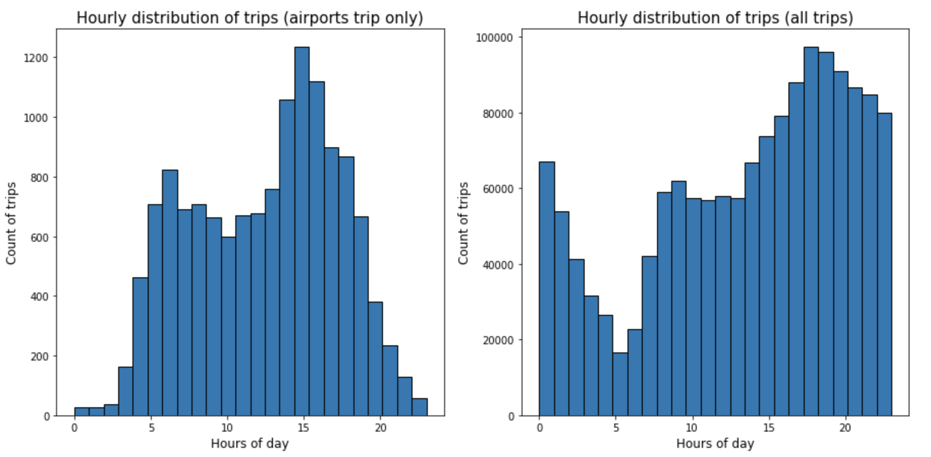
Airport Trips: Interesting Characteristics of Airport Trips
Characteristic 3: Different hour distribution compared to whole trips( more airport trips around 5am)
Airports trips number around 5am achieves a peak while the total trips number around 5am achieves nadir. These may explain why the average trip distance is relatively high around 5am, The proportion of long distance( airports trips) in 5am is higher than other hours.
Two distribution both achieve peak around 16-18pm. Although airport trips number achieve peak at 16pm, the non-airport trips number is much larger than it, which results in even shorter trip distance around 15-20pm.
The magnitudes of 2 kinds of trips population are different. So it's hard to see whether our hypothesis that the peak around 5am is the results of high proportion of airports trips. So we would look at the average trip distance with/without airports trips on hours of day to check our hypothesis.

Slide 17
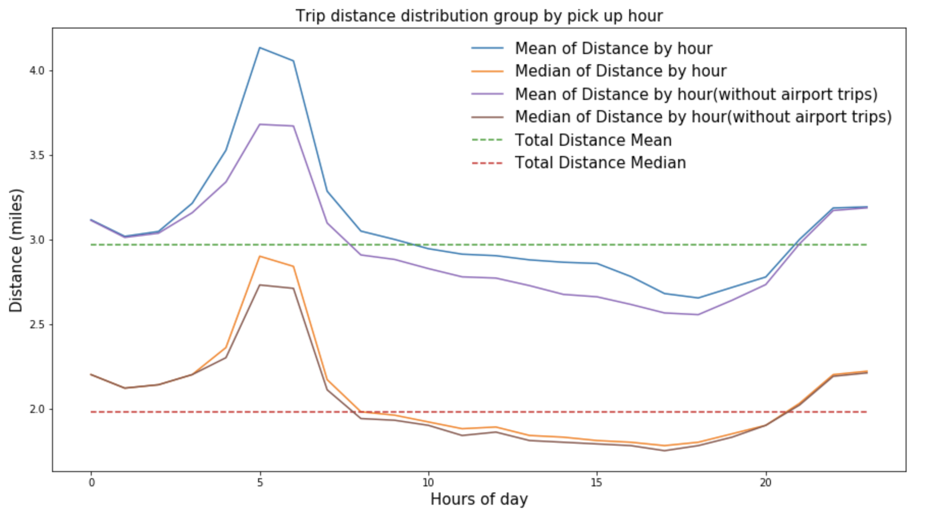
Airport Trips: Interesting Characteristics of Airport Trips
Characteristic 4: Airports trips contributes to average long distance peak around 5am
The largest difference between trip distances with/without airports trips happens at 5am. Though it doesn't fully explain the distance peak at 5am, we still verified our hypothesis that the high proportion of airports trips contributes to long distance at 5am to some extent.

Slide 18
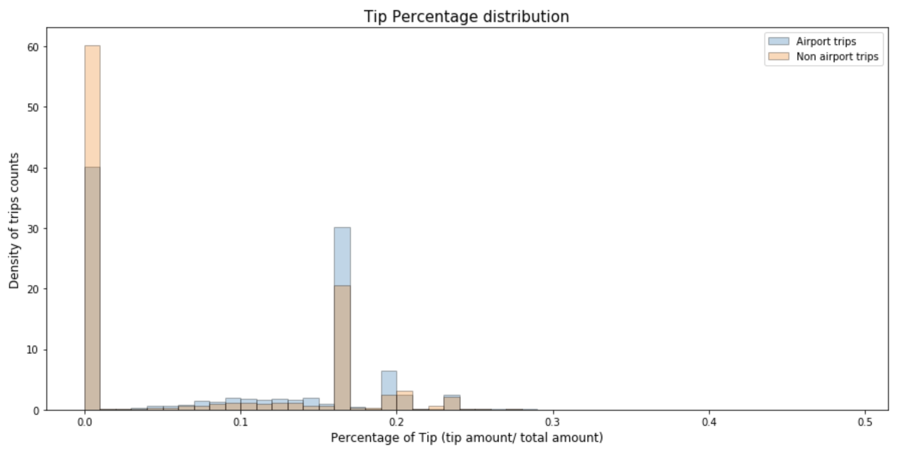
Airport Trips: Interesting Characteristics of Airport Trips
Characteristic 5: More tip percentage for airports trips
The majority percentage would be (0,0.5). So we look into the histogram of it. It seems there are less transactions with 0 tip in airport trips and more tips in airports trips. But it may also be the results of long distance other than airport trip. We can check the relation between tip proportion and trip distance to verify it, but we skip this part right now. We will discuss tips fully in next part.

Slide 19
Data Summary
Hourly Trip Distance Distribution and Airport Trips
Predictive Model on Tip Percentage
Trip Distance Exploration
Speed
Data Sampling
Data Cleaning
Feature Engineering and Selection
Model Construction and Evaluation

Slide 20
Predictive Model: Data Sampling
The initial data are 1494926 rows and 27 columns.
Missing labels on cash trips: Build our model without cash trips
Avoid leaking information: Drop columns Tip_amount and Total_amount
Sampling 10,0000 data for model efficiency
Split train and test dataset stratified by the day of month. Their size ratio are 7:3
Details can be found in Notebook: Q4_PredictiveModel

Slide 21
Predictive Model: Data Cleaning
Drop Missing feature Ehail_fee: The value in this feature is totally missing.
Missing Location data: 0.23% of location data is missing. We will assign a district code for missing location data in feature engineering part.
Categorical Data: remove 6 records whose RateCodeID are 99.
Numerical Data:
Fix 0.08% Extra according to Taxicab Rate of Fare
Replace negative values with their absolute values(0.15% in MTA_tax, Fare_amount, Improvement_surcharge, and several records in Tolls and Tip amount)
Drop records whose fare amount<2.5 (0.33%)
Re-compute Tip_percentage since there are some adjustments on numerical data.
Reference: Taxi data dictionary, Taxicab Rate of Fare explanation from government
Details can be found in Notebook: Q4_PredictiveModel

Slide 22
Predictive Model: Feature Engineering and Selection
Feature Engineering
Location Fetures: Pickup_x, Pickup_y, Dropoff_x, Dropoff_y, Pickup_district, Dropoff_district. - These features show pickup & dropoff location information
Time Features: Pickup_hour, Dropoff_hour, Pickup_weekday, Pickup_day, Workday. -These features indicate pickup/dropoff time information
Trip Duration: Trip_duration. - This features indicate how long a trip would take.
Airports Trip Indicator: Airport_trip - It indicates whether this trip dropoff or pickup near airports.
Speed Feature: Speed -It shows the speed of trips.
Categorical data onehot encoding: it’s not necessary for tree models. But in sklean, we still need to do this.
Scale: Since we are going to use tree models, we do not need to normalize each features.
Polynomial Feature
Reference: Taxi data dictionary, Taxicab Rate of Fare explanation from government
Details can be found in Notebook: Q4_PredictiveModel

Slide 23
Predictive Model: Feature Engineering and Selection
Feature Selection
Covariance: Find 8 pairs of highly correlated features
- Drop location features: 'Pickup_longitude', 'Pickup_latitude', 'Dropoff_longitude', 'Dropoff_latitude'
- Keep 'Trip_distance' , 'Fare_amount' , 'Pickup_hour', drop 'Dropoff_hour’, 'Pickup_x', 'Pickup_y', 'Dropoff_x', 'Dropoff_y’
Scatter Continuous feature Vs Tip percentage: Get some insights
Lasso Model: We would try if time permitted. We could train a basic model with L1 objective function. And then drop features those have low feature importance( particular 0).
Details can be found in Notebook: Q4_PredictiveModel

Slide 24
Predictive Model: Model Construction and Evaluation
Model Construction and Evaluation
The classification model to predict whether a trip would have tips or not.
Baseline Model: Default RandomForestClassifier ROC_AUC:0.894
Imbalanced data: Change class weight, so that it will put more weights on error for less common data
Tree Models: RandomForestClassifier
Key Parameters: n_estimators, max_features. In this part we just tune n_estimators. (the auc_ruc is high enough)
Evaluation: ROC_AUC 0.966
The regression model to predict tip percentage of a trip.
Baseline Model: RandomForestRegressor R^2: 0.616
Tree Models: RandomForestRegressor
Key Parameters: n_estimators, learning rate, max_features, max_depth. In this part, we just tune n_estimator
Evaluation: R^2 0.689
Feature Importance: Payment_type
We notice Payment_type makes a big difference in both model, so we explore deeper and find only 2 trips have tips in cash trips, which is impossible in reality. And according to description of 'Payment_type' in data dictionary, the total amount will not include tip if the passenger paid in cash. So we assume that it's high likely that it didn't record cash tips.
Details can be found in Notebook: Q4_PredictiveModel

Slide 25
Data Summary
Hourly Trip Distance Distribution and Airport Trips
Predictive Model on Tip Percentage
Trip Distance Exploration
Speed
Hypothesis test on average speed
Function of time of day

Slide 26
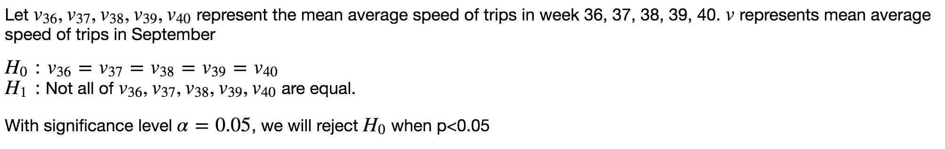
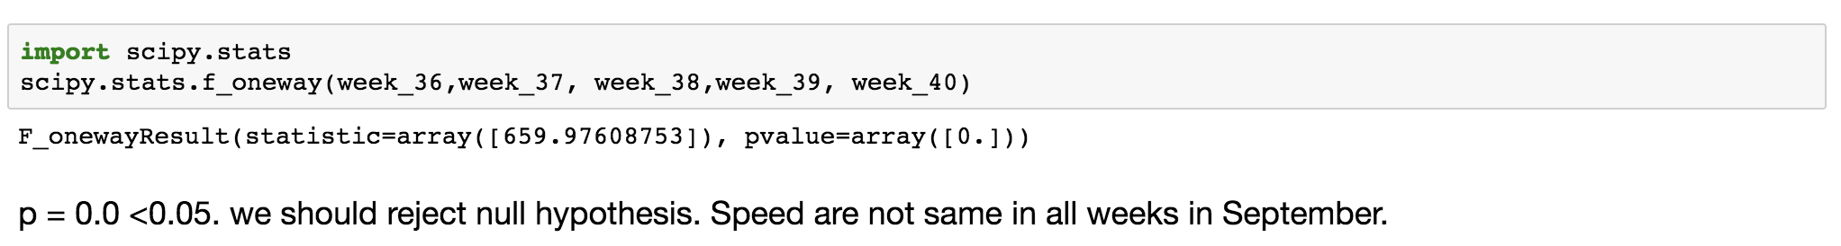
Speed: Hypothesis Test
Speed = Trip Distance / Trip Duration unit: miles/hour
Perform a test to determine if the average trip speeds are materially the same in all weeks of September
As we dive deeper, we find speed week 37 and 38 is relatively low and the number of transactions are relatively high. We assume there are more people attending to take taxi and more traffic jams. For instance, most students come back to school from other state may result in large amount of taxi get stuck when they enter Manhattan island. We could dive into trips that from airports to Manhattan to justify our hypothesis.

Slide 27
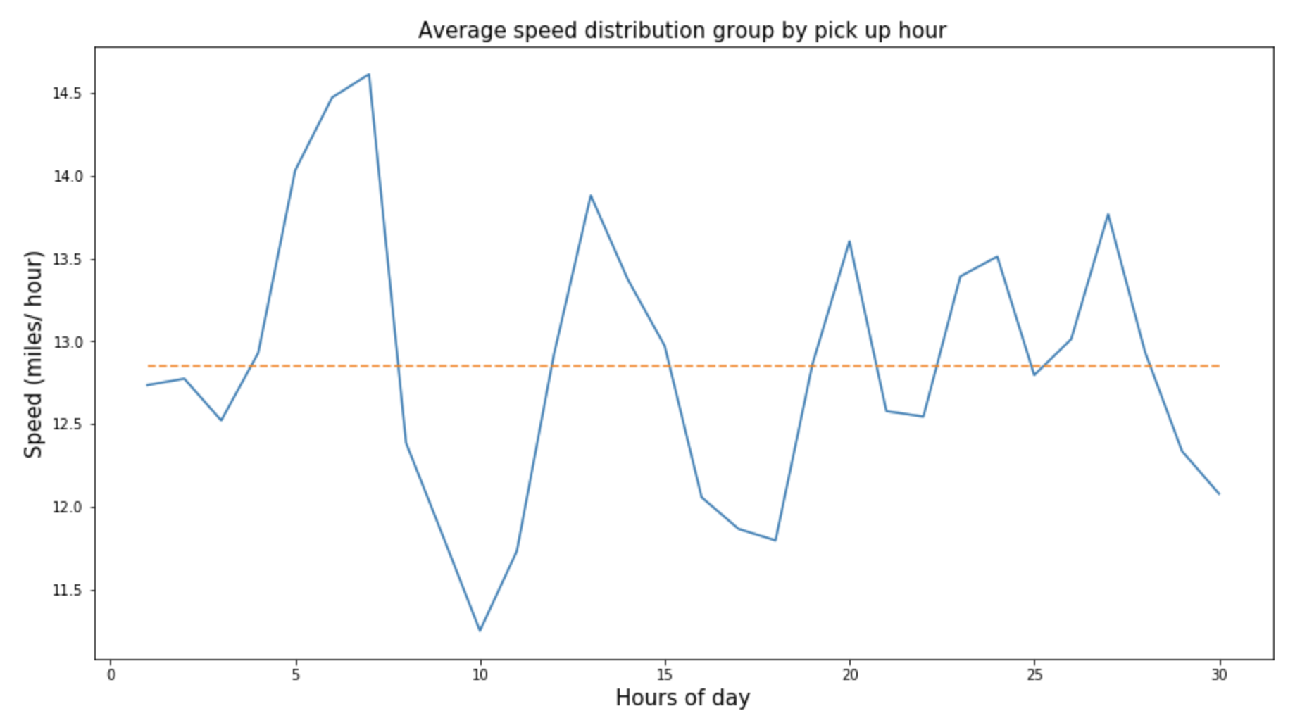
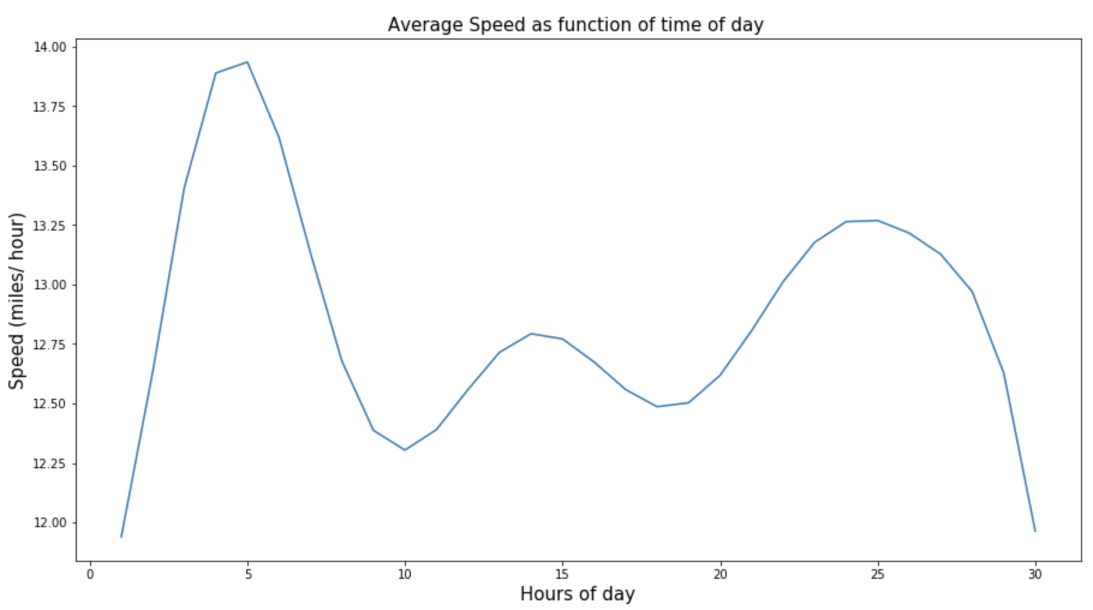
Speed: Function of the time of day
Speed = Trip Distance / Trip Duration unit: miles/hour
The function is 11-degree function and it’s coefficients are following:
[ 0.00000000e+00, 4.20145764e-02, 1.20816544e-01, 1.65685397e-01,
-8.64131425e-02, 1.69911068e-02, -1.80546053e-03, 1.15461999e-04,
-4.58476174e-06, 1.10888251e-07, -1.49849188e-09, 8.68473821e-12]

