Slide 1

图数据库的基本知识
by中亦大数据团队

Slide 2
tigergraph简介
GSQL基本语法
图数据库使用的最佳实践

Slide 3
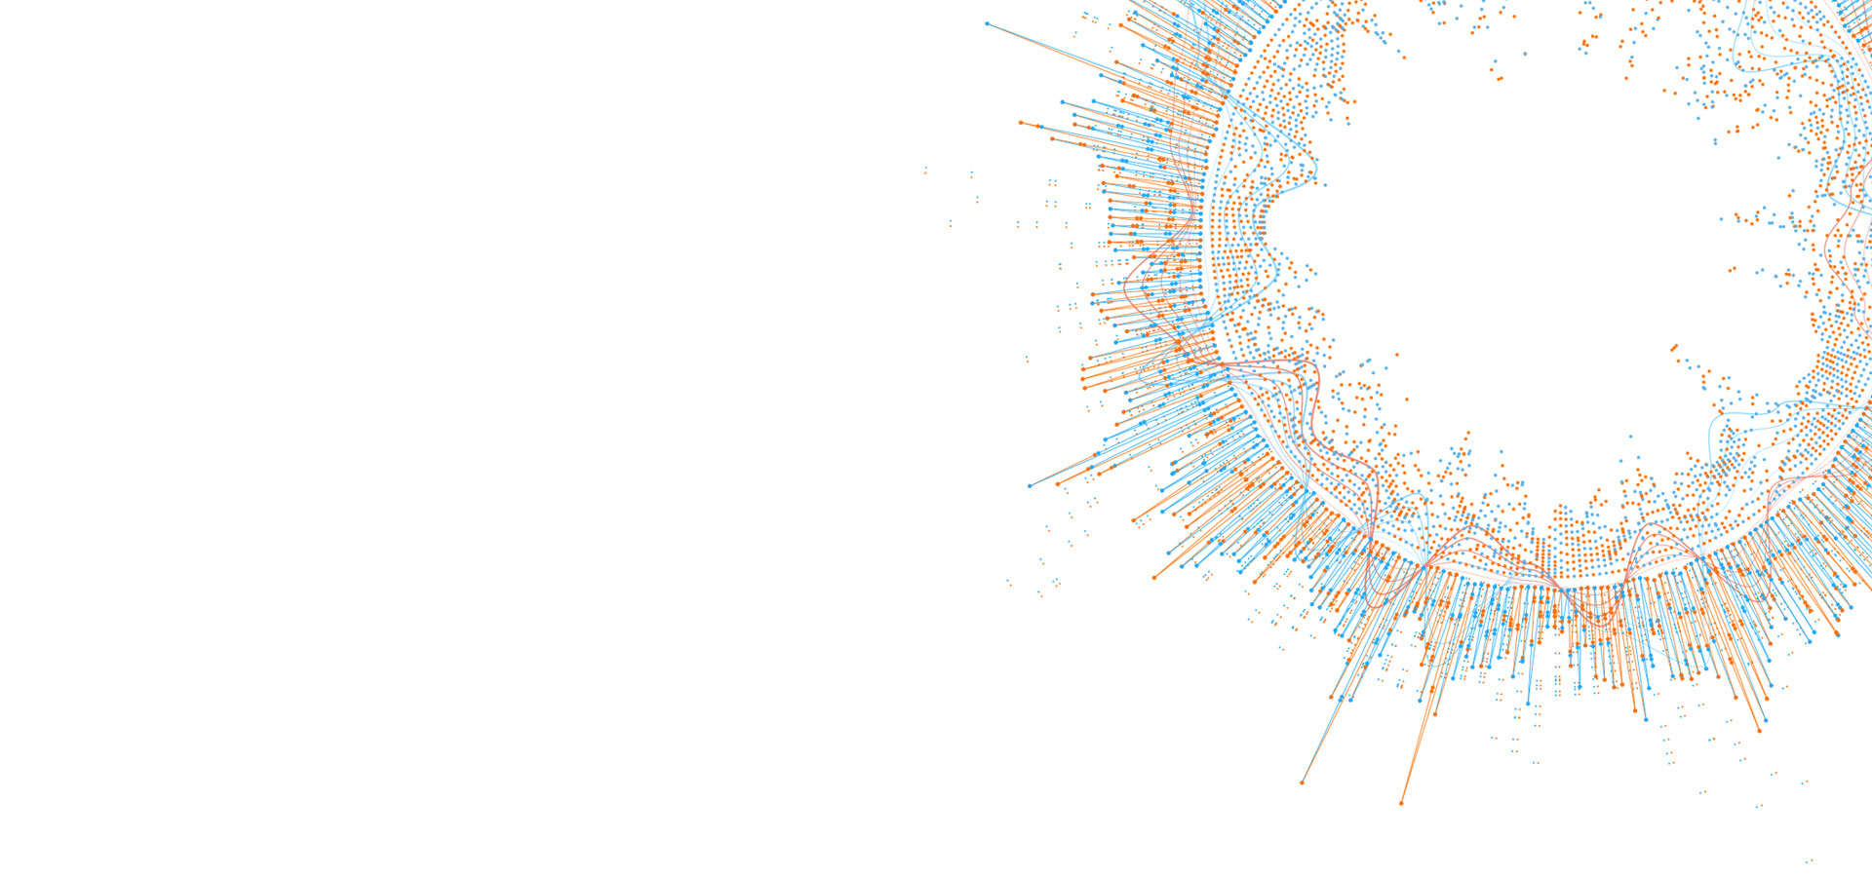

tigergraph简介
TigerGraph原创全球首个和唯一的原生并行图（Native Parallel Graph) 技术，提供目前业界最快的企业级的实时图数据库平台。

Slide 4



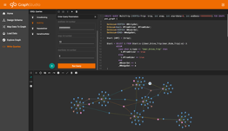
tigergraph特点
存储+计算具有数千亿个顶点/边，10倍数据压缩
实时图形更新
亚秒级查询性能
易于使用的高级SQL类SDK和基于Web浏览器的SDK

Slide 5
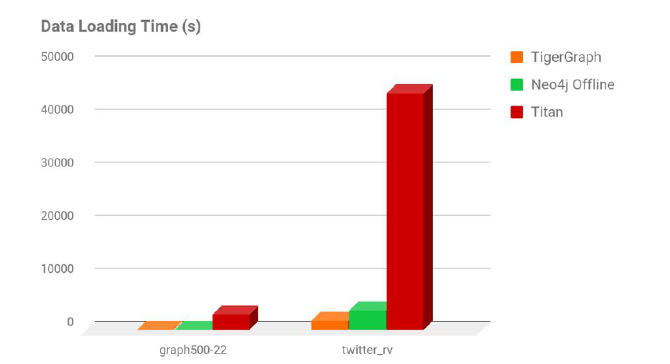
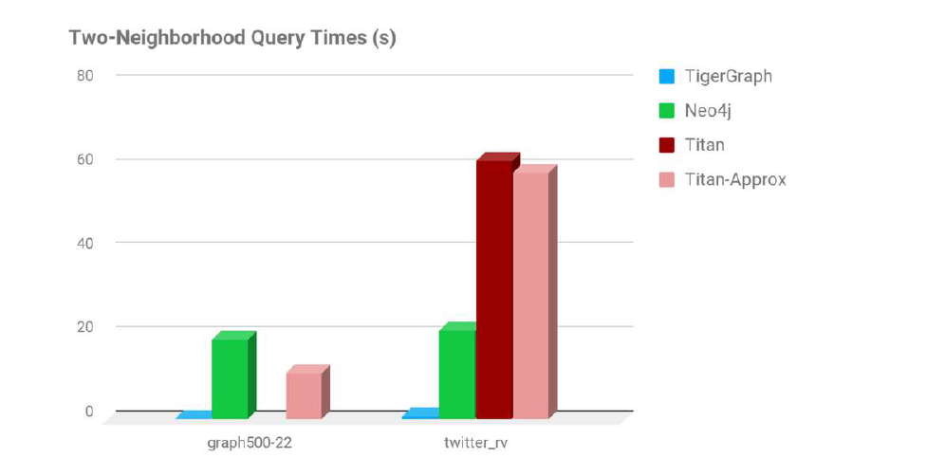
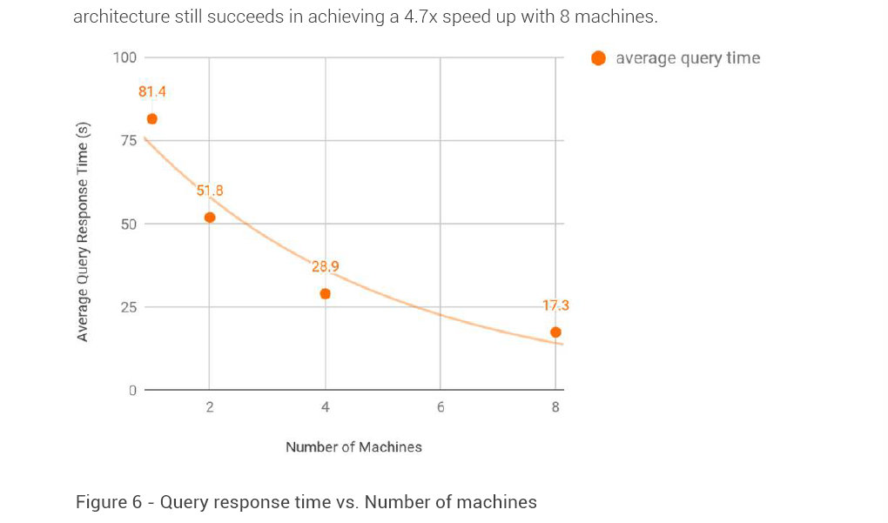
tigergraph性能
比Neo4j和Titan更快地加载，存储和查询数据。
使用单台机器时，TigerGraph的图形遍历和查询响应时间比Neo4j和Titan快4到100倍。
使用TigerGraph，查询速度几乎与机器数量呈线性增长。即使在PageRank上，需要大规模的节点到节点通信，TigerGraph仍然可以通过8x机器实现4.7倍的加速。
TigerGraph固有的并行性使其能够以比Neo4j快50倍的速度在线加载数据。即使使用一台机器，也比Titan快25倍。
TigerGraph的高压缩将存储空间减少到Neo4j和Titan的1/5左右。

Slide 6
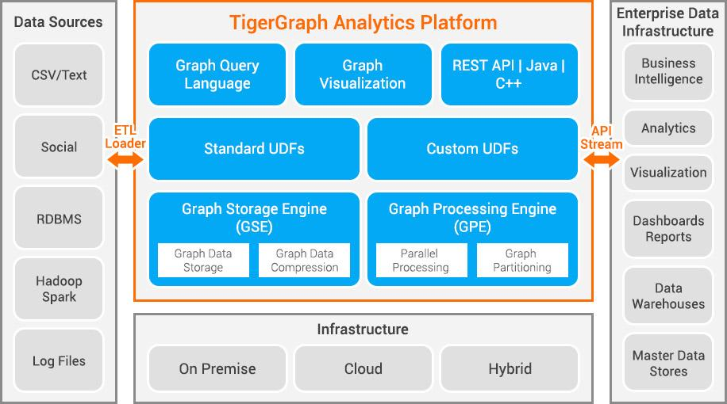
tigergraph架构

Slide 7
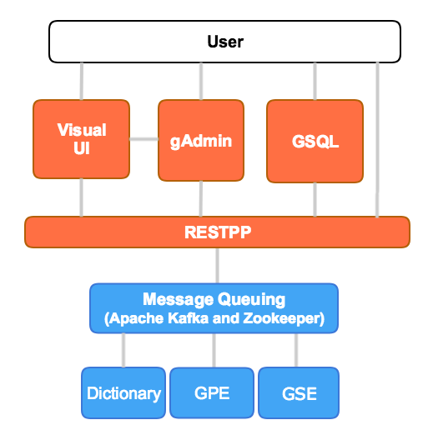
tigergraph组件
GSQL
  用于图形创建/处理操作的高级语言
  用于解释GSQL语言的组件
RESTPP – REST++ server
  接受并管理图形服务请求
GPE – Graph Processing Engine
  提供来自REST ++的图形操作请求
GSE – Graph Storage Engine
  图数据存储
  低级数据读/写API

Slide 8
用户接口
GSQL Shell
-------全部功能
RESTPP Server
--------运行已有任务
Graph Studio
--------浏览器中可视化操作

Slide 9
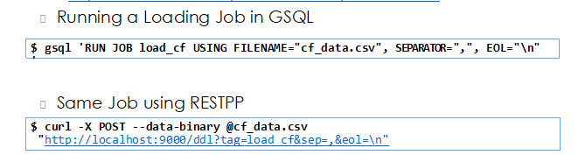
GSQL VS RESTPP
全部功能
高级语言
最适合应用程序开发或交互式使用
内置端点（API）
无法创建schema，loading，query
Curl + HTTP URL
比GSQL更低的延迟，因此最适合生产系统

Slide 10
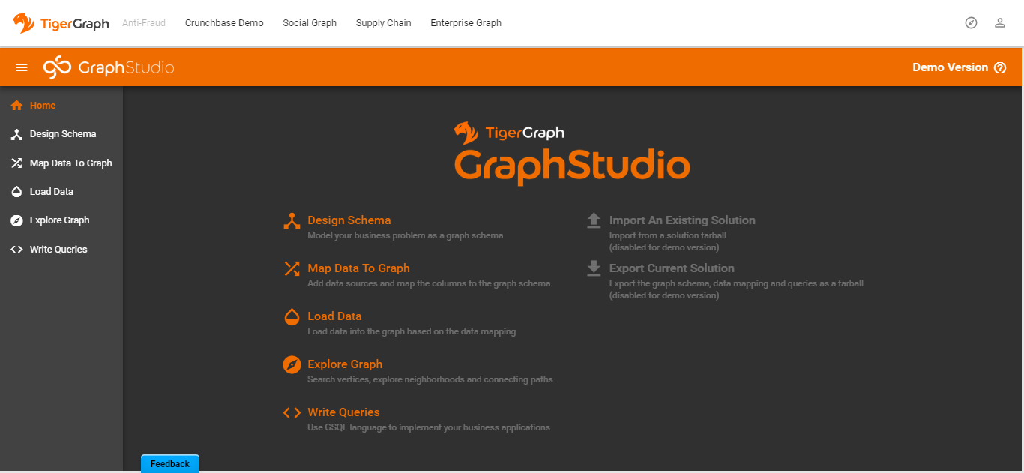
graph studio
(Google Chrome)
http://<tigergraph_server_ip>:14240

Slide 11
tigergraph工作流程
定义/创建一个 Graph Schema
Load 初始数据
创建查询
运行查询

Slide 12
tigergraph管理
  gAdmin –用于配置TigerGraph平台安装的综合实用程序
  gBAR – 备份和还原实用程序
  $ gadmin status
  $ gadmin start
  $ gadmin stop restpp
  $ gadmin set-license-key <new_key>
  $ gadmin config-apply
  $ gadmin –h
  $ man gadmin

Slide 13
tigergraph简介
GSQL基本语法
图数据库使用的最佳实践

Slide 14
创建schema
CREATE VERTEX vType (PRIMARY_ID id type, attr1 type,... attrN type)
CREATE VERTEX User (PRIMARY_ID Id string,
signupEpoch UINT, mobile STRING, trust_score float)

Slide 15
创建schema
Category | Attribute Type
Numeric | INT, UINT, FLOAT, DOUBLE
Boolean | BOOL
Text | STRING, STRING COMPRESS
Time | DATETIME
Collection | SET<t>, LIST<t>, MAP<k,v>

Slide 16
创建schema
CREATE UNDIRECTED EDGE eType(FROM vTyp1, TO vTyp2,
attr1 type,… attrN type)
CREATE DIRECTED EDGE eType(FROM vTyp1, TO vTyp2,
attr1 type,… attrN type)
[WITH REVERSE_EDGE="revType"]
CREATE UNDIRECTED EDGE User_to_Payment (FROM User, TO Payment_Instrument)
CREATE DIRECTED EDGE User_Recieve_Transaction (FROM User, TO Transaction) WITH REVERSE_EDGE="User_Recieve_Transaction_Rev"

Slide 17
创建schema
CREATE GRAPH gType(vTyp1,…, vTypN, eTyp1,…, eTypM)
CREATE GRAPH gType(*)
DROP GRAPH gType

Slide 18
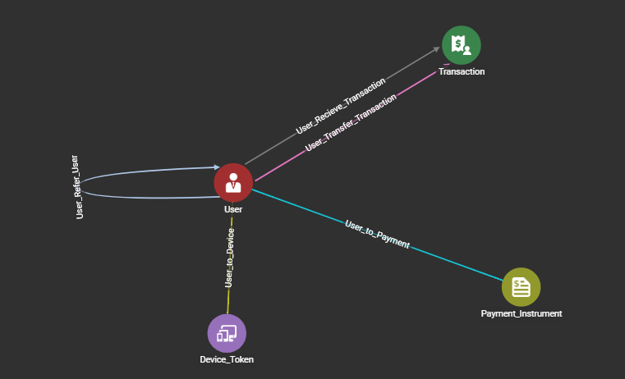
反欺诈模型
四个点：
人、
设备、
交易、
信用卡
五条边：
推荐关系
设备使用关系
信用卡使用关系
转账转出转入关系

Slide 19
创建反欺诈模型
drop all
CREATE VERTEX User (PRIMARY_ID Id string, signupEpoch UINT, mobile STRING, trust_score float)
CREATE VERTEX Device_Token (PRIMARY_ID Id STRING, is_banned bool, os_name string compress,os_version string compress)
CREATE VERTEX Payment_Instrument (PRIMARY_ID id STRING, token_handle STRING, token_type string compress,card_issuing_country_iso2 string compress)
CREATE VERTEX Transaction (PRIMARY_ID Id string, ts uint,amount float)
CREATE UNDIRECTED EDGE User_to_Device (FROM User, TO Device_Token)
CREATE UNDIRECTED EDGE User_to_Payment (FROM User, TO Payment_Instrument)
CREATE DIRECTED EDGE User_Recieve_Transaction (FROM User, TO Transaction) WITH REVERSE_EDGE="User_Recieve_Transaction_Rev"
CREATE DIRECTED EDGE User_Transfer_Transaction (FROM User, TO Transaction) WITH REVERSE_EDGE="User_Transfer_Transaction_Rev"
CREATE DIRECTED EDGE User_Refer_User (FROM User, TO User) WITH REVERSE_EDGE="User_Referred_By_User"
CREATE GRAPH MYTEST (*)

Slide 20
导入数据（loading data）
CREATE VERTEX Book (PRIMARY_ID bookCode STRING, title STRING, pubYear UINT)
978-0-8041-3902-1,"The Martian",2011
978-7-5366-9293-0,"The Three-Body Problem",2008
7207376,"The Lion, The Witch, and the Wardrobe",1950
CREATE LOADING JOB loadBooks FOR GRAPH Book_rating {
LOAD TO VERTEX Book VALUES ($0, $1, $2) USING QUOTE="double";
}
Book(978-0-8041-3902-1,"The Martian",2011)

Slide 21
查询步骤
创建查询
create query
安装查询
install query
运行查询
run query

Slide 22
select 语法
resultSet = SELECT vSet
FROM startSet:s –(edgeTypes:e)-> targetTypes:t
[sampleClause]
[whereClause]
[accumClause]
[postAccumClause]
[havingClause]
[orderClause]
[limitClause]
; # vSet is either startSet s or targetSet t

Slide 23
seed （起点）
SO = seed;
S1 = SELECT t FROM S0:s –(:e)-> :t …;
S2 = SELECT t FROM S1:s –(:e)-> :t …;
# vertex or vertex set parameter
CREATE QUERY seedEx(VERTEX<person> seed, SET<VERTEX<person> seedSet) FOR GRAPH socialNet {
S1 = {seed}; # curly braces package the vertex into a set
S2 = seedSet;
S3 = ANY; # all vertices, for global computations like PageRank
S4 = person.*; # all person vertices

Slide 24
from
可以从顶点集或者边集选择
FROM startSet:s
可以从定义的模板选择
FROM startSet:s –(edgeTypes:e)-> targetTypes:t

Slide 25
Accumulators（累加器）
声明
@@ prefix: global accumulator, accessible throughout the query
  @@globalMax += newVal;
  @ prefix: vertex-attached. Each vertex has its own independent accumulator:
    v2.@tags += "happy"; # add "happy" to v2's string set
MaxAccum<INT> @@globalMax; # global variable, initialized to 0
SetAccum<STRING> @tags; # each vertex given an empty set of strings

Slide 26
Accumulators（累加器）种类
Scalar Accumulators
  SumAccum
  MinAccum / MaxAccum / AvgAccum
  AndAccum / OrAccum
  BitwiseAndAccum / BitwiseOrAccum
Container Accumulators
  ListAccum
  SetAccum
  BagAccum
  MapAccum
  ArrayAccum
  HeapAccum
  GroupByAccum

Slide 27
Accumulators（累加器）
AvgAccum @@avgIncome;
MinAccum<DOUBLE> @@minIncome;
MaxAccum<DOUBLE> @@maxIncome;
Result = SELECT cust
FROM Customer:cust
WHERE cust.age BETWEEN 18 AND 50
ACCUM @@avgIncome += cust.income,
@@minIncome += cust.income,
@@maxIncome += cust.income ;

Slide 28
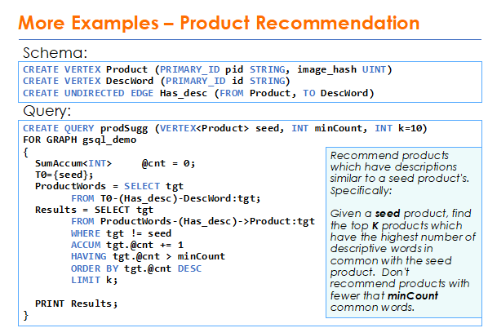
案例（商品推荐）

Slide 29
Accumulators（累加器）
postAccum
1、面向点集
2、在accum之后计算

Slide 30
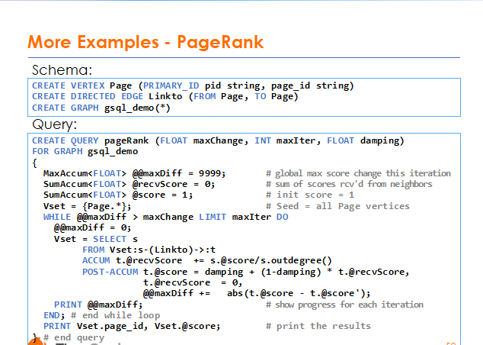

Slide 31
Print
    PRINT vSet1, vSet2; # OK
    PRINT vSet1, @@accum2; #not OK
{ "v_set":
"v_id":
"v":
{"attr1": value1, ..., "attrN": valueN}
}
{ "from_type":
"to_type":
"directed":
"from_id":
"to_id":
"e_type":
"attributes":
{"attr1": value1, ..., "attrN": valueN}
}

Slide 32
流程控制语句
IF condition THEN statements
[ELSE IF condition THEN statements]*
[ELSE statements] END
CREATE QUERY countGenderOfFriends(VERTEX<person> seed) FOR GRAPH socialNet {
SumAccum<INT> @@males, @@females, @@unknown;
startingVertex = {seed};
people = SELECT v FROM startingVertex -(friend:e)->:v
ACCUM CASE v.gender
WHEN "Male" THEN @@males += 1
WHEN "Female" THEN @@females +=1
ELSE @@unknown += 1
END;
PRINT @@males, @@females, @@unknown;
}

Slide 33
流程控制语句
WHILE condition [LIMIT (name|integer)] DO statements END
FOREACH loopVar IN setExpr DO statements END
FOREACH loopVar IN RANGE "["lowExpr,hiExpr"]" DO statements END
FOREACH loopVar IN RANGE "["lowExpr,hiExpr"]".STEP"("stepExpr")" DO statements END
FOREACH item IN @@companyList DO
IF item in selectedCountry THEN count = count + 1; END;
END;
FOREACH item IN RANGE[a,b].STEP(c) DO
@@total += @@masterList[item];
END;

Slide 34
集合操作
VSet1 = SELECT …
[1,2,3]
VSet2 = SELECT …
[3,4,5]
Vset3 = VSet1 UNION VSet2;
[1,2,3,4,5]
VSet4 = Vset1 INTERSECT VSet2;
[3]
VSet5 = VSet1 MINUS VSet2;
[1,2]

Slide 35
查询调用查询
CREATE QUERY sub (VERTEX v) FOR GRAPH MyGraph RETURNS (SumAccum<INT>) {
SumAccum<INT> @@result, @cnt = 1;
Start = {v};
Start = select t from Start-(:e)-:t;
Start = select t from Start-(:e)-:t where t!=v accum @@result += t.@cnt;
return @@result;
}
CREATE QUERY main () FOR GRAPH MyGraph{
SumAccum<INT> @cnt;
Start = {*.*};
Start = select s from Start:s post-accum s.@cnt = sub(s);
print Start;
}

Slide 36
tigergraph简介
GSQL基本语法
图数据库使用的最佳实践

Slide 37
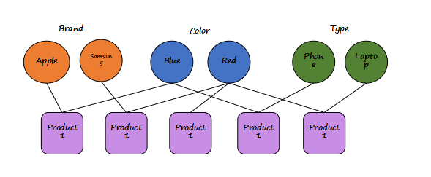
设计模型的最佳实践
将经常查询的属性作为点

Slide 38
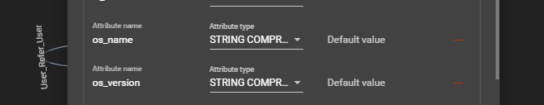
设计模型的最佳实践
将字符串的值为有限数量时，类型设为string compress
如国籍，状态，性别，操作系统等

Slide 39
查询设计最佳实践
合理选择起点
Use Start = {TYPEA.*}; and Start = {*.*};

Slide 40
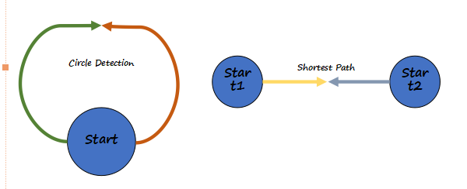
查询设计最佳实践
选择合理的查询模型
双向启动遍历

