Slide 1

图数据库的基本知识
by中亦大数据团队

Slide 2
图基本知识
图数据库简单介绍
图数据库的使用

Slide 3


目录
01
PART 01

Slide 4
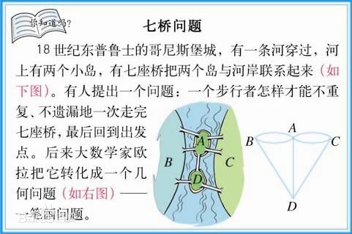
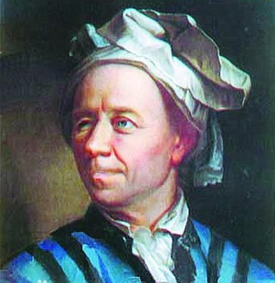
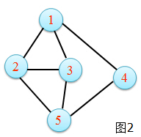
1.1 图的概念
图的定义：由若干个不同顶点与连接其中某些顶点的边所组成的图形就称为图。通常用大写字母G表示图，V表示所有顶点的集合，E表示边的集合，记作G = (V, E) 。

Slide 5
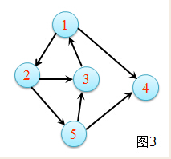
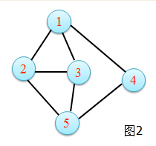
1.2 有(无)向图
有向图
无向图
有向边
无向边
微博关注
支付宝转账
微信好友关系
同学关系

Slide 6
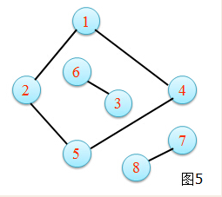
1.3 连通图、环图
连通图
有环图（有回路）
非连通图
无环图（树图）

Slide 7
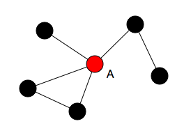
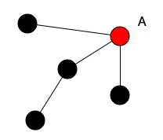
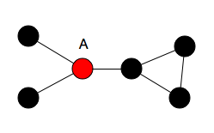
1.4 图的基本属性
出度/入度 (degree)
紧密度(closeness)
中介性(betweenness)
B(A) = 7 / 10
除了A点之外的所有最短路径中，有多少条经过A点
地铁车站网络中，市中心的站点往往拥有较大的的 betweenness
degree(A) = 4
与A直接相连的节点数
社交网络中的 KOL 往往拥有很大的 degree
C(A) = 1 / (1 + 1 + 1 + 2) = 1/5
A到剩余其他节点的距离之和的倒数公司组织架构图中，级别越高的节点，closeness越大(控制力越强)

Slide 8

目录
02
PART 02

Slide 9
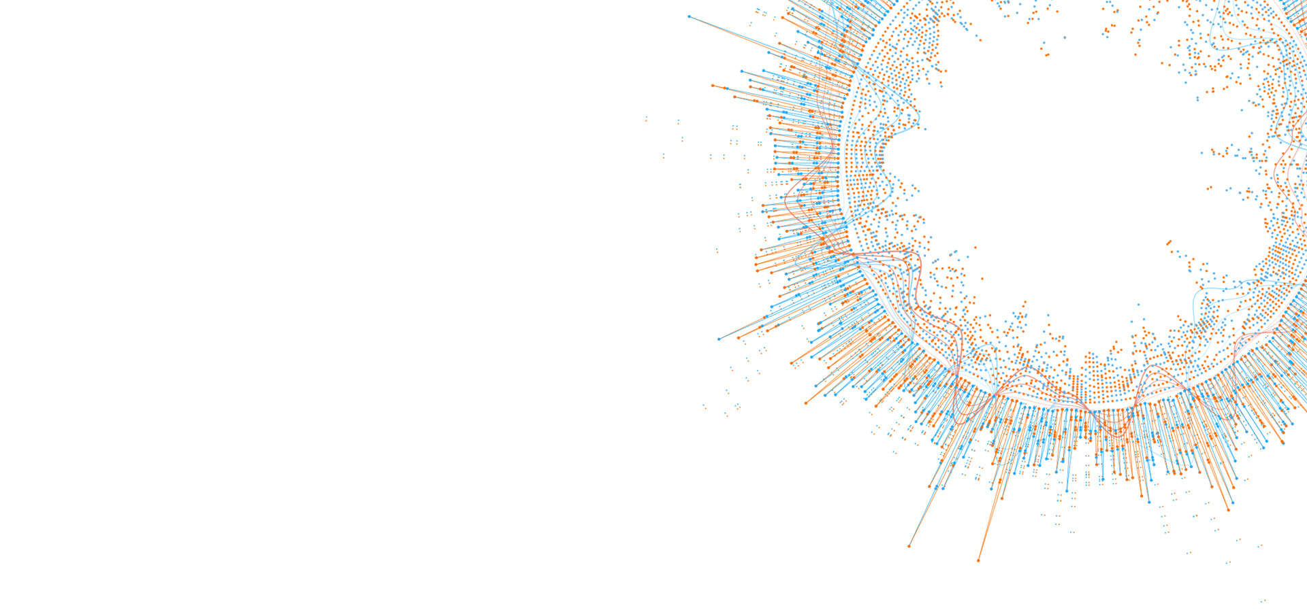

2.1 tigergraph简介
TigerGraph原创全球首个原生并行图技术，
提供目前业界最快的企业级的实时图数据库平台。

Slide 10



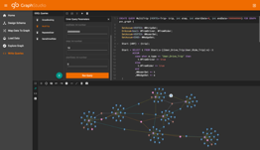
2.2 tigergraph特点
存储+计算具有数千亿个顶点/边，10倍数据压缩
实时图形更新
亚秒级查询性能
易于使用的高级SQL类SDK和基于Web浏览器的SDK

Slide 11
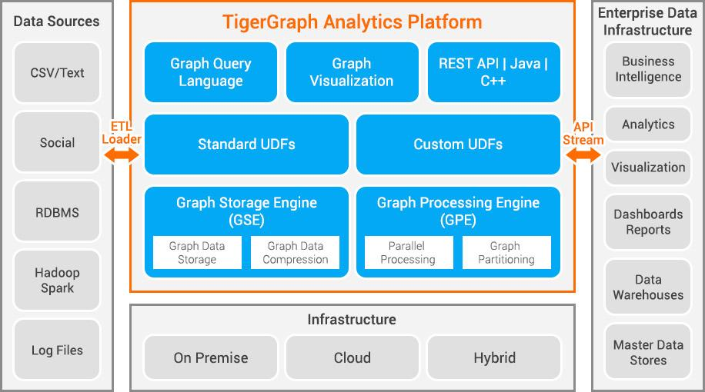
2.4 tigergraph平台

Slide 12
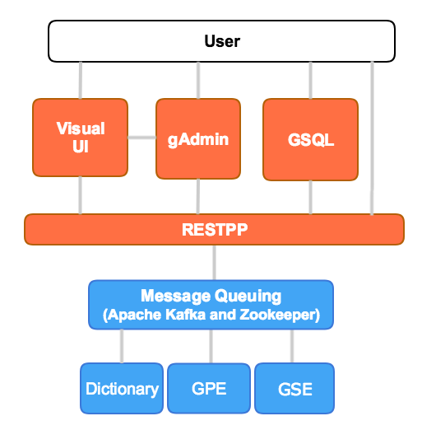
2.5 tigergraph架构
GSQL
  用于图形创建/处理操作的高级语言
  用于解释GSQL语言的组件
RESTPP – REST++ server
  接受并管理图形服务请求
GPE – Graph Processing Engine
  提供来自REST ++的图形操作请求
GSE – Graph Storage Engine
  图数据存储
  低级数据读/写API

Slide 13
2.6 tigergraph 安装演示
开发者版
  单机单图单用户
  免费
企业版
  集群多图多用户
  licence
demo
  https://testdrive.tigergraph.com/main/dashboard

Slide 14
2.7 用户接口
GSQL Shell
-------全部功能
RESTPP Server
--------运行已有任务
Graph Studio
--------浏览器中可视化操作

Slide 15

2.8 graphstudio

Slide 16
2.9 tigergraph工作流程
定义/创建一个 Graph Schema
Load 少量数据
创建查询
运行查询
导入更多数据

Slide 17
2.10 tigergraph管理
  gAdmin –用于配置TigerGraph平台安装的综合实用程序
    $ gadmin status
    $ gadmin start/stop restpp
    $ gadmin set-license-key <new_key>
    $gadmin --configure $ gadmin config-apply
    $ gadmin –h $ man gadmin
  gBAR – 备份和还原
    gbar config
    gbar list
    gbar backup/restore

Slide 18

目录
03
PART 03

Slide 19
GSQL VS RESTPP
内置端点（API）
无法创建schema，loading，query
Curl + HTTP URL
比GSQL更低的延迟，因此最适合生产系统
全部功能
高级语言
最适合应用程序开发或交互式使用

Slide 20
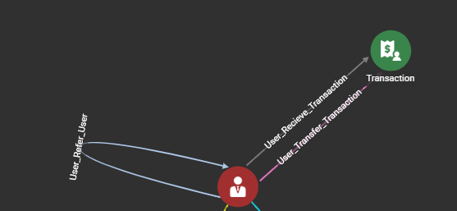
3.1 图数据模型
强调关系/关系 - 非常适合社交/交易/网络分析
点（vertex） – 现实世界或抽象实体的模型
边 （edge）– 两个顶点之间的关系
图（Schema ）– 定义完整“世界”的相关顶点和边缘的集合

Slide 21
3.2 创建schema
CREATE VERTEX vType (PRIMARY_ID id type, attr1 type,... attrN type)
CREATE VERTEX User (PRIMARY_ID Id string,
signupEpoch UINT, mobile STRING, trust_score float)
CREATE VERTEX Transaction(PRIMARY_ID Id string,
ts UINT, amount float)

Slide 22
3.2 创建schema
数据类型 | 属性类型
Numeric | INT, UINT, FLOAT, DOUBLE
Boolean | BOOL
Text | STRING, STRING COMPRESS
Time | DATETIME
Collection | SET<t>, LIST<t>, MAP<k,v>
1、PRIMARY_ID 可以是 UINT 或者 STRING，但是要唯一
2、属性有标准默认值，定制默认值：attrX type DEFAULT=val

Slide 23
3.2 创建schema
CREATE UNDIRECTED EDGE eType(FROM vTyp1, TO vTyp2,
attr1 type,… attrN type)
CREATE DIRECTED EDGE eType(FROM vTyp1, TO vTyp2,
attr1 type,… attrN type)
[WITH REVERSE_EDGE="revType"]
CREATE DIRECTED EDGE User_Recieve_Transaction (FROM User, TO Transaction) WITH REVERSE_EDGE="User_Recieve_Transaction_Rev"

Slide 24
3.2 创建schema
CREATE GRAPH gType(vTyp1,…, vTypN, eTyp1,…, eTypM)
CREATE GRAPH gType(*)
DROP GRAPH gType

Slide 25
3.2 修改schema
create schema_change job jobname for graph graph_name {
add/drop edge...;
...
}
run job jobname

Slide 26
3.2 修改schema
create global schema_change job jobname{
alter edge xx drop attribute xx;
add vertext xx to graph xx;
drop edge xx from graph xx;
}

Slide 27
3.2 创建反薅羊毛模型
drop all
CREATE VERTEX User (PRIMARY_ID Id string, signupEpoch UINT, mobile STRING, trust_score float)
CREATE VERTEX Transaction (PRIMARY_ID Id string, ts uint,amount float)
CREATE DIRECTED EDGE User_Recieve_Transaction (FROM User, TO Transaction) WITH REVERSE_EDGE="User_Recieve_Transaction_Rev"
CREATE DIRECTED EDGE User_Transfer_Transaction (FROM User, TO Transaction) WITH REVERSE_EDGE="User_Transfer_Transaction_Rev"
CREATE DIRECTED EDGE User_Refer_User (FROM User, TO User) WITH REVERSE_EDGE="User_Referred_By_User"
CREATE GRAPH MYTEST (*)

Slide 28
3.2 反薅羊毛模型
两个点：
人、（id，手机号码，登录时间，信用评分）
交易（id，交易时间，交易金额）
三条边：
用户推荐关系
发起交易关系
接受交易关系

Slide 29
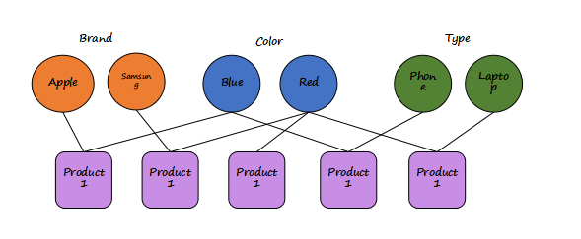
3.3 设计模型的最佳实践
将经常查询的属性作为点

Slide 30

3.3 设计模型的最佳实践
将字符串的值为有限数量时，类型设为string compress
如国籍，状态，性别，操作系统等

Slide 31
3.3 schema小练习
#-------------------- define vertices --------------------
CREATE VERTEX imsi (PRIMARY_ID imsi_id string, flag uint)
CREATE VERTEX imei (PRIMARY_ID imei_id string, flag uint)
CREATE VERTEX phone (PRIMARY_ID phone_id string, flag uint, regist_imsi uint,
initial_active_time uint, fraud_flag uint, adversary uint,
num_of_short_call uint, external_fraud_flag uint)
CREATE VERTEX call_event (PRIMARY_ID event_id string, src_id string, tgt_id string,
start_time uint, total_duration uint, src_region uint, tgt_region uint, flag uint)
CREATE VERTEX text_event (PRIMARY_ID event_id string, src_id string, tgt_id string,
start_time uint, flag uint)

Slide 32
3.3 schema小练习
#-------------------- define edges --------------------
CREATE DIRECTED EDGE phone_phone (from phone, to phone, num_of_call uint,
total_duration uint, num_of_rejection_type1 uint, num_of_rejection_type3 uint,
num_of_text_message uint,start_time uint, max_duration uint)
with reverse_edge = "phone_phone_reversed"
CREATE UNDIRECTED EDGE calling_edge (from phone, to call_event)
CREATE UNDIRECTED EDGE receiving_edge (from phone, to call_event)
CREATE UNDIRECTED EDGE sending_text_edge (from phone, to text_event)
CREATE UNDIRECTED EDGE receiving_text_edge (from phone, to text_event)
CREATE UNDIRECTED EDGE imsi_phone (from imsi, to phone, start_time uint)
CREATE UNDIRECTED EDGE imei_phone (from imei, to phone, start_time uint)
#-------------------- creat graph --------------------
create graph sdmGraph(*)

Slide 33
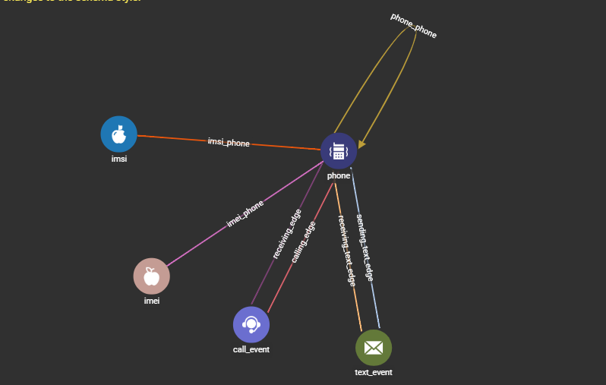
3.3 schema小练习效果

Slide 34
3.4 导入数据（loading）
定义loading逻辑
从csv读取数据，
指定分隔符
用户自定义tokenfunction

Slide 35
3.4 导入数据（loading）
定义loading逻辑
CREATE loading JOB jobName FOR GRAPH graphName {
DEFINE filename f;
load f
TO VERTEX vType VALUES (idExpr, attr1Expr,…) [WHERE condition],
TO EDGE eType VALUES (fromExpr, toExpr, attr1Expr,…) [WHERE condition]}
开启loading任务
RUN JOB jobName using f=””

Slide 36
3.3 导入数据（loading）
CREATE VERTEX v_set (PRIMARY_ID id STRING, nicknames SET<STRING>)
#导入到元组
#Thomas,Tom,Tommy,
LOAD TO VERTEX v_set VALUES ($0, SET($1,$2);
#分割导入元组
#Thomas,Tom|Tommy
LOAD TO VERTEX v_set VALUES ($0, SPLIT($1, "|");
#导入元组去重
#Thomas,Tom
#Thomas,Tommy
#Thomas,Tom
LOAD TO VERTEX v_set VALUES ($0, $1);

Slide 37
3.3 导入数据（loading）
# 跳过加载
# User (PRIMARY_ID userId UINT, age UINT, gender STRING, postalCode STRING)
# Update the postalCode of a User
LOAD TO VERTEX User VALUES ($0, _, _, $1)

Slide 38
3.3 导入数据（loading）
CREATE LOADING JOB load_reject FOR GRAPH sdmGraph {
DEFINE FILENAME fn;
LOAD fn
TO VERTEX phone VALUES (removeAllPrefix($8), _, _,
REDUCE(ignore_if_exists(gsql_to_uint(initialEpochSec($1, "r")))), _, _, DailyFrequency(0,0,0,0), _, _, _),
TO EDGE phone_phone VALUES (removeAllPrefix($8), removeAllPrefix($9), _, _, REDUCE(add(1)), _, _, RealTimeProperty(0, 0),
REDUCE(ignore_if_exists(gsql_to_uint(initialEpochSec($1, "r")))), _) WHERE $0 == "1",
}
RUN JOB load_reject using fn=”/tmp/file”

Slide 39
3.4 查询步骤
创建查询 create query
安装查询 install query
运行查询 run query
CREATE QUERY topCoLiked (VERTEX<User> inputUser, INT topK) FOR GRAPH gsql_demo
{
SumAccum<INT> @cnt = 0;
L0 = {inputUser};
L1 = SELECT tgt
FROM L0 -(Liked_By)-> User:tgt;
L2 = SELECT tgt
FROM L1 -(Liked)-> :tgt
WHERE tgt != inputUser
ACCUM tgt.@cnt += 1
ORDER BY tgt.@cnt DESC
LIMIT topk;
PRINT L2;
}
install query topCoLiked ;

Slide 40
select 语法
3.5 查询语法
resultSet = SELECT vSet
FROM startSet:s –(edgeTypes:e)-> targetTypes:t
[sampleClause]
[whereClause]
[accumClause]
[postAccumClause]
[havingClause]
[orderClause]
[limitClause]
;

Slide 41
seed （起点）
3.5 查询语法
SO = seed;
S1 = SELECT t FROM S0:s –(:e)-> :t …;
S2 = SELECT t FROM S1:s –(:e)-> :t …;
# vertex or vertex set parameter
CREATE QUERY seedEx(VERTEX<person> seed, SET<VERTEX<person> seedSet) FOR GRAPH socialNet {
S1 = {seed}; # curly braces package the vertex into a set
S2 = seedSet;
S3 = ANY; # all vertices, for global computations like PageRank
S4 = person.*; # all person vertices

Slide 42
from 目标结果
3.5 查询语法
可以从顶点集或者边集选择
FROM startSet:s
可以从定义的模板选择
FROM startSet:s –(edgeTypes:e)-> targetTypes:t

Slide 43
Accumulators（累加器）
3.5 查询语法
声明
@@ prefix:全局变量
@ prefix: vertex-attached. 局部变量
MaxAccum<INT> @@globalMax; # global variable, initialized to 0
SetAccum<STRING> @tags; # each vertex given an empty set of strings

Slide 44
Accumulators（累加器）种类
3.5 查询语法
Scalar Accumulators（标量累加器）
  SumAccum
  MinAccum / MaxAccum / AvgAccum
  AndAccum / OrAccum
  BitwiseAndAccum / BitwiseOrAccum
Container Accumulators（全局累加器）
  ListAccum
  SetAccum
  BagAccum
  MapAccum
  ArrayAccum
  HeapAccum
  GroupByAccum

Slide 45
ACCUM （面向边计算）
3.5 查询语法
AvgAccum @@avgIncome;
MinAccum<DOUBLE> @@minIncome;
MaxAccum<DOUBLE> @@maxIncome;
Result = SELECT cust
FROM Customer:cust
WHERE cust.age BETWEEN 18 AND 50
ACCUM @@avgIncome += cust.income,
@@minIncome += cust.income,
@@maxIncome += cust.income ;

Slide 46
postAccum（面向点集计算）
3.5 查询语法
postAccum
1、面向点集
2、在accum之后计算
users = SELECT t
FROM users:s-(User_Refer_User:e)-:t
WHERE t != inputUser
ACCUM @@visRes += e
POST-ACCUM @@invitedPersonNum += 1;

Slide 47
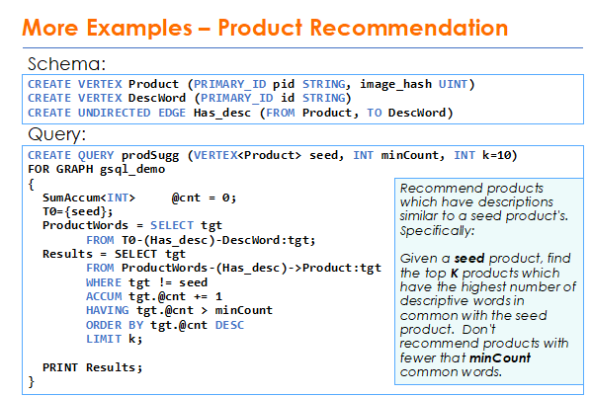
3.6 案例（商品推荐）

Slide 48
3.6 案例（PageRank）
CREATE QUERY pageRank (FLOAT maxChange, INT maxIter, FLOAT damping)
FOR GRAPH gsql_demo
{
MaxAccum<FLOAT> @@maxDiff = 9999;
SumAccum<FLOAT> @recvScore = 0;
SumAccum<FLOAT> @score = 1;
Vset = {Page.*};
WHILE @@maxDiff > maxChange LIMIT maxIter DO
@@maxDiff = 0;
Vset = SELECT s
FROM Vset:s-(Linkto)->:t
ACCUM t.@recvScore += s.@score/s.outdegree()
POST-ACCUM t.@score = damping + (1-damping) * t.@recvScore,
t.@recvScore = 0,
@@maxDiff += abs(t.@score - t.@score');
PRINT @@maxDiff;
END;
PRINT Vset.page_id, Vset.@score;
}

Slide 49
流程控制语句
IF condition THEN statements
[ELSE IF condition THEN statements]*
[ELSE statements] END
CREATE QUERY countGenderOfFriends(VERTEX<person> seed) FOR GRAPH socialNet {
SumAccum<INT> @@males, @@females, @@unknown;
startingVertex = {seed};
people = SELECT v FROM startingVertex -(friend:e)->:v
ACCUM CASE v.gender
WHEN "Male" THEN @@males += 1
WHEN "Female" THEN @@females +=1
ELSE @@unknown += 1
END;
PRINT @@males, @@females, @@unknown;
}

Slide 50
流程控制语句
WHILE condition [LIMIT (name|integer)] DO statements END
FOREACH loopVar IN setExpr DO statements END
FOREACH loopVar IN RANGE "["lowExpr,hiExpr"]" DO statements END
FOREACH loopVar IN RANGE "["lowExpr,hiExpr"]".STEP"("stepExpr")" DO statements END
FOREACH item IN @@companyList DO
IF item in selectedCountry THEN count = count + 1; END;
END;
FOREACH item IN RANGE[a,b].STEP(c) DO
@@total += @@masterList[item];
END;

Slide 51
集合操作
VSet1 = SELECT …
[1,2,3]
VSet2 = SELECT …
[3,4,5]
Vset3 = VSet1 UNION VSet2;
[1,2,3,4,5]
VSet4 = Vset1 INTERSECT VSet2;
[3]
VSet5 = VSet1 MINUS VSet2;
[1,2]

Slide 52
查询调用查询
CREATE QUERY sub (VERTEX v) FOR GRAPH MyGraph RETURNS (SumAccum<INT>) {
SumAccum<INT> @@result, @cnt = 1;
Start = {v};
Start = select t from Start-(:e)-:t;
Start = select t from Start-(:e)-:t where t!=v accum @@result += t.@cnt;
return @@result;
}
CREATE QUERY main () FOR GRAPH MyGraph{
SumAccum<INT> @cnt;
Start = {*.*};
Start = select s from Start:s post-accum s.@cnt = sub(s);
print Start;
}

Slide 53
查询设计最佳实践
合理选择起点
Use Start = {TYPEA.*}; and Start = {*.*};

Slide 54
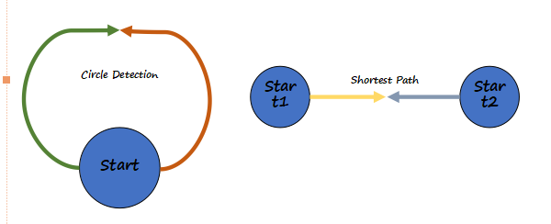
查询设计最佳实践
选择合理的查询模型
双向启动遍历

Slide 55

目录
04
PART 03

Slide 56
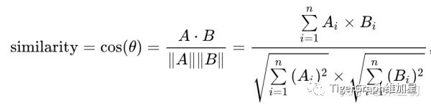
一个简单的电影推荐系统实现
算法的输入为需要被推荐电影的person节点p，以及两个整数参数k1，k2。
算法的输出为一个movie节点集合，表示被推荐的电影，最多会推荐k2部电影。每个电影对应一个浮点数的推荐系数，系数越大则推荐越强烈。
算法的过程为：首先找到p打过分的所有电影集合m。然后找到所有对集合m中的电影打过分的p之外的人，计算这些人与p的看电影品味的相似度（余弦相似度），从中选出最相似的k1个人。找到这k1个人打过分的电影中p没有打过分的电影集合m2，计算这k1个人对m2中的电影打分的平均值，选择其中平均值最高的k2部电影推荐给p，将平均分作为推荐系数。似度是一个(0, 1]的浮点数。

Slide 57
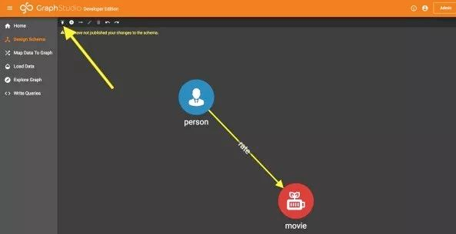
图结构

Slide 58
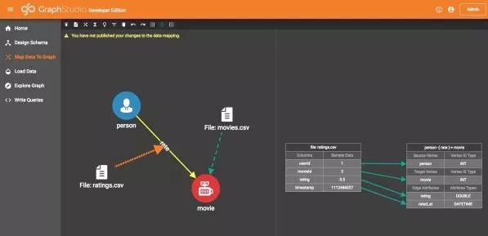
导入数据

Slide 59
导入数据

Slide 60
创建查询
CREATE QUERY RecommendMovie(
vertex<person> p, int k1, int k2) FOR GRAPH MyGraph {
OrAccum @rated;
SumAccum<double> @ratingByP;
SumAccum<double> @lengthA, @lengthB, @dotProductAB;
SumAccum<double> @cosineSimilarity;
AvgAccum @recommendScore;
PSet = { p };
PRatedMovies =
SELECT m
FROM PSet -(rate:r)-> movie:m
ACCUM m.@rated = true, m.@ratingByP = r.rating;

Slide 61
创建查询
PeopleRatedSameMovies =
SELECT tgt
FROM PRatedMovies:m -(reverse_rate:r)-> person:tgt
WHERE tgt != p
ACCUM tgt.@lengthA += m.@ratingByP * m.@ratingByP,
tgt.@lengthB += r.rating * r.rating,
tgt.@dotProductAB += m.@ratingByP * r.rating
POST-ACCUM
tgt.@cosineSimilarity =
tgt.@dotProductAB / sqrt(tgt.@lengthA) / sqrt(tgt.@lengthB)
ORDER BY tgt.@cosineSimilarity DESC
LIMIT k1;

Slide 62
创建查询
RecommendedMovies =
SELECT m
FROM PeopleRatedSameMovies -(rate:r)-> movie:m
WHERE m.@rated == false
ACCUM m.@recommendScore += r.rating
ORDER BY m.@recommendScore DESC
LIMIT k2;
PRINT RecommendedMovies.title,
RecommendedMovies.@recommendScore;}

Slide 63
运行查询
curl 'http://<MACHINE-IP>:9000/query/MyGraph/RecommendMovie?p=238&k1=50&k2=20'

