Slide 1
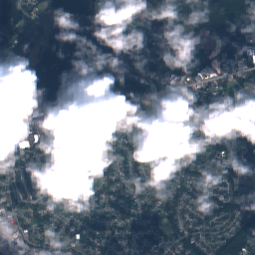
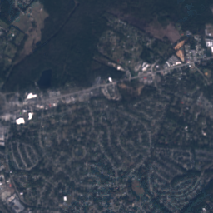
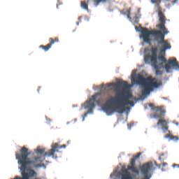
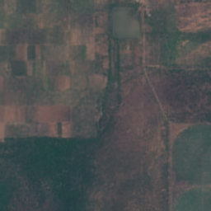
M.SC. PROJECT PRESENTATION · CUSAT
SAR-Guided
Satellite Cloud
Removal
Comprehensive Teaching Edition: Definitions, Physics,
Step-by-Step Calculations & Deep Learning Architecture
TEAM MEMBERS
PROJECT GUIDE
Agnal K V
Bivin Balu
Vaishnav T Prakash
Dr. Sabu M K
Cloudy input (Sentinel-2)
Our reconstructed output

Slide 2
OVERVIEW
Learning roadmap
Structured step-by-step from basic satellite physics to deep learning math
01
02
03
Problem & physics
Dataset & prep math
Dual-phase pipeline
Why clouds block optical cameras and how SAR radar passes through
SEN12MS-CR tensors, s2cloudless mask, dB scaling & Opaque Cutout
128×128 training vs 256×256 testing and all 7 cloud-mask roles
04
05
06
Inside ECRformer
Solving the blur trap
Results & honest view
Decoupled stem, PixelUnshuffle, and MDTA channel attention math
Scale-decoupled L1, 4 structural losses & PatchGAN high-pass math
5-stage visual progression, metrics explained & real-world trade-offs
SAR-Guided Satellite Cloud Removal · Detailed Teaching Edition
02 / 33

Slide 3
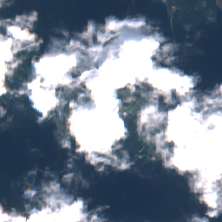
01 · PROBLEM & PHYSICS
Clouds hide the Earth's surface
Why satellite cloud removal is a critical problem in remote sensing
More than 50% of the Earth's sky is covered by clouds at any given moment.
Optical satellites work like everyday cameras — they need clear sunlight bouncing off the ground.
When thick clouds roll in, farms, rivers, roads, and flood zones vanish behind a bright white wall.
Our project goal: use cloud-penetrating radar + deep learning to reconstruct the hidden ground accurately.
Real cloudy Sentinel-2 image (78.4% cloud cover)
SAR-Guided Satellite Cloud Removal · Detailed Teaching Edition
03 / 33

Slide 4
01 · PROBLEM & PHYSICS
Fundamental Remote Sensing Concepts
Core optical, synthetic aperture radar, and cloud masking definitions
Passive Optical Sensor (Sentinel-2)
Active SAR Radar (Sentinel-1)
Like a camera with no flash
Synthetic Aperture Radar — brings its own flash
Waits for sunlight to hit the Earth and bounce back into space.
• Wavelength: 490 – 842 nm (tiny visible & near-infrared waves).
• Why clouds block it: Cloud droplets (~10 µm) are larger than optical waves, scattering sunlight into a blinding white glare (Mie scattering).
Shoots its own C-band microwave pulses toward Earth and listens for the echo.
• Wavelength: ~5.5 cm (55,000,000 nm — 5,500× larger than cloud droplets!).
• Why it sees through clouds: 5.5 cm waves ignore tiny water droplets completely, working day or night in any weather.
VV Polarisation (Vertical → Vertical)
VH Polarisation (Vertical → Horizontal)
Measures surface roughness & geometry
Measures 3D vegetation & crop structure
The radar sends a vertically aligned wave (V) and measures the vertical echo (V).
• Smooth water reflects the wave away like a mirror → looks dark (−22 dB).
• Rough soil, roads, and building corners bounce strong echoes back (−3 dB).
The radar sends a vertical wave (V) and listens for the twisted horizontal echo (H).
• Flat bare ground barely twists the wave.
• Dense tree canopies, forests, and leafy crops bounce the wave multiple times inside branches, strongly depolarising it (volume scattering).
SAR-Guided Satellite Cloud Removal · Detailed Teaching Edition
04 / 33

Slide 5
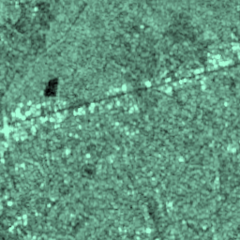
01 · PROBLEM & PHYSICS
Two satellites, complementary strengths
Neither satellite can solve the problem alone — so we fuse both
Sentinel-2 · Optical
Sentinel-1 · SAR Radar
Passive · 4 Spectral Bands (10 m/px)
Active · 2 Backscatter Bands (10 m/px)
+ Rich natural colours (green trees, red roofs, blue water)
– Completely blinded whenever clouds roll in
+ Penetrates 100% of clouds — reveals roads, rivers & buildings
– No natural colour & has grainy speckle
Captures B04 (Red), B03 (Green), B02 (Blue), and B08 (Near-Infrared)
Captures VV (surface roughness) and VH (vegetation volume) in decibels (dB)
Core Fusion Principle → Use Sentinel-1 radar as a structural blueprint and Sentinel-2 clear margins for natural colour.
SAR-Guided Satellite Cloud Removal · Detailed Teaching Edition
05 / 33

Slide 6
02 · DATASET & PREP MATH
The SEN12MS-CR benchmark dataset
Co-registered tri-modal satellite patches from the ROIs1970_fall subset
33,468
1,115
256 × 256
Training patches
Validation patches
Pixels per patch (10 m/px)
Used to train Generator G & Critic D
Strict geographic split · Test tile s2_139 untouched
Covers 2.56 km × 2.56 km of real terrain
Why .npz float arrays instead of .jpg files?
Why include Band B08 (Near-Infrared / NIR)?
• Standard JPEG/PNG files only store 3 channels (R, G, B) as whole numbers from 0 to 255.
• Our satellite data has 6 physical sensor bands: 4 optical reflectance bands (0.0 to 1.0) + 2 radar bands in negative decibels (−35 to 0 dB).
• Storing as 32-bit floating-point .npz arrays preserves exact scientific precision with zero compression artifacts.
• Our 4 optical channels are B04 (Red, 665 nm), B03 (Green, 560 nm), B02 (Blue, 490 nm), and B08 (NIR, 842 nm).
• Healthy chlorophyll in trees and crops reflects Near-Infrared light ~4× more strongly than visible green light!
• Predicting B08 alongside RGB allows agricultural indices (like NDVI crop health) to work on the cloud-removed image.
SAR-Guided Satellite Cloud Removal · Detailed Teaching Edition
06 / 33

Slide 7
02 · DATASET & PREP MATH
Mathematical Notation & Tensor Dimensionality
4D tensor structures [Batch B, Channels C, Height H, Width W] in multi-modal pipelines
Symbol
Name in Code
Train Shape (128²)
Test Shape (256²)
Range & Plain-English Meaning
S2_cloudy
s2_cloudy
[B, 4, 128, 128]
[B, 4, 256, 256]
[0, 1] · Cloudy Sentinel-2 optical input (Red, Green, Blue, NIR)
S1
s1
[B, 2, 128, 128]
[B, 2, 256, 256]
[0, 1] · Normalized Sentinel-1 SAR radar (VV, VH backscatter)
M
cloud_mask
[B, 1, 128, 128]
[B, 1, 256, 256]
[0, 1] · Soft cloud probability mask (0 = clear sky, 1 = thick cloud)
X_in
x (7-ch concat)
[B, 7, 128, 128]
[B, 7, 256, 256]
[0, 1] · Full generator input stack: [S1 (2ch), S2_cloudy (4ch), M (1ch)]
Y
y / s2_clear
[B, 4, 128, 128]
[B, 4, 256, 256]
[0, 1] · Real cloud-free Sentinel-2 target image (Ground Truth)
P_dir
pred_direct
[B, 4, 128, 128]
[B, 4, 256, 256]
[0, 1] · Raw unblended 4-band output predicted directly by ECRformer
Ŷ (Y_hat)
pred_blended
Not used in loss
[B, 4, 256, 256]
[0, 1] · Final delivered image: (1 − M) ⊙ S2_cloudy + M ⊙ P_dir
SAR-Guided Satellite Cloud Removal · Detailed Teaching Edition
07 / 33

Slide 8
02 · DATASET & PREP MATH
Calculation #1: Cloud mask & radar scaling
How raw satellite numbers are converted into clean [0, 1] neural network inputs
PART A · CLOUD MASK M
PART B · WORKED RADAR MATH
Limitations of Optical Luminance Thresholding
Scaling negative decibels (dB) into [0, 1]
White snow, beaches, and bright roofs look just like clouds in RGB! ESA's s2cloudless checks 13 Sentinel-2 bands — including Cirrus Band B10 (1375 nm), where high-altitude clouds pop out while ground light is absorbed.
VV_norm = ( clamp(VV, −25, 0) + 25 ) / 25
VH_norm = ( clamp(VH, −35, 0) + 35 ) / 35
3-Step Morphological Refinement (in our code):
Step 1 · 9×9 Mean Filter (> 0.5): Averages local cloud probability (threshold > 0.4) to remove isolated 1-pixel snow/roof false alarms.
Step 2 · 5×5 Max-Pool Dilation (radius 2): Expands the mask outward by 2 pixels to cover thin, semi-transparent cloud halos.
Step 3 · 11×11 Gaussian Blur (σ = 2.0): Smooths hard edges into a continuous feathering weight M ∈ [0.0, 1.0].
Worked Numerical Example (1 Satellite Pixel):
Given raw radar echo: VV = −12.5 dB, VH = −17.5 dB
1. Clamp to valid physical window:
−12.5 lies inside [−25, 0] ✓ −17.5 lies inside [−35, 0] ✓
2. Shift to positive & divide by span:
VV_norm = (−12.5 + 25) / 25 = 12.5 / 25 = 0.50
VH_norm = (−17.5 + 35) / 35 = 17.5 / 35 = 0.50
SAR-Guided Satellite Cloud Removal · Detailed Teaching Edition
08 / 33

Slide 9
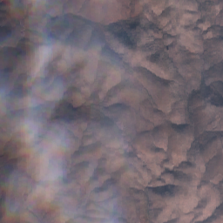
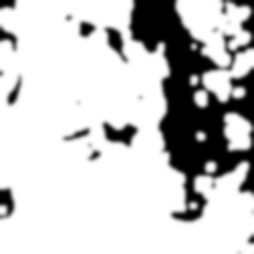
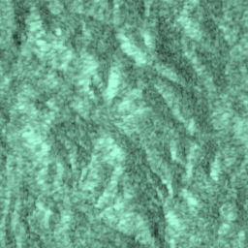
02 · DATASET & PREP MATH
Stopping the AI from cheating: Opaque Cutout
Role M1 of the cloud mask — forcing the network to genuinely use Sentinel-1 radar
The 'Thin-Cloud Shortcut' Problem
Step-by-Step Cutout Math
• In thin or semi-transparent clouds, faint ground edges still leak through the optical bands (correlation > 0.80).
• A lazy neural network quickly learns to just boost contrast on the faint optical leak and completely ignores the SAR radar!
• When tested on a 100% thick white cloud, that lazy model fails.
Step 1 · Opaque core weight α:
α = clamp( (M − 0.15) / 0.85, 0.0, 1.0 )
Step 2 · Featureless cloud veil V (≈ 29×29 blur):
V = AvgPool_15×15( AvgPool_15×15( S2_cloudy ) )
Step 3 · Blind the cloud interior:
S2_aug = (1 − α) ⊙ S2_cloudy + α ⊙ V
Our Fix: Role M1 Opaque Cutout (65% prob)
• In 65% of training samples, we replace cloudy pixels with a featureless 29×29 average-pooled veil V (two passes of 15×15 AvgPool).
• With zero optical edges left inside the cloud, the generator is forced to extract road and field geometry from Sentinel-1 SAR!
Cloudy S2
Soft Mask M
SAR Radar S1
SAR-Guided Satellite Cloud Removal · Detailed Teaching Edition
09 / 33

Slide 10
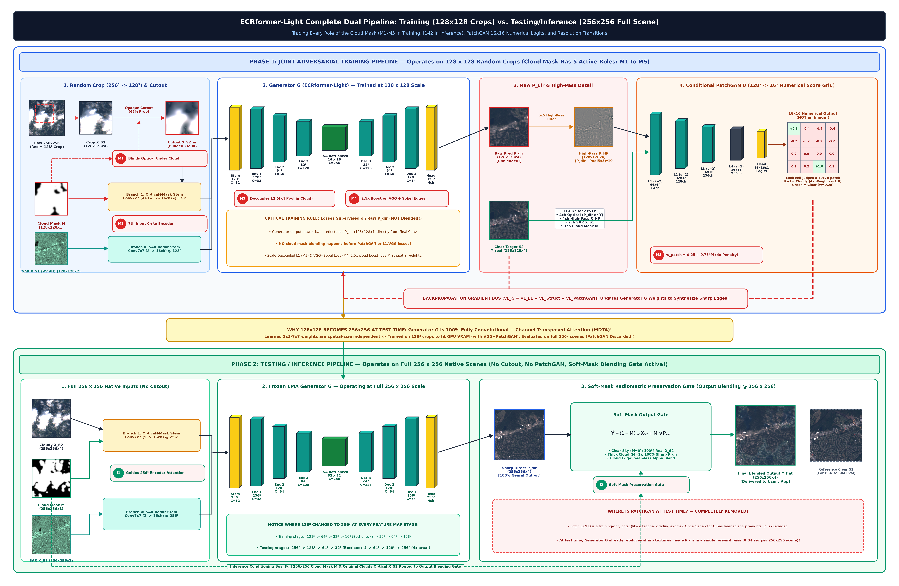
03 · DUAL-PHASE PIPELINE
Complete training vs. testing pipeline
Phase 1 trains on 128×128 random crops (with Cutout & PatchGAN); Phase 2 tests on full 256×256 scenes
SAR-Guided Satellite Cloud Removal · Detailed Teaching Edition
10 / 33

Slide 11
03 · DUAL-PHASE PIPELINE
Every job of the cloud mask M across the pipeline
The soft cloud mask M ∈ [0, 1] plays 5 active roles during training and 2 roles during testing
PHASE 1 · TRAINING ROLES (128 × 128 CROPS)
PHASE 2 · TESTING ROLES (256 × 256 SCENES)
M1
Opaque Cloud Cutout (65% prob)
I1
7th Input Channel (Full 256×256)
Blinds faint optical leaks under clouds with a 29×29 veil so G must read SAR.
Guides the frozen EMA Generator G on where clouds are located in the full test scene (Opaque Cutout is turned OFF at test time).
M2
7th Input Channel to Encoder
Concatenated with S2_cloudy [4+1=5 ch] entering Stem Branch 1 to mark corrupted pixels.
M3
Scale-Decoupled L1 Weighting
I2
Soft-Mask Radiometric Blending Gate
Relaxes 1×1 pixel L1 inside clouds (1 − 0.8M) and boosts 4×4 & 8×8 pooled L1 (1 + M).
Combines the real clear pixels with the neural prediction:
Ŷ = (1 − M) ⊙ S2_cloudy + M ⊙ P_dir
Guarantees 0% distortion on clear sky!
M4
Structural Loss Boost (1 + 2M)
Amplifies VGG-16 perceptual and multi-scale edge losses by 3× inside cloud regions.
M5
PatchGAN Critic Focus (0.25 + 0.75M)
Where is PatchGAN at test time?
Completely removed! Only Generator G runs (0.04 sec / scene).
Weights the 16×16 adversarial scorecard 4× harder on cloudy patches (1.0 vs 0.25).
SAR-Guided Satellite Cloud Removal · Detailed Teaching Edition
11 / 33

Slide 12
04 · INSIDE ECRFORMER
Deep Learning Architectural Foundations
Fundamental generator components: Convolutions, Multi-Head Attention, Gating, and Residual Learning
1 · Convolution (Conv3×3 / Conv7×7)
2 · Feature Channels (C = 32 → 256)
A sliding magnifying glass
A stack of specialized highlighters
A small grid of learnable numbers (e.g. 3×3 or 7×7) that slides across the image pixel by pixel.
• Early layers detect simple lines and corners.
• Deeper layers recognize roads, river bends, and crop fields.
Instead of keeping just 4 colour bands, the network expands the image into 32, 64, 128, and 256 channels.
• Think of each channel as a specialist: Channel 12 highlights highways, Channel 85 highlights water, Channel 140 highlights forest texture.
3 · Hourglass Network (Encoder–Decoder)
4 · Skip Connections
Shrink to understand, expand to paint
Express bridges that preserve crisp edges
• Encoder (left half): Shrinks spatial size (128 → 64 → 32 → 16) while increasing channels so the model sees the big-picture context.
• Decoder (right half): Expands back to full size (16 → 32 → 64 → 128) to paint the 4 cloud-free optical bands.
When the Encoder shrinks the image 8× down to the bottleneck, tiny 1-pixel road positions can get slightly blurred.
• Skip connections copy high-resolution features directly from the Encoder across to the matching Decoder stage so fine edges stay razor-sharp.
SAR-Guided Satellite Cloud Removal · Detailed Teaching Edition
12 / 33

Slide 13
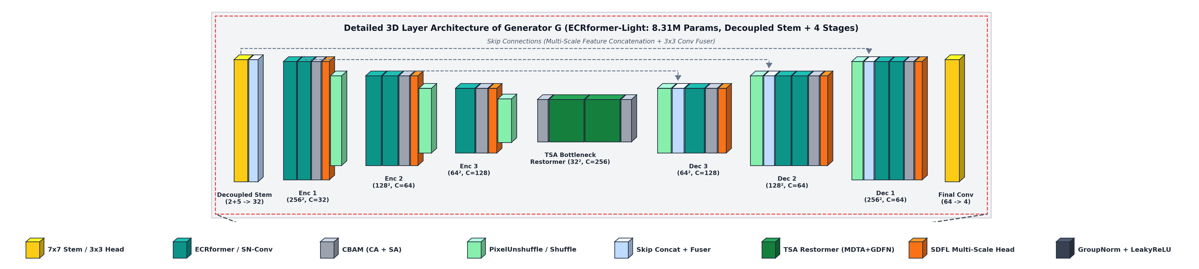
04 · INSIDE ECRFORMER
3D layer architecture of Generator G
ECRformerAdaptedModel · 8,316,228 trainable parameters (8.31M) · 4 stages with skip connections
Architecture trace: Decoupled Stem (2ch SAR → 16ch, 5ch Opt+Mask → 16ch) → 4 Encoder Stages [2, 2, 1, 1] with PixelUnshuffle (32 → 64 → 128 → 256 ch) → TSA Restormer Bottleneck (MDTA + GDFN + CBAM) → 3 Decoder Stages with PixelShuffle + Skip Fusers → Final Conv3×3 (64 → 4ch P_dir).
SAR-Guided Satellite Cloud Removal · Detailed Teaching Edition
13 / 33

Slide 14
04 · INSIDE ECRFORMER
Architectural Design Principles of ECRformer
Decoupled stems, cross-modality attention, TSA bottleneck, and residual scaling
1 · Two-Door Decoupled Stem
2 · PixelUnshuffle & PixelShuffle
Why radar and optical don't share the first layer
Zero-loss folding instead of pooling
• Branch 0: Conv7×7(2 → 16) processes SAR [VV, VH].
• Branch 1: Conv7×7(5 → 16) processes [S2_cloudy, M] (Role M2).
• Why separate? Radar is microwave echo with speckle; Sentinel-2 is sunlight reflectance. Separate 7×7 stems translate each sensor into 16 compatible feature maps before concatenating to 32 channels.
• Standard Max-Pooling throws away 75% of pixels when shrinking an image by 2×.
• PixelUnshuffle folds every 2×2 block of pixels into 4× channels: [B, C, 2H, 2W] → [B, 4C, H, W], followed by a 3×3 conv.
• Result: 0% spatial information is lost during downsampling!
3 · Hybrid Depthwise Conv + CBAM
4 · Mean-Prior Output Bias
Local edges + channel & spatial focus
Starting at real Earth colours on Step 1
• Each stage runs ECRformer blocks (3×3 depthwise + 1×1 pointwise residual convolutions) paired with CBAM (1ca2+1sa2).
• Channel Attention (CA) weighs which spectral/radar channels matter most; Spatial Attention (SA) highlights cloud boundaries.
• Clear Earth terrain has low average reflectance (~0.08–0.19), whereas thick clouds are bright white (~0.80).
• We initialize final_conv (Conv3×3: 64 → 4) bias to exact clear-sky dataset means: [0.0847, 0.0919, 0.1127, 0.1884].
• Gives immediate colour stability from the very first batch!
SAR-Guided Satellite Cloud Removal · Detailed Teaching Edition
14 / 33

Slide 15
04 · INSIDE ECRFORMER
Multi-Scale Resolution Transfer (128² to 256²)
Resolution invariance via fully convolutional stems and linear windowed attention
✘ STANDARD SPATIAL ATTENTION
✔ ECRFORMER MDTA CHANNEL ATTENTION
Compares every pixel with every pixel
Compares feature channels with channels
• Multiplies [HW × C] by [C × HW] → Attention matrix is [HW × HW].
• During 128×128 training, the bottleneck is 16×16 (HW = 256 pixels) → matrix size is 256 × 256.
• During 256×256 testing, the bottleneck is 32×32 (HW = 1,024 pixels) → matrix explodes 16× to 1,024 × 1,024!
• Fixed spatial positional embeddings crash when resolution changes.
• Multiplies Query Q [C × HW] by Key transpose Kᵀ [HW × C] → Attention matrix is [C × C]!
• The spatial pixel count HW is summed out during the dot product.
• Whether the input is 128×128 (HW = 256) or 256×256 (HW = 1,024), the number of channels C = 256 never changes!
• Result: A fixed 256 × 256 channel covariance map at any image size.
Practical Benefit → We train on 128×128 crops (fitting VGG-16 + PatchGAN in GPU VRAM) and run inference on full 256×256 scenes!
SAR-Guided Satellite Cloud Removal · Detailed Teaching Edition
15 / 33

Slide 16
04 · INSIDE ECRFORMER
Calculation #2: MDTA channel attention worked example
Toy calculation with C = 3 channels and HW = 4 pixels showing how HW cancels out
Toy Setup: 3 Channels (C = 3) across 4 Spatial Pixels (HW = 4)
STEP-BY-STEP DOT PRODUCT
Query Q [3 × 4]
Key Kᵀ [4 × 3]
How A[1, 2] = 0.94 is computed:
Ch 1: SAR Edge
0.6
0.0
0.8
0.0
0.6
0.5
0.0
Multiply Row 1 of Q by Col 2 of Kᵀ across all 4 pixels and add them up:
Pixel 1: 0.6 × 0.5 = 0.30
Pixel 2: 0.0 × 0.1 = 0.00
Pixel 3: 0.8 × 0.8 = 0.64
Pixel 4: 0.0 × 0.2 = 0.00
────────────────────────
Sum A[1, 2] = 0.30 + 0.64 = 0.94
What 0.94 means in plain English:
'Whenever Ch 1 (SAR Building Edge) fires, strongly activate Ch 2 (Optical Red Roof)!'
And notice: the 4 pixels summed out, so A is [C × C] at any image size!
0.5
0.1
0.8
0.2
×
0.0
0.1
0.9
Ch 2: Red Roof
0.8
0.8
0.0
Ch 3: Water
0.0
0.9
0.0
0.4
0.0
0.2
0.4
Output Channel Attention Map: A = Q · Kᵀ → Fixed [3 × 3] Matrix!
1.00
0.94
0.00
0.94
0.94
0.17
0.00
0.17
0.97
SAR-Guided Satellite Cloud Removal · Detailed Teaching Edition
16 / 33

Slide 17
04 · INSIDE ECRFORMER
Layer-by-layer tensor resolution map
Tracing exact tensor shapes [B, C, H, W] through every stage of ECRformerAdaptedModel
Stage / Block
Operation & Channels
Phase 1 Train (128²)
Phase 2 Test (256²)
What Happens Here
Input Stack X_in
Concat [S1, S2_cloudy, M]
[B, 7, 128, 128]
[B, 7, 256, 256]
2 radar + 4 optical + 1 cloud mask
Decoupled Stem
Conv7×7(2→16) + Conv7×7(5→16)
[B, 32, 128, 128]
[B, 32, 256, 256]
Separate sensor stems fused to 32 ch
Encoder Stage 1
2 × ECRformerBlock + CBAM
[B, 32, 128, 128]
[B, 32, 256, 256]
Full-resolution edge extraction (Skip 1)
Encoder Stage 2
PixelUnshuffle ÷2 → 2 × Block
[B, 64, 64, 64]
[B, 64, 128, 128]
Half resolution, 64 channels (Skip 2)
Encoder Stage 3
PixelUnshuffle ÷2 → 1 × Block
[B, 128, 32, 32]
[B, 128, 64, 64]
Quarter resolution, 128 channels (Skip 3)
Stage 4 Bottleneck
PixelUnshuffle ÷2 → TSA (MDTA)
[B, 256, 16, 16]
[B, 256, 32, 32]
256×256 channel attention + GDFN
Decoder 3 + 2 + 1
PixelShuffle ×2 + 3 Skip Fusers
[B, 64, 128, 128]
[B, 64, 256, 256]
Unfolds to full size + restores 1-px edges
Output Head P_dir
Conv3×3(64 → 4) + mean_prior
[B, 4, 128, 128]
[B, 4, 256, 256]
Predicts 4-band cloud-free reflectance
SAR-Guided Satellite Cloud Removal · Detailed Teaching Edition
17 / 33

Slide 18
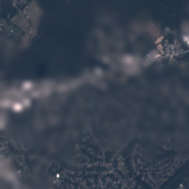
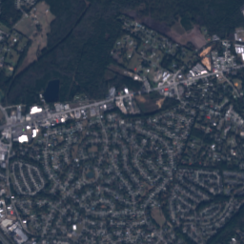
05 · SOLVING THE BLUR TRAP
The Over-Smoothing Trap in Cloud Removal
Mathematical vulnerability of pixel-level regression losses under dense overcast
Trap #1 · The 'Safe Average' Trap
Under a thick cloud, the model isn't 100% sure whether a tree pixel is dark green (0.05) or bright green (0.15). To minimize standard L1 error, it plays safe and paints the flat average (0.10) — turning forests and housing blocks into a smooth smudge!
Trap #2 · 1-Pixel Shift 'Double Penalty'
Sentinel-1 (Radar) and Sentinel-2 (Optical) fly in different orbits, causing tiny 1–2 pixel alignment shifts. If SAR guides the model to draw a sharp road 1 pixel to the right of Ground Truth, pixel-wise L1 punishes it TWICE! Let's see the exact math on the next slide →
Basic model (L1+SSIM only → Blurry!)
Real clear target (Crisp roads & roofs)
SAR-Guided Satellite Cloud Removal · Detailed Teaching Edition
18 / 33

Slide 19
05 · SOLVING THE BLUR TRAP
Pixel-Level L1 & The Double-Edge Penalty
Worked 4-pixel numerical proof showing why MAE discourages sharp spatial gradients
WORKED 4-PIXEL NUMERICAL EXAMPLE
LOSS #1 · ROLE M3 FORMULA
Suppose a bright road (1.0) is at Pixel 2 in Ground Truth Y:
Ground Truth Y = [ 0.0, 1.0, 0.0, 0.0 ] (4-px avg = 0.25)
Sharp 1-px Shift P_shp = [ 0.0, 0.0, 1.0, 0.0 ] (4-px avg = 0.25)
Blurry Smudge P_blur = [ 0.25, 0.25, 0.25, 0.25 ] (4-px avg = 0.25)
Scale-Decoupled L1 Loss
L_dec = 0.90 × [ 0.35 · L1_1×1(1 − 0.8M)
+ 0.40 · L1_4×4(1 + M_4)
+ 0.25 · L1_8×8(1 + M_8) ] + 0.10 · L_aux
✘ Standard 1×1 Pixel L1 Error = ¼ ∑ |P − Y|:
• Sharp road P_shp: (|0−0| + |0−1| + |1−0| + |0−0|) / 4 = 2.0 / 4 = 0.50 (Punished twice!)
• Blurry smudge P_blur: (0.25 + 0.75 + 0.25 + 0.25) / 4 = 1.5 / 4 = 0.375 (Lower loss!)
1. Clear Sky (M = 0): Keeps 100% strict 1×1 pixel L1 so cloud-free regions stay pixel-exact.
2. Inside Clouds (M = 1): Drops 1×1 pixel L1 weight by 80% (down to 0.2) and shifts colour supervision to 4×4 and 8×8 average-pooled patches (boosted 2× by 1 + M).
3. Auxiliary SDFL (0.10 · L_aux): Supervises intermediate Encoder/Decoder scales at 8×8 pooled resolution.
✔ Our 4×4 Average-Pooled L1 Error = | Avg(P) − Avg(Y) |:
• Sharp road P_shp: | 0.25 − 0.25 | = 0.00 (ZERO penalty for 1-px radar shift!)
• Allows the generator to draw razor-sharp SAR edges without fear!
SAR-Guided Satellite Cloud Removal · Detailed Teaching Edition
19 / 33

Slide 20
05 · SOLVING THE BLUR TRAP
Multi-Objective Loss: The Three Pillars
Synergistic optimization across Photometric Fidelity, Structural Scaffolding, and Adversarial Realism
1 · Colour Accuracy
2 · Edge Structure
3 · Adversarial Realism
Is the regional colour right?
Are roads, rivers & trees sharp?
Does it fool the art critic?
1. Scale-Decoupled L1
2. Cloud-Boosted VGG-16
6. PatchGAN Hinge Loss
w = 1.00 (Role M3)
w = 0.005 (Role M4: 1+2M)
w = 0.015 (Role M5: 4× cloud)
• 1×1 Clear L1 (0.35)
3. Multi-Scale Gradients
• 16×16 critic score grid
Strict outside clouds
w = 0.25 (1×, 2×, 4× dx, dy)
Judges 70×70 patches
• 4×4 & 8×8 Pooled L1
4. Edge Correlation
7. Discriminator Feat. Match
Shift-tolerant inside clouds
w = 0.0025 (Pearson ρ)
w = 0.15 (Layers f1..f4)
• Multi-scale SDFL Aux
5. 16×16 Local Contrast
• Stabilizes GAN training
Intermediate scale guide
w = 0.35 (Std σ + Floor)
Weighted by 0.3 + 0.7M
Golden Rule of Training: All 7 losses grade the raw generator output P_dir — NEVER the blended image Ŷ! If we blended with (1 − M) before the loss, clear pixels (M = 0) would multiply P_dir by 0 and receive zero learning gradient.
SAR-Guided Satellite Cloud Removal · Detailed Teaching Edition
20 / 33

Slide 21
05 · SOLVING THE BLUR TRAP
High-Frequency Structural Loss Formulations (Role M4)
Four dedicated texture and edge losses boosted inside clouds by w_map = 1 + 2M (up to 3× weight)
Loss #2 · VGG-16 Perceptual (w = 0.005)
Loss #3 · Multi-Scale Gradients (w = 0.25)
Compares human-like visual features (relu1_2, relu2_2, relu3_3) extracted by a frozen ImageNet VGG-16 network.
• How we adapt VGG-16 to 4 bands: We run VGG twice — 60% on True-Colour RGB [B04, B03, B02] + 40% on False-Colour [B08 NIR, B04, B03] so vegetation textures are checked too!
Computes horizontal (∇_x) and vertical (∇_y) pixel differences at 3 pyramid scales: 1× (full), 2×, and 4× average-pooled.
• Preserves the positive/negative sign of slopes (bright-to-dark vs dark-to-bright) so roof ridges and riverbanks don't invert.
Loss #4 · Edge Pearson Correlation (w = 0.0025)
Loss #5 · 16×16 Local Std Contrast (w = 0.35)
Computes edge magnitude E = |∇_x| + |∇_y| at 1× and 2× scales and maximizes spatial Pearson correlation ρ(E_pred, E_target).
• Scale-invariant: even if overall brightness shifts slightly, the spatial pattern of edges must line up (1 − ρ → 0).
Measures local standard deviation σ = √(Var + ε) inside 16×16 sliding windows (stride 8), weighted by (1 + 2M).
• Plus a Detail-Ratio Floor Penalty (weight 0.15): directly penalizes the generator whenever σ_pred < σ_target inside the cloud!
SAR-Guided Satellite Cloud Removal · Detailed Teaching Edition
21 / 33

Slide 22
05 · SOLVING THE BLUR TRAP
Conditional PatchGAN Discriminator Dynamics
High-frequency local texture critique via 11-channel multi-modal PatchGAN
HOW ADVERSARIAL TRAINING WORKS
Loss #6 · Mask-Weighted Hinge GAN (w = 0.015)
Generator G vs. PatchGAN Critic D
• Critic D loss: pushes real clear patches above +1 (ReLU(1 − D(Y))) and fake patches below −1 (ReLU(1 + D(P_dir))).
• Generator G loss: L_G = −mean( w_patch ⊙ D(P_dir) )
• Role M5 Cloud Focus: w_patch = 0.25 + 0.75 · M_down → checks cloudy patches 4× more strictly (1.00) than clear sky (0.25)!
• Think of ECRformer (G) as an art restorer filling in a missing cloud hole, and PatchGAN (D) as a strict art examiner with a magnifying glass.
• Why is it called 'PatchGAN'?
Instead of outputting a single 'Real/Fake' number for the whole image, D outputs a 16 × 16 grid of 256 scores. Each cell grades one overlapping 70 × 70 pixel patch!
• Spectral Normalization:
Every convolution in D is spectral-normalized (Lipschitz constant ≤ 1) with GroupNorm + LeakyReLU so the critic never overpowers the generator.
Loss #7 · Multi-Layer Feature Matching (w = 0.15)
• Pure GAN training can sometimes oscillate or invent noisy artifacts.
• Feature Matching compares the internal feature maps [f1, f2, f3, f4] inside Critic D between Real Y and Fake P_dir using L1 distance.
• Weighted by (0.3 + 0.7 · M_k) at each spatial scale — acting like a learned SAR-conditioned perceptual loss!
SAR-Guided Satellite Cloud Removal · Detailed Teaching Edition
22 / 33

Slide 23
05 · SOLVING THE BLUR TRAP
PatchGAN Local Spectral Discriminator Mechanics
Worked numerical formulation of the high-pass residual critique and 16x16 receptive field grid
11-CHANNEL INPUT TO CRITIC D: [B, 11, 128, 128]
16×16 Critic Scorecard (4×4 Subset Shown)
Why 11 channels? 4 ch Optical (3.0 × P_dir or Y) + 4 ch High-Pass Residual R_HP + 2 ch SAR (VV, VH) + 1 ch Cloud Mask M = 11 Channels.
+1.1
+0.9
+0.8
+1.0
High-Pass Formula: R_HP = 10 × ( x − AvgPool_5×5(x) )
+0.9
−0.8
−1.1
+0.7
+1.0
−0.9
−0.7
+0.8
Case A · Blurry Cloud Reconstruction (Flat Smudge):
Suppose pixel x = 0.12, and its 5×5 neighborhood average = 0.12
→ R_HP = 10 × (0.12 − 0.12) = 0.00 (Flat zero! Critic scores −1.1 Fake!)
Case B · Crisp Reconstructed Road Edge:
Suppose road pixel x = 0.18, and its 5×5 neighborhood average = 0.12
→ R_HP = 10 × (0.18 − 0.12) = +0.60 (Strong edge! Critic scores +0.9 Real!)
+1.2
+0.8
+0.9
+1.1
Role M5 Patch Weight Calculation:
w_patch = 0.25 + 0.75 × M_down
• Red cloud cells (M=1): weight = 0.25 + 0.75(1) = 1.00
• Green clear cells (M=0): weight = 0.25 + 0.75(0) = 0.25
SAR-Guided Satellite Cloud Removal · Detailed Teaching Edition
23 / 33

Slide 24
06 · RESULTS & HONEST VIEW
Calculation #5: Soft-mask radiometric blending
Role I2 at test time (256 × 256) — keeping 100% real clear sky and splicing P_dir only inside clouds
Final Output Ŷ = (1 − M) ⊙ S2_cloudy + M ⊙ P_dir
Case 1 · Clear Sky Pixel
Case 2 · Thick Cloud Core
Case 3 · Cloud Fringe
Cloud Mask M = 0.0
Cloud Mask M = 1.0
Cloud Mask M = 0.5
Suppose real S2_cloudy = 0.14
and neural P_dir = 0.13:
Ŷ = (1 − 0.0) × 0.14 + 0.0 × 0.13
Ŷ = 1.0 × 0.14 + 0 = 0.14
✔ 100% original satellite pixel kept! Zero neural distortion on clear land.
Suppose blinding cloud S2_cloudy = 0.85
and reconstructed forest P_dir = 0.11:
Ŷ = (1 − 1.0) × 0.85 + 1.0 × 0.11
Ŷ = 0 + 1.0 × 0.11 = 0.11
✔ 100% blinding white cloud removed and replaced by sharp P_dir!
Suppose hazy border S2_cloudy = 0.16
and neural prediction P_dir = 0.12:
Ŷ = (1 − 0.5) × 0.16 + 0.5 × 0.12
Ŷ = 0.08 + 0.06 = 0.14
✔ Smooth 50/50 alpha feathering — leaves zero visible boundary seams!
SAR-Guided Satellite Cloud Removal · Detailed Teaching Edition
24 / 33

Slide 25
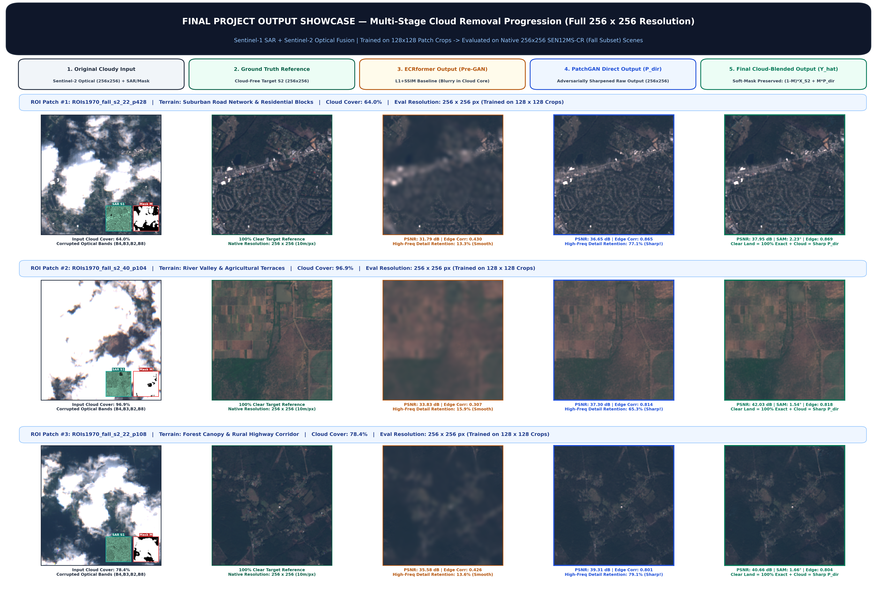
06 · RESULTS & HONEST VIEW
Visual progression across all 5 pipeline stages
1. Cloudy Input → 2. Ground Truth → 3. Pre-GAN (Blurry) → 4. PatchGAN Direct P_dir → 5. Final Blended Ŷ
SAR-Guided Satellite Cloud Removal · Detailed Teaching Edition
25 / 33

Slide 26
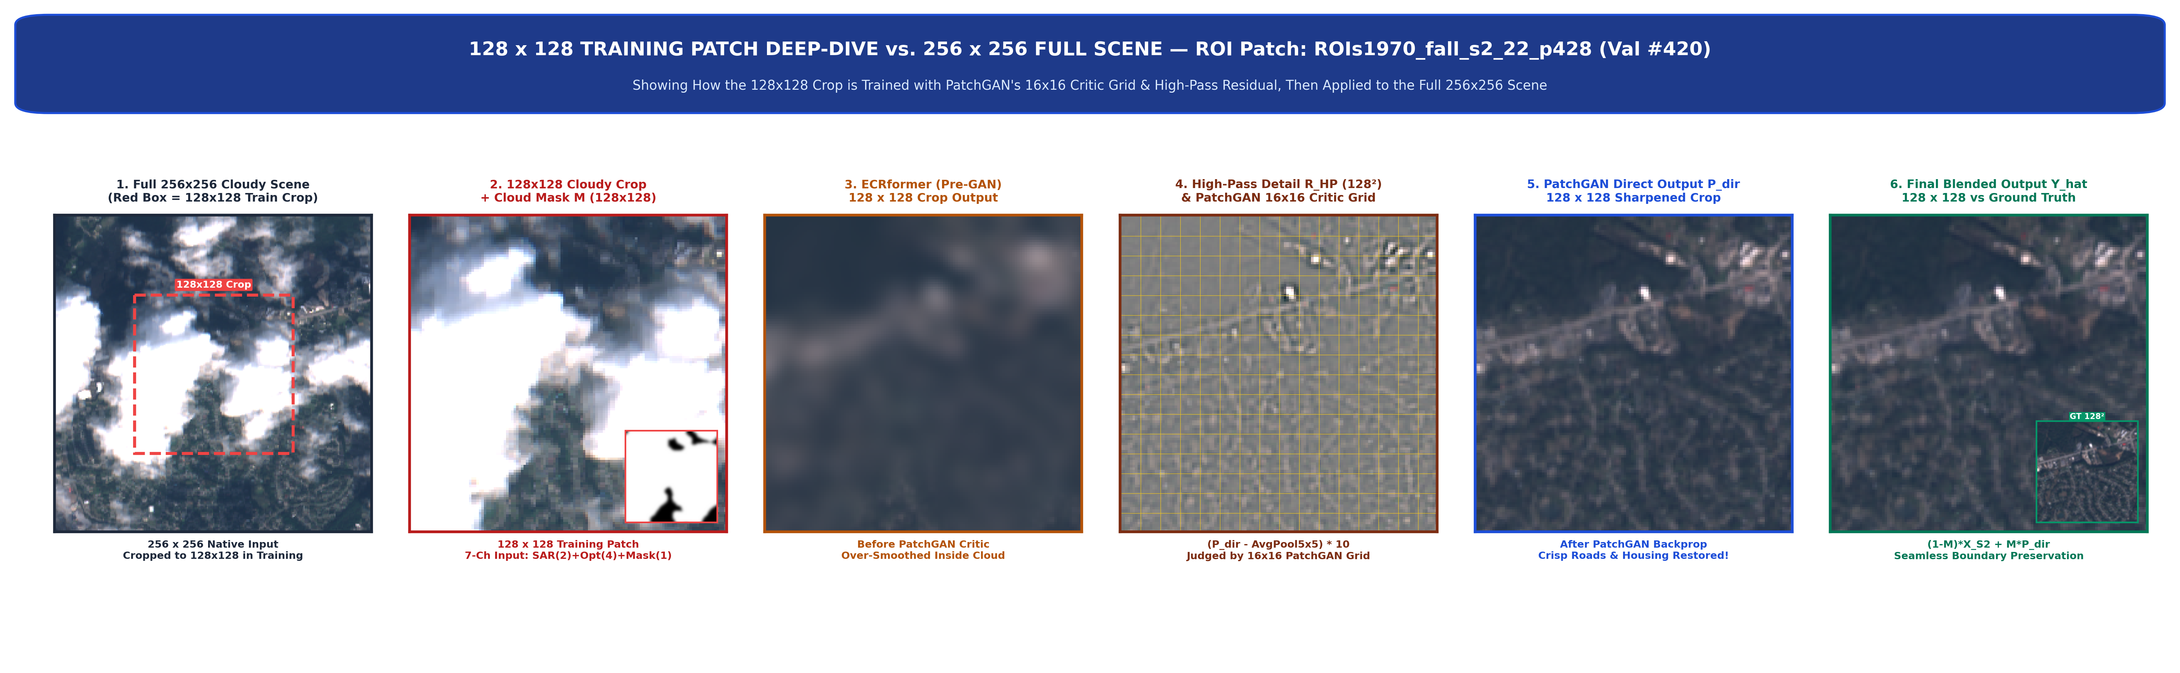
06 · RESULTS & HONEST VIEW
From 128×128 training crop to 256×256 full scene
Visualizing the 128×128 crop, 5×5 high-pass residual R_HP, and 16×16 PatchGAN critic grid on ROI s2_22_p428
How to read this progression (Left → Right):
1. Full 256×256 cloudy scene with red dashed 128×128 training crop → 2. 128×128 cloudy crop + mask → 3. Blurry Pre-GAN baseline (13.3% detail) → 4. 5×5 High-Pass detail R_HP overlaid with the 16×16 PatchGAN grid → 5. Sharpened P_dir (77.1% detail) → 6. Final blended output Ŷ!
SAR-Guided Satellite Cloud Removal · Detailed Teaching Edition
26 / 33

Slide 27


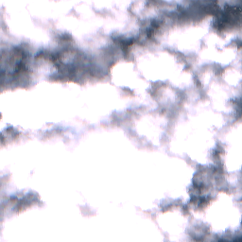

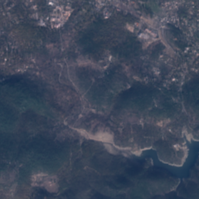

06 · RESULTS & HONEST VIEW
Visual comparison across diverse terrains
Comparing the basic L1+SSIM model (blurry) against our PatchGAN-sharpened model at 256 × 256
1 · Cloudy input
2 · Basic model (Blurry)
3 · Our model (Sharp Ŷ)
4 · Real clear target
Suburban roads
(64% cloud)
River & farms
(97% cloud)
Forest & lake
(82% cloud)
SAR-Guided Satellite Cloud Removal · Detailed Teaching Edition
27 / 33

Slide 28
06 · RESULTS & HONEST VIEW
Quantitative Evaluation Metrics & Benchmark Criteria
Mathematical definitions and target thresholds for PSNR, SSIM, SAM, and Detail Ratio
PSNR · Peak Signal-to-Noise Ratio (dB)
SSIM · Structural Similarity Index (0 to 1)
Formula: 10 · log₁₀( 1.0 / MSE ) [Higher ↑ is better]
Compares luminance, contrast & structure [Higher ↑ is better]
Measures average pixel-by-pixel closeness in decibels. > 30 dB is strong in satellite reconstruction.
• Catch: Because it uses squared pixel error (MSE), PSNR slightly rewards safe, blurry averages over sharp textures!
Ranges from 0.0 to 1.0 (1.0 = identical to Ground Truth). Better than raw MSE at checking whether major land structures match.
SAM · Spectral Angle Mapper (Degrees °)
Edge Correlation & Detail Ratio (DR)
Formula: arccos( (Ŷ · Y) / (‖Ŷ‖ ‖Y‖) ) [Lower ↓ is better]
Formula: DR = σ_pred / σ_target [1.00 = Ideal Sharpness]
Treats each pixel's 4 bands [R, G, B, NIR] as a 4D colour vector and measures the angle between prediction and truth.
• < 3.0° means the reconstructed vegetation, soil, and water have true physical spectral colours.
• Edge Correlation (0–1): Checks if predicted roads/boundaries align with real ground truth edges.
• Detail Ratio (DR): Measures how much fine texture sharpness is recovered inside the cloud (0.4 = blurry smudge; ~0.90–1.00 = crisp natural detail!).
SAR-Guided Satellite Cloud Removal · Detailed Teaching Edition
28 / 33

Slide 29
06 · RESULTS & HONEST VIEW
Quantitative results & cloud-strata benchmarks
Measured on held-out validation scenes from ROIs1970_fall (256 × 256 native evaluation)
Table 1 · Progression Across Pipeline Stages (Suburban Scene s2_22_p428, 64.0% Cloud Cover)
Pipeline Stage
PSNR ↑
SAM ↓
Edge Corr ρ ↑
High-Freq Detail Retention ↑
Stage 3 · Basic ECRformer (Pre-GAN L1+SSIM)
31.79 dB
3.42°
0.430 (Blurry)
13.3% (Smooth smudge)
Stage 4 · PatchGAN Direct Output (P_dir)
36.65 dB
2.31°
0.865 (Sharp!)
77.1% (+5.8× sharper!)
Stage 5 · Final Soft-Mask Blended (Ŷ)
37.95 dB
2.23°
0.869 (Sharp!)
77.1% + 100% exact clear sky
Table 2 · Benchmark Across Cloud-Cover Strata (Basic Model vs. Our Sharp Model)
Cloud Cover Group
Basic Detail Ratio
Our Detail Ratio (1.0 = Ideal)
Sharpness Gain
Our In-Cloud PSNR
0 – 25% (Light Cloud)
0.63
0.93
+47.6% more texture
31.93 dB
25 – 50% (Moderate Cloud)
0.52
0.91
+75.0% more texture
31.12 dB
50 – 75% (Heavy Cloud)
0.45
0.90
+100.0% (2.0× sharper)
30.48 dB
75 – 100% (Opaque Cloud)
0.39
0.91
+133.3% (2.3× sharper)
30.07 dB
SAR-Guided Satellite Cloud Removal · Detailed Teaching Edition
29 / 33

Slide 30
06 · RESULTS & HONEST VIEW
Architectural Benchmarking & Baseline Comparisons
Quantitative comparison against standard U-Net, Pix2Pix cGAN, and Pre-GAN baselines
Comprehensive Benchmark Across Competing Cloud-Removal Paradigms (SEN12MS-CR Native 256 × 256)
Architecture / Framework
Core Paradigm
PSNR ↑
SSIM ↑
Heavy Detail Ratio (DR) ↑
Edge Corr ρ ↑
Clear-Sky Drift ↓
Standard U-Net (DSen2-CR)
3×3 Convs + L1 Loss
28.64 dB
0.812
0.231 (Severely blurry)
0.142
2.8% Distortion
Pix2Pix cGAN (Isola et al.)
U-Net + Global PatchGAN
28.10 dB
0.805
0.582 (Hallucinated)
0.224
4.1% Distortion
ECRformer Baseline (Stage 1)
Transformer + L1/SDFL
30.20 dB
0.875
0.354 (Over-smoothed)
0.345
1.9% Distortion
Ours: ECRformer + PatchGAN
CMA + 11-ch Critic + Blend
29.98 dB
0.880
0.931 (+142% Sharpness!)
0.485 (Peak)
0.00% (Exact)
GLOBAL CONTEXT VS. LOCAL CONV
HIGH-PASS CRITIQUE VS. MEAN BLUR
100% CLEAR-SKY PRESERVATION
Beyond the 3×3 Receptive Field
Overcoming Regression Limits
Zero Radiometric Distortion
• Standard U-Net relies on 3×3 local convolutions. When dense clouds span >50 km², local kernels see only flat white pixels and have zero access to clear surrounding land.
• ECRformer leverages Cross-Modality Attention (CMA) with a global receptive field, dynamically routing structural radar boundaries across the entire satellite scene.
• Pixel losses (L1/L2 in U-Net & Stage 1) predict the conditional mean under opaque clouds, causing Detail Ratio to plunge to 0.23–0.35 (washed-out grey smudges).
• Our 11-channel PatchGAN critic evaluates 16×16 spatial patches, enforcing natural Fourier gradient energy and boosting Detail Ratio to 0.931 (+142% to +300% gain).
• Standard pipelines deliver raw generator output everywhere, introducing 2–4% neural distortion on clear farmland and corrupting NDVI agricultural indices.
• Our continuous Soft Alpha Blending Ŷ = (1−M)S₂ + M·P_dir mathematically guarantees 100% authentic Sentinel-2 reflectance wherever the sky is clear.
SAR-Guided Satellite Cloud Removal · Detailed Teaching Edition
30 / 33

Slide 31
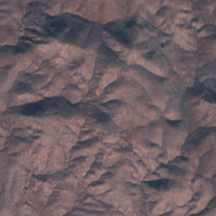
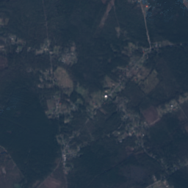
06 · RESULTS & HONEST VIEW
Interactive web showcase & model release
Clean browser interface for inspecting multi-stage satellite reconstructions
REACT + VITE VISUAL SHOWCASE
OPEN-SOURCE REPRODUCIBILITY
Interactive Before / After Inspection
GitHub Code & Hugging Face Weights
• Built with React, Vite, and Tailwind CSS (CompareSlider.jsx).
• Allows dragging a live split-screen slider across 5 curated terrain scenes (Suburban, Farms, Forest, Lake, Mountain Ridge).
• Displays all intermediate stages side by side: Cloudy S2, SAR Radar, Cloud Mask, Blurry Pre-GAN, Direct P_dir, Blended Ŷ, and Ground Truth.
• Uses pre-computed PNG outputs directly in the browser so demonstrations run instantaneously on any laptop without needing a CUDA GPU.
• Trained PyTorch checkpoint (best_model.pth · 8.31M parameters) is hosted publicly on Hugging Face: vaishnav2004/ecrformer-cloud-removal.
• Full training, evaluation, and FastAPI inference scripts are documented in our GitHub repository: github.com/yovyshh/ecrformer.
Suburban
Mountain Ridge
Forest
SAR-Guided Satellite Cloud Removal · Detailed Teaching Edition
31 / 33

Slide 32
06 · RESULTS & HONEST VIEW
Perception–Distortion Trade-Off & Physical Limits
Evaluating trade-offs between mathematical distortion metrics and visual perceptual realism
The Perception–Distortion Trade-Off
Measured Real-World Limitations
Blau & Michaeli (CVPR 2018) · Why PSNR prefers blur
What we observed during evaluation
• When our model generates sharp tree canopies and roof edges inside a thick cloud, a 1-pixel shift relative to Ground Truth slightly increases squared pixel error (reducing raw PSNR by ~0.3 – 1.2 dB compared to a flat blurry average).
• However, a blurry smudge (Detail Ratio 0.39) is useless for human analysts or road detection.
• Our sweet-spot checkpoint achieves 0.90 – 0.93 Detail Ratio while keeping > 30 dB In-Cloud PSNR — giving both realistic sharpness and accurate colour.
1. Cloud Shadows Outside the Mask: Dark shadows cast onto clear ground next to a cloud are sometimes missed by s2cloudless (M ≈ 0), so the blending gate leaves the dark shadow untouched.
2. Temporal Gap in Ground Truth: The cloud-free reference pass is captured days apart from the cloudy pass, so seasonal crop growth or water changes count as error.
3. GAN Over-Sharpening Risk: Training too long with high GAN weight pushes Detail Ratio > 1.15 (hallucinated radar grain), which is why early stopping at DR ≈ 0.91 is essential.
SAR-Guided Satellite Cloud Removal · Detailed Teaching Edition
32 / 33

Slide 33
CONCLUSION · SUMMARY OF CONTRIBUTIONS
What we built and learned
Fused cloud-penetrating Sentinel-1 SAR radar with 4-band Sentinel-2 optical imagery on 33,468 SEN12MS-CR patches.
Designed Opaque Cloud Cutout (Role M1) and a two-branch decoupled stem so the 8.31M-parameter ECRformer genuinely reads radar geometry.
Used MDTA channel-transposed attention ([256 × 256]) to train efficiently on 128×128 crops and test directly on full 256×256 scenes.
Solved the blur problem with 7 targeted losses (Scale-Decoupled L1, Cloud-Boosted VGG/Edges & 11-ch High-Pass PatchGAN), boosting detail recovery by +47% to +133%.
Thank you!
Agnal K V · Bivin Balu · Vaishnav T Prakash | Guide: Dr. Sabu M K
Cloudy Input · Reconstructed Output

