Slide 1
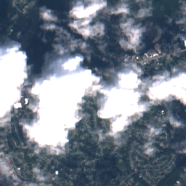
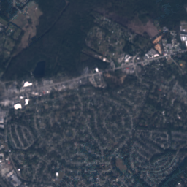
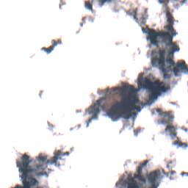
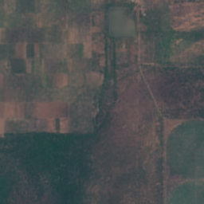
M.SC. PROJECT PRESENTATION · CUSAT
SAR-Guided
Satellite Cloud
Removal
Seeing through clouds by combining radar
with deep learning
TEAM
GUIDE
Agnal K V
Bivin Balu
Vaishnav T Prakash
Dr. Sabu M K
Cloudy input
Our output

Slide 2
OVERVIEW
What we will cover
01
02
03
The problem
The data
The model
Why clouds are a big issue
Satellites, dataset, preparation
How ECRformer works
04
05
06
Sharper results
Results
Conclusion
Fixing blur with smart losses
What the model produces
Limits and takeaways
SAR-Guided Satellite Cloud Removal
02 / 18

Slide 3
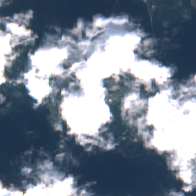
01 · THE PROBLEM
Clouds hide the ground
More than half of the Earth is covered by cloud at any moment.
Optical satellites cannot see through them — the ground simply disappears.
Goal: rebuild the hidden ground so the image is usable again.
A real cloudy Sentinel-2 image
SAR-Guided Satellite Cloud Removal
03 / 18

Slide 4
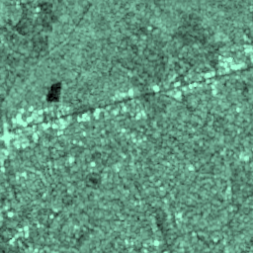
01 · THE IDEA
Two satellites, two strengths
Sentinel-2
Sentinel-1
Optical camera
SAR radar
+ Rich natural colour
– Blocked by clouds
+ Passes through clouds
– No natural colour
Sees sunlight reflected by the ground
Sends its own microwaves and listens for echoes
Our idea → use radar structure to fill in what the clouds hide.
SAR-Guided Satellite Cloud Removal
04 / 18

Slide 5
02 · THE DATA
SEN12MS-CR dataset
Paired radar, cloudy and cloud-free images of the same place
33,468
1,115
256 × 256
training patches
validation patches
pixels per patch · 10 m each
WHAT GOES INTO THE MODEL
4 optical bands
+
2 radar bands
+
1 cloud mask
=
7 input channels
SAR-Guided Satellite Cloud Removal
05 / 18

Slide 6
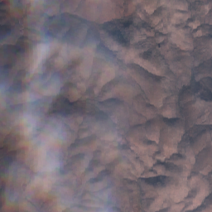
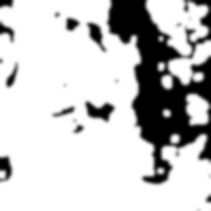
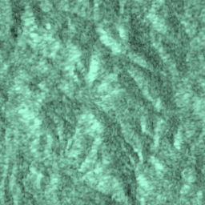
02 · THE DATA
Preparing the data in 3 steps
1
2
3
Find the clouds
→
Scale the radar
→
Stop shortcuts
ESA's s2cloudless tool marks every cloudy pixel, giving a cloud mask.
Radar values (in decibels) are rescaled to the range 0 – 1.
In 65% of training samples, cloudy areas are blurred so the model must rely on radar.
Cloudy
Cloud mask
Radar
SAR-Guided Satellite Cloud Removal
06 / 18

Slide 7
03 · THE MODEL
How the system works
Inputs
ECRformer
Prediction
Blend
→
→
→
Cloudy image
Radar · Cloud mask
Deep network that
rebuilds the ground
A full cloud-free
guess of the scene
Keep real clear pixels,
fill only the clouds
Training
Random 128 × 128 crops. A critic network (PatchGAN) judges if the result looks real.
Testing
Full 256 × 256 scenes. The critic is removed — only ECRformer runs.
SAR-Guided Satellite Cloud Removal
07 / 18

Slide 8
03 · THE MODEL
Inside ECRformer
An hourglass-shaped network: shrink to understand, expand to rebuild
Two-door input
Encoder
Decoder
Radar and optical enter through separate layers first — they behave very differently.
Attention core
Shrinks the image step by step while learning richer features.
Expands back to full size. Skip links carry fine edges across.
Looks at the whole scene at once to connect distant clues.
Model size: about 8.3 million parameters — light enough for a single desktop GPU.
SAR-Guided Satellite Cloud Removal
08 / 18

Slide 9
03 · THE MODEL
Train small, test big
Normal attention
ECRformer attention (MDTA)
Compares every pixel with every pixel.
Its size grows with the image — change the image size and it breaks.
Compares feature channels with each other.
Its size stays the same for any image size.
Result → trained on 128 × 128 crops, runs directly on 256 × 256 scenes.
SAR-Guided Satellite Cloud Removal
09 / 18

Slide 10
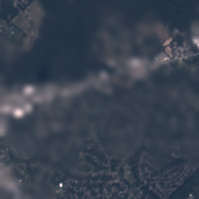
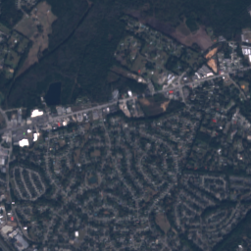
04 · SHARPER RESULTS
The blur problem
Why does it blur?
1 Unsure what lies under the cloud, the model plays safe and paints an average.
2 Radar and optical images are often shifted by 1–2 pixels, so sharp edges get punished.
Basic model (blurry)
Real clear image
SAR-Guided Satellite Cloud Removal
10 / 18

Slide 11
04 · SHARPER RESULTS
Teaching the model to be sharp
Seven loss functions, grouped by what they check
Colour
Structure
Realism
Is the colour right?
Are the edges right?
Does it look real?
Scale-decoupled L1
VGG perceptual
Multi-scale gradient
Edge correlation
Local contrast
PatchGAN adversarial
Feature matching
SAR-Guided Satellite Cloud Removal
11 / 18

Slide 12
04 · SHARPER RESULTS
The PatchGAN critic
A second network that acts like a strict art examiner.
• Looks at small regions and scores each one real or fake.
• Blurry patches get low scores, pushing ECRformer to draw sharp detail.
• Checks cloudy areas 4× more strictly than clear ones.
Used only during training — removed at test time.
+1.1
+0.9
+0.8
+1.0
+0.9
−0.8
−1.1
+0.7
+1.0
−0.9
−0.7
+0.8
+1.2
+0.8
+0.9
+1.1
Illustration: each score judges one region
(red = looks blurry / fake)
SAR-Guided Satellite Cloud Removal
12 / 18

Slide 13
05 · RESULTS
Building the final image
Output = (1 − M) × Cloudy + M × Prediction
Clear sky (M = 0)
Thick cloud (M = 1)
Cloud edges
Real satellite pixels are kept exactly as they are.
The model's reconstruction fills the gap.
Soft blending, so no visible seams.
SAR-Guided Satellite Cloud Removal
13 / 18

Slide 14


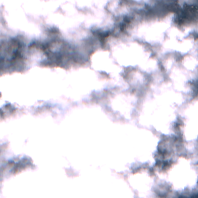

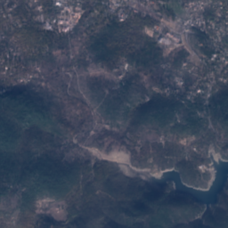

05 · RESULTS
Results on real scenes
Cloudy input
Basic model
Our model
Real clear image
Suburban
Farms
Lake
SAR-Guided Satellite Cloud Removal
14 / 18

Slide 15
05 · RESULTS
What the numbers say
Compared with the basic model, across four cloud-cover groups
+47% to +133%
≈ 0.9
30 – 32 dB
more fine detail recovered
detail ratio (1.0 = as sharp as reality)
PSNR under the cloud
Basic model detail ratio: 0.39 – 0.63 → Ours: 0.90 – 0.93
Detail ratio = how much of the real image's fine texture is reproduced.
SAR-Guided Satellite Cloud Removal
15 / 18

Slide 16
06 · CONCLUSION
An honest look
The trade-off
Limitations
• Sharper images score slightly lower on PSNR (0.3 – 1.2 dB).
• PSNR rewards safe, blurry averages — the known perception–distortion trade-off.
• We chose sharpness, which matters for real use.
• Cloud shadows are not always caught by the cloud mask.
• The clear reference image is taken on a different day.
• Training too long adds artificial grain, so we keep the best checkpoint.
SAR-Guided Satellite Cloud Removal
16 / 18

Slide 17
CONCLUSION
What we achieved
Removed clouds by combining radar with optical images
Turned blurry reconstructions into sharp, detailed ones
Trained on small crops, works on full scenes
Thank you
Questions are welcome
Before · After

Slide 18
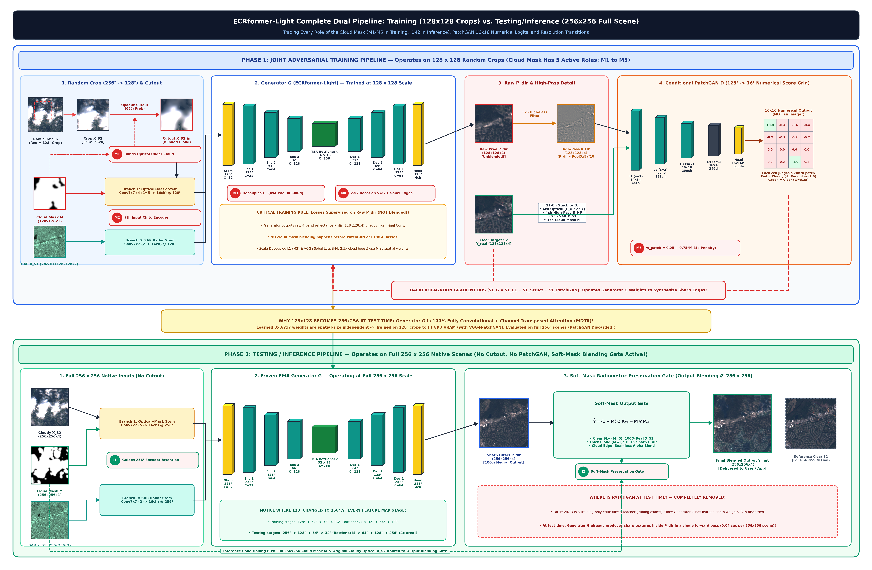
APPENDIX
Detailed pipeline (for reference)
SAR-Guided Satellite Cloud Removal
18 / 18

