Slide 1
Project based learning
COMP-3333 App Development
--- Temperature Conversion
Dr. Y. Yang, CS, PVAMU

Slide 2
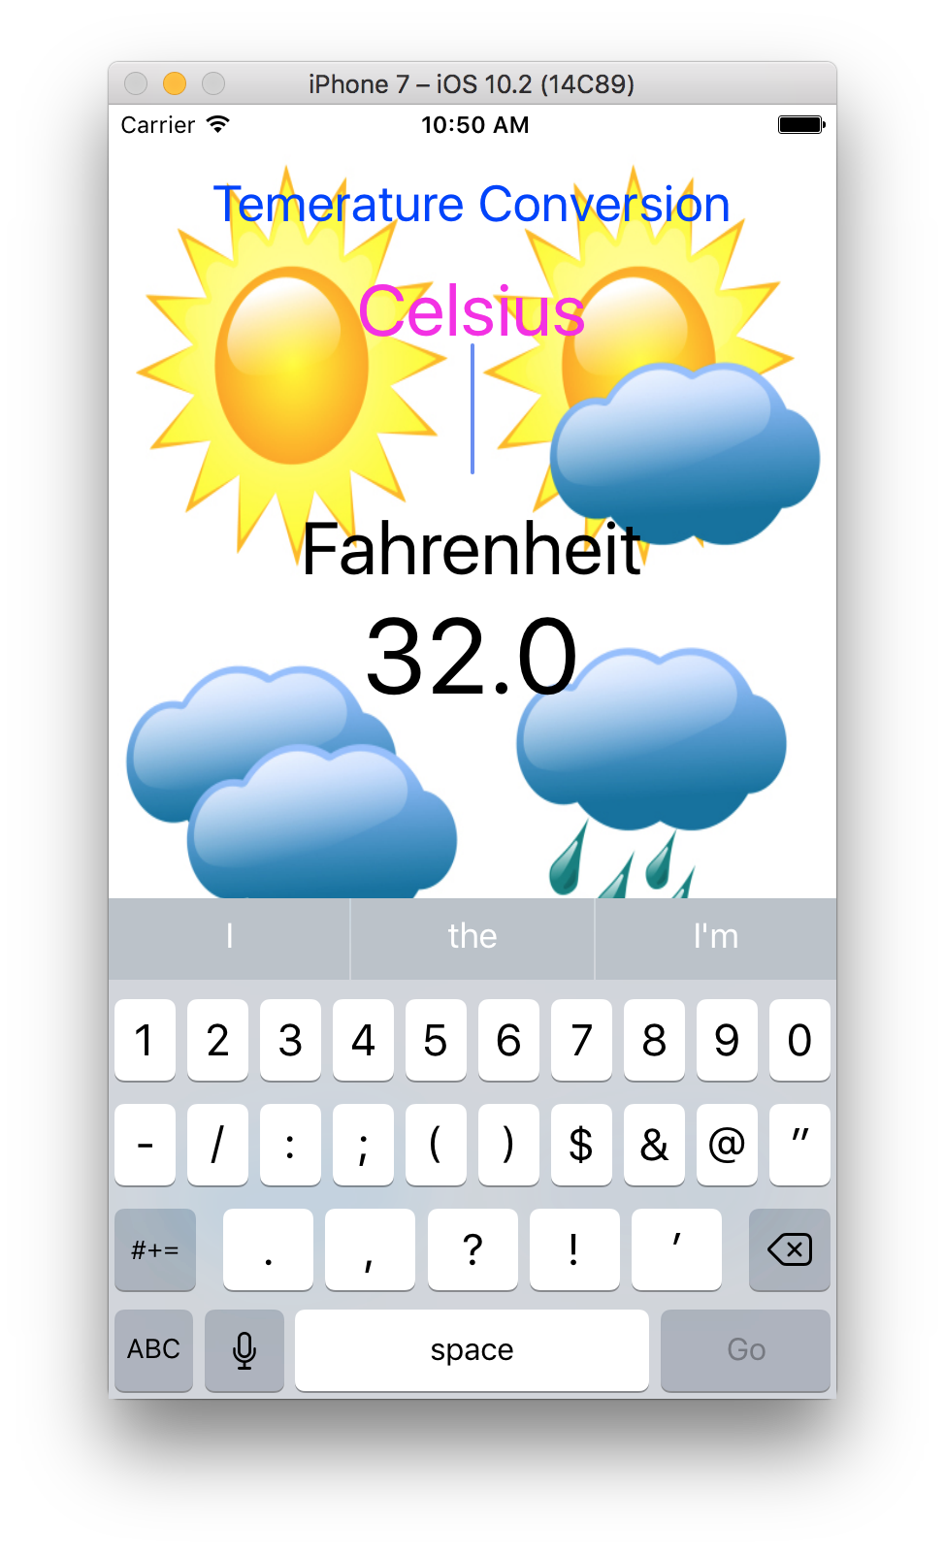
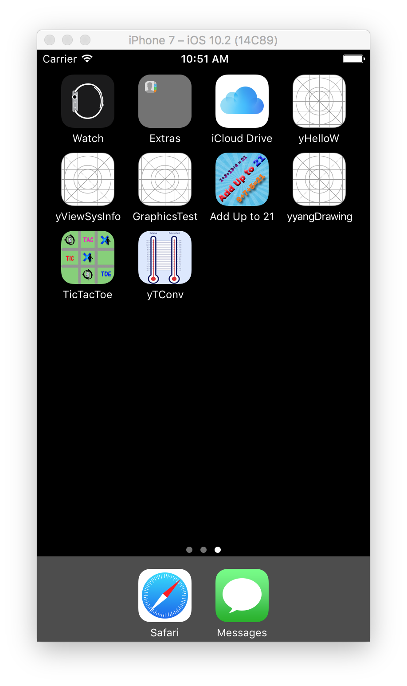
Convert temperature between Celsius and Fahrenheit
A button with an image as the background
Enter T in Celsius – display that in Fahrenheit
Enter T in Fahrenheit --- display that in Celsius

Slide 3

Create an single view app named as your 1st name
Download images/icons from eCourse (or have your own images/icons). Copy these files to your project. Add them to your project.
Add a button to the storyboard. Remove the button title. Set its background with the bg image. Use Automatic Layout function to make it cover the entire screen.
Add one label saying “temperature conversion”
Add one label saying “Celsius”
Add one text field for entering/displaying the T in Celsius
Add one label saying “Fahrenheit”
Add one text field for entering/displaying T in Fahrenheit
Build connection between text fields and their outlets, the background button (action)

Slide 4
Working on the code
Fahrenheit to Celsius: tInC = (tInF-32.0)*5.0/9.0
Celsius to Fahrenheit: tInF = (tInC*9.0/5.0)+32.0
Hit “Enter/Go” to carry out the conversion
Hit the background button also to do the conversion
“Enter frame”
“Clear when editing begins”
“Keyboard Type” --- Numbers and Punctuation
“Return Key” --- “Go”
“Border Style” --- dotted frame (no frame)
Align --- “Centralized”

Slide 5
Design icon for your app
Need to design one icon, but save it in several solutions:
iPhone App
Two png images in resolution of 120 x 120 and 180 x 180
iPad
Two png images in resolution of 76 x 76 and 152 x 152
iPad Pro
One png image in resolution of 167 x 167
Import these images to your project.

