Slide 1
Project based learning
COMP-3333 App Development
--- Flashcard II
Dr. Y. Yang, CS, PVAMU

Slide 2
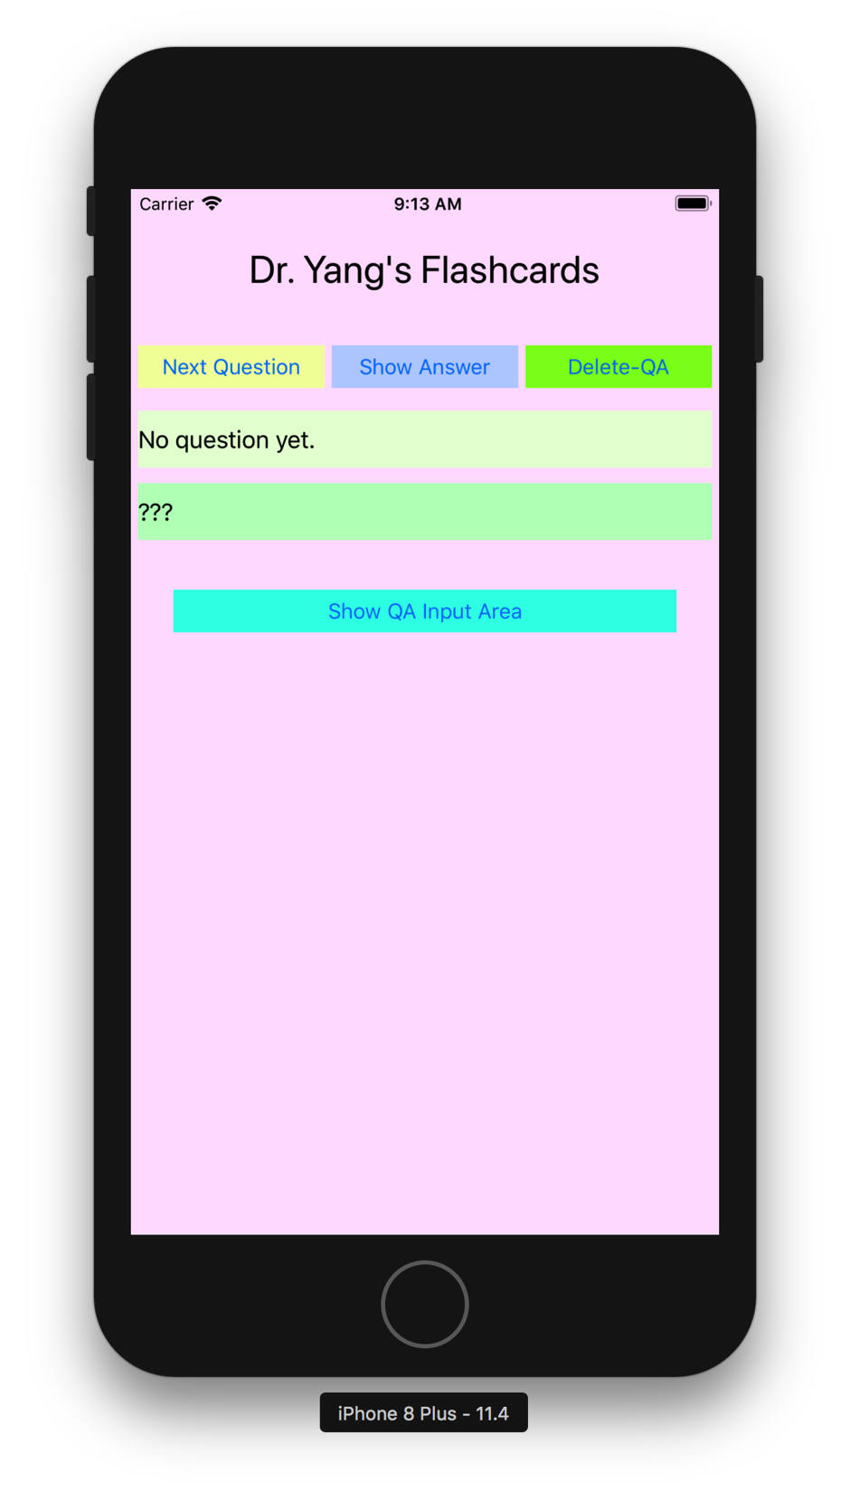
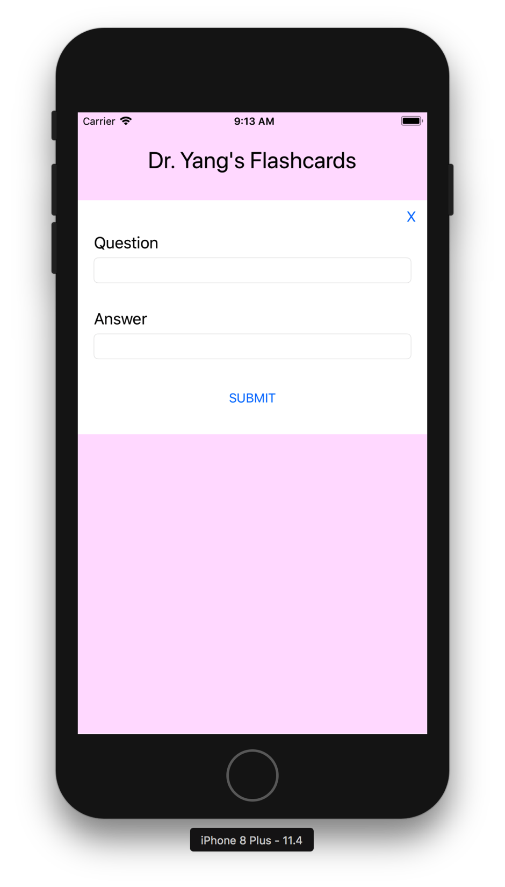
Based on the simplified 1st version of flashcard, we are now building the 2nd version of the app.
The QA sets in the 1st version are imbedded in the code, thus not allow user to make changes --- add/delete.
This 2nd version will allow users to add new QA sets and delete QA sets
Should we use the screen bottom area for user to enter QA sets?
We will have an extra view container holding the input widgets → need to be hide/show-up
Use this area for
user to enter info?

Slide 3

Interface Design
Design 1st part of the interface
Add constraints to layout them appropriately

Slide 4

Interface Design
Design the 2nd part of the interface
One “View” serving as a container
Inside this view, we have a button “x”, label “question”, label “answer”, and button “Submit”. These widgets are inside the view container

Slide 5
Interface Design
Add constraints to the “View”
Add constraints to the widgets inside this view appropriately.
Now coding…

