Slide 1
AutoBoost: Test Suite Boosting by Patches
Shing-Chi Cheung
HKUST

Slide 2
Preliminary
Background: Test suites of existing projects are mostly inadequate due to two common issues
Issue 1: Insufficient coverage
Issue 2: Weak test oracles
Goal: Automatically boost the test suite of existing projects using their patches

Slide 3
Insight
Automated program repair generates many plausible patches but few of them are correct because existing test suite is too weak to differentiate correct patches from incorrect ones
Automated generated tests cannot improve the effectiveness of automated program repair because many tests generated are noisy or irrelevant to the fault to be repaired

Slide 4
Idea to address the first issue
Given a correct patch and a set of incorrect plausible patches, we can retain only those generated tests that are passing for the correct patch and failing for the incorrect patches
These retained tests likely capture additional domain knowledge made by developers beyond the existing test suite
We can repeat the above two steps on a collection of patches prior to a particular release to boost its test suite
Evaluation: We can evaluate (1) whether the boosted test suite can detect faults of the release that cannot be detected by the original test suite, (2) whether the boosted test suite can facilitate automated fault localization, (3) correct patches are more likely to be generated using the boosted test suite than the original test suite and (4) the boosted test suite achieves a higher coverage than the original test suite
Corpus: Defect4J ver 2.0 (17 projects) https://github.com/rjust/defects4j

Slide 5
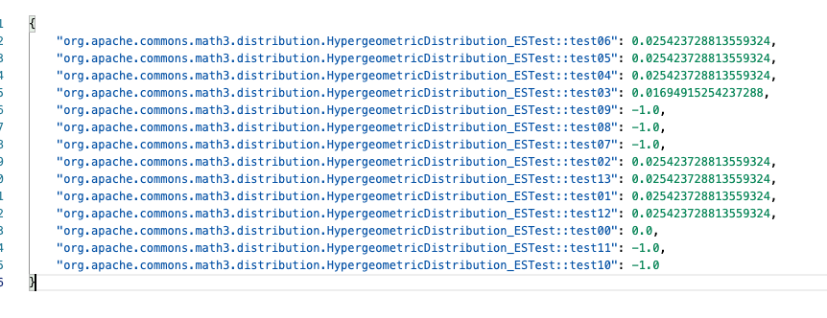
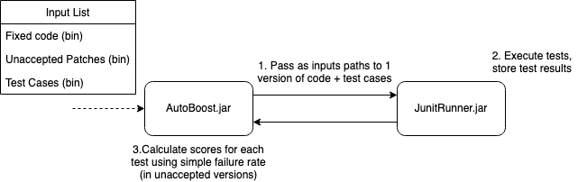
Current
Ideas extending it will be discussed
Example using defects4J-Math-2

Slide 6
Potential open issues
Current version == before fixing?
Would it help to use fixed version to generate test, use buggy version, similar to unaccepted patches, to check failure rate?
Given a patch, which program version should we use to generate tests?
The version to which the patch is applied
The current version
I incline to use the current version because it is the version that we boost its test suite
What if Evosuite is unable to generate a test that accepts the given patch (i.e., the patched program version) but only rejects some of the incorrect plausible patches
I incline to identify a minimal set of the generated tests whose inclusion to the original test suite can maximally promote the rank of the faulty statement (i.e., the statement where the patch is applied) in fault localization. Ideally, the rank of the faulty statement can be promoted to the top after inclusion of the test set.
Next page

Slide 7
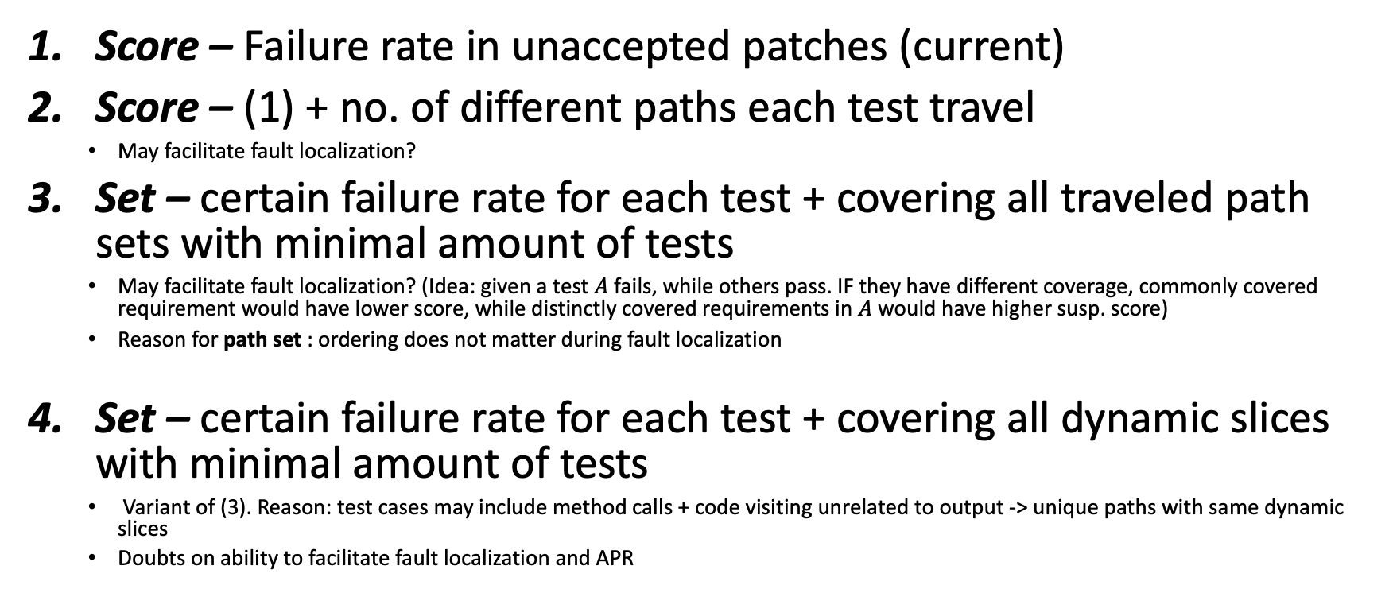
Ideas on output
Score – Failure rate in unaccepted patches (current)
Score – (1) + no. of different paths each test travel
May facilitate fault localization?
Set – certain failure rate for each test + covering all traveled path sets with minimal amount of tests
May facilitate fault localization? (Idea: given a test $A$ fails, while others pass. IF they have different coverage, commonly covered requirement would have lower score, while distinctly covered requirements in $A$ would have higher susp. score)
Reason for path set : ordering does not matter during fault localization
Set – certain failure rate for each test + covering all dynamic slices with minimal amount of tests
Variant of (3). Reason: test cases may include method calls + code visiting unrelated to output -> unique paths with same dynamic slices
Doubts on ability to facilitate fault localization and APR
Fault localization and APR consider covered target requirement, not dynamic slice

Slide 8
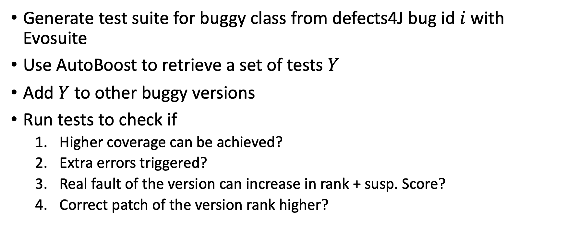
Experiments in mind
Generate test suite for buggy class from defects4J bug id $i$ with Evosuite
Use AutoBoost to retrieve a set of tests $Y$
Add $Y$ to other buggy versions
Run tests to check if
Higher coverage can be achieved?
Extra errors triggered?
Real fault of the version can increase in rank + susp. Score?
Correct patch of the version rank higher?

Slide 9
Issues I encounter
Tried multiple APR tool from https://program-repair.org/tools.html, ran them for HOURS, yet they either find NO PLAUSIBLE FIXES OR 1 PLAUSIBLE FIXES
List of tools I have tried: ARJA, Astor, GenPat, kGenProg, SimFix

Slide 10
Potential open issues
Automated program repair techniques can generate many plausible patches. Should all of them (i.e., the program versions obtained by applying each of these patches) need to be considered?
I think we need only to consider those incorrect plausible patches that are ranked higher than the correct patch in automated program repair

Slide 11
Idea to address the second issue
Not covered
Design a set of mutation operators to tighten test oracles based on the common patterns found in unit test assert statements
Generate mutants by tightening the assert statements in the existing test suite
Retain those mutants that accept the correct patch and reject all incorrect patches generate by automated program repair techniques
The retained mutants likely capture additional domain knowledge beyond the existing test oracles
Repeat the above three steps on a set of patches prior to a particular release to boost the test oracles of its test suite
Evaluation: Similar to the previous one. At the end, we apply AutoBoost to the latest release and see if the boosted test suite can detect new bugs

