Slide 1
AutoBoost: Test Suite Boosting by Patches
Shing-Chi Cheung
HKUST

Slide 2
Preliminary
Background: Test suites of existing projects are mostly inadequate due to two common issues
Issue 1: Insufficient coverage
Issue 2: Weak test oracles
Goal: Automatically boost the test suite of existing projects using their patches

Slide 3
Insight
Automated program repair generates many plausible patches but few of them are correct because existing test suite is too weak to differentiate correct patches from incorrect ones
Automated generated tests cannot improve the effectiveness of automated program repair because many tests generated are noisy or irrelevant to the fault to be repaired

Slide 4
Idea to address the first issue
Given a correct patch, we can generate many passing tests.
We can retain only those generated tests that are passing for the correct patch and failing for the incorrect plausible patches. The retained tests should also reject the mutants of the patched code.
These retained tests likely capture additional domain knowledge made by developers beyond the existing test suite.
We can repeat the above two steps on a collection of patches prior to a particular release to boost its test suite
Evaluation: We can evaluate (1) whether the boosted test suite can detect faults of the release that cannot be detected by the original test suite, (2) whether the boosted test suite can facilitate automated fault localization, (3) correct patches are more likely to be generated using the boosted test suite than the original test suite and (4) the boosted test suite achieves a higher coverage than the original test suite
Corpus: Defect4J ver 2.0 (17 projects) https://github.com/rjust/defects4j

Slide 5
Potential open issues
Given a patch, which program version should we use to generate tests?
The version to which the patch is applied
The current version (after fixing)
I incline to use the current version because it is the version that we boost its test suite
What if Evosuite is unable to generate a test that accepts the given patch (i.e., the patched program version) but only rejects some of the incorrect plausible patches
I incline to identify a minimal set of the generated tests whose inclusion to the original test suite can maximally promote the rank of the faulty statement (i.e., the statement where the patch is applied) in fault localization. Ideally, the rank of the faulty statement can be promoted to the top after inclusion of the test set.

Slide 6
Output
List of prioritized test cases
Priority (under testing):
Failure rate in incorrect patches
Failure rate in incorrect patches + no. of different targets covered by each test
Targets:
Path
Dynamic slice
Statement set
Branch set
Another idea: use differential path coverage for fitness function of test generation tool
Would test after priority, may use it to compare with simply using priority

Slide 7
Output – (2)’s implementation
Instrument the fixed class and generate index file with <statement, index> mapping in instrumentation
Instrument the plausible fixes based on index file generated (i.e. only statements that are SAME with fixed class would be “counted” when invoked)
Execute test cases on correct fix and plausible fixes to collect target coverages
Extra testing: instrument only modified class? Or all classes?
Intuition: would affect test case ranking, not sure about the effects on future fault localization

Slide 8
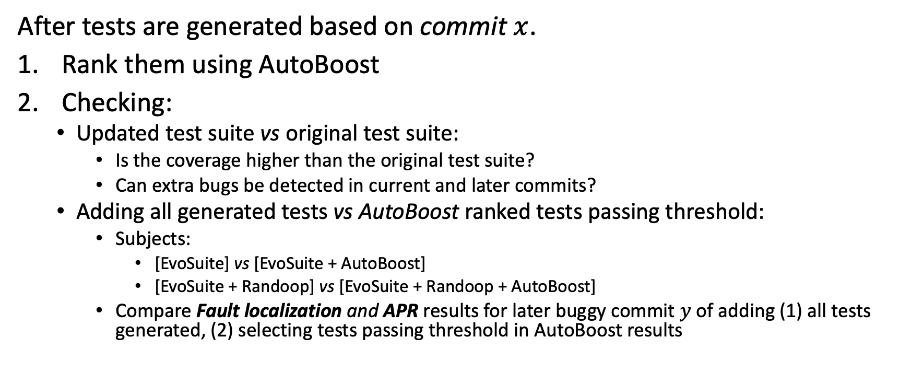
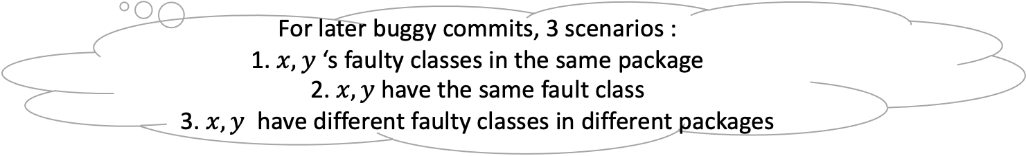
Evaluation Implementation
After tests are generated based on commit $x$.
Rank them using AutoBoost
Checking:
Updated test suite vs original test suite:
Is the coverage higher than the original test suite?
Can extra bugs be detected in current and later commits?
Adding all generated tests vs AutoBoost ranked tests passing threshold:
Subjects:
[EvoSuite] vs [EvoSuite + AutoBoost]
[EvoSuite + Randoop] vs [EvoSuite + Randoop + AutoBoost]
Compare Fault localization and APR results for later buggy commit $y$ of adding (1) all tests generated, (2) selecting tests passing threshold in AutoBoost results
For later buggy commits, 3 scenarios :
1. $x, y$ ‘s faulty classes in the same package
2. $x, y$ have the same fault class
3. $x, y$ have different faulty classes in different packages
Notes:
Subjects:

Slide 9
Potential open issues
Automated program repair techniques can generate many plausible patches. Should all of them (i.e., the program versions obtained by applying each of these patches) need to be considered?
I think we need only to consider those incorrect plausible patches that are ranked higher than the correct patch in automated program repair

Slide 10
Idea to address the second issue
Design a set of mutation operators to tighten test oracles based on the common patterns found in unit test assert statements
Design a set of mutation operators to the patched code
Generate mutants by tightening the assert statements in the existing test suite
Retain those mutants that accept the correct patch and reject all incorrect patches generated by automated program repair techniques as well as all inequivalent mutants of the patched code
The retained mutants likely capture additional domain knowledge beyond the existing test oracles
Repeat the above three steps on a set of patches prior to a particular release to boost the test oracles of its test suite
Evaluation: Similar to the previous one. At the end, we apply AutoBoost to the latest release and see if the boosted test suite can detect new bugs

