Slide 1
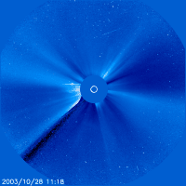
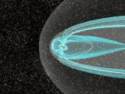
Imaging the Ionosphere and plasmasphere using tomographic technique!
Endawoke Yizengaw
IGPP, UCLA, Los Angeles, California
Prof. Peter Dyson and Dr. Elizabeth Essex
Physics Department, La Trobe University, Australia

Slide 2
Research Goals
The overall purpose of this research work was:
To develop computerized tomographic reconstructions technique and image the structure of the ionosphere and plasmasphere using GPS.
Validate the tomographically obtained electron densities with data measured by other independent instruments such as ionosonde (in the present case).
Then, use the technique to examine the behavior of plasma content in the ionosphere, particularly during the disturbed periods.
Apply the technique to the GPS data from LEO satellites (e.g. FedSat, the Australian first ever satellite in 30 years) and image the plasma content in the topside ionosphere and plasmasphere.

Slide 3
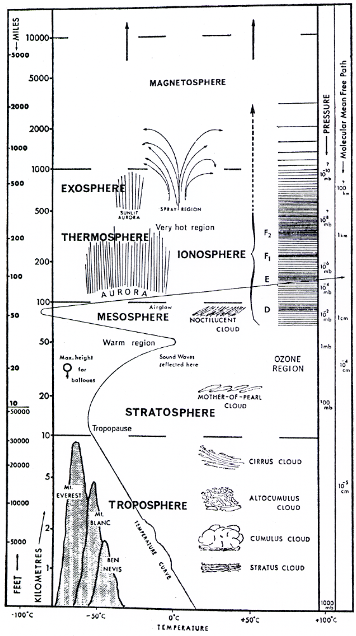
Electron density (cm⁻³)
10³
10⁵
10⁷
Electron density profile
Region of interest
Ionosphere and plasmasphere
Topside ionosphere and plasmasphere
Ras Dashen

Slide 4
What does it mean Tomography?
Tomography is the process of inferring the internal structure of an object, which can not be measured directly, by mathematically treating measurements of some integrated quantity determined along various paths through that object.
Perhaps tomographic technique is most familiar in its medical applications, where a sequence of X-rays is usually sent through a body at a number of different angles to allow the determination of the tissue density in a plane of interest
First introduced to ionospheric research in 1986 by Austen and his group. They used model simulation to prove their proposal.
Then in 1990 the Russian research team took advantage and reported the first experimental tomographically reconstructed results (Andreeva et al., 1990).
Total Electron Content (TEC) of the ionosphere is the main ingredient of ionospheric tomography.

Slide 5
Where can we get the ingredient?

Slide 6
Possible stores of TEC
TEC can be obtained from the signals of
geostationary orbit satellite with an altitude of 36000 km.
low-altitude (~1000 km) polar orbit satellite (e.g. the US Navy Navigation Satellite System (NNSS))
The disadvantage of these satellite measurements are
For type (): Limited geographic coverage. Further more, TEC can be measured up to an altitude of ~2000 km because the TEC is weighted by the Earth’s B, which decrease with altitude
For type (): TEC can be measured only up to the height of the satellite.
Today, Global Positioning System (GPS) has solved all these problems and became possible to measure TEC up to the heights of GPS (20,200 km) in a good global coverage. It uses dual frequency measurement technique.

Slide 7
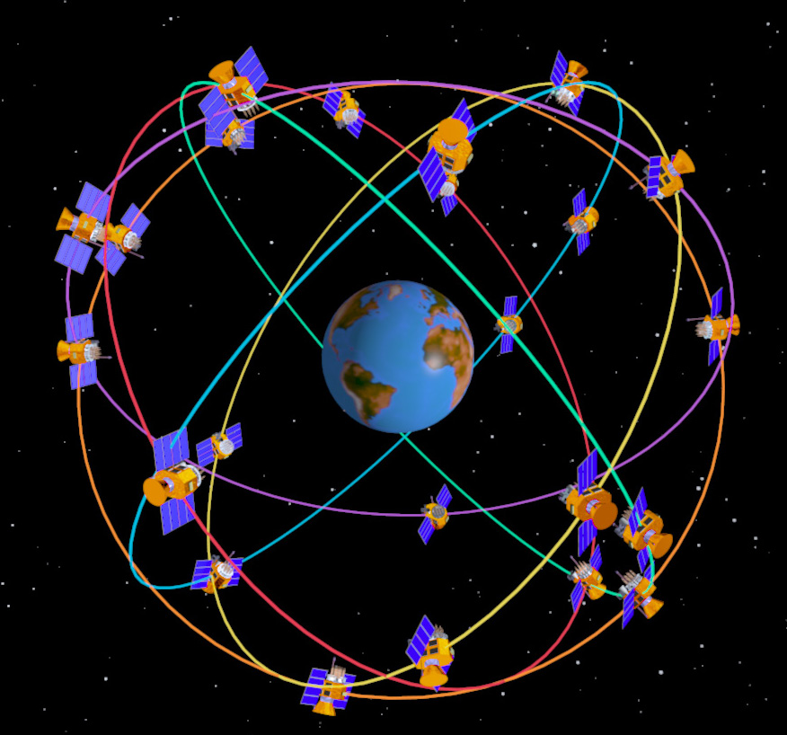
GPS Satellite orbit constellation
GPS satellite information
Altitude: ~20,200 km
Orbit inclination: 55°
Orbiting period: 12 hrs
Transmit dual frequency
f₁ = 1.575 GHz
f₂ = 1.228 GHz

Slide 8
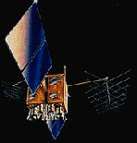
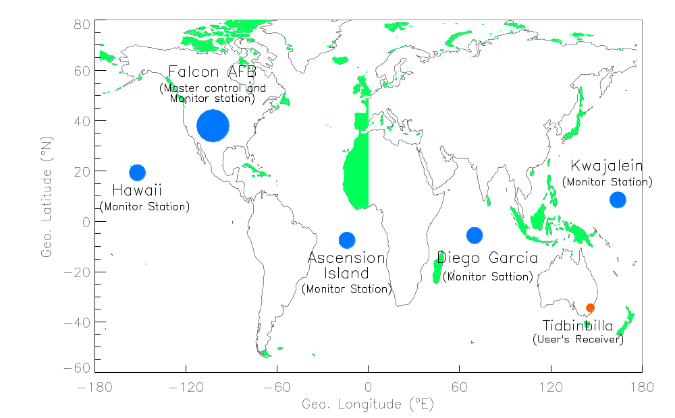
GPS Segments
Space Segment
Ranging information from satellite broadcast
LEO
Send the information to master control station that precisely calculate the satellite orbit
Converted to updated navigation message for each satellite and transmitted back to the satellites
The satellites then broadcast coded signals to the user segment
Control Segment
User Segment

Slide 9
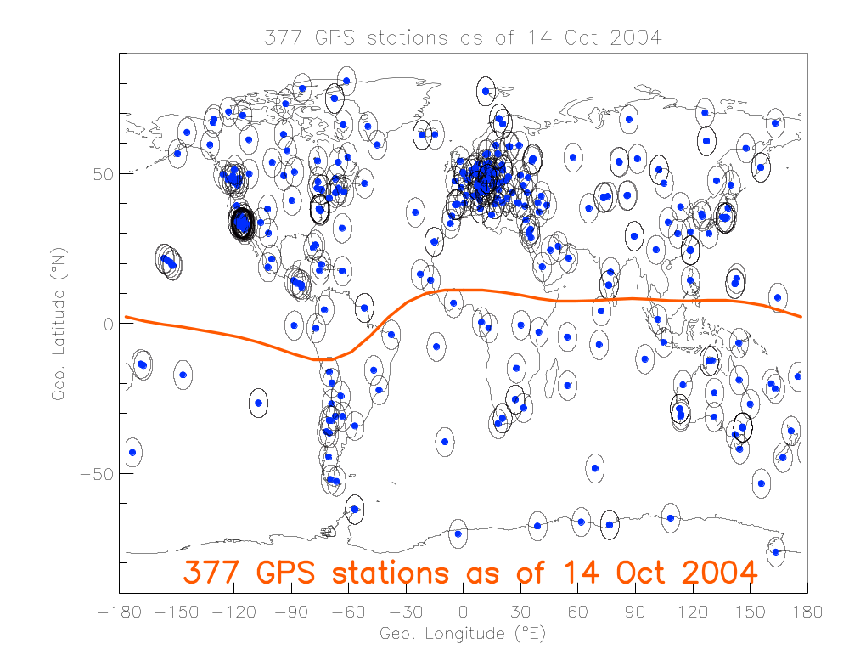
Global GPS receivers network

Slide 10
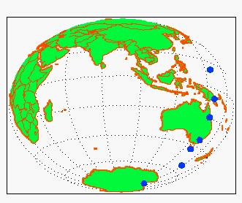
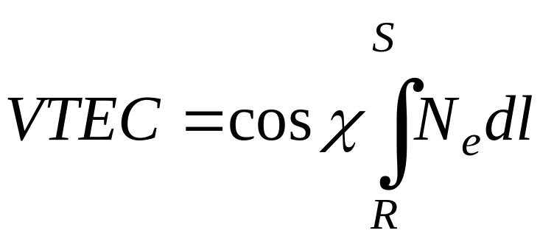
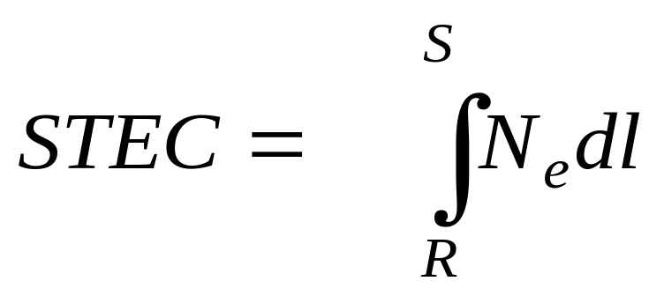
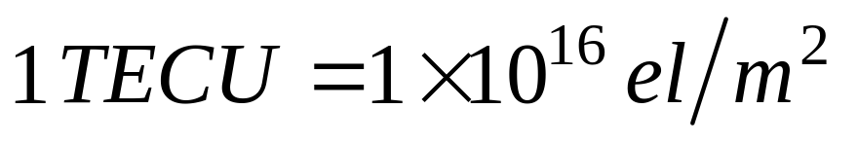
Mathematical paths to the pure ingredients (TEC)
GPS Satellite
Sub-Ionospheric point
S
χ
Zenith
R
400 km
Ionospheric pierce point.
Ionosphere
Where, VTEC is vertical TEC
Where, STEC is slant TEC

Slide 11
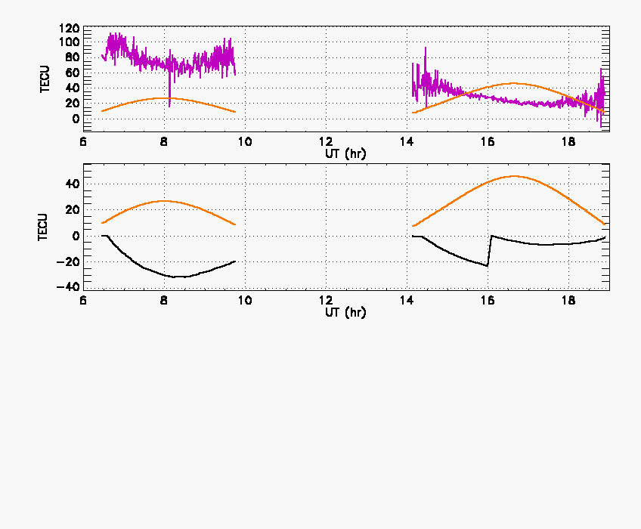
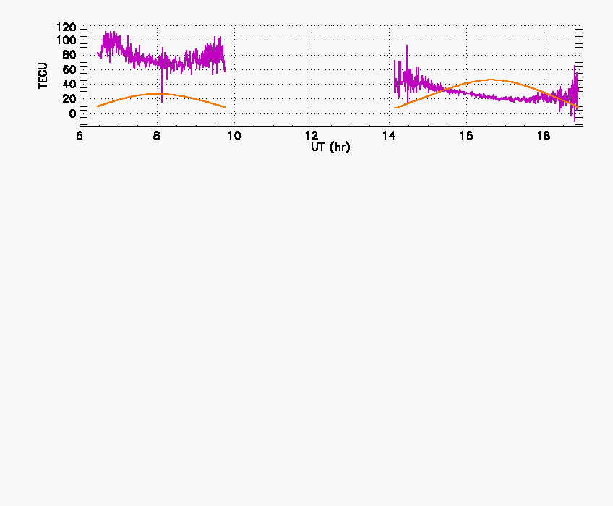
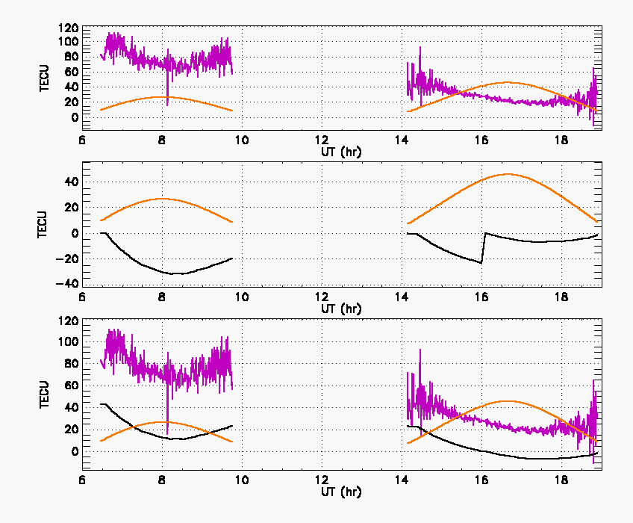
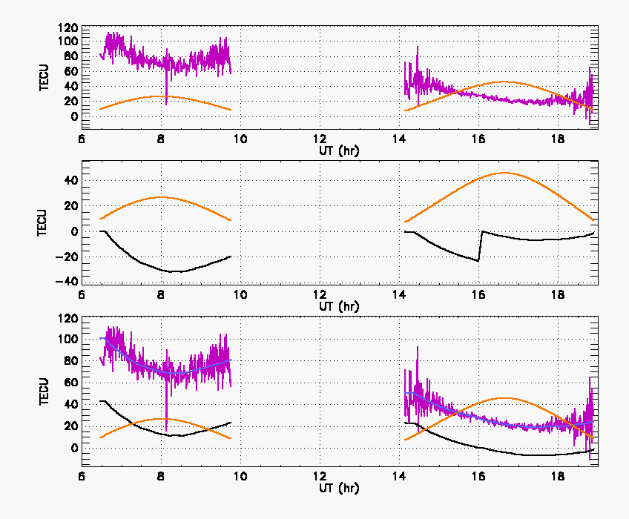
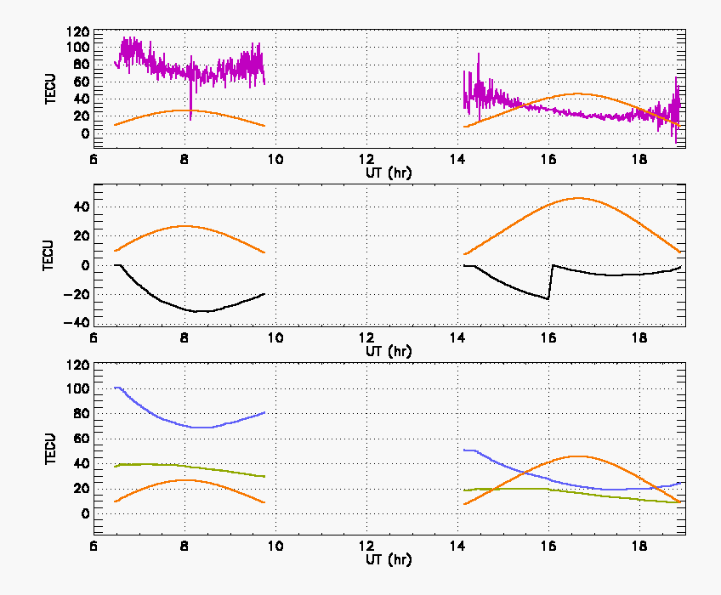
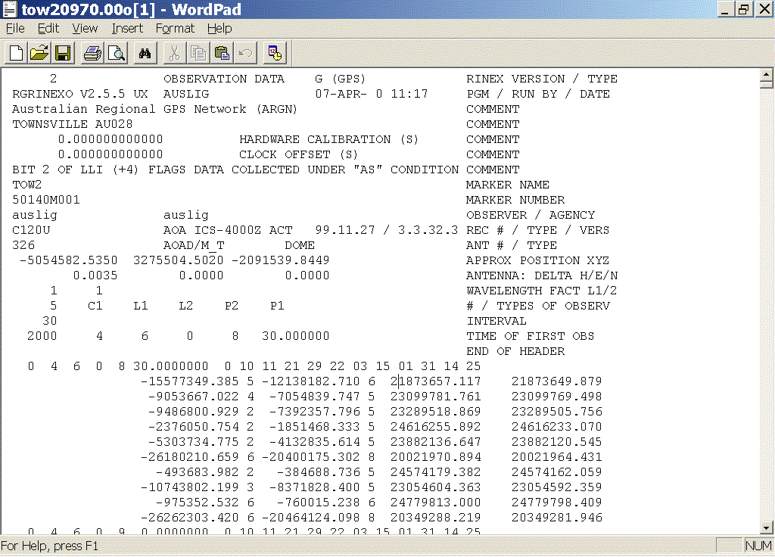
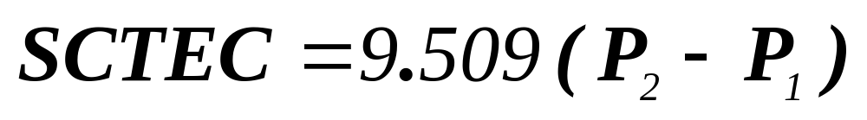
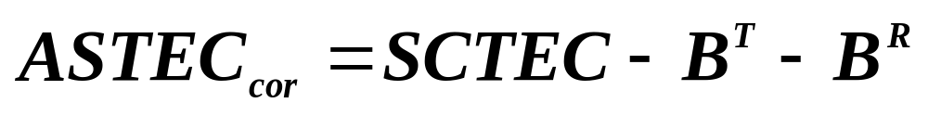
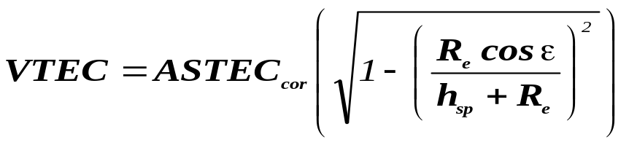
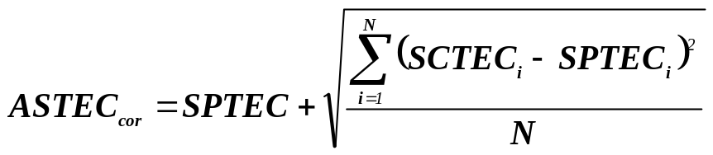
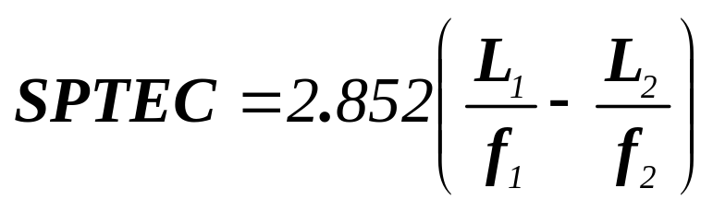
What can be measured from GPS signals?
Code TEC
Elevation angle
Phase TEC
Elevation angle
Cycle slip
Code TEC
Phase TEC
Elevation angle
Fitted TEC
Vertical TEC

Slide 12
Validating GPS TEC before using as input to tomography!

Slide 13
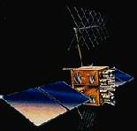
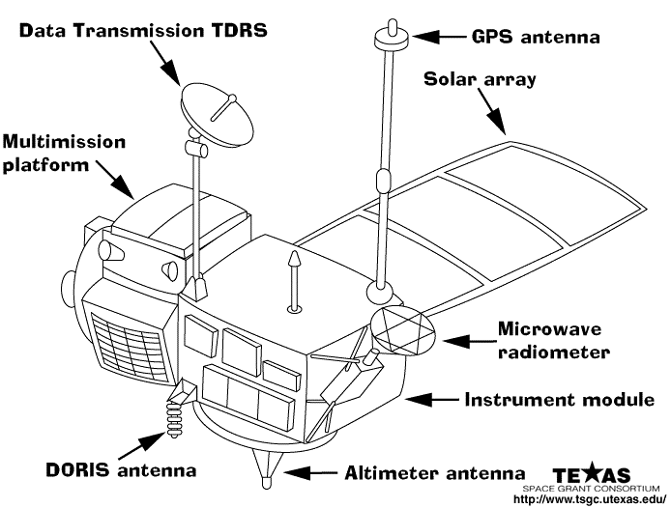
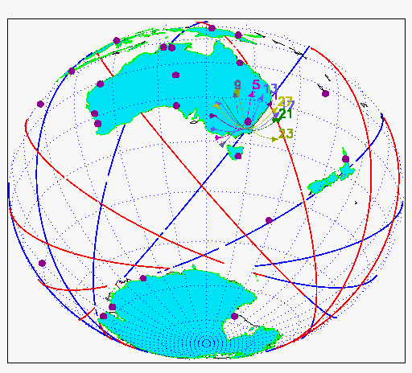
GPS and TOPEX satellite coordination
The TOPographic EXplorer (TOPEX)
Alt. : 1336 km
Orbit incl. 66°
Orbit per.: 1.87 hr

Slide 14
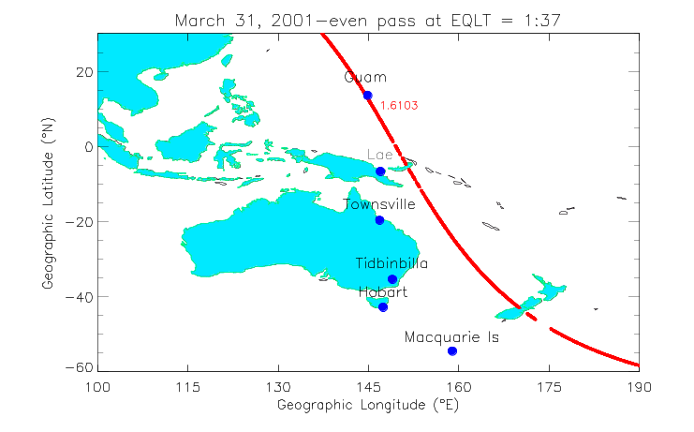
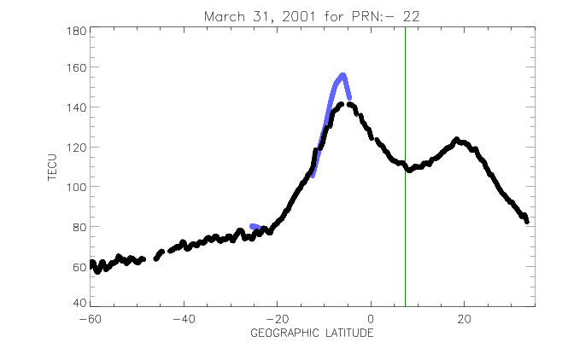
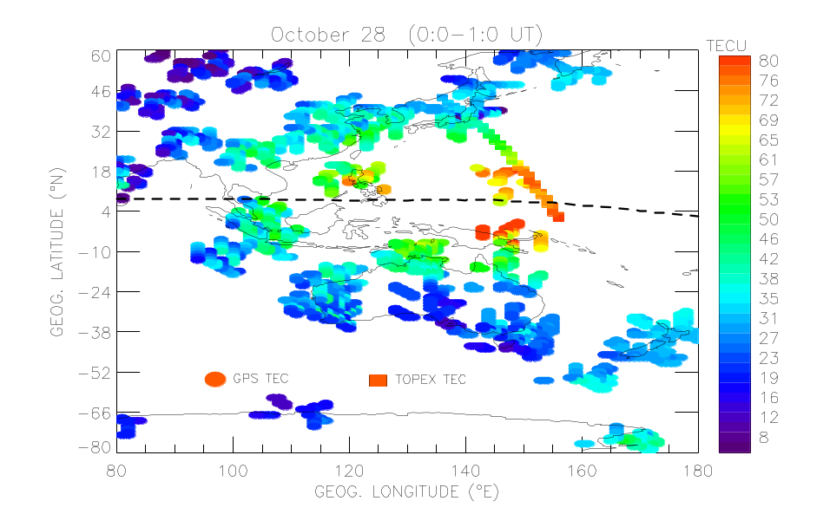
Comparison of GPS and TOPEX TEC
TEC from individual GPS
Yizengaw et al., 2005b

Slide 15
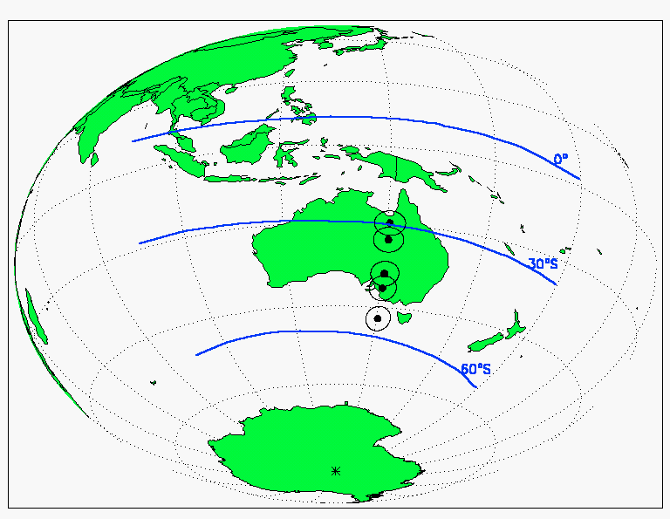
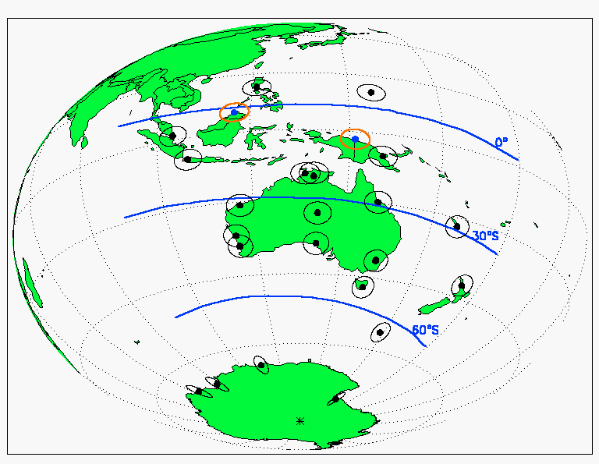
GPS receivers used for tomography

Slide 16
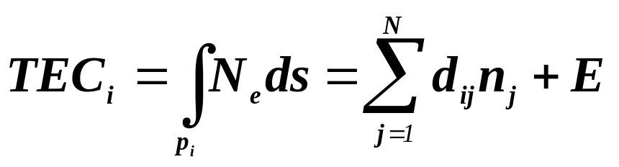
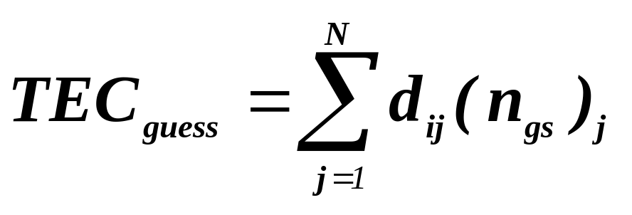
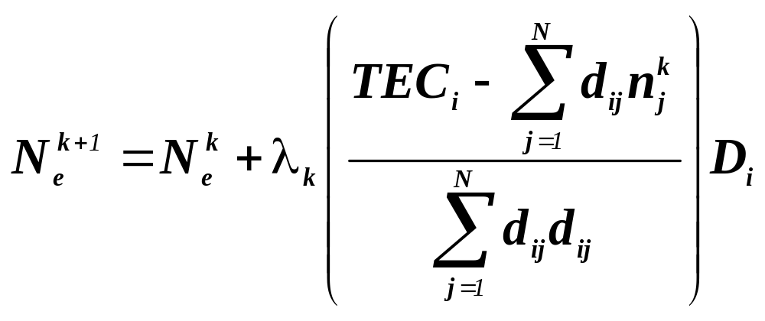
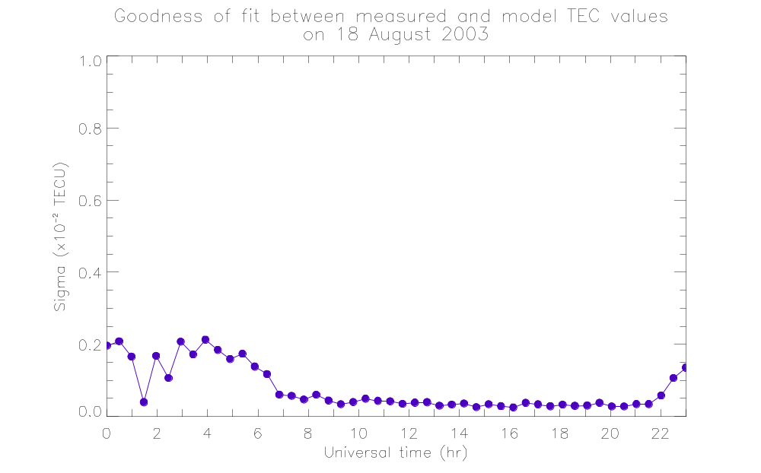
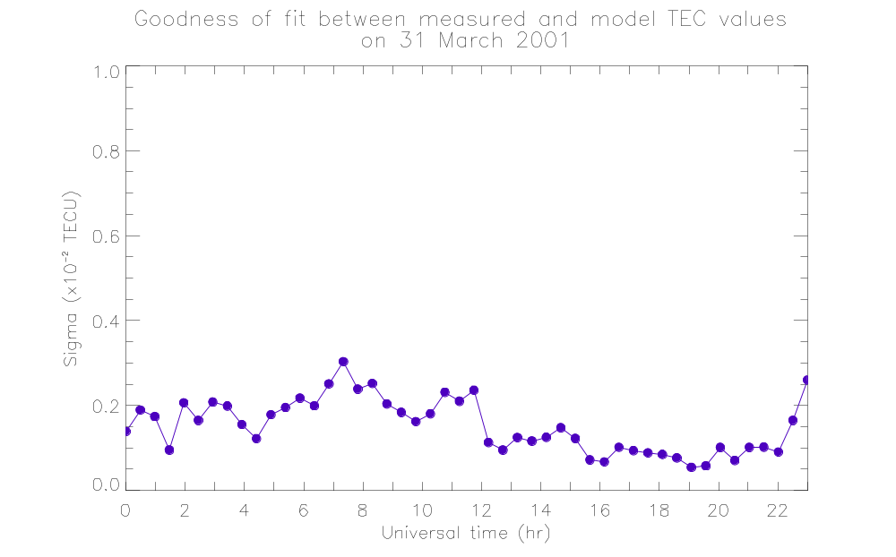
CIT inversion technique
Divide the imaging region in to number of pixels
T
Quiet day
P_{i}
1000 km
Fill each pixel with initial electron density guess, which can be obtained from model profiles (IRI for bottom side and CHAPMAN profile for the top side ionosphere).
100 km
Calculate TEC for the current raypaths through initial guess.
19°S
43°S
R
Quiet day
Disturbed day
Using an iterative fashion, the vertical electron density profile then can be calculated as:
0.002 TECU
Which ensures that the correction remains stable

Slide 17
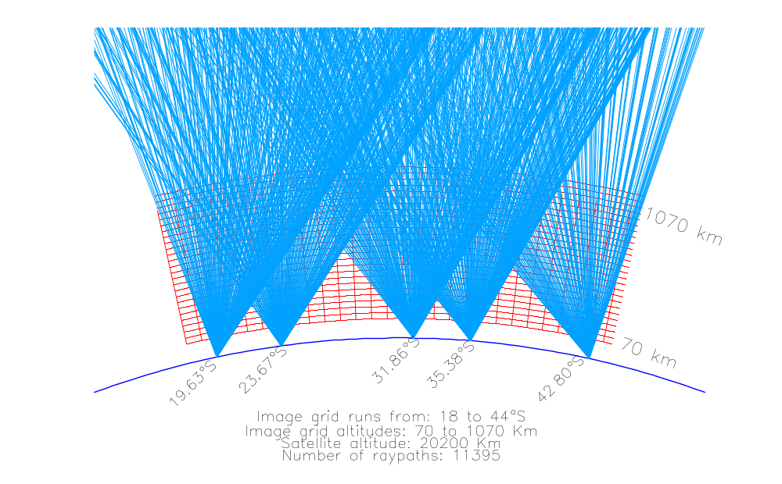
Ground based GPS tomography setup
S
GPS Satellites
34.0°S
43.0°S
47.0°S
29.6°S
55.1°S
Corresponding geomagnetic latitudes

Slide 18
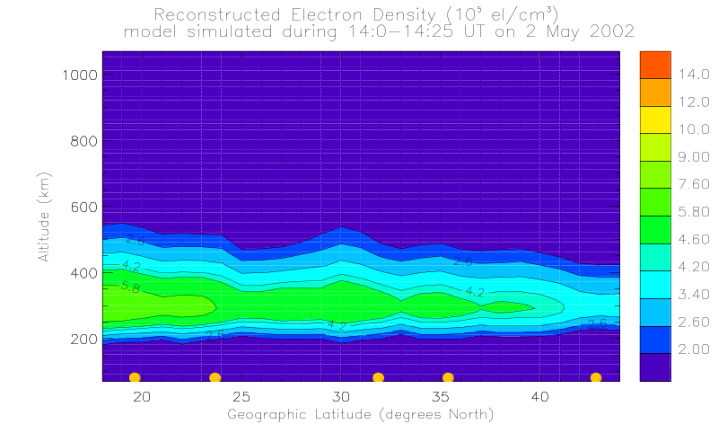
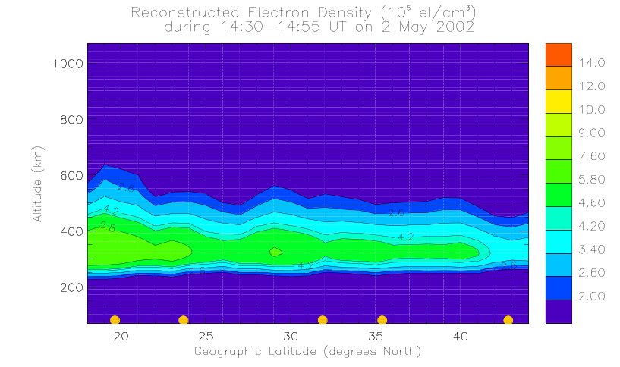
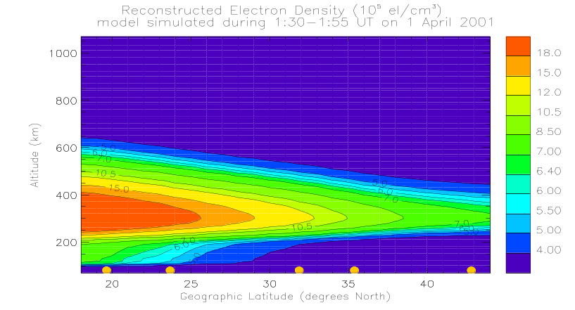
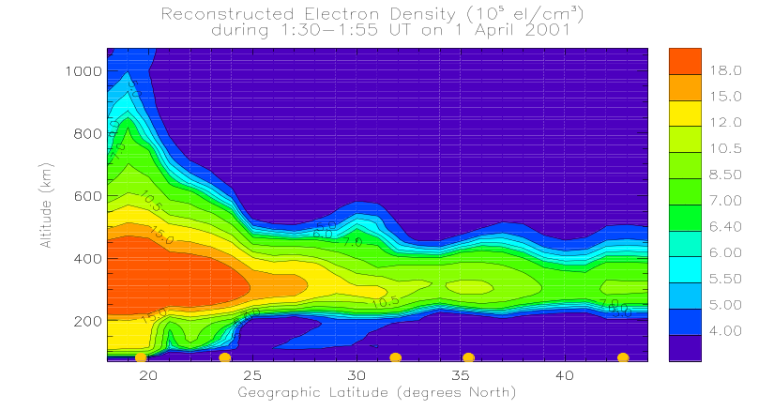
Comparison between tomographic images obtained using model simulation and real data.
During quiet day (with K_{p} < 3)
Model-simulation
Experimental data
Geographic latitude (degree South)
Geographic latitude (degree South)
During disturbed day (with K_{p} > 6)
Model-simulation
Experimental data
Geographic latitude (degree South)
Geographic latitude (degree South)

Slide 19
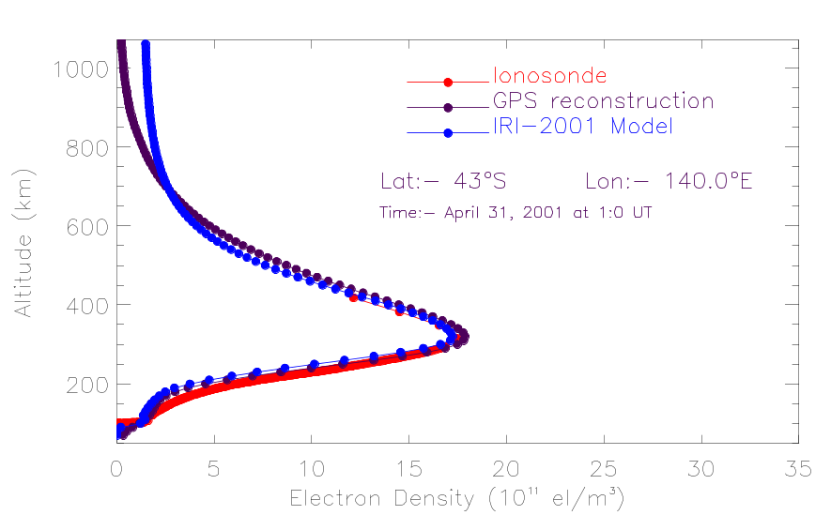
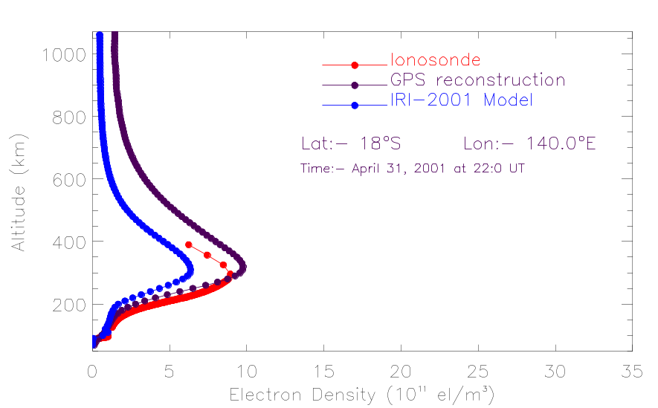
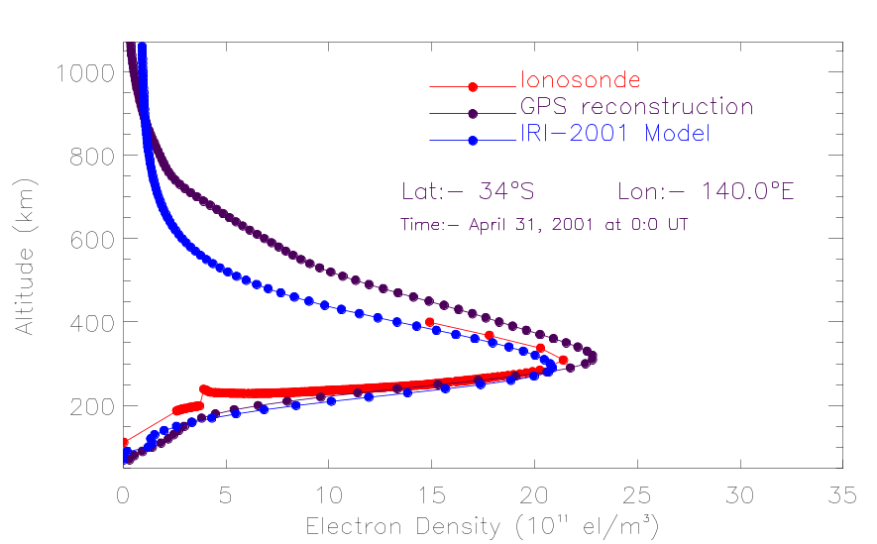
Validation with other independent measurements and model profiles
Quiet time
Disturbed time
March 31,
March 31,
Tomographic electron density profiles (black dots), IRI-2001 model density profiles (blue dots) and density profiles determined from ionosonde observations at Hobart, Canberra, and Townsville (red dots) are plotted. These three independent density profiles generally show excellent agreement.
Disturbed time
March 31,

Slide 20
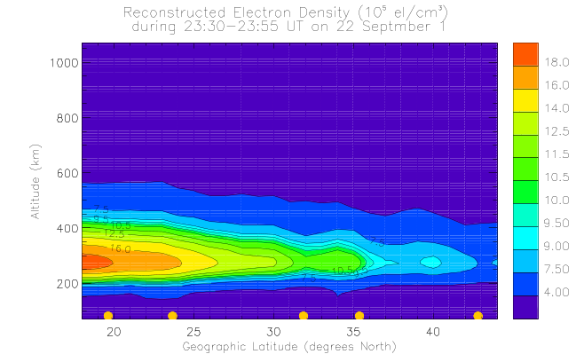
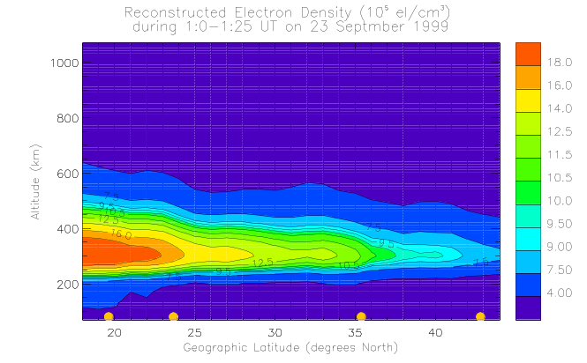
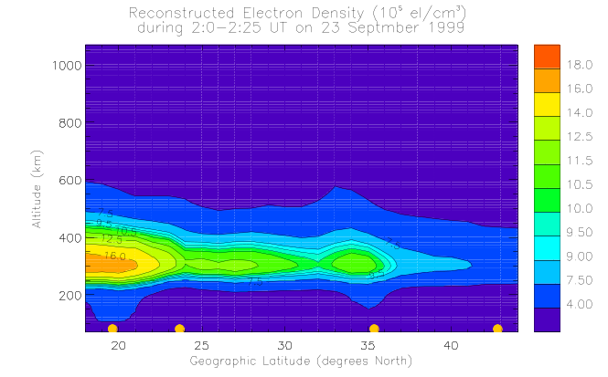
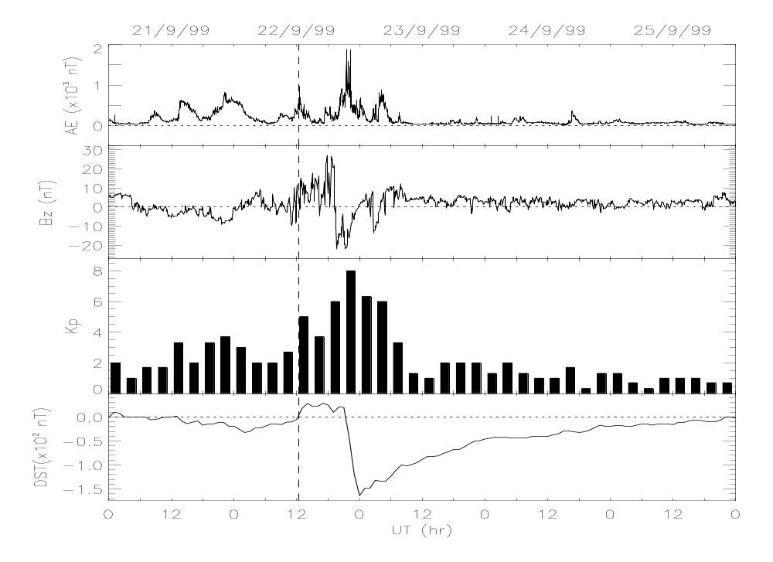
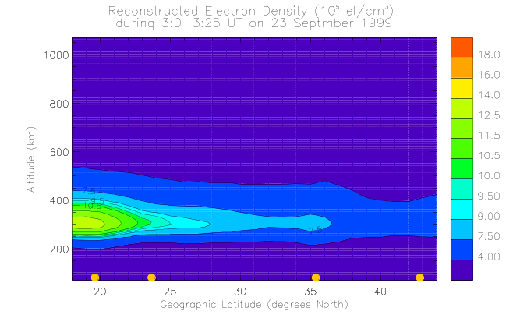
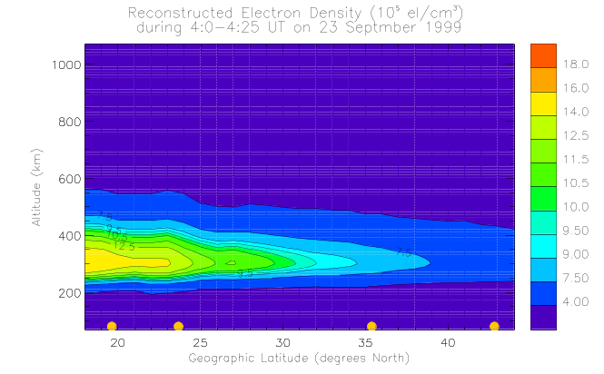
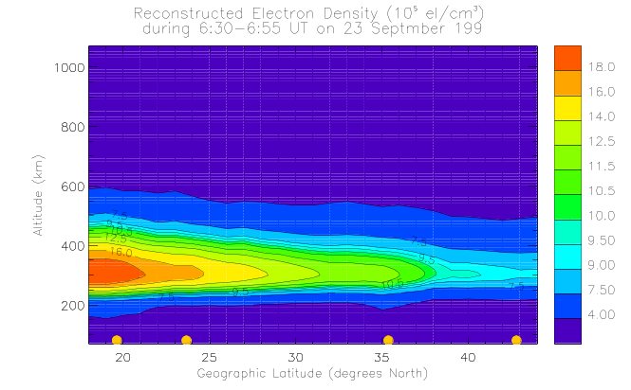



  Composition change observations
09:30 LT
11:00 LT
12:00 LT
13:00 LT
14:00 LT
16:30 LT
18:00 LT
19:00 LT
21:30 LT
Geographic latitude (degree South)
Geographic latitude (degree South)
Geographic latitude (degree South)

Slide 21





Quasi-wave structure observation
At 35.38°S latitude
at 42.80°S latitude
23:30 LT
00:00 LT
00:30 LT
01:00 LT
Yizengaw et al., 2005a
Quasi-wave structures perturbing the ionosphere are evident, demonstrating that tomography can be an important technique for studying ionospheric irregularities.

Slide 22





Ionospheric perturbation observation (cont.)
54.12°S
The rates of change of TEC (dTEC) at 35.38°S and 42.80°S latitudes also indicate that the TIDs were migrating quatorward.
45.72°S
Yizengaw et al., 2005a
Latitudinal variations of electron density at three altitudes, determined by subtracting background density values from the density values shown in the previous slide. Quasi-wave disturbance are clearly evident and their parameters are more readily determined from this type of plot.
Figure 7

Slide 23






  F-layer uplifting during Halloween storm
12:30 LT
19:30 LT
17:30 LT
E × B

Slide 24







  Average density observations
Taken all the TEC data obtained in a three hour period on a single day and used it to derive a tomographic image.
09:30-12:30 LT
12:30-15:30 LT
18:30-21:30 LT
Geographic latitude (degree South)
Geographic latitude (degree South)
Geographic latitude (degree South)
21:30-00:30 LT
00:30-03:30 LT
03:30-06:30 LT
Geographic latitude (degree South)
Geographic latitude (degree South)
Geographic latitude (degree South)

Slide 25




  Average density profile comparisons

Slide 26




Temporal density variation
29.07°S Geom.
45.72°S Geom.
54.12°S Geom.

Slide 27
Is it possible to apply the technique to GPS data from LEO satellites?
Certainly YES!

Slide 28
What is the goal?
The overall purpose of topside ionosphere and plasmasphere tomography is:
to examine the behaviour of plasma content in the topside ionosphere and plasmasphere.
Why not by ground-based GPS receiver?
Because with ground base receivers, the topside ionosphere and the plasmasphere contribute only a small fraction to the ground based TEC and so the reconstructions are dominated by the ionospheric structure at the F2 peak.
Therefore, being in a polar LEO, and with a GPS data sampling rate of ~ 10 minute, tomography with data from LEO satellite provide detail structure of topside ionosphere and plasmasphere.

Slide 29






LEO-GPS TEC and Tomography
Best for topside tomography measurements
Best for occultation measurements
LEO
Calibration

Slide 30

Australian LEO satellite (FedSat)
The first Australian microsatellite in 30 years
Developed by the CRC for Satellite System of which La Trobe University is a part
The name FedSat was given to commemorate the Australian centenary of Federation
Period 100.9 min
Apogee 806 km
Weighs 50 kg and has a size of ~50 cm³
Perigee 793 km
Has a three-axis stabilized with a 2.5 meter deployable boom antenna
Inclination 98.7°
Launched at 0131 UT on Saturday 14 December 2002
FedSat is orbiting the Earth with the following instruments
Dual-frequency GPS receiver from JPL/NASA
A very sensitive magnetometer (named NewMag) from UCLA
High performance computing device
UHF communications payload
Compact disk containing voice recordings of 300 Australians

Slide 31




LEO-GPS Tomography (Cont.)
09°S
69°S
9° - 69°S
Yizengaw et al., 2005b

Slide 32

LEO-GPS Tomography (Cont.)

Slide 33




LEO-GPS Tomography (Cont.)
20:20 UT
Yizengaw et al., 2004b

Slide 34
Summary
Although the tomographic observations presented here are from a campaign of limited duration, they revealed that tomographic technique clearly identified the important features of the ionosphere.
Excellent agreement between independently measured profiles and the reconstruction density profiles, as shown in the typical examples, confirms the capability of ionospheric tomography in detecting the different important features of the ionosphere.
Tomography has advantages of being readily transportable, inexpensive and a reliable means of monitoring the lower and higher ionospheric electron density structures, and it can replace the well known density profile measurement techniques (ionosonde radar) if dense GPS network is available in the region of interest.
The topside ionosphere and plasmasphere tomographic reconstruction is also a new technique and will contribute a lot in searching the solution of many unanswered questions about the plasmasphere.

Slide 35
Future tasks!!
Open question to be answered in the future!!
It is known that the plasmasphere contributes to the ground based TEC; the question is how much???

Slide 36
Schematic diagram of future tasks!
GPS
(20200 km)
GPS_{TEC}-TOP_{TEC}
LEO_{TEC}
TOPEX
(1335 km)
LEO (e.g. FedSat)
(800 km)
GPS Receiver
Is LEO_{TEC} = Plasmaspheric TEC contribution??

Slide 37


Thank You

