Slide 1
Proposal for Potential Candidate Detection
Company XYZ
Yang Liu Kunz

Slide 2
TOC
Overview
Problem Identification
Dataset description
Data Wrangling
Key Findings
Modeling and Analysis
Summary and Recommendation

Slide 3
Overview
The aim of this project is to use the credential/demographics/experience related data we collected from our training platform to find out the optimal solution to detect enrollees that are open for career change.
The dataset we used for analysis contains information of 18,359 unique enrollees, among them 2425 enrollees were open for a career change, which are defined as our Target in this proposal.
The final model we chose was able to identify 38.9%, 70% of Target from 20%, 50% of the testing dataset, respectively. Testing dataset contains non-Target and Target enrollee with a ratio of 6:1 (imbalanced data).

Slide 4
Problem Identification: How can we identify Target enrollee as many as possible and approach them with efficiency
Criteria for success
Scope of solution space
Constrains within solution space
Key data sources

Slide 5
Dataset description
Data sources: Company XYZ training platform database
18,359 observations of 14 variables
Input variables:
Experience related variables: experience, last_new_job, relevant_experience
Employer related variables: company_type, company_size
Education related variabels: education_level, major_discipline, enrolled_university
Gender: gender
City related variables: city (name), city_development_index
Training related variables: training_hours
target: open for career change or not (0=no, 1=yes)
*enrollee_id is excluded from input variables

Slide 6
Data Wrangling
Group | Variable Feature | Variable Names | Missing Value Percentage | Process Method
Group 1 | experience related variables | relevent_experience | 0 | data type correction
 |  | experience | 0.32 | data type correction, missing value imputation (fill with mode)
 |  | last_new_job | 2 | data type correction, missing value imputation (fill with mode)
Group 2 | employer related variables | company_type, | 27.45 | data grouping, missing value imputation (fill with KNN imputation) *KNN imputation will automatically convert the variable’s data type to float
 |  | company_size | 26.03 | data grouping, missing value imputation (fill with KNN imputation)
Group 3 | education related variables | education_level, | 2.49 | data grouping, data type correction, missing value imputation (fill with 0)
 |  | major_discipline | 15.46 | data grouping, data type correction, missing value imputation (fill with 0 or mode) *when education_level equals to 0 (None) or 1 (high school or primary school), fill missing value with 0, then fill the rest with 0
 |  | enrolled_university | 1.86 | fill with mode
Group 4 | gender | gender | 22.32 | data type correction, missing value imputation (fill with mode)
Group 5 | city related variables | city | - | data grouping, data type correction (dummy encoding)
 |  | city_development_index | - | -
Group 6 | training related variables | training_hours | - | -

Slide 7
Key Findings

Slide 8
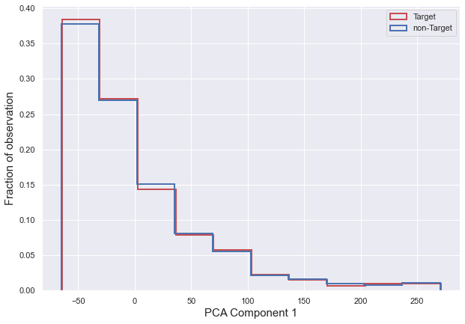
1 Feature Space Overlap
Converted categorical variables to numerical variables
Applied PCA reduction to 1 component to all variables (enrollee_id excluded)
Note lack of distinction between distribution of 2 classes cross all variables (histogram is normalized)

Slide 9
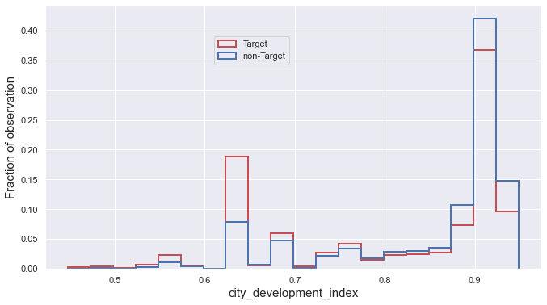
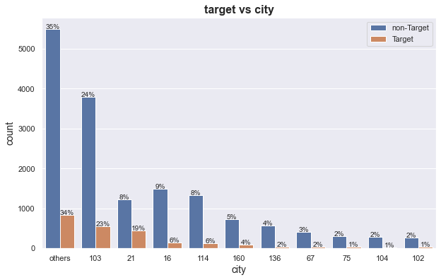
2 City vs. Target
Normalized histogram
City | city_development_index | Total enrollee | Target enrollee
103 | 0.920 | 4358 | 563
21 | 0.624 | 1672 | 453
16 | 0.910 | 1654 | 154
32% of the total enrollees, 30% of the Target enrollees are from cities where city_development_index ranges 0.910 ~ 0.920 (city 103, 16)
42% of the total enrollees, 48% of the Target enrollees are from city 103, 21, 16.

Slide 10
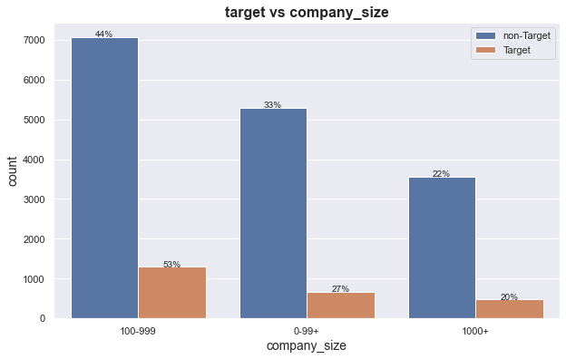
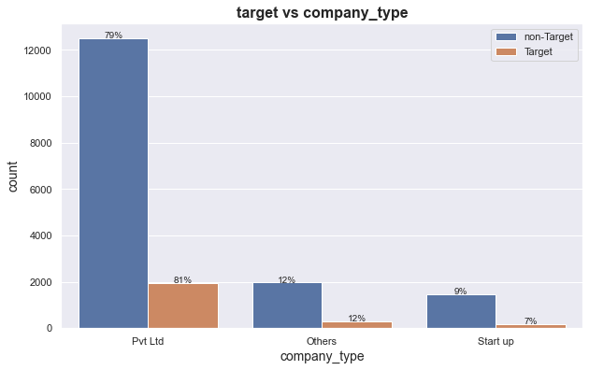
3 Employer vs. Target
46% of the total enrollees, 53% of Target enrollees are from medium size company (100~999)
79% of the total enrollees, 81% of the Target enrollees are from private limited company

Slide 11
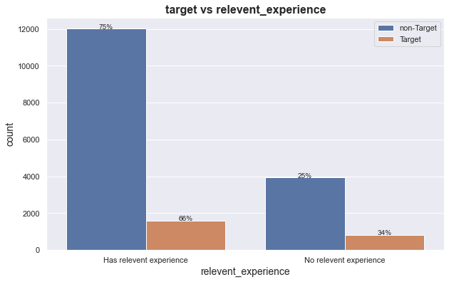
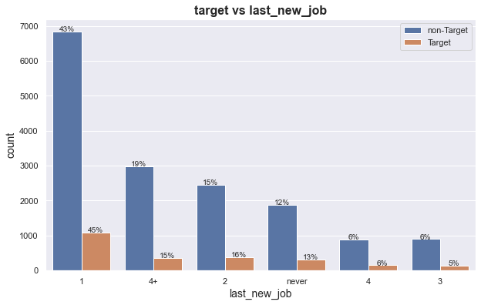
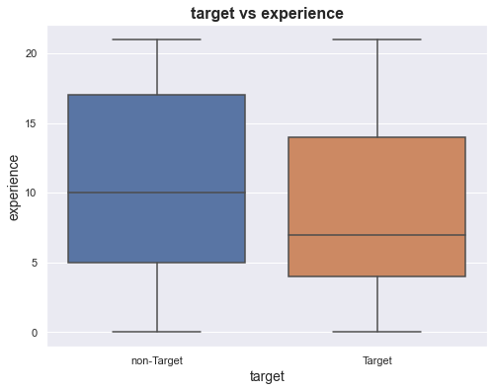
4 Experience vs. Target
66% of the Target enrollees has relevant experience in data science/analytics field
45% of the Target enrollees have stayed in their current company for 1 or less than 1 year. 15% of them have stayed in current company longer than 4 years.
non-Target enrollee compares to Target enrollee, has slightly longer average working years and wider range of working experience in years. (21 years means longer than 20 years)

Slide 12
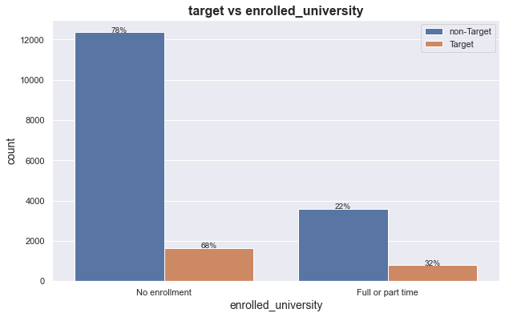
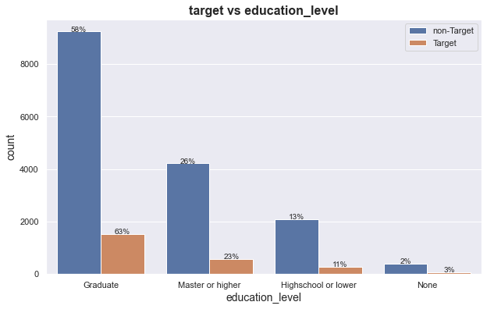
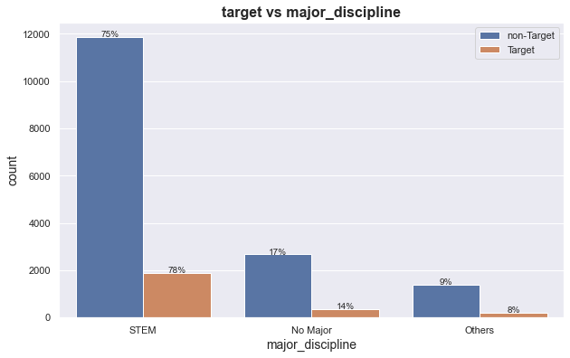
5 Education vs. Target
32% of the Target enrollees are enrolled in Full or part time university.
Graduate degree is the most common degree among all enrollees, 63% of the Target enrollees have a Graduate degree
Major STEM is the most common major among all enrollees, 78% of the Target enrollees have a STEM background

Slide 13
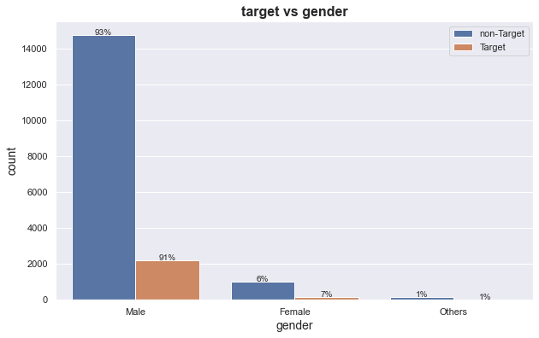
6 Gender vs. Target
Male is very dominant. 92% of the total enrollees are male
91% of the Target enrollees are male.

Slide 14
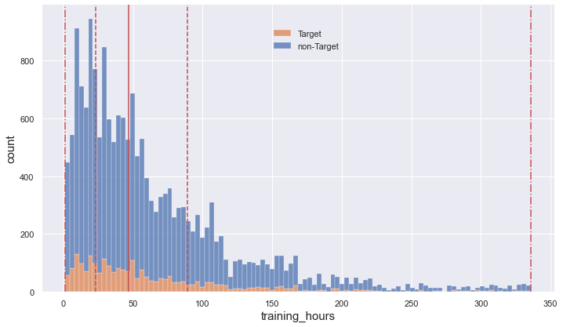
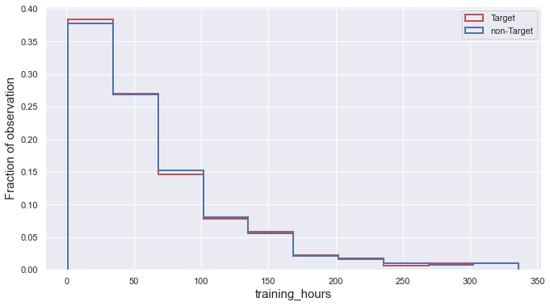
7 Training_hours vs. Target
Normalized histogram
Regardless of the class, the training time distribution is skewed right with a wide range of training time from 1 hour to 336 hours.
Two classes share lots of similarities in terms of summary statistic and distribution. The average training hours for Target and non-Target enrollee only has less than 1hour difference.

Slide 15
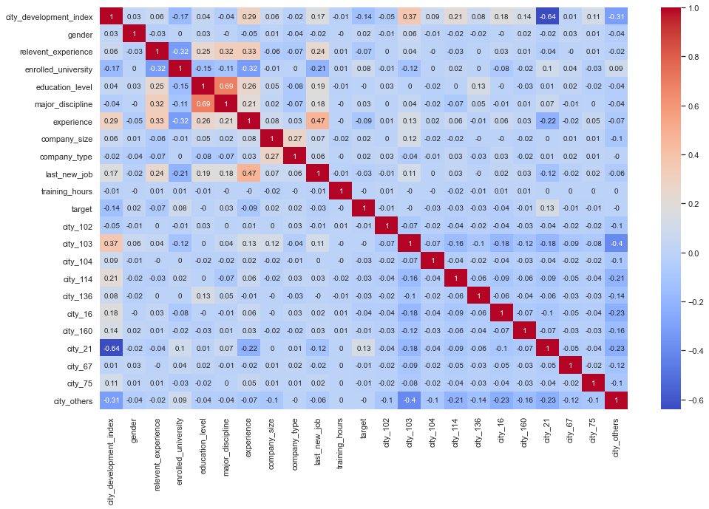
8 Multi
Multicollinearity
Variables are not highly correlated

Slide 16
Modeling and Analysis

