Slide 1
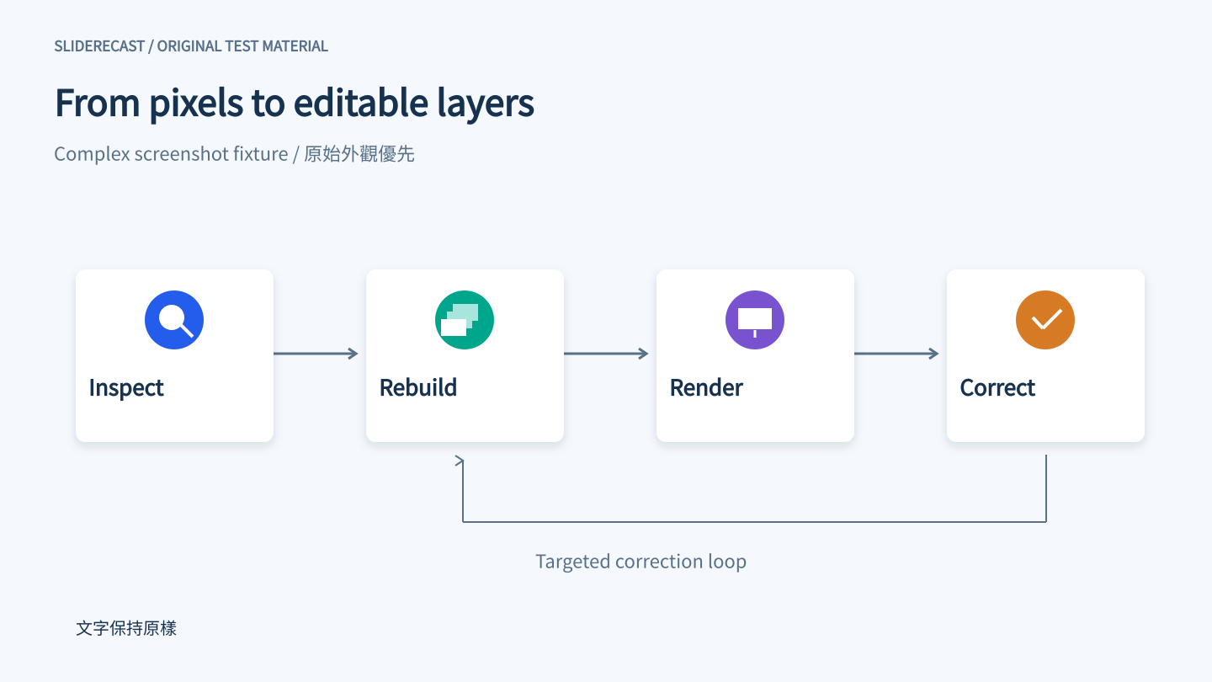
PNG embedding compatibility probe

