Slide 1

MARS DAY JAM
Event Planner App
Juan Alonso, Shawn Aten, Richard Avelar, Michael Murata, Darren Ybarra

Slide 2
Objectives
Create an Android app for an Event Planning company
The app will have different uses for different employee types
For managers & general employees it will organize event planning tasks
For HR it will serve as an access point to employee information
Notes:
Be brief here, the class knows what the project is.

Slide 3
Scrum Stories & Tasks
Sprint #1 User Login (10 points)
Sprint #2 Create / Delete / Edit Accounts (10 points)
Sprint #3 Create / Edit Events (5 points)
Sprint #4 Create / Edit Teams (5 points)
Sprint #5 Calendars (10 points)
Sprint #6 Messaging (1 point)
Sprint #7 Permissions (5 points)
Notes:
These are all the stories we outline for ourselves. We ended up working on some features out of this sequence. (calendar stuff) We put these in GitHub as milestones.

Slide 4
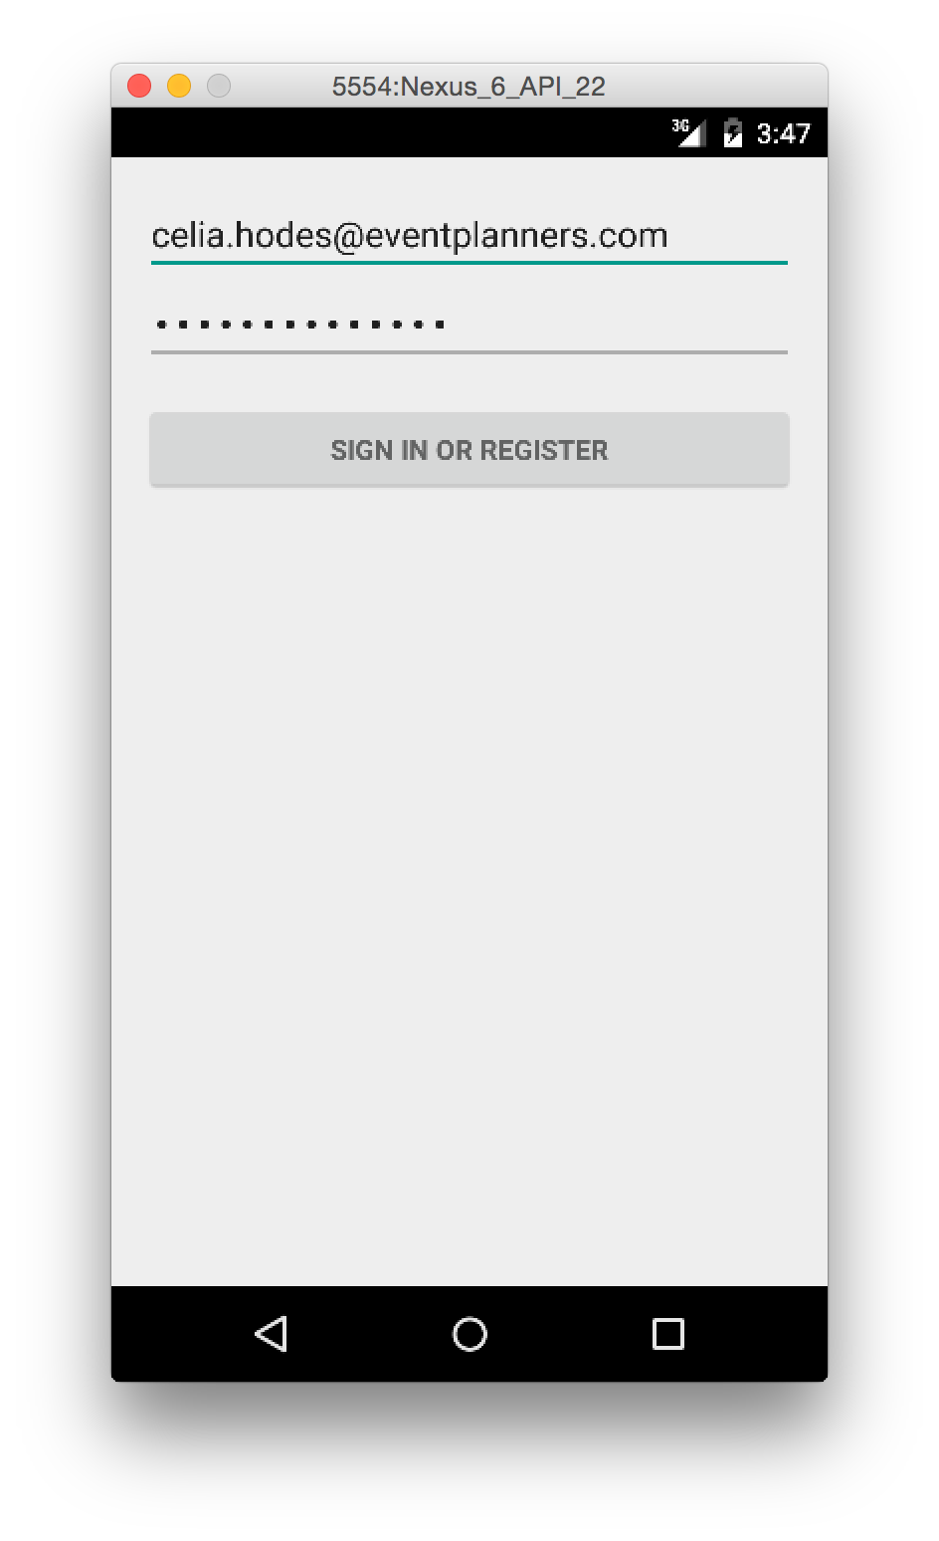
Example of Tasks
(Story #1)
Create Base App
Setup SQLLite Database
Insert Database Test Data
Create Login Activity & UI
Test Successful Login on Device
Notes:
This is to show an example of how we divided a story into smaller tasks. We’re showing the tasks we setup as issues in GitHub. These are show in order of completion.

Slide 5
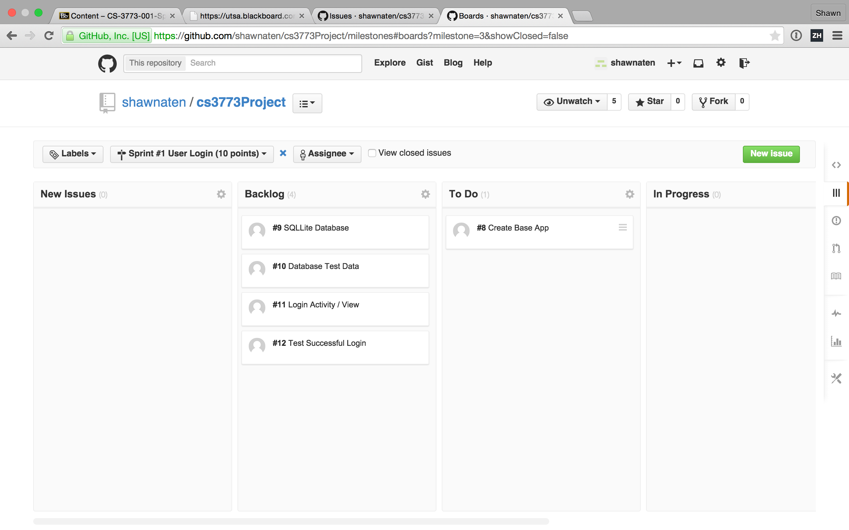
Example Taskboard
Notes:
We used a Chrome plugin called ZenBoard to give us an online TaskBoard on GitHub. The regular milestones & issues were really adequate however. We had meetings

Slide 6
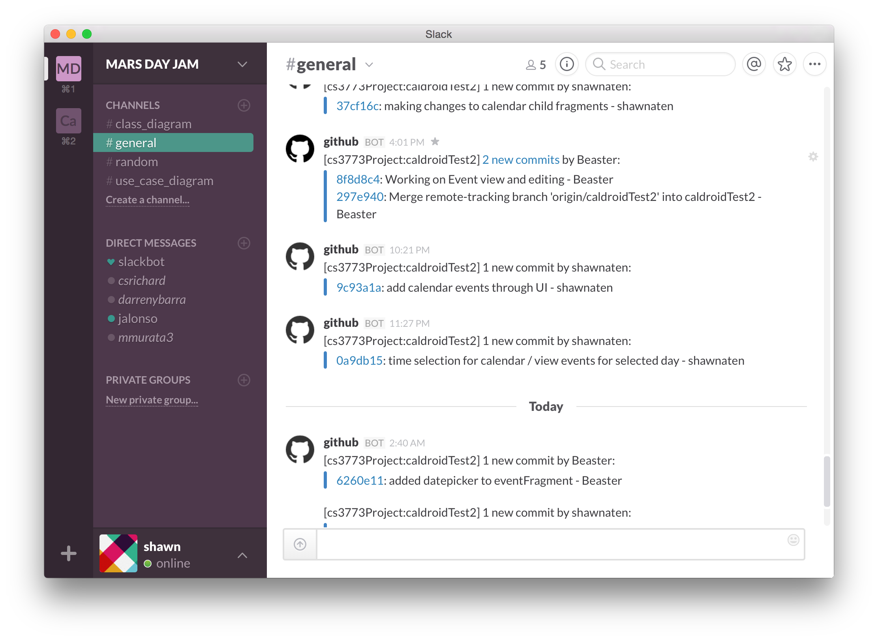
Collaboration
GitHub to host our code and documentation
Meetings on Thursdays
Slack to chat and share files

Slide 7
(Team Roles Explanation)
Notes:
Everyone will explain what they were responsible for and what they contributed to the project.

Slide 8
Design Patterns Overview
Object-Oriented Style
Related responsibilities grouped into classes
Implicit Invocation Style
Launching other activities
Repository Style
Specific classes control DB, other classes use these classes
Notes:
Object-Oriented:
All of our code corresponds to objects. The types of objects we’ve developed are Activity, Fragment, Database, and Employee classes. For each object we have defined its attributes, its internal maintenance of data, and methods for other objects to interact with that data. For example, the Employee class has attributes for the name, email, password, and role of an employee.
Implicit Invocation:
Used in the launching of Activity classes in Android. In the MainActivity class an Intent object is configured and launched causing the OS to create and start an instance of our LoginActivity class.
Repository Style:
Used in the maintaining of all employee, event, team, calendar, and etc. data. We have a single central SQL database setup by DBContract and DBHelper. Its connector methods are inside DBController. All other classes interact with data through DBController.

Slide 9
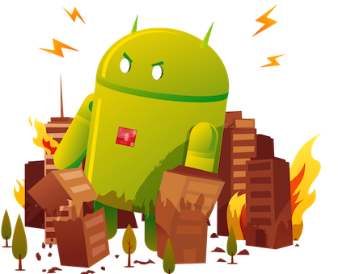
Difficulties
Most of our group members had no prior experience with Android
Confusion about how Android works, what to override, what Activities / Fragments do
Time crunch
Merge conflicts
Creating and testing DB methods was extremely tedious
Notes:
Elaborate on these points. Allow everyone else to state anything they found difficult.

Slide 10
Demo

