Slide 1
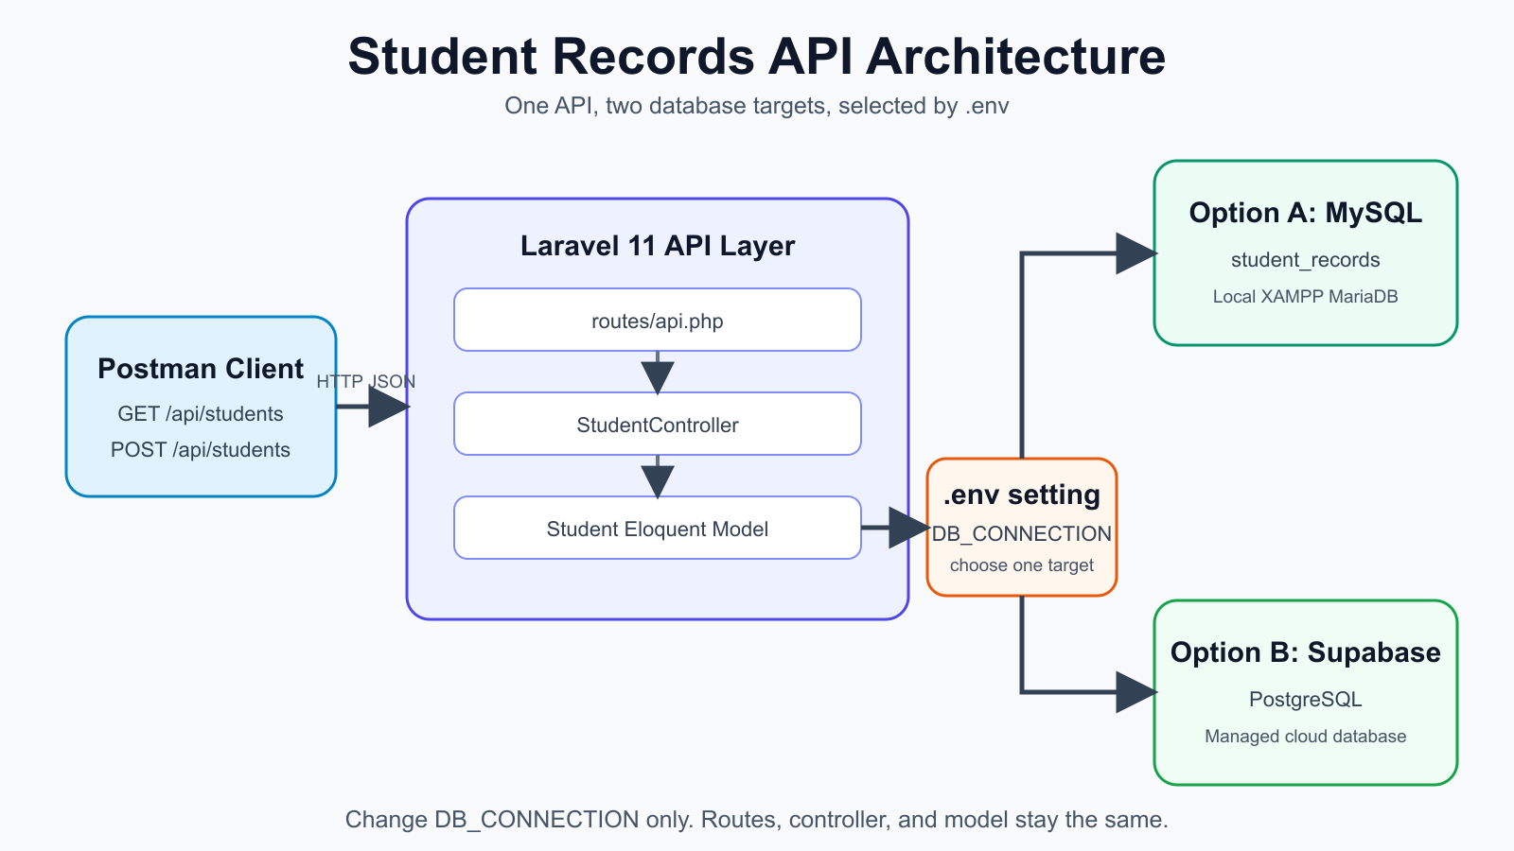
MIT 202 | Laboratory Activity No. 01
Student Records API
Laravel with MySQL and Supabase PostgreSQL
[Student Name] | [Section]
Notes:
0:00–0:45. Introduce the goal: build one Student Records REST API, prove it against local MySQL, then move only the database connection to Supabase PostgreSQL. Point to the diagram and stress that Postman uses the same HTTP and JSON contract throughout.

Slide 2
API and database design
02
GET
/api/students
students table
Returns all student records with HTTP 200
id primary key
student_number required, unique
first_name required
last_name required
email required, unique
course required
created_at timestamp
updated_at timestamp
POST
/api/students
Validates input and returns the new record with HTTP 201
Laravel routes requests to StudentController. Eloquent keeps storage details outside the API contract.
Notes:
0:45–1:35. Explain the two required operations. GET lists records. POST validates the student number, name, email, and course, then returns status 201. Describe the students table and its unique fields. Mention that routes, controller methods, validation, and the Eloquent model contain no Supabase-specific logic.

Slide 3
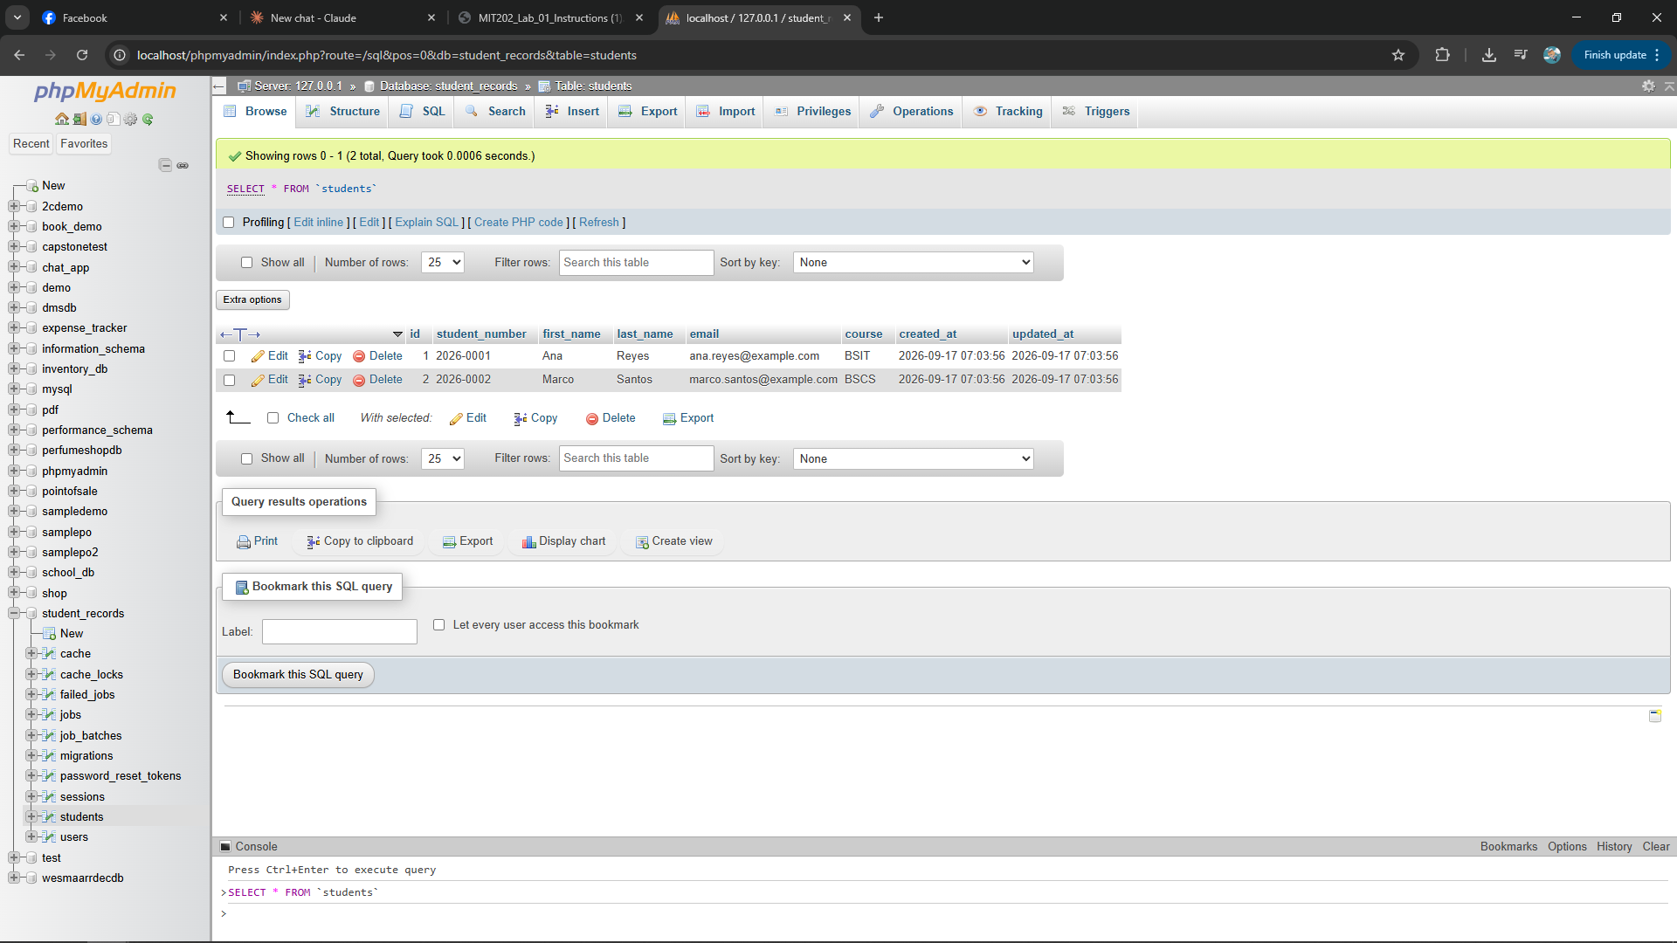
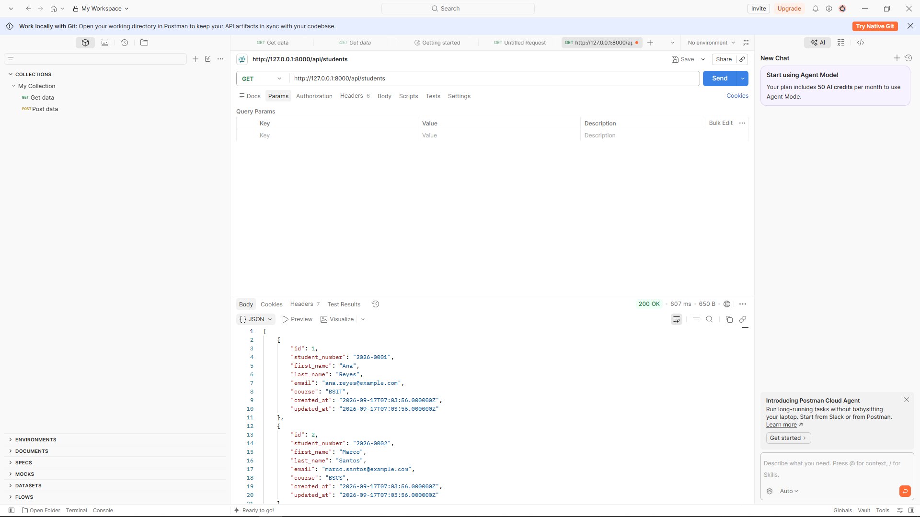
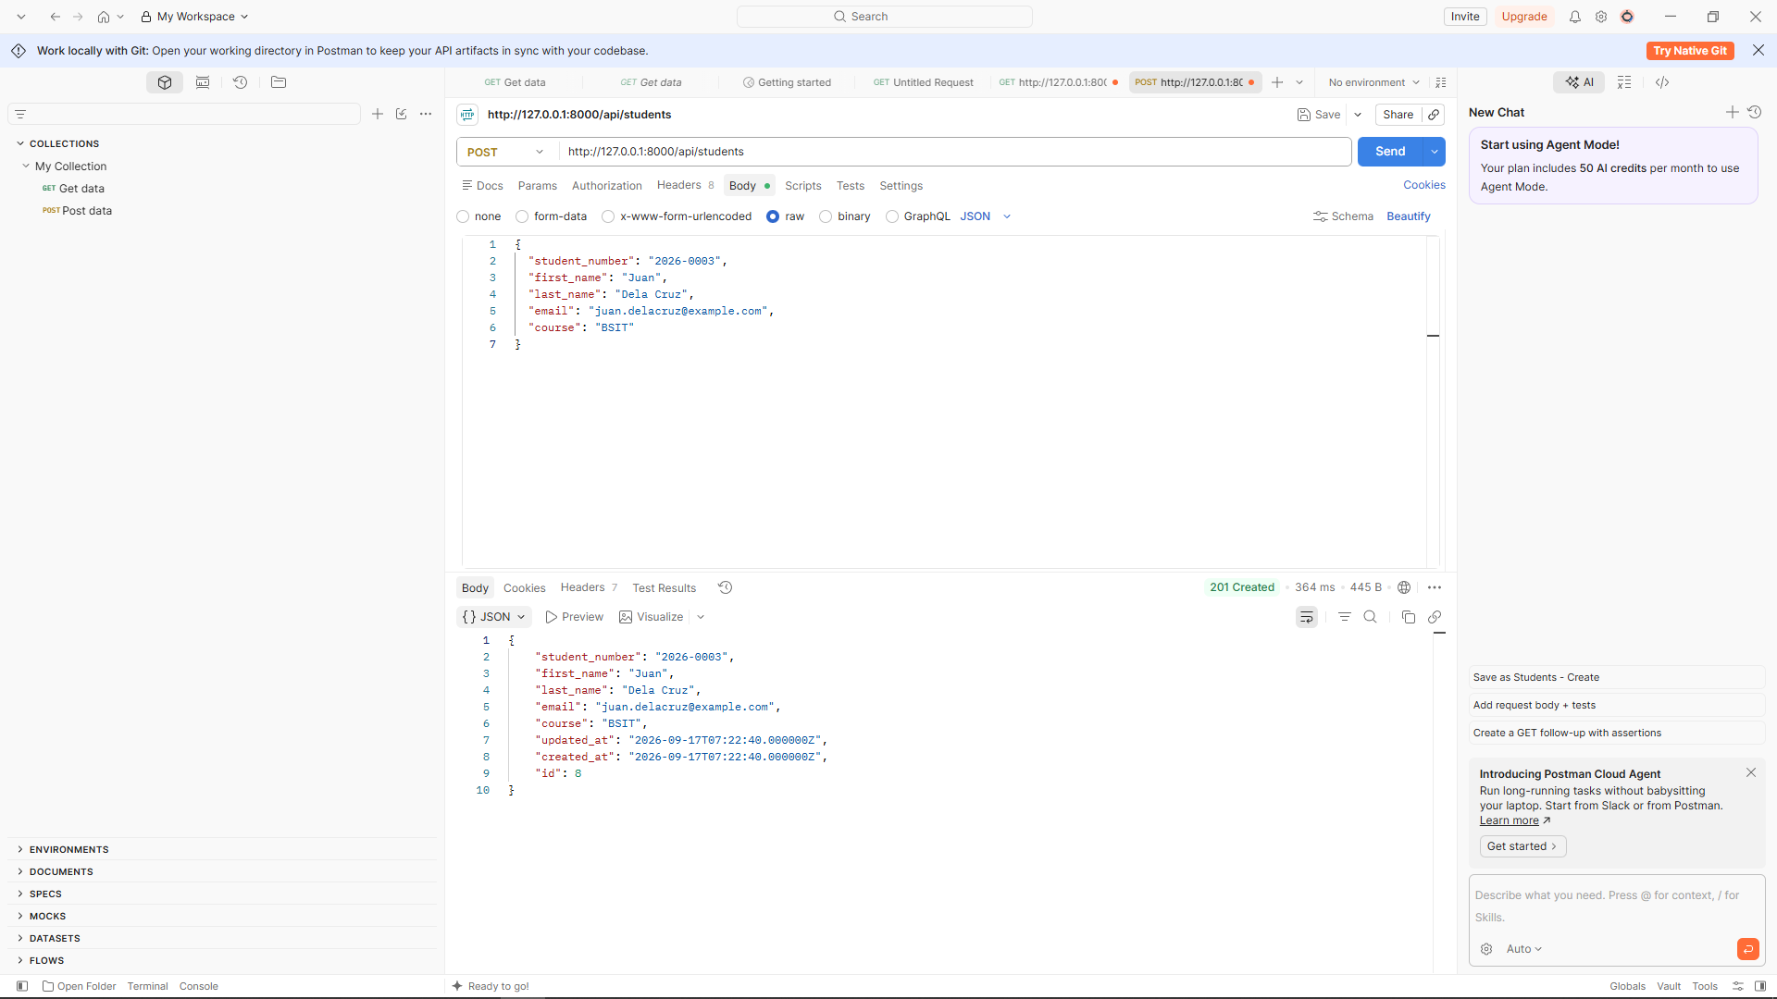
Local MySQL implementation
03
Set 1
Migration and seeder created the table and two starting records.
Sets 2–3
Postman confirmed HTTP 200 for GET and HTTP 201 for POST.
Notes:
1:35–2:35. Show the local database first. The Laravel migration created the students table and the seeder inserted two records. Then explain the Postman evidence: the GET request returned the existing rows with status 200, and the POST request created a new student with status 201.

Slide 4
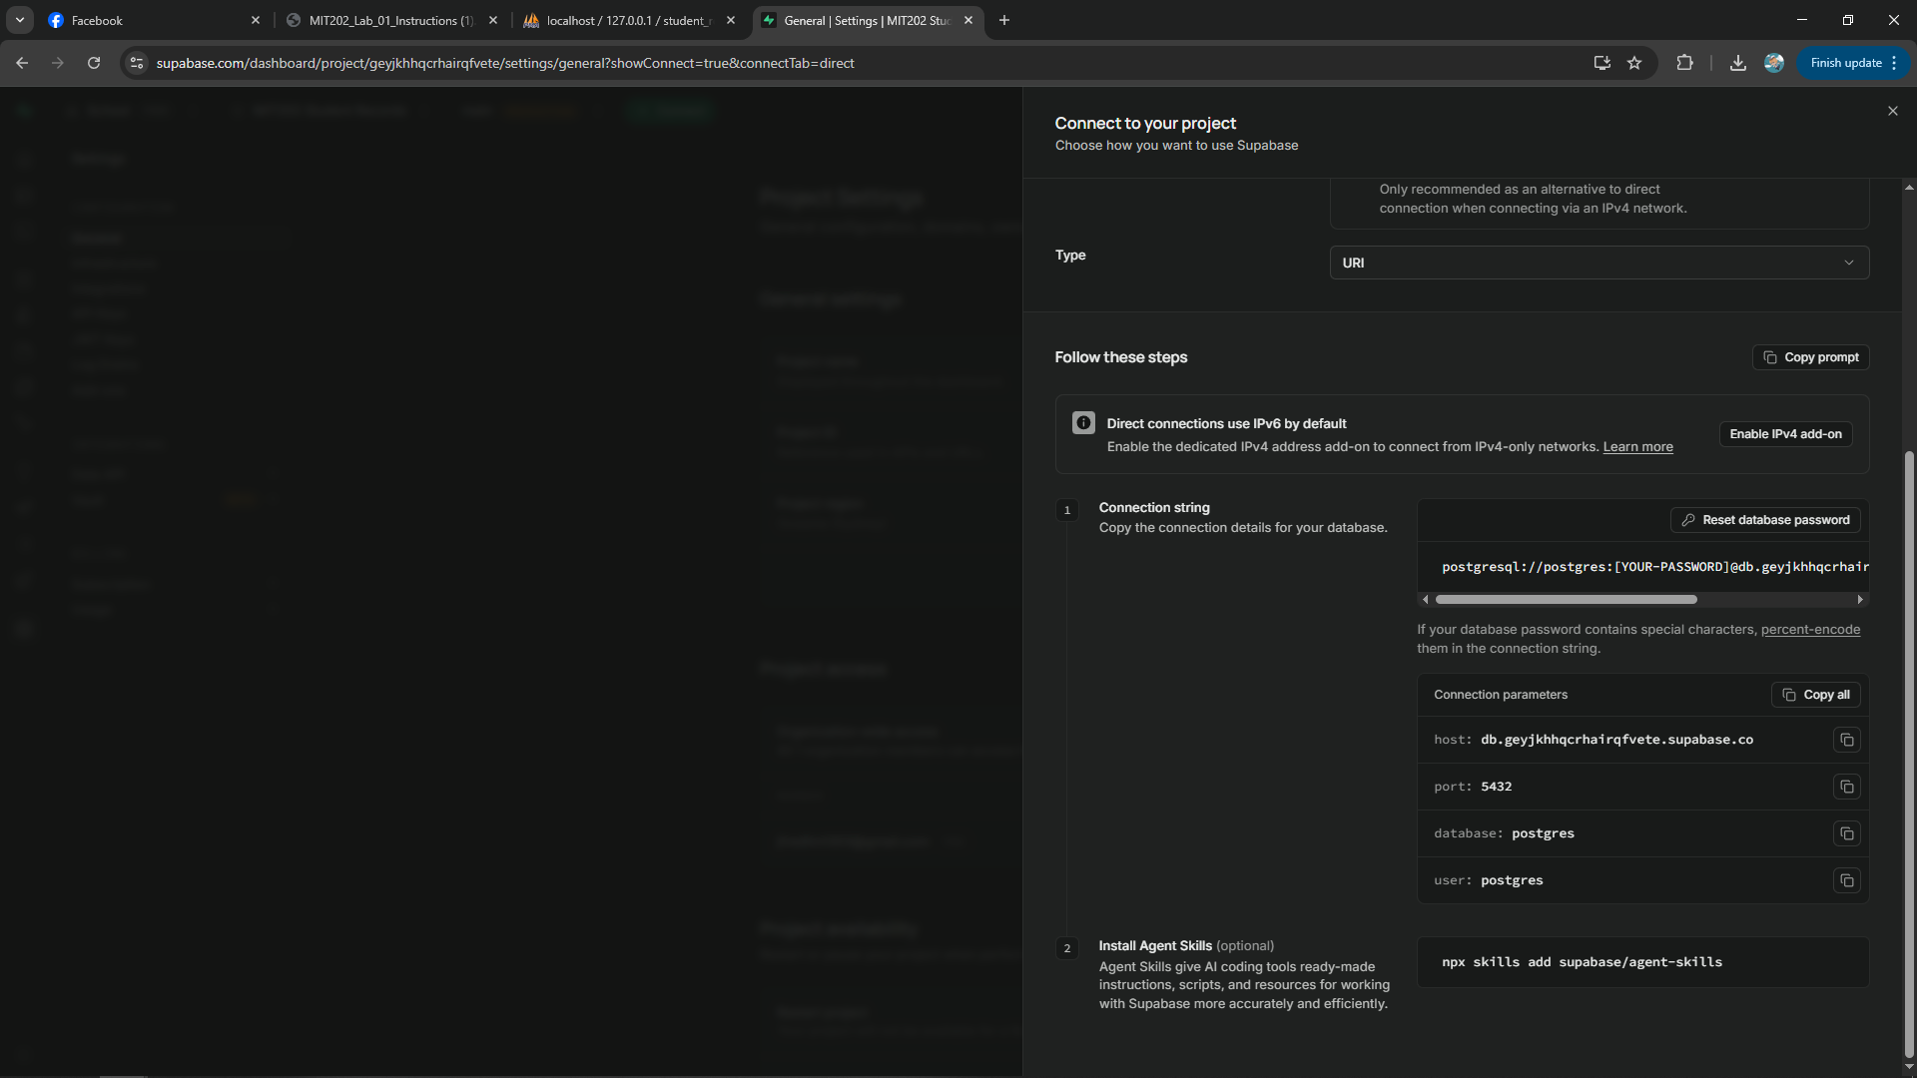
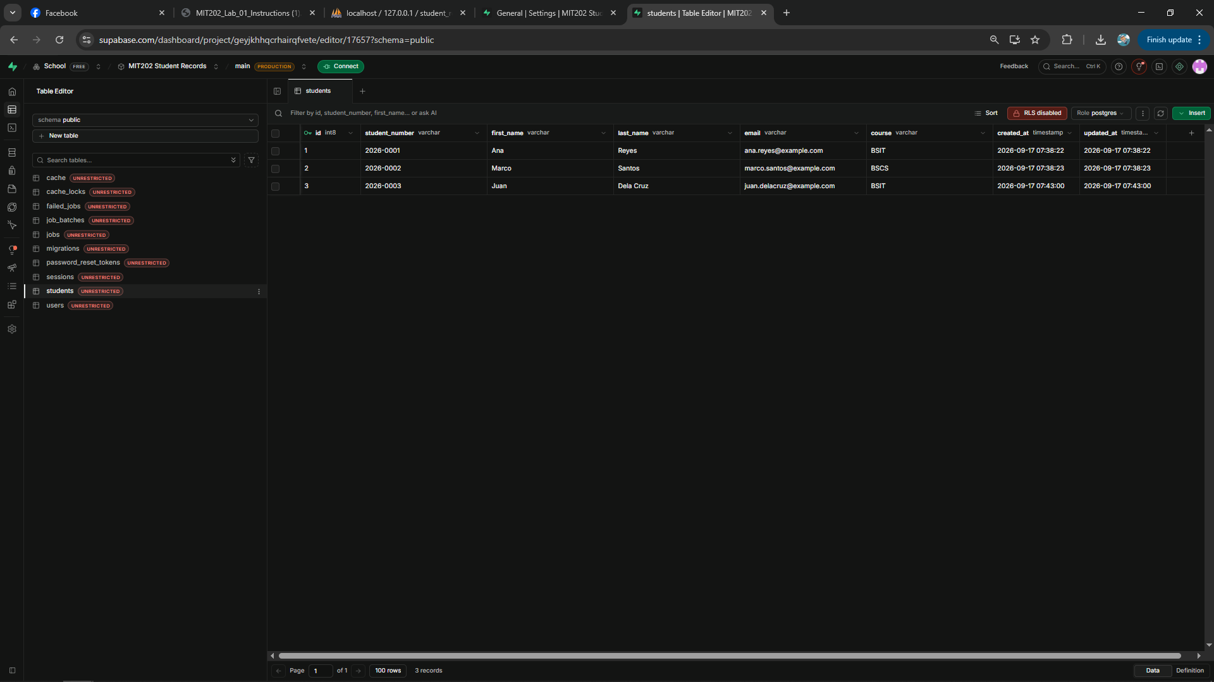
Supabase migration through configuration
04
.env
Application code
DB_CONNECTION=pgsql
DB_HOST=Supabase session pooler
DB_PORT=5432
DB_DATABASE=postgres
Routes unchanged
Controller unchanged
Eloquent model unchanged
Notes:
2:35–3:45. Explain that Supabase supplied PostgreSQL connection parameters. PHP needed the PostgreSQL driver, and Laravel needed only new database values in the environment file. The same migrations and seeder then created the cloud table. Point to the Supabase table and emphasize that route, controller, and model code stayed unchanged.

Slide 5
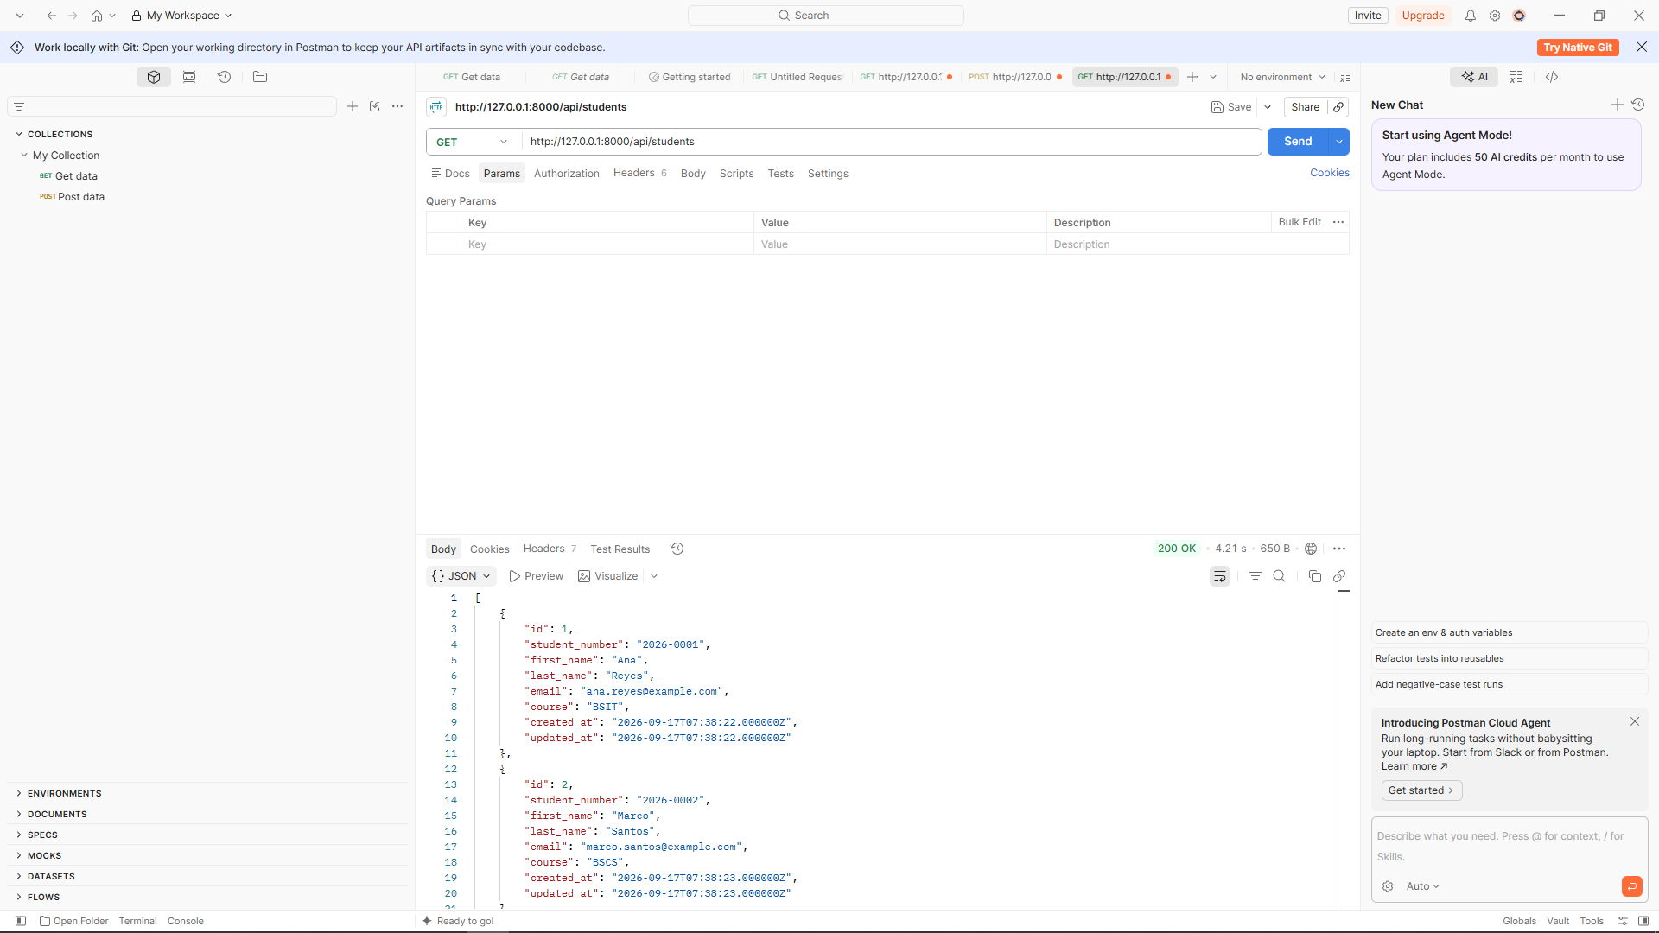
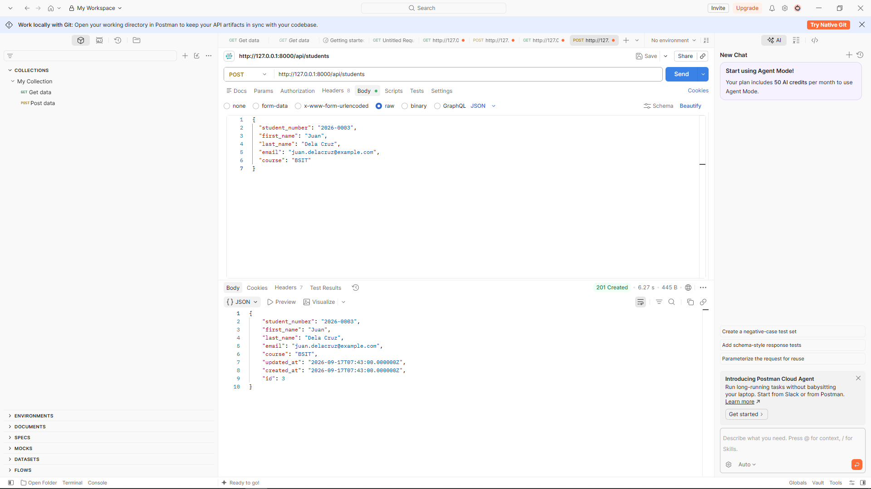
Same API contract after migration
05
GET 200
POST 201
The endpoint paths, request body, validation rules, and JSON responses worked with both databases.
Result: Laravel application logic stayed separate from storage configuration.
Notes:
3:45–5:00. Show the final GET and POST evidence after migration. Both requests use the same URLs and JSON structure as before, and they still return 200 and 201. Conclude that Laravel's environment configuration and Eloquent abstraction allowed the database change without rewriting API logic. The main challenge was establishing the PostgreSQL connection; the Supabase session pooler resolved it. Invite questions.

