Slide 1
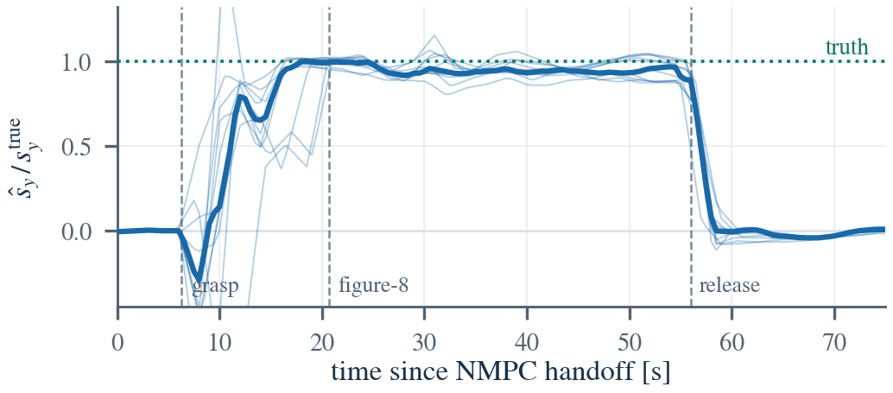
MHE–NMPC
Eventless Payload-Adaptive NMPC: letting the controller decide for itself whether the parcel is gone
Paper Fig. 3 — estimated first mass moment ŝ_y against truth (0.15 kg, 2 m/s, n = 11).
It rises at grasp, holds through the figure-eight, decays to zero after release — with no attach/drop notification ever entering the estimator. Truth is reconstructed offline and never reaches it.
ROS 2 Jazzy · PX4 SITL · Gazebo Harmonic · acados
Under review (target ICRA 2027) · all evidence is SITL
Numbers and figures from paper/main.pdf (Fig. 1–4, Tables I–V)

Slide 2
02
MOTIVATION
Grasping a parcel breaks the model the controller is using
PROBLEM
An NMPC's predictive power rests on one assumption: that it knows its own mass, where its centre of mass sits, and how hard it is to rotate. A grasp changes all three at once.
1 / THRUST · OUTER LOOP
2 / TORQUE · INNER LOOP
3 / INERTIA · INNER LOOP
Hover throttle is wrong
A constant trim torque appears
Attitude response slows
Mass rescales the thrust-to-acceleration map. A biased m biases feed-forward thrust — and the margin set against mg with it.
Thrust no longer passes through the composite CoM: τ ≈ Δr × f. Since f ≈ mg is large, even a small offset matters.
The same torque now yields less angular acceleration — effectively lowering inner-loop bandwidth.
The abstract opens on the premise: “A release command does not guarantee that a payload has physically detached.”
A command is an intent, not an event. The gripper may not open; the object may lag; the notification may be lost. A controller that clears its model on that command flies a loaded vehicle as if it were empty.
02 / 16

Slide 3
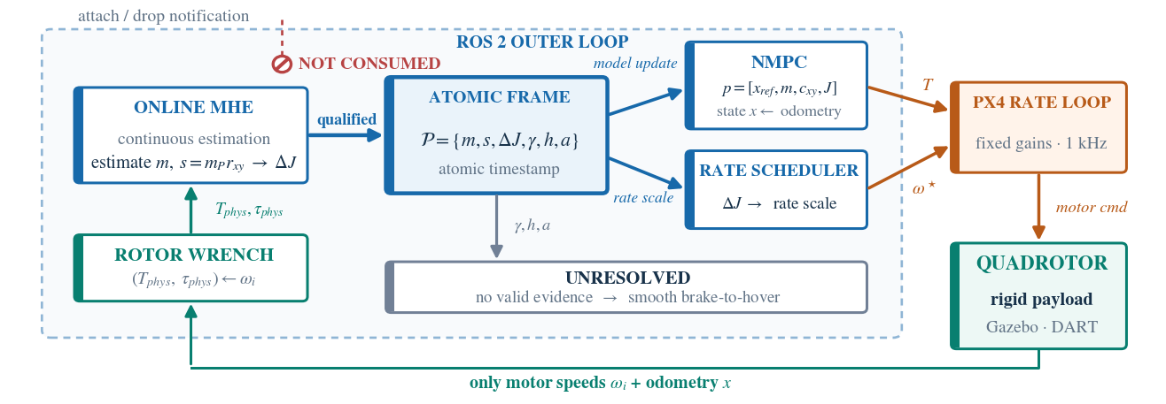
03
ARCHITECTURE · FIG. 1
The pipeline consumes only motor speeds and odometry
SYSTEM
The attach/drop notification is drawn as NOT CONSUMED — not an omission in the figure, but the constraint this work imposes on itself.
TWO SOLVERS
ONE ATOMIC FRAME
MHE 10 Hz · 16 states · 2.0 s window; NMPC 20 Hz · 13 states / 4 inputs · 1.0 s preview.
{m, s, ΔJ, γ, h, a} on one timestamp, with health bit and solution age — never split across topics.
03 / 16

Slide 4
04
WHY THE FIRST MOMENT · §IV-B
Estimate the first mass moment, not the CoM offset
CONTRIBUTION 1
The most important modelling choice in the paper — and the one most likely to be challenged.
WHY c_xy FAILS
WHY s WORKS
The CoM offset is undefined at release
Inertial parameters enter linearly
Physically s = m_P·r_xy → 0, but r_xy is 0/0 as m_P → 0.
Not hypothetical: in the mass-only formulation the optimizer could suppress a phantom eccentricity only by driving mass below the bare airframe — 14 of 55 post-release samples pinned at the bound.
The first moment is the standard linear parameterization of rigid-body inertial parameters — classical in manipulator load identification.
It supplies the rotational channel directly, and c_xy = s/m follows without knowing the grasp geometry.
The smallest structure, not extra degrees of freedom: the least that represents payload existence, trim moment and roll/pitch inertia without measuring attachment geometry.
ΔJ is not estimated independently — it follows from m̂ and a weak vertical-arm prior r_z, structurally unobservable from the thrust-moment channel.
04 / 16

Slide 5
05
NMPC
Re-solving one second of future every 50 milliseconds
METHOD
Unlike a PID it does not react to the present error: it predicts one second ahead, picks an optimal input sequence inside the actuator envelope, and applies only the first step.
ITEM | VALUE
States / inputs | 13 / 4
Horizon | N=20 × Δt=0.05 s → 1.0 s
Solver | acados SQP-RTI + HPIPM
Thrust envelope | T ∈ [1.27, 31.35] N
Torque envelope | |τx|,|τy| ≤ 0.5 · |τz| ≤ 0.2 N·m
Solve time | 1.3 ms median / 2.2 ms p99
Share of period | 2.6% / 4.4% (n = 1009)
COST
Bryson's rule + a live hover reference
Tolerances 0.1 m / 0.3 m/s / 0.05 / 0.3 rad/s / 2 N.
ū(p) = [mg, c_y·mg, −c_x·mg, 0] tracks the estimate and includes the eccentric trim torque — never the bare mass.
RUNTIME PARAMETERS
p = [x_ref, m, ΔJ, c_xy]
Payload information enters as a runtime parameter — no code change, no solver regeneration.
m / s / ΔJ each pass a filter and a slew limit before every solve.
05 / 16

Slide 6
06
MHE
Payload parameters become extra states
METHOD
Over the last two seconds, find the states and parameters that best reconcile model with measurement — not one instant, so time itself suppresses noise.
x_MHE = [ x(13) m s_x s_y ] ∈ R^16
ṁ = 0, ṡ = 0 in-window N=20 × Δt=0.1 s → 2.0 s @ 10 Hz
AN ARRIVAL COST THAT KNOWS NOTHING
W_0 is nearly uninformative — σ ≈ 3.2 kg in m, σ = 0.1 kg·m in s. A strong prior would make the estimate an echo of itself.
WEIGHTS ARE A STATEMENT · W_w ≫ W_y
Deliberately trust the dynamics
State the timing honestly: 9.2 ms median, 24.6 ms p90, 59.2 ms p99, 72.8 ms max — against a 100 ms period.
It meets the deadline in simulation, but the tail margin is narrow (≈7× the mass-only estimator), so the paper makes no onboard-headroom claim.
Process-noise weights diag(1e4·I6, 1e5·I4, 1e3·I3) are far tighter than the measurement weights.
The meaning: apart from the payload parameters, the model is right.
The optimizer must then explain the observed acceleration by moving m and s — it cannot quietly charge the mismatch to process noise.
06 / 16

Slide 7
07
ESTIMATE-INDEPENDENT PROXY
Never feed the controller's own thrust command back in
CONTRIBUTION 2
The MHE needs a known input force. The nearest source is the NMPC's own command — and that closes an estimator–controller loop.
THE TRAP · A SELF-CONSISTENT BLIND SPOT
THE FIX · SAMPLE DOWNSTREAM
The command comes from m̂
Reconstruct from rotor speeds
The cost anchors T near m̂·g. Once m̂ is wrong, the commanded thrust is no longer the force the vehicle feels.
Worse: inversion error, saturation and motor lag between command and rotor are invisible to the estimator. A mass error can persist self-consistently instead of showing up as a residual.
T_phys = k·Σωᵢ² and τ_phys = Σ rᵢ × Fᵢ
Measured rotor speeds, downstream of the real nonlinear mapping, not computed from m̂.
Detail: rotor messages are far faster than the MHE period, so the window averages per-rotor thrust Fᵢ — never ωᵢ before squaring.
What it does depend on: a calibrated k, which loses validity under large induced inflow in fast translation — a term we do not model. Slide 15 prices it: a ±5% error defeats the interface in both directions.
07 / 16

Slide 8
08
RELEASE SEMANTICS
Issuing the release command is not evidence
CONTRIBUTION 3
The controller clears its payload model through one route only: confirmation — no-payload confidence γ > 0.90 held for 1.0 s on healthy, fresh frames.
γ = empty-score(mass) × empty-score(first moment) × empty-score(inertia)
→ a nonzero first moment alone vetoes a false EMPTY, even with mass on its bound
WHEN EVIDENCE IS MISSING
THE FAST PATH WE DELETED
Enter UNRESOLVED — do not guess
It caused real premature releases
12 s timeout → declare UNRESOLVED → 3 s smooth brake to hover, then gather evidence in low-dynamic flight.
A timeout is treated as unknown, never as proof of an empty vehicle.
“Residual + quantity-empty”, without moment evidence, released early in 3 of 9 flights during a 4 m/s figure-eight.
Cause: under aggressive flight m̂ sits on its lower bound for long stretches, so the quantity channel reads empty persistently.
A recorded figure-eight transient reached −1.69 N — larger than the −1.47 N step of a real release of the smallest payload. Amplitude alone cannot separate manoeuvre from detachment.
08 / 16

Slide 9
09
TABLE I · PROVENANCE
Where every threshold came from
RIGOUR
The paper spends a whole table on this, and states plainly: all values were fixed in code before the final campaign and were not retuned on it.
THRESHOLD | VALUE | PROVENANCE
Moment-collapse ratio ρ | 0.30 | leave-one-out CV on 59 earlier flights; every fold chose 0.30
Residual floor / persist | 0.9 N; 2 or 4 frames | below the 1.47 N weight of the smallest payload; recorded figure-eight excursions lasted ≤3 frames, the release step 4
Slow-path persistence | 5 frames (0.5 s) | engineering choice
Mass-domain release | m_P < 0.030 kg, 20 fr. | between the loaded minimum (0.079 kg) and post-release maximum (0.007 kg) of earlier flights
No-payload confidence | 0.90 for 1.0 s | engineering choice
UNRESOLVED timeout / brake | 12 s / 3 s | engineering choice
Only ρ and the residual floor were selected against data — and against earlier flights disjoint from the reported campaign. The rest are engineering choices, and the paper says outright that their closed-loop sensitivity was not swept.
The point is not the numbers: the provenance of a threshold is itself something to be audited.
09 / 16

Slide 10
10
EXPERIMENT DESIGN
One mission, four ways for the payload to be gone
EXPERIMENTS
Showing that a normal release is recognised proves little. The real test is a mismatch between command and physics — the only place “eventless” can be falsified.
CASE A
CASE B
CASE C
CASE D
Nominal release
Delayed detachment
Unsignaled loss
Partial loss
Approach → grasp → lift → figure-eight → phase-triggered release.
The joint is held a median 4.01 s past the command. Anything clearing on the command must be early.
The payload goes, but no command reaches the controller. A command-armed confirmer cannot see this.
Four 0.05 kg boxes, three detached one at a time, unsignaled. Tests multi-step tracking, not a binary call.
Pre-registered and reported in full: the paired design was fixed before the comparison, not chosen after it; the paper reports every attempt (84), the confirmation path each flight took, and the failures at the actuator limit.
Safety is measured separately and at scale: across 209 loaded flights (3.7 h), releases declared before any command or injected loss = 0 (one-sided 95% upper bound 1.4% per flight).
10 / 16

Slide 11
11
TABLES III + IV
32 of 36 — and what that does not establish
EXPERIMENTS
Every flight in which the payload physically attached and the vehicle survived to the release command is counted.
CONDITION | n | COMPL. | IN-MANOEUVRE | VIA BRAKE
0.15 kg, 4 m/s | 11 | 10/11 | 2.90 s | 16.60 s
0.30 kg, 4 m/s | 13 | 10/13 | 8.95 s | 16.40 s
0.15 kg, 2 m/s | 12 | 12/12 | 3.31 s | 16.48 s
pooled | 36 | 32/36 | 3.46 s | 16.56 s
CONDITION | n | MOMENT | MASS-DOM. | CONF. ONLY
0.15 kg, 4 m/s | 10 | 9 | 1 | 0
0.30 kg, 4 m/s | 10 | 1 | 3 | 6
0.15 kg, 2 m/s | 12 | 9 | 0 | 3
pooled | 32 | 19 | 4 | 9
95% Clopper–Pearson [73.9%, 96.9%]. All four failures are at 4 m/s and all trace to estimator failure — three never recognised the payload, one diverged after release.
A limitation, not a score: 32/36 holds for the interface as a whole, not for any single detector — confirmation arrived by three different paths.
The delay is bimodal, and the paper refuses to pool it: 17 of 32 confirm while still flying the figure-eight (median 3.46 s); the other 15 find no evidence in manoeuvre, hit the 12 s timeout, brake to hover, and confirm at a median 16.56 s.
11 / 16

Slide 12
12
TABLE II · PAIRED ABLATION
Head-to-head with clearing on the command
EXPERIMENTS
Arm A clears the payload model at the command (the conventional approach); arm B is the proposed interface; arm C is arm B, armed only by the command.
CONDITION | PAIRS | A COMPL. | B COMPL. | EARLY CLEAR (A / B)
nominal, pooled | 19 | 19/19 | 19/19 | — (no mismatch to measure)
+ 4 s detachment hold | 5 | 5/5 | 5/5 | A 5/5 early / B 0/5
same, arm C instead of A | 6 | 6/6 | 6/6 | 0/6 / 0/6
THE ARMS TIE UNDER NOMINAL CONDITIONS
THE ONE DECISIVE CASE
19/19 vs 19/19, no post-release instability. The paper therefore does not sell the nominal case.
Arm A cleared a median 4.01 s before detachment; arm B cleared early in none of its six valid runs.
With losses injected and no command reaching the controller: arm B detected 10 of 18; arm C detected none, and kept a phantom first moment.
The difference is possible vs impossible, not better vs worse.
Seven of the eight misses share one cause: the moment reference had not formed before the loss.
12 / 16

Slide 13
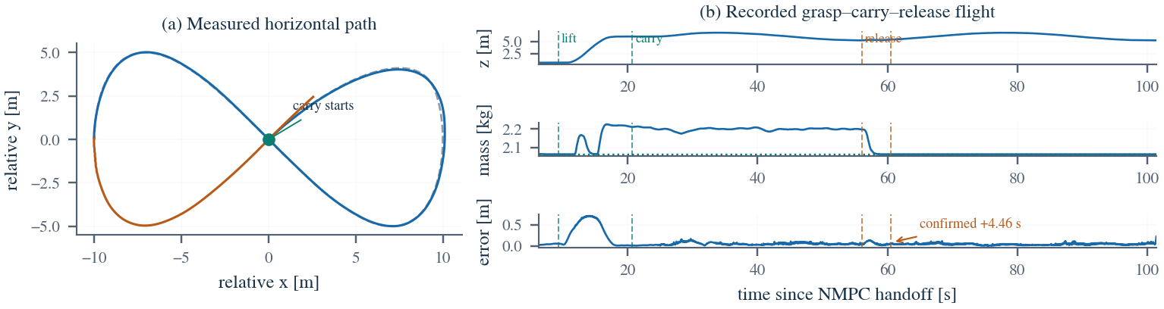
13
FIG. 4 · ONE EVENTLESS FLIGHT
What one complete flight looks like
EXPERIMENTS
0.15 kg at 2 m/s, confirmed in manoeuvre. Right: height, the mass estimate the controller actually consumed, and position-error norm.
GRASP
CARRY
RELEASE
The mass rises on its own
The model stays consistent
Confirmed 4.46 s later
No attach signal — the 0.6 m error peak is the lift itself, not recognition.
Loaded tracking RMS 0.053 m; 0.060 m after release.
The delay is the price we choose: semantics that never run ahead of evidence.
13 / 16

Slide 14
14
TABLE V · vs. L1-ADAPTIVE NMPC
Against the adaptive baseline: claims and non-claims
EXPERIMENTS
{truth, online, l1} × {0.2, 0.3} kg × {0.05, 0.10} m, n = 5 per cell — 60 of 60 runs stable, zero divergence.
CELL (MASS / ECC) | TRUTH | ONLINE | L1
0.2 kg / 0.05 m | 0.806 / 4.28 | 0.768 / 3.70 | 0.821 / 4.26
0.2 kg / 0.10 m | 0.794 / 3.62 | 0.810 / 3.92 | 0.812 / 4.24
0.3 kg / 0.05 m | 0.834 / 3.56 | 0.837 / 3.72 | 0.883 / 4.90
0.3 kg / 0.10 m | 1.011 / 3.64 | 0.876 / 3.88 | 0.891 / 4.54
WHAT WE DO NOT CLAIM
Transient peaks are indistinguishable
Within-cell peaks agree to 0.05 m. L1 is higher in the two low-eccentricity cells (p = .008, .012), but that does not survive correction over eight tests.
cell = position-error peak [m] / recovery [s]
WHAT WE DO CLAIM
L1 recovers 8–32% slower
Two caveats travel with this table: it was recorded with the earlier mass-only 14-state MHE, not the proposed first-moment interface — so it supports only a bounded baseline comparison; and L1 yields no interpretable m or c_xy while still needing the same class of prior for gain scheduling.
Median 16%, significant in three of four cells. The mechanism is a bandwidth wall: L1's compensation cutoff ω_c is bounded by closed-loop stability (0.5 stable, 1.0 unstable here).
14 / 16

Slide 15
15
LIMITATIONS · §VII
What does not hold yet
STATUS
Every item below is stated by the paper itself. They are worth presenting plainly, because they define the next steps.
1 All system-level evidence is SITL. Hardware migration replaces simulated rotor speeds with ESC telemetry and must re-identify thrust/torque coefficients, noise floors, timing and gripper compliance.
2 k must be calibrated well within 5%. Scaling only the estimator's thrust map by ±5%: at 0.95 the payload was never recognised (4/4); at 1.05 a phantom 0.09 kg persisted after release.
3 The first moment is biased low. Slope 0.85 in carry, median underestimate 10.8%, same direction in 31/31 flights. The cause is not identified.
4 Reference formation is unreliable. In 13 of the 32 completed flights the in-envelope reference window never filled, so the moment-ratio test never ran.
5 Release is not gated on estimator health. One flight's estimate was unhealthy for 48 s before release; the phase-timed command fired anyway and the vehicle diverged.
6 0.30 kg at 4 m/s is a stress test, not an operating point. Hover needs 74% of maximum thrust, but torque binds first: pitch saturated within 98% of diagnostic windows.
Two more that are easy to miss: a sustained updraft or downdraft is intrinsically confounded with a payload change on a collective-thrust-only residual (wind is not evaluated here); and the release-evidence path is off by default, so deployment needs an explicit enable plus startup validation.
15 / 16

Slide 16
16
SUMMARY
What stands, and what I did myself
SUMMARY
32/36
0 / 209
10/18
0/60
±5%
eventless confirmations
pre-command releases
unsignaled losses caught
baseline divergences
thrust-map tolerance
Established
✓ Minimal sensing — the path consumes only rotor speeds and odometry; no attach/drop notification enters it.
✓ A first-moment interface that stays well defined as the payload vanishes.
✓ Release semantics that clear the model only on persistent evidence, and brake to hover otherwise.
Next
→ Hardware migration and bench calibration of k — the prerequisite named in §VII.
→ Gate the release command on estimator health; make reference formation reliable.
→ Close the missing baselines: fixed-parameter NMPC, a CUSUM detector, L1 with the final estimator.
On AI assistance — worth stating up front: this project used AI assistance for code generation, refactoring, test coverage and documentation; the experiment design, the choices between criteria, and the conclusions are mine.
I distinguish three kinds of statement throughout: confirmed by code and tests, true in simulation only, and still to be verified — for instance, the Chinese README still says the MHE is diagnostic-only, while the estimate has long been inside the NMPC loop. I found that by reading the code, not the docs.
16 / 16

