Slide 1
Applied Deep Learning HW2
Natural Language Generation
Deadline: 2024/10/24 23:59:59

Slide 2
Links
NTU COOL (To be modified)
Data & Evaluation
adl-ta@csie.ntu.edu.tw
When sending the email, please add [ADL2024 HW2] at the beginning of the title.
TA Hours:
Monday 16:00~17:00
9/30 10/7 @ 德田524
10/14 @ Online https://meet.google.com/rhj-ugax-tpu
10/21: 10:00~11:00 @ 德田524

Slide 3
Updates
[09/25] HW2 announced
[10/11] Do not use public.jsonl as training data. If validation is needed, please split the data from train.jsonl
[10/14] Homework 2 deadline extended by 1 week (10/24 23:59)
10/21 OH change to 10:00~11:00 @ 德田524
[10/16] Allowed gdown==5.2.0, nltk punkt tokenizer (the data will be included)

Slide 4
Task Description

Slide 5
Chinese News Summarization (Title Generation)
input: news content
從小就很會念書的李悅寧， 在眾人殷殷期盼下，以榜首之姿進入臺大醫學院， 但始終忘不了對天文的熱情。大學四年級一場遠行後，她決心遠赴法國攻讀天文博士。 從小沒想過當老師的她，再度跌破眾人眼鏡返台任教，......
output: news title
榜首進台大醫科卻休學 、27歲拿到法國天文博士 李悅寧跌破眾人眼鏡返台任教

Slide 6
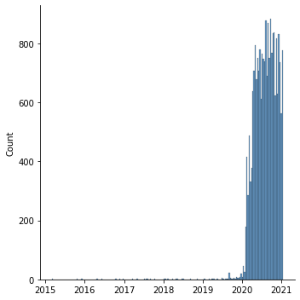
Data
Source: news articles scraped from udn.com
Train: 21710 articles from 2015-03-02 to 2021-01-13
Public: 5494 articles from 2021-01-14 to 2021-04-10
Private: Not released and will include articles after deadline

Slide 7
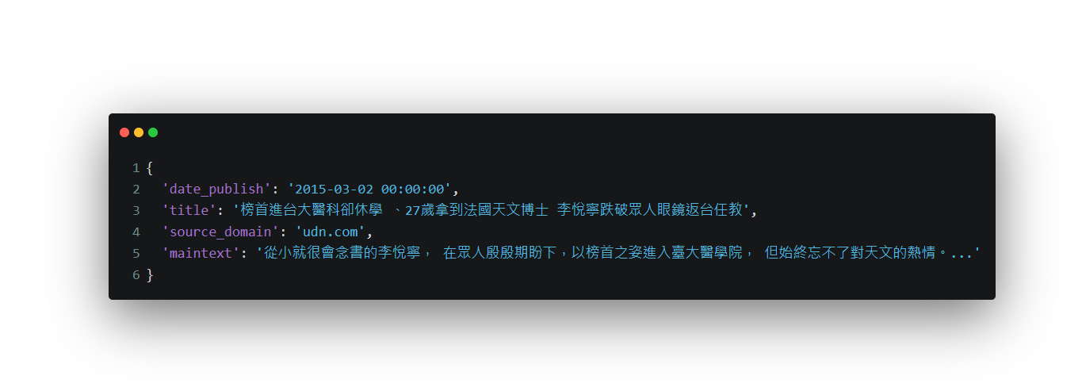
Data (cont.)
Example

Slide 8
Metrics
ROUGE score with chinese word segmentation
What is ROUGE score?
Chinese word segmentation: ckiptagger(github)
Example
candiate: 我 是 人
reference: 我 是 一 個 人
rouge-1: precision=1.0, recall=0.6, f1=0.75
rouge-2: precision=0.5, recall=0.25, f1=0.33
rouge-L: precision=1.0, recall=0.6, f1=0.75

Slide 9
Objective
Fine-tune a pre-trained small multilingual T5 model to pass the baselines
Public baseline
rouge-1: 22.0, rouge-2: 8.5, rouge-L: 20.5 (f1-score * 100)
Private baseline
Will be announced after deadline

Slide 10
Bonus: Applied GPT-2 on Summarization
Time step 1
Time step 1
Time step 3
to
read
<eos>
Decoder
Decoder
Decoder
I
like
...
...
...
I
like
to
...
...
I
like
to
read
...
Final Generated Output
I
like
to
read
<eos>
https://towardsdatascience.com/language-models-gpt-and-gpt-2-8bdb9867c50a

Slide 11
Bonus: Applied GPT-2 on Summarization (cont.)
You can use any gpt-2 related models (gpt2, gpt2-medium, gpt2-large etc.)
GPT-2
https://insightcivic.s3.us-east-1.amazonaws.com/language-models.pdf

Slide 12
Report

Slide 13
Q1: Model (2%)
Model (1%)
Describe the model architecture and how it works on text summarization.
Preprocessing (1%)
Describe your preprocessing (e.g. tokenization, data cleaning and etc.)

Slide 14
Q2: Training (2%)
Hyperparameter (1%)
Describe your hyperparameter you use and how you decide it.
Learning Curves (1%)
Plot the learning curves (ROUGE versus training steps)

Slide 15
Q3: Generation Strategies(6%)
Stratgies (2%)
Describe the detail of the following generation strategies:
Greedy
Beam Search
Top-k Sampling
Top-p Sampling
Temperature
Hyperparameters (4%)
Try at least 2 settings of each strategies and compare the result.
What is your final generation strategy? (you can combine any of them)

Slide 16
Bonus: : Applied GPT-2 on Summarization (2%)
Model (1%)
Describe gpt2 architecture and hyperparameters you use.
Compare to t5 model (1%)
Observe the loss, ROUGE score and output texts, what differences can you find?

Slide 17
Rules

Slide 18
What You Can Do
Allowed packages/tools:
Python 3.8.10 and Python Standard Library
PyTorch 2.1.0
Transformers==4.44.2, datasets==2.21.0, accelerate==0.34.2, sentencepiece==0.2.0, evaluate==0.4.3
rouge==1.0.1, spacy==3.7.6, nltk==3.9.1, ckiptagger==0.2.1,
gdown ==5.2.0, tqdm==4.66.5, pandas==2.0.3, jsonlines==4.0.0, protobuf==4.25.5
Dependencies of above packages/tools.
You may use any pakages to plot the figure, but do not import them in your submitted code for testing
If you want to use other package, mail TA.
You can use any package you want when writing report.

Slide 19
What You Can NOT Do
Use external training data
E.g. scrape news from the internet
Any means of cheating or plagiarism, including but not limited to:
Use other classmates’ published / unpublished code.., including students who took previous ML / ADL / MLDS.
Just copy and past any public available code without modification
Use package or tools not allowed.
Give/get trained model to/from others.
Give/get report answers or plots to/from others.
Publish your code before deadline.
Violation may cause zero/negative score and punishment from school.

Slide 20
Logistics

Slide 21
Grading
Model performance (10%)
Public baseline (5%)
Private baseline (5%)
Report (10% + 2%)
In PDF format!
Score of each problem is shown in the Report section.
Format
You may lose (some or all) of your model performance score if your script is at wrong location, causes any error, etc.

Slide 22
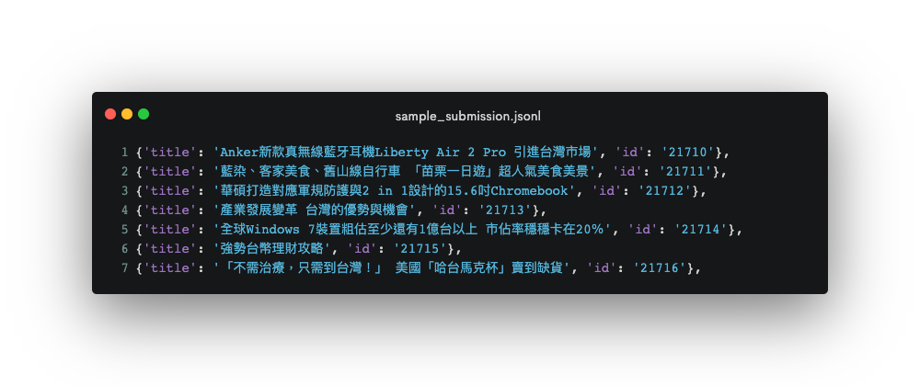
Submission - Format

Slide 23
Submission - File Layout
You are required to submit .zip file to NTU Cool
File structure for the .zip file (case-sensitive):
/[student id (lower-cased)]/ (Brackets not included.)
download.sh
run.sh
README.md
report.pdf
code/all other files you need
You can use unzip -l to check your zip file

Slide 24
Submission - Scripts
download.sh
Do not modify your file after deadline, or it will be seen as cheating.
Keep the URLs in download.sh valid for at least 3 weeks after deadline.
Do not do things more than downloading. Otherwise, your download.sh may be killed.
You can download at most 4G, and download.sh should finish within 1 hour. (At csie dept with maximum 10MB/s bandwidth)
Do not pip install ANYTHING in your download.sh, you are not allowed to modify the testing environment
You can upload your model to Dropbox or Google Drive.
We will execute download.sh before predicting scripts.

Slide 25
Submission - Scripts
run.sh
Arguments:
${1}: path to the input file
${2}: path to the output file
TA will predict testing data as follow:
bash ./download.sh
bash ./run.sh /path/to/input.jsonl /path/to/output.jsonl
Make sure your code works!
DO not unzip or download during inferencing. run.sh will be executed 2 times.

Slide 26
Submissiom - Reproducibility
All the code you used to train, predict, plot figures for the report should should be upload.
We will remove the answers (title column) in public.jsonl when we reproduce your submission.
README.md
Write down how to train your model with your code/script specifically.
If necessary, you will be required to reproduce your results based on the README.md.
If you cannot reproduce your result, you may lose points.
You will get at least - 2 penalty if you have no or empty README.md.

Slide 27
Execution Environment
Will be run on computer with
Ubuntu 20.04
32 GB RAM, RTX 2080 11G VRAM, 20G disk space available.
the packages we allow only.
python 3.8.10
Use only mt5-small. Larger models (e.g., mt5-xl) will cause out-of-memory errors on 11G VRAM.
Time limit: 1 hour total execution time for run.sh
You will lose (some or all) your model performance score if your script is at wrong location, or cause any error.

Slide 28
Late Submission Penalty
No Late submission
Late submission is determined by the last submission.
Do not update your submission after deadline.

Slide 29
Guide

Slide 30
Text-to-Text Transformer (T5)
HW1: BERT
HW2: T5
<input>
<input>
<s>,y1,y2,y3
Q,K,V
Q,K,V
Q
Bi-Encoder
Bi-Encoder
K,V
Decoder
Hidden state
Hidden state
y1,y2,y3,</s>
<output>

Slide 31
Training
Pre-trained mt5-small is very large. (300M parameters, 3x than BERT-base)
Some tips to reduce GPU memory usage:
Reduce batch size + gradient accumulation
Truncate text length (256/64 for input/output can pass the baseline)
fp16 (transformers has a bug on T5 fp16 training)
adafactor (instead of Adam)
For reference, you can pass the baseline within 4 hours training on single RTX 3070 8G if your code is correct.

Slide 32
Some Reminders
Please check the your file structure is correct after zip
You are not allowed to modify TA’s testing environment
You don’t have to include tw_rouge neither in your code nor in the folder
There would be no title column in input.jsonl during inferencing
If using ckiptagger and tensorflow>=2.16, add: os.environ["TF_USE_LEGACY_KERAS"] = "1”
Please comment out check_min_version("4.35.0.dev0") before submission
If you are using Windows, please be sure your script could be executed as well in Ubuntu. (Might encounter line encoding issue)

Slide 33
How to Fix T5 FP16 Training
https://github.com/huggingface/transformers/pull/10956
Install fixed version transformers library
git clone https://github.com/huggingface/transformers.git
git checkout t5-fp16-no-nans
pip install -e .

Slide 34
Documents
T5
https://huggingface.co/transformers/model_doc/t5.html
https://huggingface.co/transformers/model_doc/mt5.html
Generation:
https://huggingface.co/transformers/main_classes/model.html#generation

Slide 35
Q&A

