Slide 1
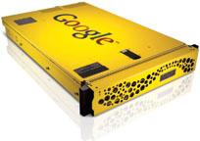
Google Search Appliance presentation
By Marius Palade

Slide 2
What is the Google Search Appliance(GSA)?
A physical machine with an operating system based on CentOS
Also comes with a T-shirt
Brings the power of Google Search to our business
Provides intuitive accurate search results across intranets, portals, file shares, databases, CRM&CMS systems etc.
Can index more than 220 file types
Intuitive and customizable interface
Integration and security
Google calls this Universal search

Slide 3
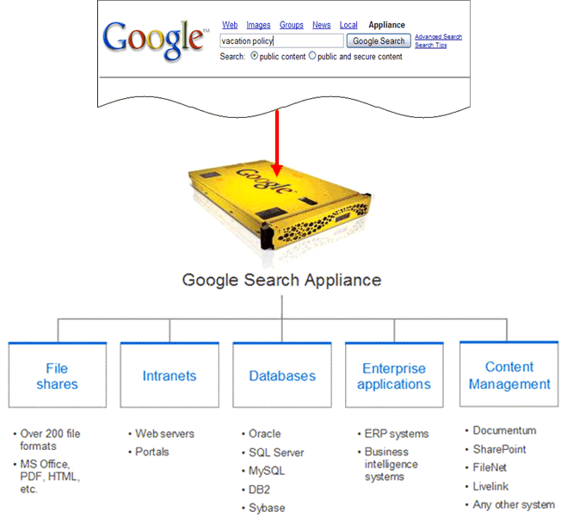
What is Universal search?
Search all content in a company through a single search box

Slide 4
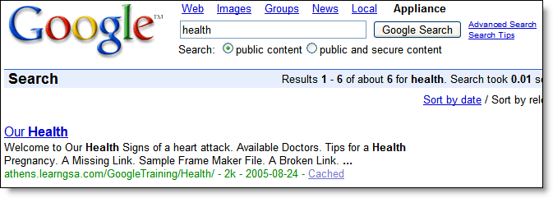
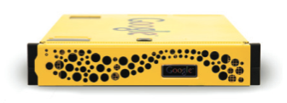
How the GSA works?
Three main processes:
Acquire content (crawl)
Cache content and build an index for fast lookup
Serve results to users
3
1
Web Servers
File Servers
2
Index

