Slide 1





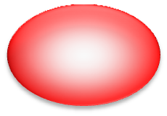







Dermatomyosites
Polymyosites
LES
Gougerot-Sjögren
Ac anti-ARNt synthétase (JO1, PL7, PL12, OJ, EJ)
Ac anti-SRP, PMScl, Ac anti-Mi2
Ac anti-SS-A/Ro
Ac anti-SS-B/La
Ac anti-ADN natif
Ac anti-Sm
Ac anti nucléaires
Ac anti- centromères
Syndrome de Crest
LES
Ac anti-RNP
Ac anti-Scl-70
PMScl
LES
Connectivites mixtes
Sclérodermie

