Slide 1
UE20CS344 – Network Analysis and Mining
Course Project
Project Title : Predicting Drug-Drug Interaction Using GNN
Team member :
PES2UG20CS569 : Vasudha M
PES2UG20CS815 : Vijay J
PES2UG20CS903 : D Jaya Kiran
PES2UG20CS907 : Gande Bala Rahul Sai

Slide 2
Topic
Due to its enormous relevance, drug-drug interaction is one of the most sought-after research areas.
Its definition is the result of an interaction between two or more medicines. These interactions may have beneficial effects or they may have unfavourable outcomes.

Slide 3
Uniqueness
The distinction of the aforementioned remark comes from its emphasis on the use of graph neural networks (GNNs) in the study of drug-drug interactions. The remark implies that conventional manual procedures can be improved to recognise intricate connections and interactions between medications by utilising GNNs. The statement also emphasises how crucial it is to evaluate many GNN models side by side in order to discover which ones function best in certain situations. Overall, the statement outlines an original and cutting-edge method for employing machine learning to solve a medical problem.

Slide 4
Dataset
Obl-ddi from Open Graph Benchmark.
Nodes - 4267
Edges - 13,34,889
It is a Homogenous, Undirected, Unweighted Graph representing drug-drug interactions
Source - link

Slide 5
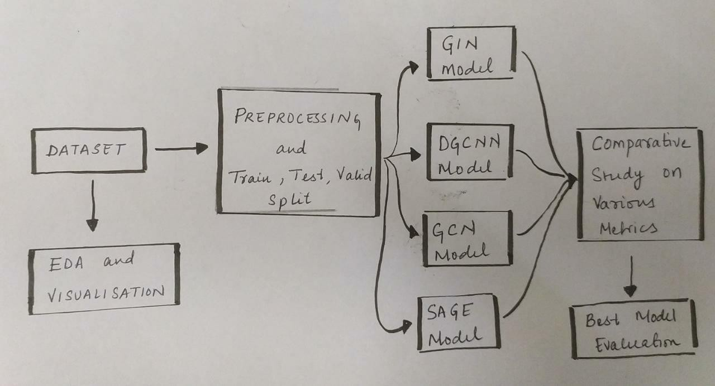
Overall design or approach in a free hand diagram

Slide 6
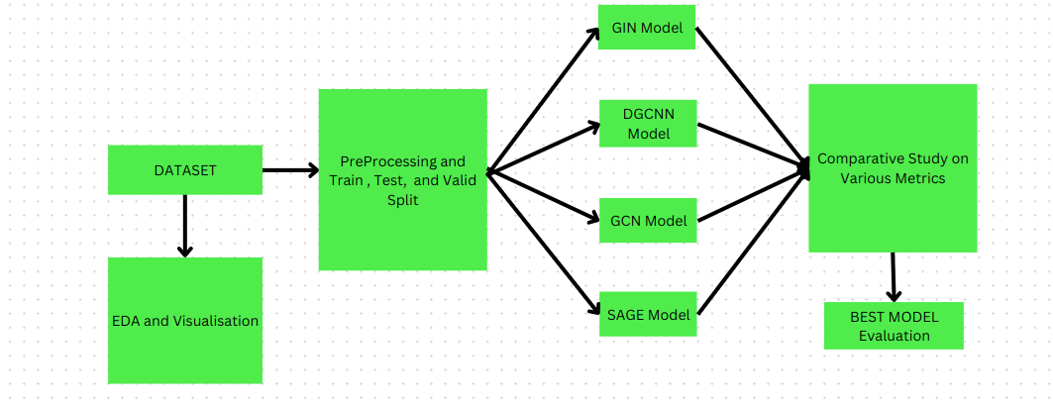
Overall design or approach in uml diagram

Slide 7
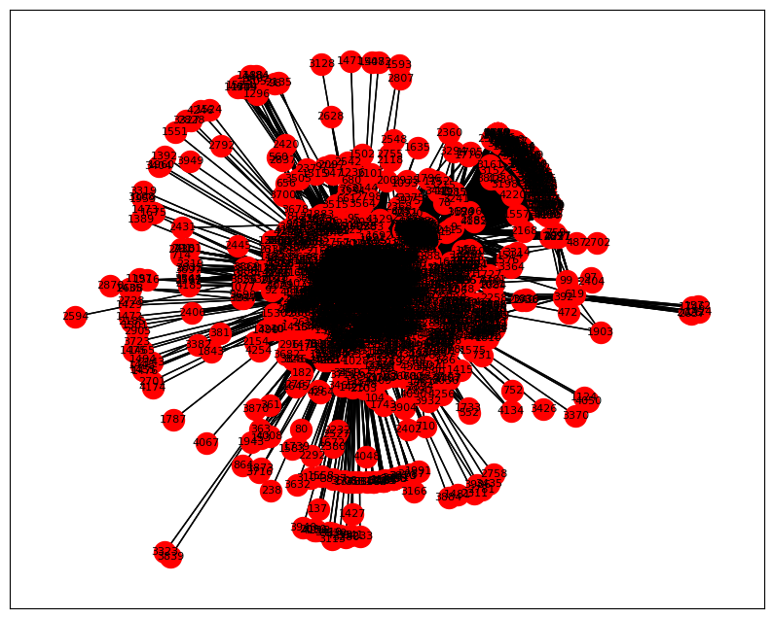
Final results so far
The Fruchterman_reingold_layout
for the Drug Drug Interaction which is
showing using Undirected the Graph

Slide 8
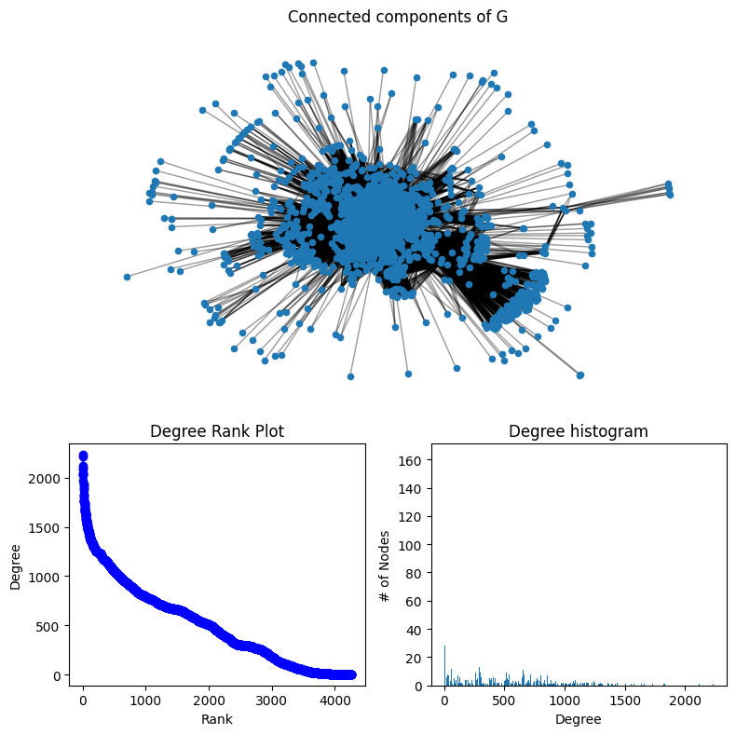
Final results so far
SpectralClustering
Where we used the EignVector
and K mean to find the Degree
Rank and Histogram

Slide 9
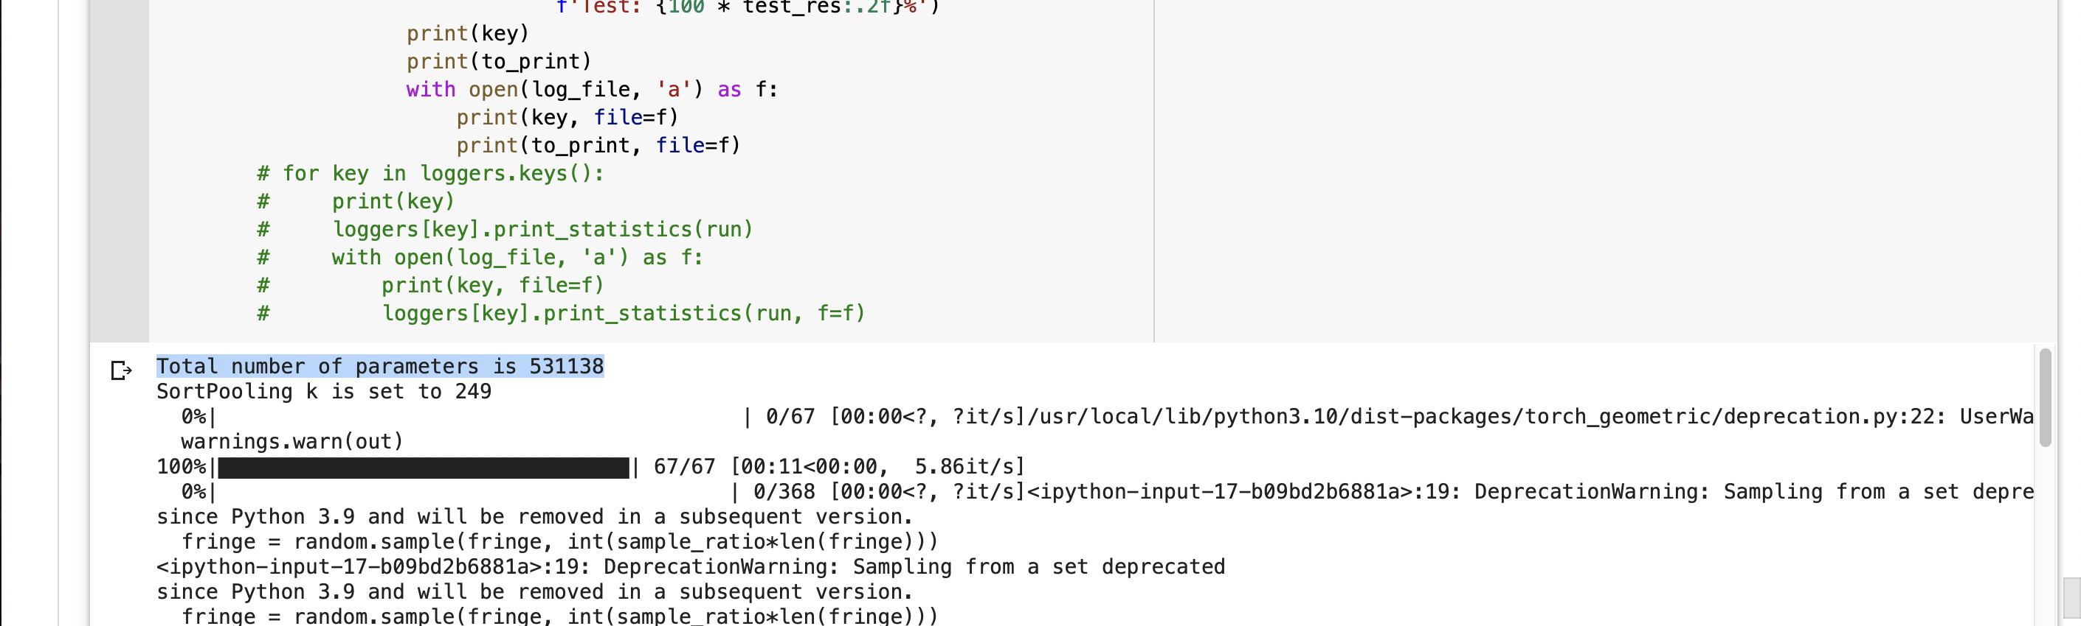
Total number of parameters
Predicting Link using Graph Neural Network
DGCNN

Slide 10
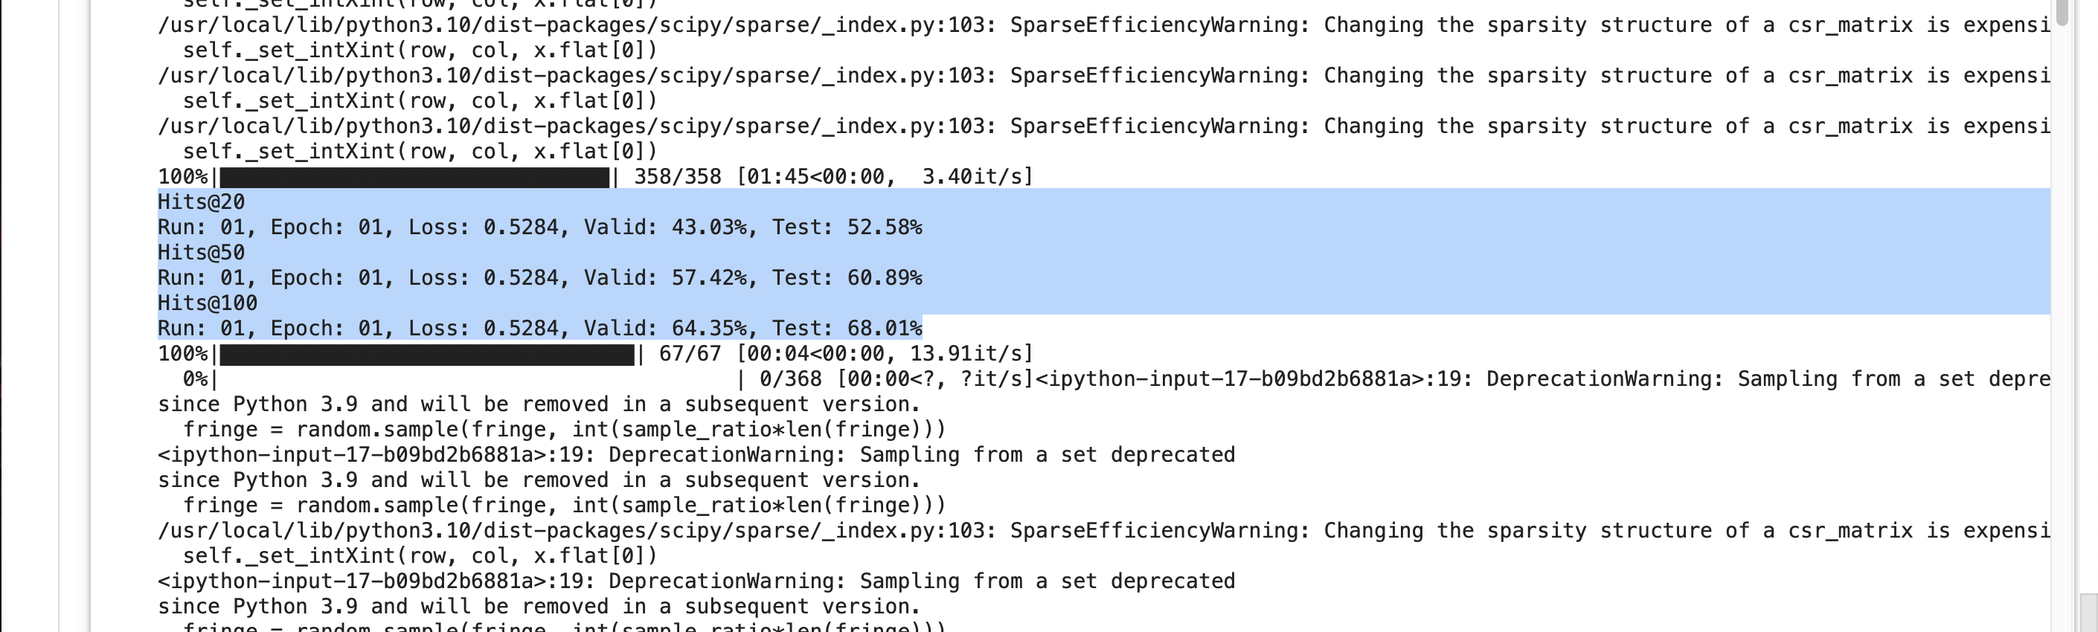
First Iteration
Predicting Link using Graph Neural Network
DGCNN

Slide 11
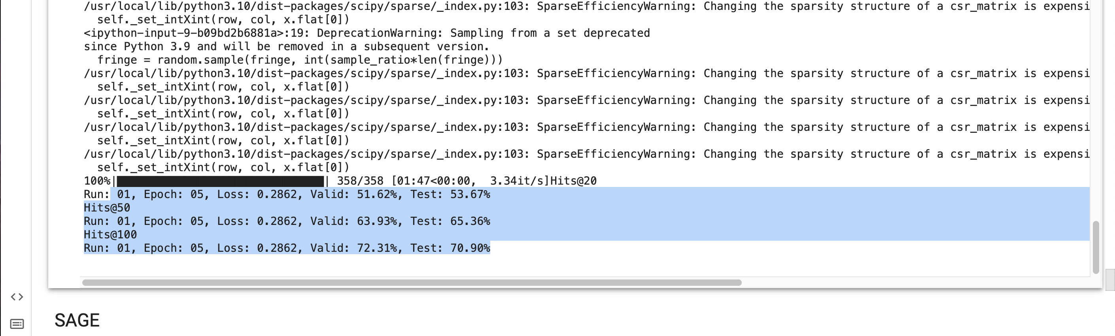
Last Iteration
Predicting Link using Graph Neural Network
DGCNN

Slide 12
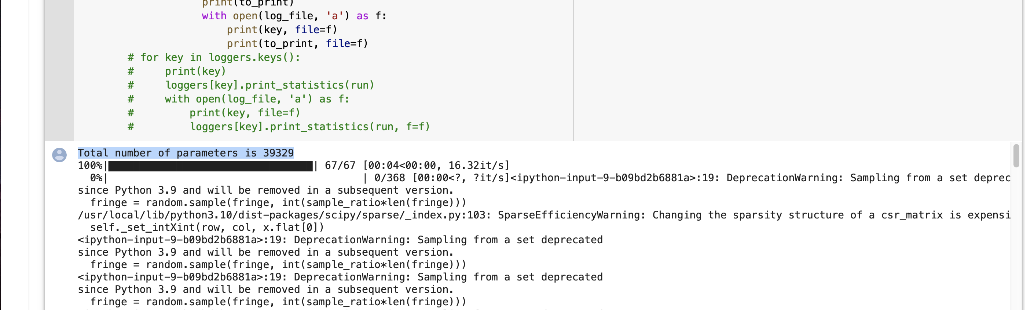
Total number of parameters
Predicting Link using Graph Neural Network
SAGE

Slide 13
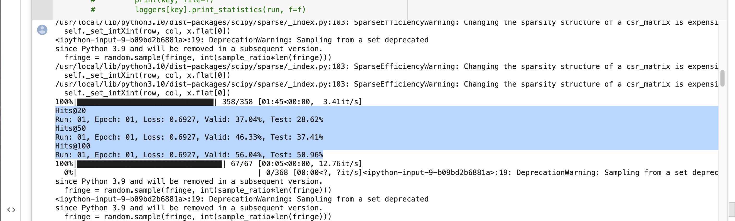
First Iteration
Predicting Link using Graph Neural Network
SAGE

Slide 14
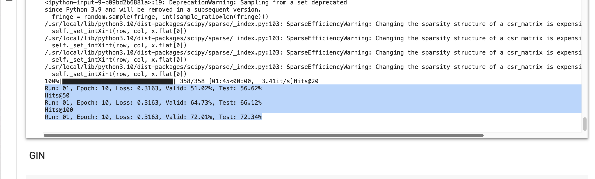
Last Iteration
Predicting Link using Graph Neural Network
SAGE

Slide 15
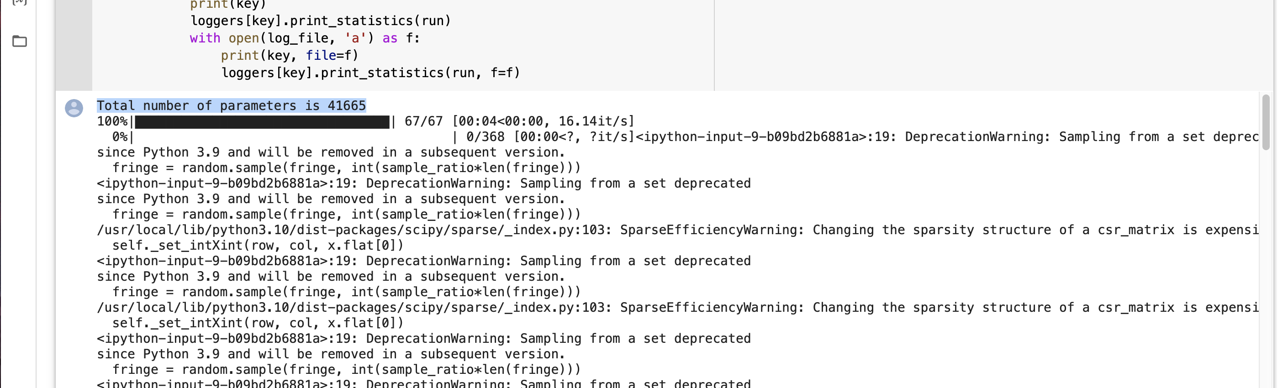
Total number of parameters
Predicting Link using Graph Neural Network
GIN

Slide 16
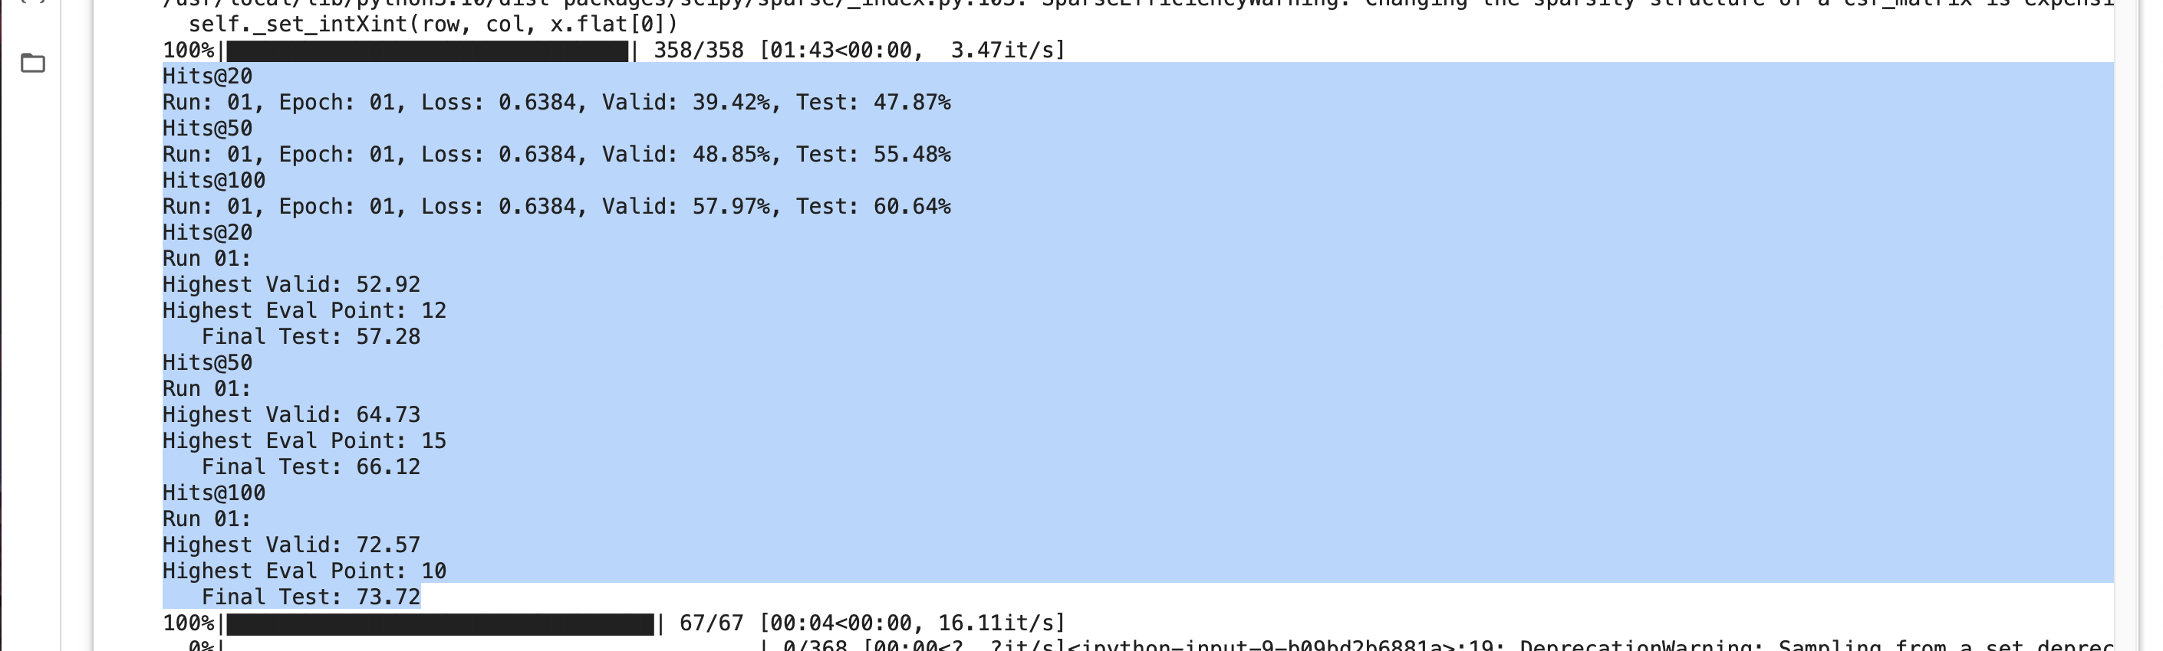
First Iteration
Predicting Link using Graph Neural Network
GIN

Slide 17
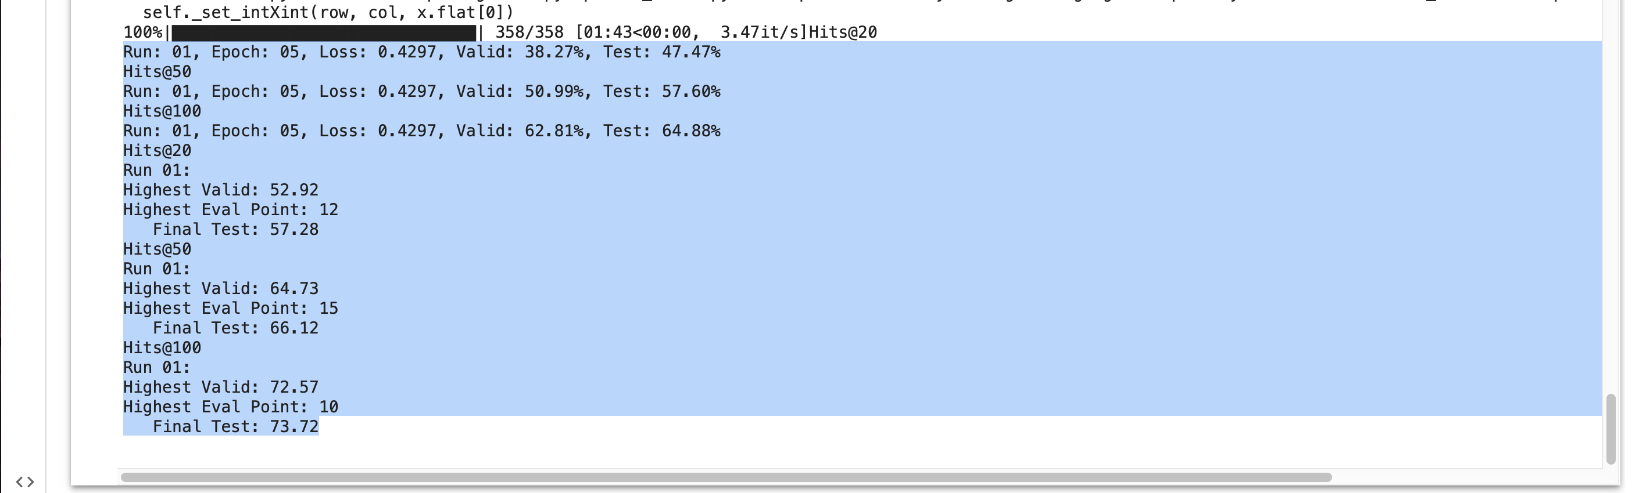
Last Iteration
Predicting Link using Graph Neural Network
GIN

Slide 18
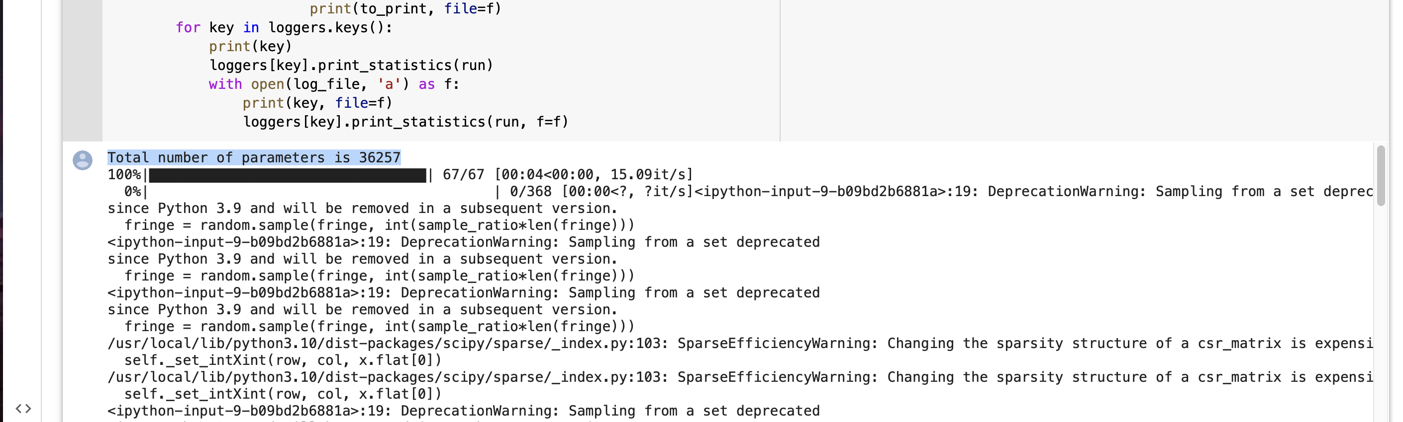
Total number of parameters
Predicting Link using Graph Neural Network
GCN

Slide 19
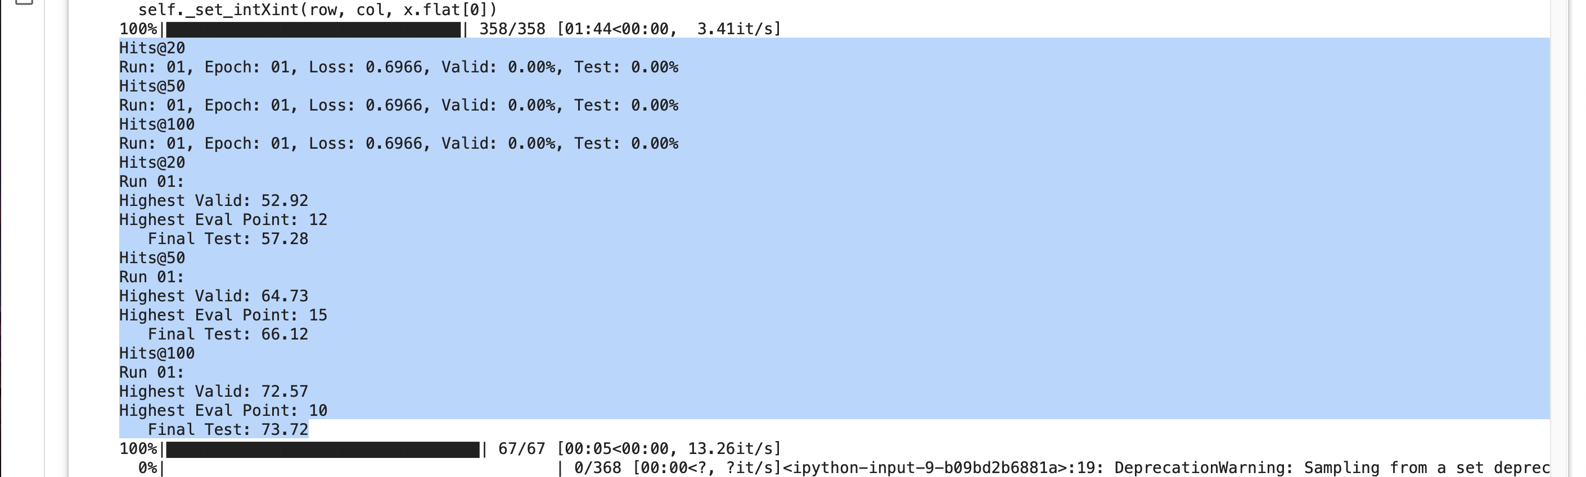
First Iteration
Predicting Link using Graph Neural Network
GCN

Slide 20
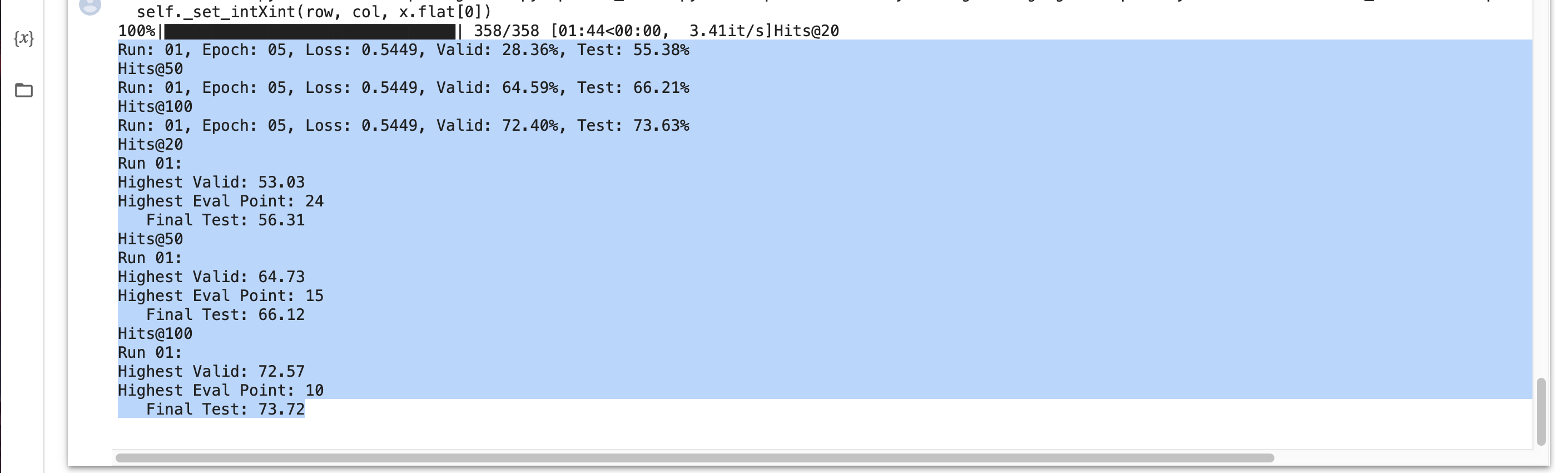
Last Iteration
Predicting Link using Graph Neural Network
GCN

Slide 21
Final results so far
Metric :
Loss - BCEWithLogitsLoss
Accuracy
Hits : On validation set
Models | Hits@20 | Hits@50 | Hits@100
DGCNN | 53.93 | 63.34 | 71.52
SAGE | 58.23 | 73.18 | 73.18
GIN | 47.89 | 58.54 | 66.54
GCN | 0.4819 | 67.47 | 67.47

Slide 22
Quantity and quality of work
no | Code functionality | % Complete | Runs without problem (Y/N) | If there are minor issues, indicate | Individual Contribution(SRN)
1 | Load Dataset - Pyg , PreProcessing the Dataset | 100 | Y | Google Colab resource limit disallowed running on entire train, test or val split. Epochs limited to 1 for submission purpose due to same reason. | PES2UG20CS569,PES2UG20CS903
2 | DGCNN Model With Evaluation, Visualizing the dataset | 100 | Y |  | PES2UG20CS815
3 | GCN Model With Evaluation , Train Set Model | 100 | Y |  | PES2UG20CS569
4 | SAGE ModelWith Evaluation , Test Set Model | 100 | Y |  | PES2UG20CS903
5 | GIN Model With Evaluation , Test Multiple Models | 100 | Y |  | PES2UG20CS907
6 | Evaluation - Hits, MRR, AUC. , Sealing the dataset | 100 | Y |  | PES2UG20CS815,PES2UG20CS907

Slide 23
Top few learning
Serial No | Top learning in this project
1 | Given the different techniques and implementations of Link Prediction - GraphSAGE, GCN , DGCNN, GIN – Putting them all together into one framework so that we don’t have to re-code train, test and evaluation based on different formats of implementation.
2 | Fascinating to model and learn the inner workings of drug-drug interactions via Graph Neural Networks.
3 | Key choice of evaluation metrics, overcoming hurdles of compute resource shortage.

Slide 24
Top unresolved challenges
Serial No | Brief description of unresolved challenges | Type of challenge (scope/data/design/implementation / others)
1 | Running model on entire dataset with multiple epochs. | Lack of GPU

Slide 25
Reference papers
No | Paper Title | Authors
1 | Link Prediction Based on Graph Neural Network | Muhan Zhang, Yixin Chen
2 | DGCNN: Disordered Graph Convolutional Neural Network Based on the Gaussian Mixture Model | Bo Wu, Yang Liu, Bo Lang, Lei Huang
3 | Semi-Supervised Classification with Graph Convolutional Networks | Semi-Supervised Classification with Graph Convolutional Networks

