Slide 1
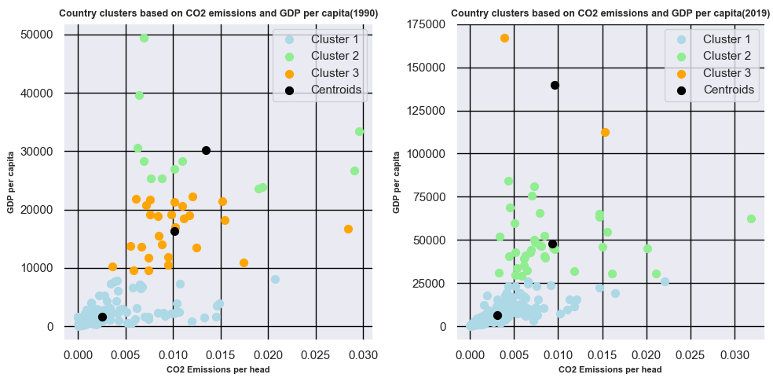
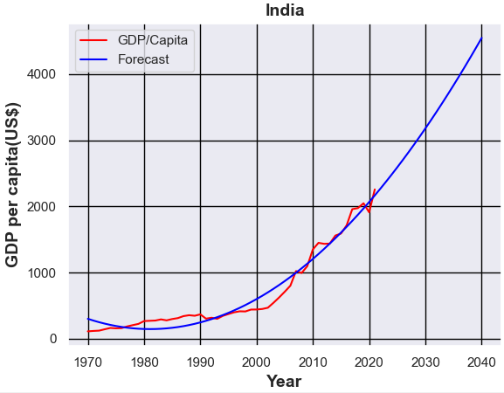
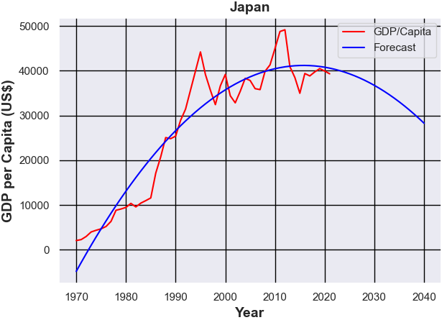
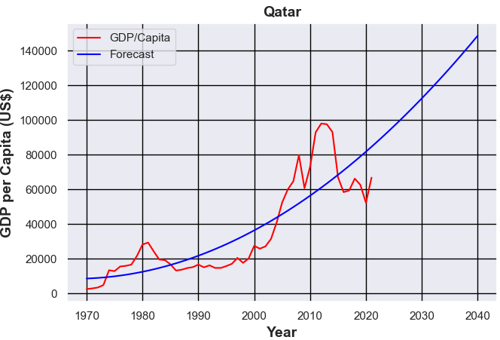
Climate Change and Economic Effect
Student Name: Yogesh Pandit
Student ID: 22095146
Abstract
A relation of Economic development with environment has been rationalized in this analysis. The study has interpreted this development negatively to showcase its impact the over the environment. The presentation was very clear where different pattern of graphical patterns have been applied to convey the message.
Introduction
Economic development brings industrialization in a nation whose various applications give direct as well as indirect influence over an environment. It has been noticed that the pollution has been increased with economic development and its visualization would present the scenario in a transparent manner. The purpose of this poster is to outline few visualizations in order to figure out the climatic change at global context. In addition, this study also has objective of conducting critical evaluation between the years.
Country Cluster on CO2 Emission & GDP per Capita
The first visualization consists of two pictures conveying four clusters of countries represented as four different colors. One picture of visualization showcased the orange color as most dense color indicating the CO2 emission between 0.005 and 0.013. These countries comprises of GDP per capita from 10000 to 22000. Hence, countries grouped as Cluster 3 exhibited the moderated outcomes between CO2 emission and GDP growth.
Forecasting of India’s GDP
The second figure describes the GDP growth of India which is predicted till the year 2040. It has been understood that the growth of GDP of India is consistently growing starting from 1970 and it would abruptly reach to its maximum level. As per the graph, the GDP per capita of India will reach to 4000 US Dollar by the year it reaches 2040.
Forecasting of Japan’s GDP
It can be seen that the growth of GDP of Japan already reached to its saturation level from where will decline by the year the nation would reach to the year 2040. By this year, the GDP of Japan would go down to $30000.
Forecasting of Qatar’s GDP
The GDP of Qatar has been forecasted in this fourth visualization where it appears to be highly fluctuating. In the meantime, it exhibited an abrupt increment in its GDP for the forthcoming year 2040.
Conclusion
From the various visualizations, it has been learned that GDP growth is somewhat responsible for the enhancement of CO2 gas emission in nations. Multiple forecasting of countries have been accomplished in this poster that justified the economic growth in nations like Qatar, India or Japan and found it a bit of hazardous for its environment in the coming years. A negative aspects have been revealed from economic development of nations and this poster inspire the governmental bodies to take initiative to control the CO2 emission.
GitHub Source: https://github.com/yp23aae/Applied-Data-Science1.git

