Slide 1

Title:
Regional Language Toxic comment classification
Yashkumar Parikh
Student ID No.: 1138765
Supervised by
Dr. Jinan Fiaidhi

Slide 2

Motivation
Our Ties to Social Media
Consequences of toxic comments

Slide 3
Aim
Classification of toxic comments
Regional Languages like Hindi, Marathi, Punjabi, Gujarati etc.
Achieving high accuracy

Slide 4
Related Work
NLP Context
BERT Embeddings
Common languages like English, French, etc.

Slide 5
Challenges
Regional language data set
High accuracy

Slide 6
Solutions
Create new regional language dataset
Data Pre-processing and cleaning

Slide 7
Technologies
Python
TensorFlow
Keras
NumPy
Pandas
Matplotlib
SkLearn

Slide 8
Data Gathering and Preprocessing
Dataset consists languages like English, Hindi, Gujarati, Marathi, Punjabi
Removed URLs, special chars, hashtags, mentions emoji, etc. from text
Shape (14995, 2)
Toxic 7500
Non-toxic 7495

Slide 9
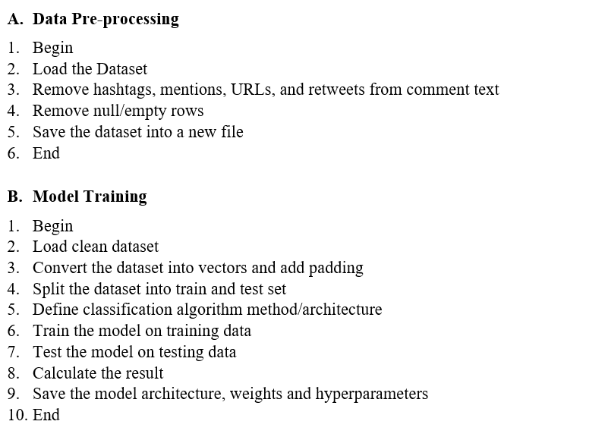
Pseudo Code

Slide 10
Model Implementation
Code

Slide 11
Results
Model | Train Accuracy | Test Accuracy
Logistic Regression | 99% | 88%
SVM | 97% | 87%
LSTM | 92% | 85%
CNN | 91% | 87%
DistilBERT | 78% | 60%

Slide 12
Conclusion

Slide 13
Future Work
Edge cases
Data centric approach

Slide 14
References
Darko Androcec, “Machine learning methods for toxic comment classification: a systematic review,” ResearchGate, Dec. 2020.https://www.researchgate.net/publication/349929587_Machine_learning_methods_for_toxic_comment_classification_a_systematic_review (accessed Mar. 31, 2022).
T. Chu, K. Jue, and M. Wang, “Comment Abuse Classification with Deep Learning.” [Online]. Available: https://web.stanford.edu/class/archive/cs/cs224n/cs224n.1174/reports/2762092.pdf
V. Sanh, L. Debut, J. Chaumond, and T. Wolf, “DistilBERT, a distilled version of BERT: smaller, faster, cheaper and lighter,” arXiv.org, 2019, doi: 10.48550/arXiv.1910.01108.

Slide 15
Thank you

