Slide 1
Using the KNN Machine Learning algorithm to solve the issue of consumer churn in Credit Card Services.
YASH PATEL

Slide 2

Problem
Image credit :https://www.revechat.com/blog/reduce-customer-churn/
The bank’s manager is concerned that more and more customers are abandoning their credit card services. Here it would be really helpful if someone could foretell who is going to leave so they could go out of their way to offer better services and sway the customer’s decision.

Slide 3
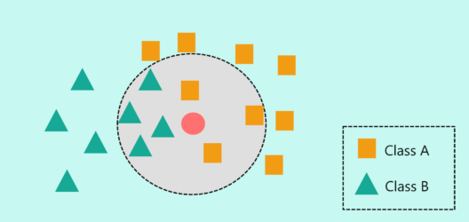
Approach
Image credit: https://www.edureka.co/blog/knn-algorithm-in-r/
In this case, we'll use the KNN to classify which customers are likely to stop using the credit card service.
Prior to using the KNN, we first cleaned and normalized the data to prepare it for the next stage.
Afterward, the KNN function was used to create model.

Slide 4
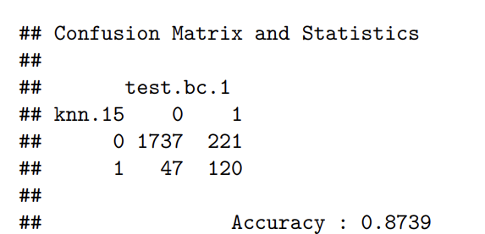
Results
After completing the entire process, we observed that the k value of 15 gives the most accurate indication of whether or not a customer will discontinue using the service.
Therefore, with the aid of this model, the bank manager can anticipate which customers will discontinue using the service and take the appropriate action to retain them.

Slide 5
Thank you
Yash Patel
ypatel15@kent.edu
PROJECT DATA SOURCE :https://www.kaggle.com/datasets/sakshigoyal7/credit-card-customers

