Slide 1

Portage APL Donation Dashboard

Slide 2
Big Idea
Using donor data to create a decision-making tool that helps Portage APL increase fundraising impact — so more animals can receive care and support through smarter, more targeted outreach.

Slide 3
Project Overview
This dashboard project uses real donor data from Portage APL to uncover insights into donation behavior, donor segmentation, and campaign timing. The goal is to empower nonprofit fundraising efforts with clearer, data-backed decisions.
Tools: Power BI, DAX, Power Query, Excel

Slide 4
Data Preparation & Cleaning
- Loaded donor and donation data from Excel (multiple related sheets)
- Removed blank and negative donation values (errors from data entry)
- Cleaned and standardized date formats for accurate trend analysis
- Created donation amount buckets (0–500, 501–1000, etc.) for segmentation
- Filtered out null or non-joinable records for a clean model
- Used Power Query for transformations, DAX for calculated columns

Slide 5
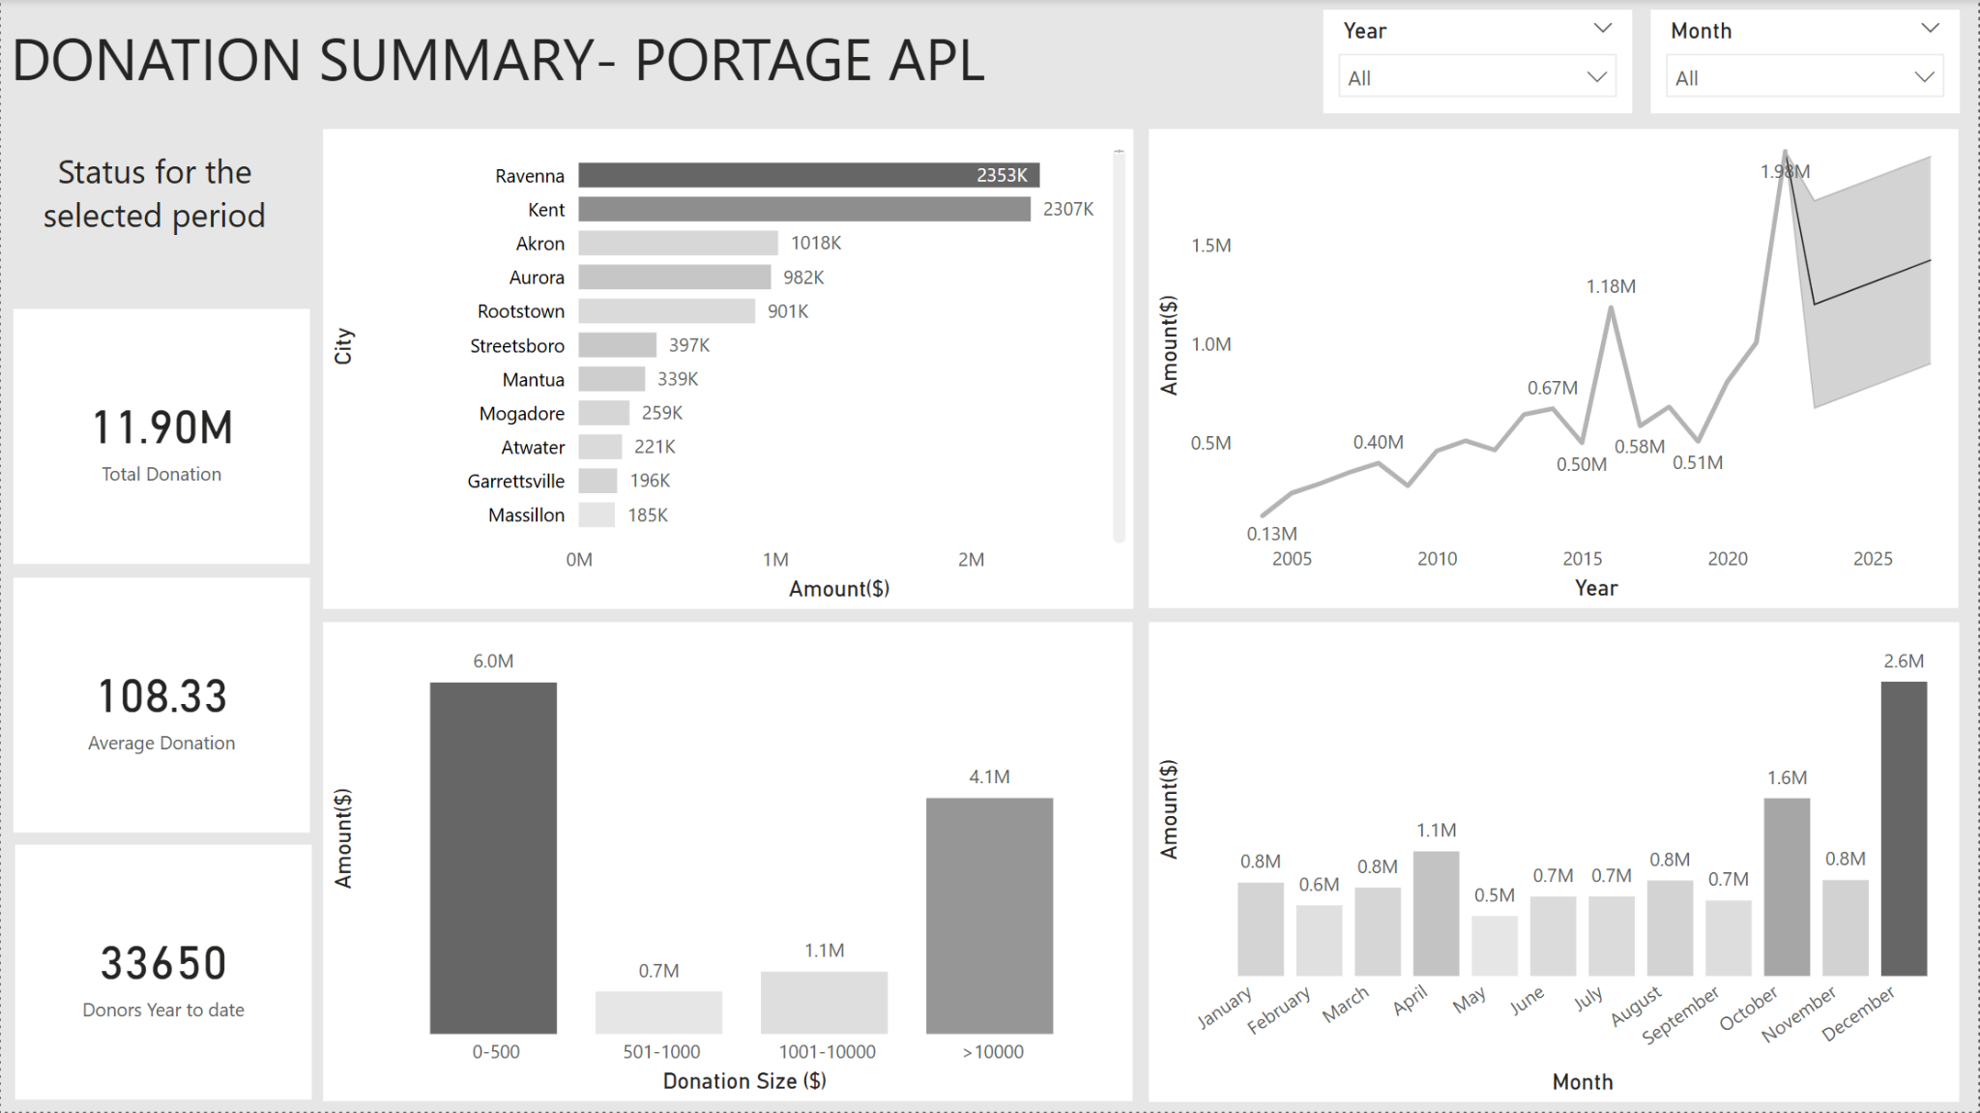
Dashboard

Slide 6

How the Dashboard Supports Decision-Making

Slide 7
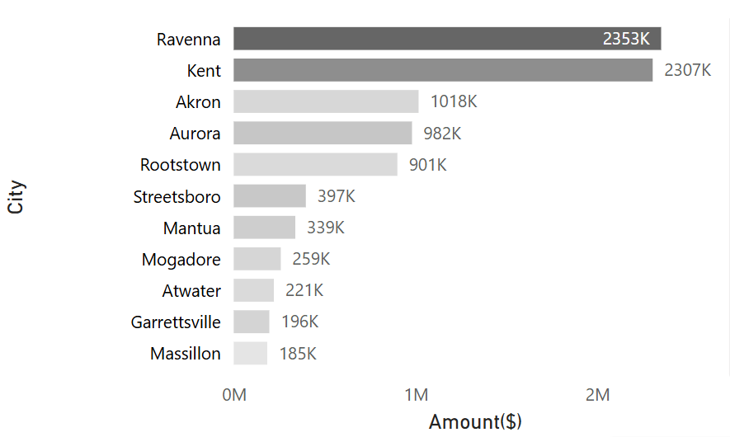
Identify key cities for targeted fundraising and event planning

Slide 8
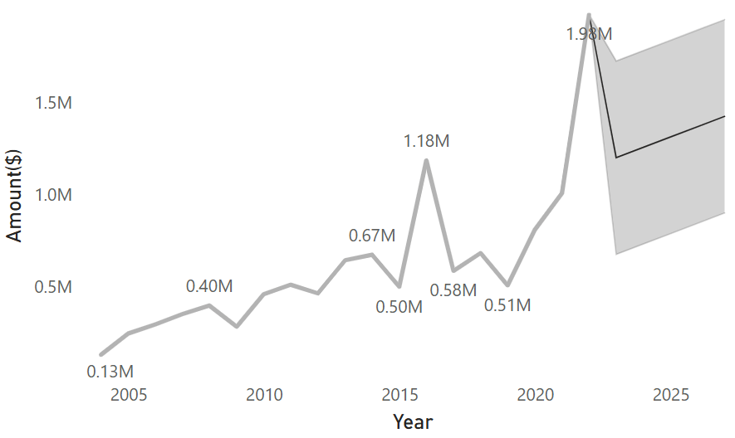
Helps in setting up benchmark for future years and for forecasting, the total amount of donations can be used to set fundraising goals for the organization.

Slide 9
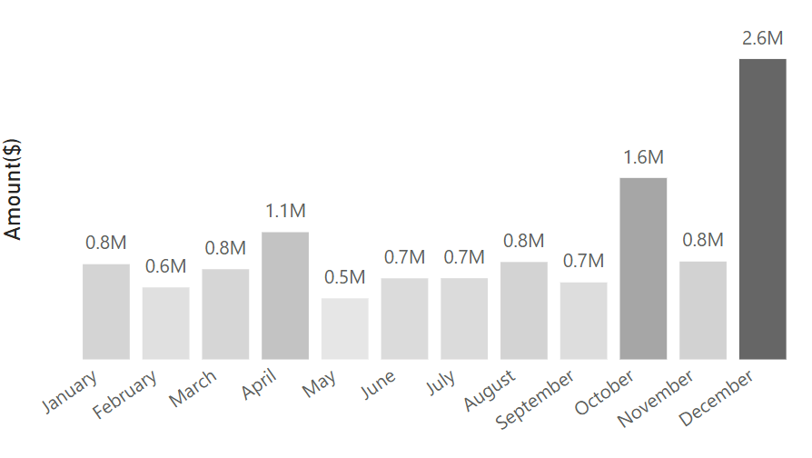
Understand seasonal donation trends to schedule campaigns strategically

Slide 10
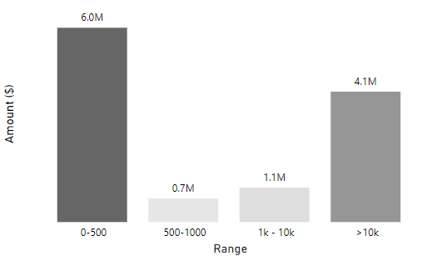
Focus on small-dollar contributions, which make up the majority

Slide 11
Key Insights from the Dashboard
- Peak donation period: December, indicating strong year-end giving
- Ravenna and Kent were leading cities in donation volume
- Donations over time align with common seasonal patterns
- Small-dollar donors (<$500) represent a consistent and scalable base of ongoing community support. - While donations over $10,000 account for a large portion of total contributions (e.g., $4M), the dashboard does not specify donation types. However, based on common nonprofit practices, many of these high-value gifts may stem from wills, trusts, or estate giving — typically one-time contributions rather than recurring support.

Slide 12

Thank you !

