Slide 1
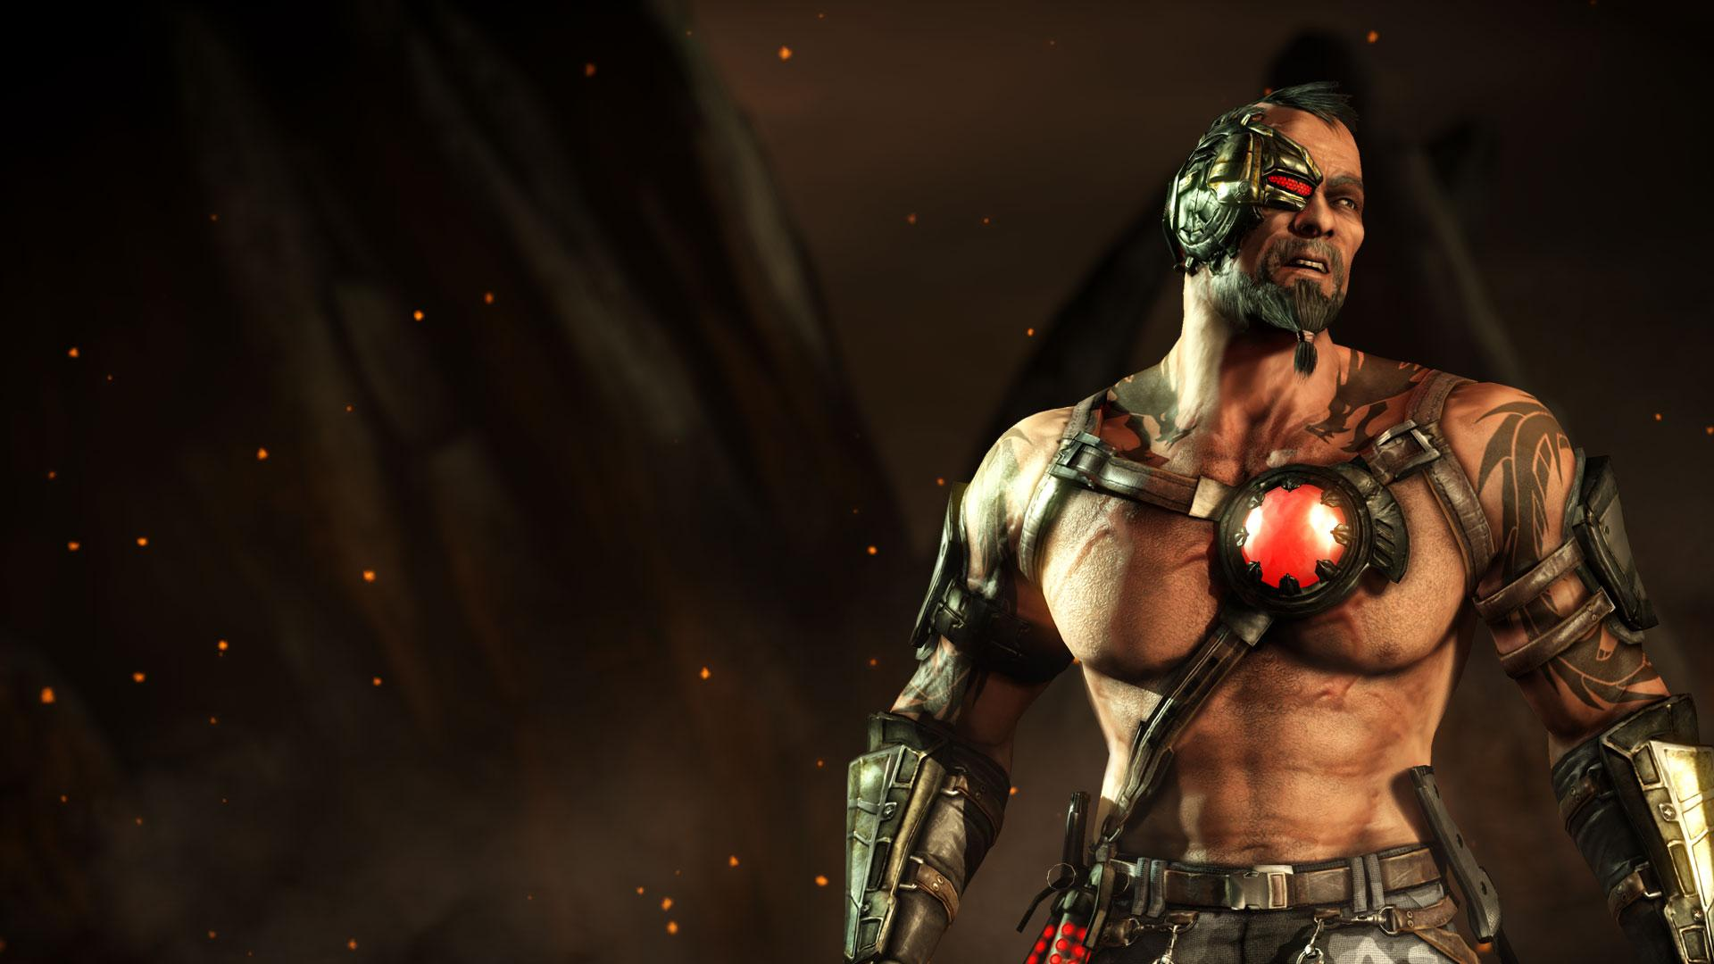

ProFighters
BY: LEGEND GAMES
Harjas Sidana, Mandeep Singh, Yash Patel

Slide 2
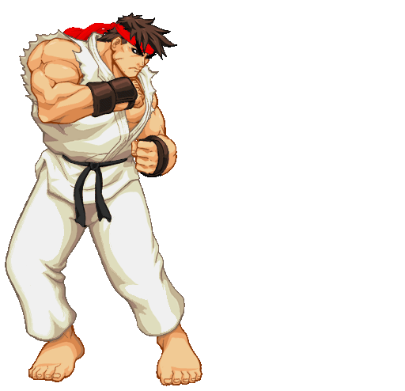
Notes:
Do you hate the president of the United States? Well, now you have a chance to fight him in ProFighters. ProFighters is a game where Shinsuke, a retired boxer who has to defeat his enemies, the secret army of Donald Trump, who has kidnapped his family. Now, Will you step up and fight Donald Trump’s army or are you too scared of dying and facing the president. Fight or Forfeit?

Slide 3
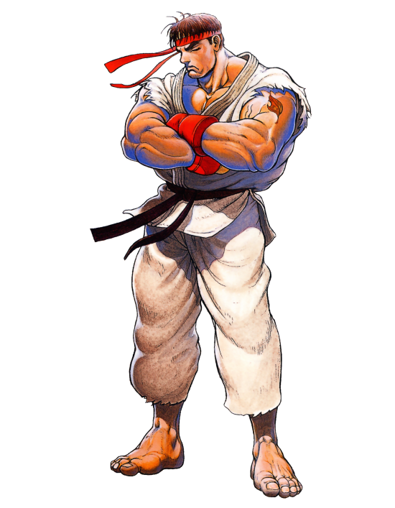
Notes:
In every good game, there are many controls that help the player get through the game. Some of the controls include movement, attacking, and many more. If the player presses any of the two arrows, Shinsuke will move around. The hero, Shinuski, will also have many special abilities. If the player presses Q,W,E or R then it will activate the special abilities. If you press “SPACE” then it will activate it’s passive.

Slide 4
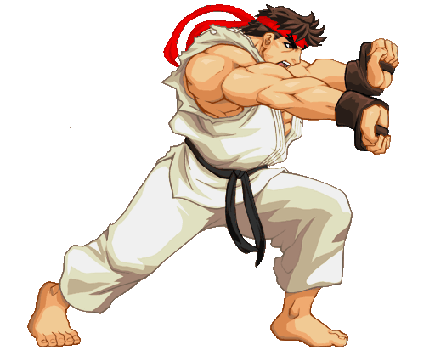
Notes:
In this game, there are going to be plenty of levels and stages you can play in. Each level gets harder as you pass it. The way to win is by defeating Donald Trump’s army and beating up whoever he gives for you to fight. You can fight by punching, kicking but we can’t spoil the fun. Just don’t lose by getting beaten up and letting him kill your family.
So head over to www.legendgames.com/fightinggames/ProFighters and try the good fun and challenge yourself. Go Play ProFighters!!

Slide 5

