Slide 1
Assignment 4
Your name: Bing Yang
Your GTID: byang322@gmail.com (903563092)

Slide 2
Seq2Seq Results
Put your results from training before and after hyperparameter tuning here.
Results for default configuration using RNN |  | Results for default Configuration Using LSTM
Training Loss | 4.5958 | Training Loss | 4.3472
Training Perplexity | 99.0695 | Training Perplexity | 77.2650
Validation Loss | 4.5215 | Validation Loss | 4.2230
Validation Perplexity | 91.9775 | Validation Perplexity | 68.2360
Result for your Best Model using RNN after hyperparameter tuning |  | Resut for your Best Model using LSTM after hyperparameter tuning
Training Loss | 4.1303 | Training Loss | 3.3429
Training Perplexity | 62.1949 | Training Perplexity | 28.3002
Validation Loss | 4.1795 | Validation Loss | 3.4789
Validation Perplexity | 65.3362 | Validation Perplexity | 32.4235
Your best model configuration for RNN after hyperparameter tuning |  | Your best model configuration for LSTM after hyperparameter tuning
EPOCH = 150, LR = 5e-4 others same |  | EPOCH = 150, LR = 5e-4 others same
Table 1

Slide 3
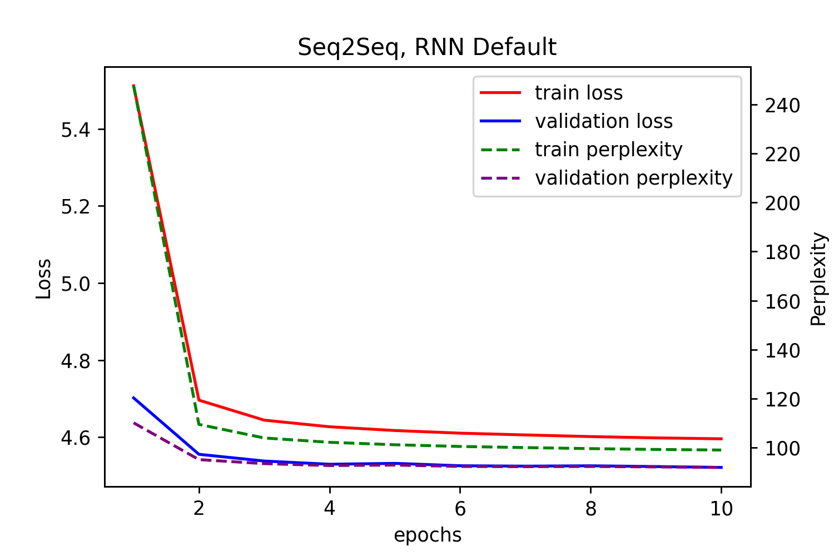
Seq2Seq Curves
Put the plots for loss/perplexity curves (training & validation) for your configuration with default setting and for your best model here.

Slide 4
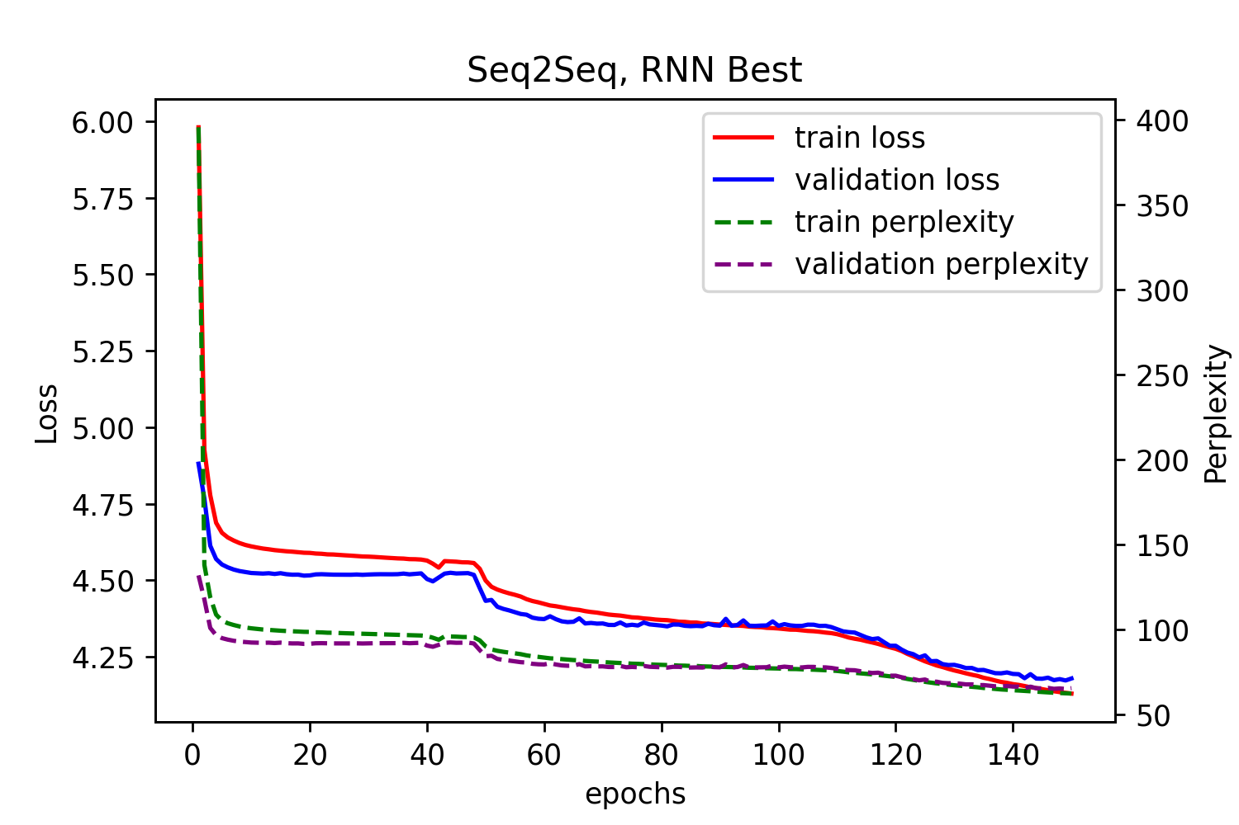
Seq2Seq Curves
Put the plots for loss/perplexity curves (training & validation) for your configuration with default setting and for your best model here.

Slide 5
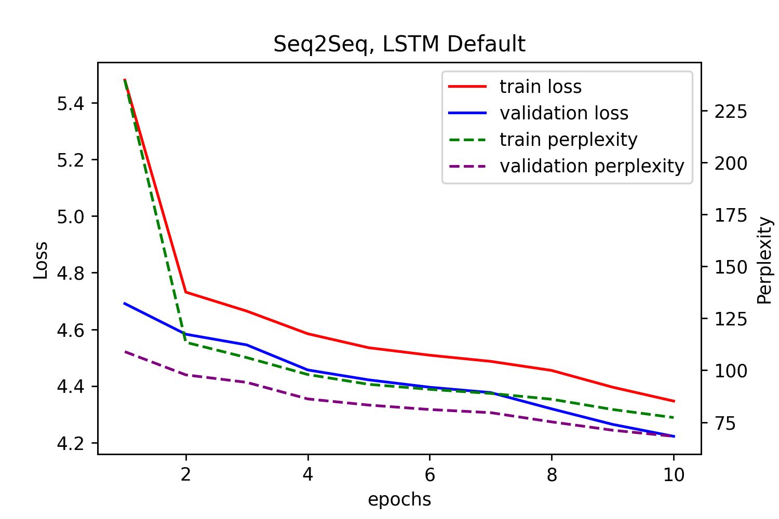
Seq2Seq Curves
Put the plots for loss/perplexity curves (training & validation) for your configuration with default setting and for your best model here.

Slide 6
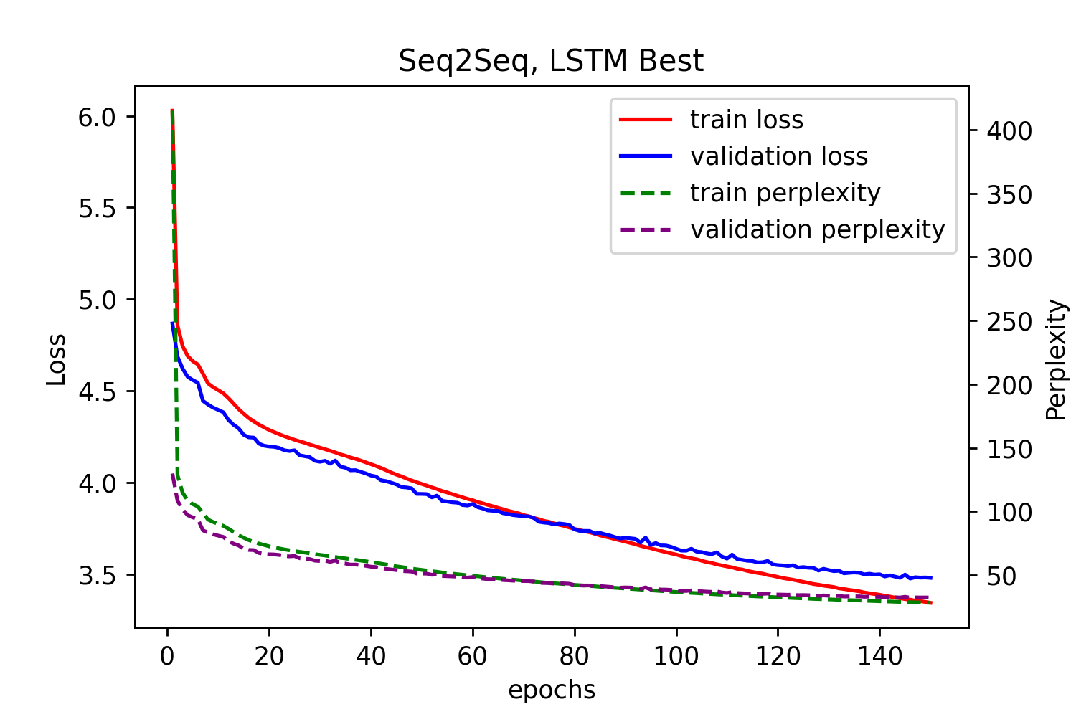
Seq2Seq Curves
Put the plots for loss/perplexity curves (training & validation) for your configuration with default setting and for your best model here.

Slide 7
Seq2Seq Explanation
Explain what you did here and why you did it to improve your model performance. You can use another slide if needed.
I simply increased number of epochs and lower the learning rate. I found out that changing other hyperparameters do not have significant effects on the output.
Training longer can generate better results in general. By experimentation, I found out overfitting is a problem. To solve that, I lowered the learning rate to let the model explore more slowly in the parameter space.

Slide 8
Transformer Results
Put your results from training before and after hyperparameter tuning here.
Results for default configuration
Training Loss | 2.2837 | Validation Loss | 3.0061
Training Perplexity | 9.8127 | Validation Perplexity | 20.2077
Result for your Best Model
Training Loss | 2.5079 | Validation Loss | 2.9947
Training Perplexity | 12.2789 | Validation Perplexity | 19.9797
Your best model configuration after hyperparameter tuning
BATCH_SIZE = 64, LR = 5e-4, EPOCHS = 12, others same
Table 2

Slide 9
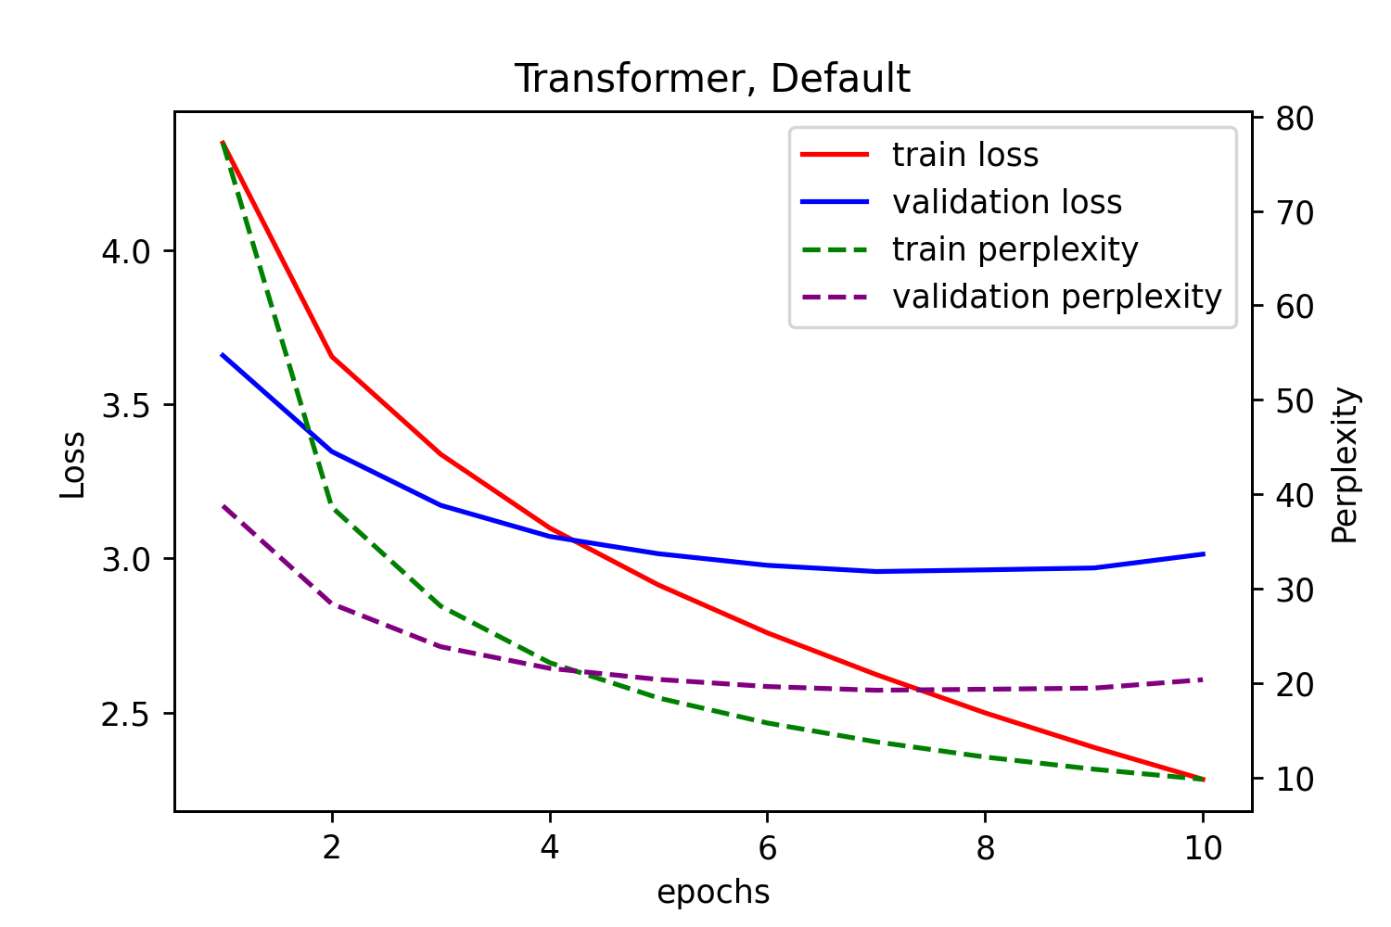
Transformer Curves
Put the plots for loss/perplexity curves (training & validation) for your configuration with default setting and for your best model here.

Slide 10
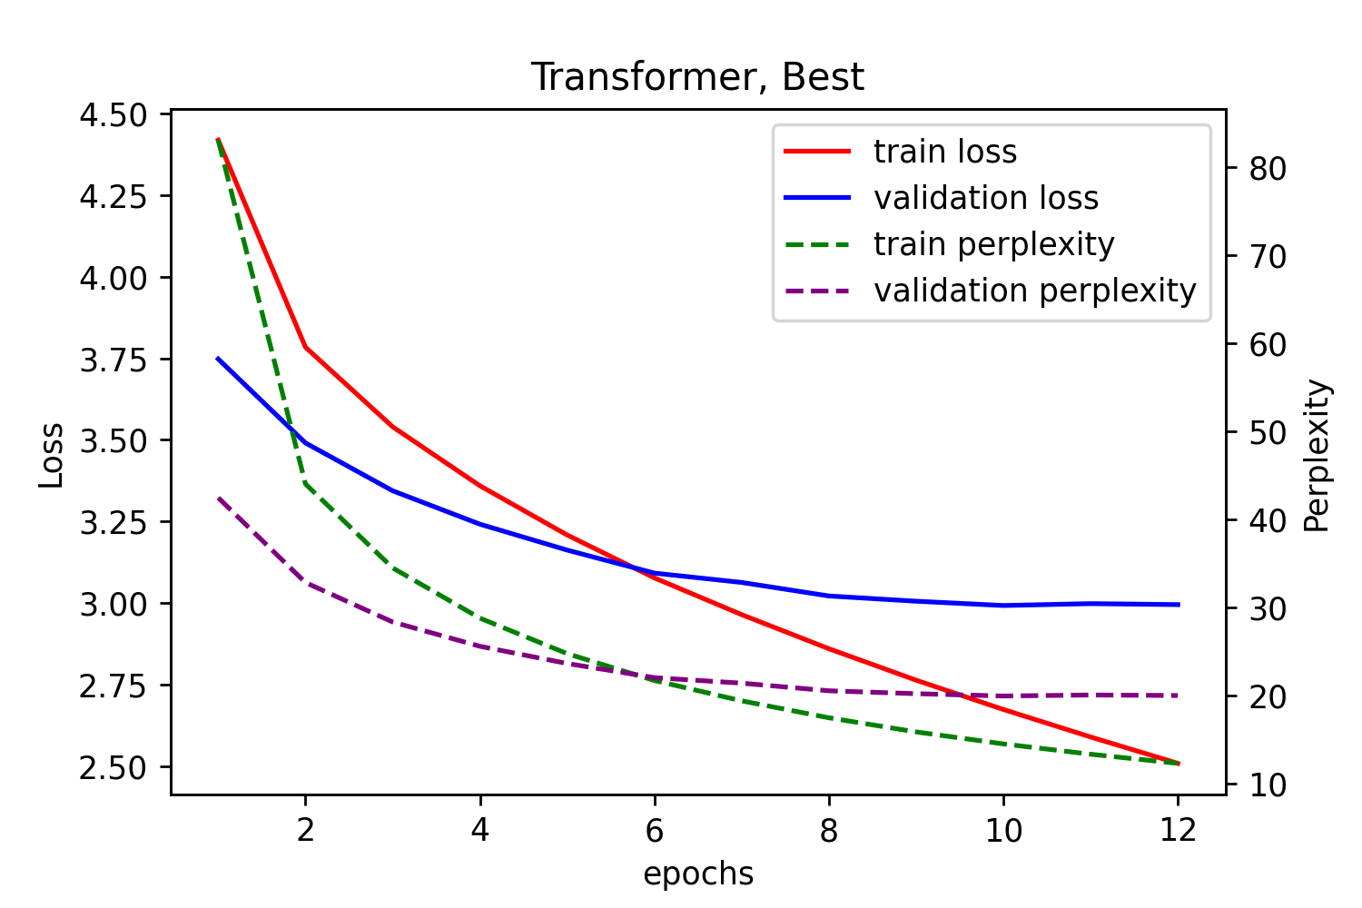
Transformer Curves
Put the plots for loss/perplexity curves (training & validation) for your configuration with default setting and for your best model here.

Slide 11
Transformer Explanation
Explain what you did here and why you did it to improve your model performance. You can use another slide if needed.
I decreased the batch size from 128 to 64 and adjusted the epochs by experimentation.
The main issue for training transformer is overfitting from my experimentations. Small batch size can usually result in better generalization in practice. Also, I set training time manually by experimentation to avoid overfitting.

Slide 12
Transformer Translation Results
Put translation results for your best model (1st 9 sentences) here
Input sentence | Back translation
‘'<sos>', 'a', 'young', 'boy', 'jumps', 'into', 'water', '.', '<eos>', | '<sos>', 'a', 'young', 'boy', 'is', 'into', 'into', 'water', '.', '<eos>'
'<sos>', 'a', 'native', 'woman', 'is', 'working', 'on', 'a', 'craft', 'project', '.', '<eos>' | '<sos>', 'a', 'is', 'works', 'on', 'a', 'a', '.', '.', '<eos>'
'<sos>', 'an', 'asian', 'woman', 'sitting', 'outside', 'an', 'outdoor', 'market', 'stall', '.', '<eos>' | '<sos>', 'an', 'asian', 'is', 'sitting', 'in', 'of', 'a', 'a', 'a', '.', '<eos>'
'<sos>', 'woman', 'standing', 'on', 'a', 'brick', 'wall', 'and', 'taking', 'a', 'picture', '<eos>' | '<sos>', 'woman', 'stands', 'standing', 'a', 'a', 'a', 'and', 'photographs', '.', '.', '<eos>'
'<sos>', 'there', 'are', 'construction', 'workers', 'working', 'hard', 'on', 'a', 'project', '.', '<eos>' | '<sos>', 'construction', 'workers', 'workers', 'hard', 'a', 'a', 'a', '.', '.', '.', '<eos>'
'<sos>', 'a', 'man', 'in', 'a', 'cluttered', 'office', 'is', 'using', 'the', 'telephone', '<eos>' | '<sos>', 'a', 'man', 'is', 'on', 'a', 'a', 'office', '.', '.', '<eos>'
'<sos>', 'two', 'chinese', 'people', 'are', 'standing', 'by', 'a', 'chalkboard', '.', '<eos>' | '<sos>', 'two', 'chinese', 'stand', 'at', 'by', 'a', 'a', 'a', '.', '.', '<eos>'
'<sos>', 'children', 'are', 'playing', 'a', 'sport', 'on', 'a', 'field', '.', '<eos>' | '<sos>', 'children', 'are', 'playing', 'playing', 'a', 'a', 'a', '.', '<eos>'
'<sos>', 'a', 'man', 'is', 'working', 'at', 'a', 'construction', 'site', '.', '<eos>' | '<sos>', 'a', 'man', 'is', 'working', 'a', 'construction', 'construction', 'construction', 'site', '<eos>'
Table 3

Slide 13
LSTM Translation Results
Put translation results for your best model (1st 9 sentences) here
Input sentence | Back translation
‘'<sos>', 'a', 'young', 'boy', 'jumps', 'into', 'water', '.', '<eos>', | '<sos>', 'a', 'little', 'boy', 'is', 'jumping', 'in', 'the', '.', '.', '<eos>'
'<sos>', 'a', 'native', 'woman', 'is', 'working', 'on', 'a', 'craft', 'project', '.', '<eos>' | '<sos>', 'a', 'asian', 'is', 'is', 'a', 'a', 'a', '.', '.', '<eos>'
'<sos>', 'an', 'asian', 'woman', 'sitting', 'outside', 'an', 'outdoor', 'market', 'stall', '.', '<eos>' | '<sos>', 'a', 'asian', 'woman', 'stands', 'standing', 'front', 'front', 'of', 'a', '.', '.', '<eos>'
'<sos>', 'woman', 'standing', 'on', 'a', 'brick', 'wall', 'and', 'taking', 'a', 'picture', '<eos>' | '<sos>', 'woman', 'sitting', 'on', 'a', 'a', 'a', '.', '.', '<eos>'
'<sos>', 'there', 'are', 'construction', 'workers', 'working', 'hard', 'on', 'a', 'project', '.', '<eos>' | '<sos>', 'construction', 'workers', 'are', 'working', 'a', 'a', 'a', '.', '.', '<eos>'
'<sos>', 'a', 'man', 'in', 'a', 'cluttered', 'office', 'is', 'using', 'the', 'telephone', '<eos>' | '<sos>', 'a', 'man', 'is', 'sitting', 'a', 'a', '.', '.', '<eos>'
'<sos>', 'two', 'chinese', 'people', 'are', 'standing', 'by', 'a', 'chalkboard', '.', '<eos>' | '<sos>', 'two', 'women', 'are', 'sitting', 'in', 'a', 'a', '.', '.', '<eos>'
'<sos>', 'children', 'are', 'playing', 'a', 'sport', 'on', 'a', 'field', '.', '<eos>' | '<sos>', 'children', 'are', 'on', 'a', 'a', 'a', 'a', '.', '<eos>'
'<sos>', 'a', 'man', 'is', 'working', 'at', 'a', 'construction', 'site', '.', '<eos>' | '<sos>', 'a', 'man', 'is', 'a', 'a', 'a', '.', '.', '<eos>'
Table 4

Slide 14
Compare LSTM to Transformer
Compare your LSTM results to your Transformer Results both quantitatively and qualitatively and explain the differences.
Even though transformer has a significant lower loss compared to LSTM seq2seq model (perplexity 32 for LSTM and 19.9 for transformer), neither model gives satisfactory translations.
I would say transformer does a slightly better job because it captures most pieces for most sentences. LSTM model generates many repeated ‘a’ at the end of sentences.
The transformer I implemented in this assignment is a very simple version (not even the complete one) of the original model. This might explain the poor performance.

