Slide 1
Title Here
Name/subtitle here:

Slide 2
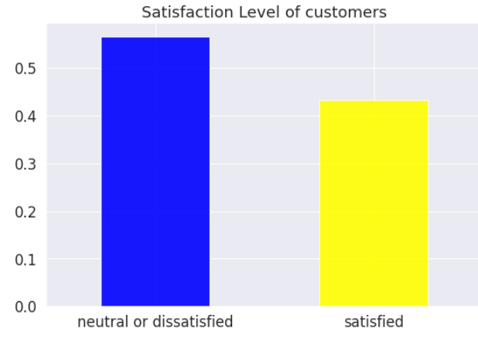
EDA – Check for Data Imbalance
We see that we have 56.67% of 'Neutral or Dissatisfied' customers as compared to 43.33% of 'Satisfied' customers and thus our data is almost balanced.

Slide 3
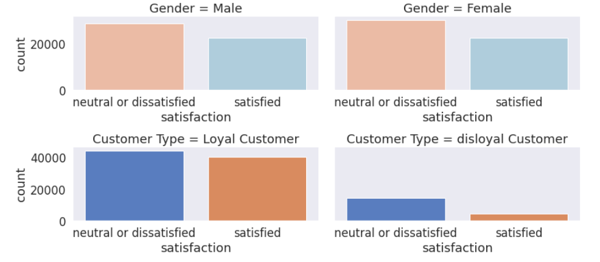
EDA – Gender and Customer Type
For both Males and Females, we see that no. of 'Neutral or Dissatisfied' customers are more as compared to 'Satisfied' customers. The same logic applies to 'Loyal' and 'Disloyal' Customers. Also we see that the no . of Loyal customers are way more than 'Disloyal' customers.

Slide 4
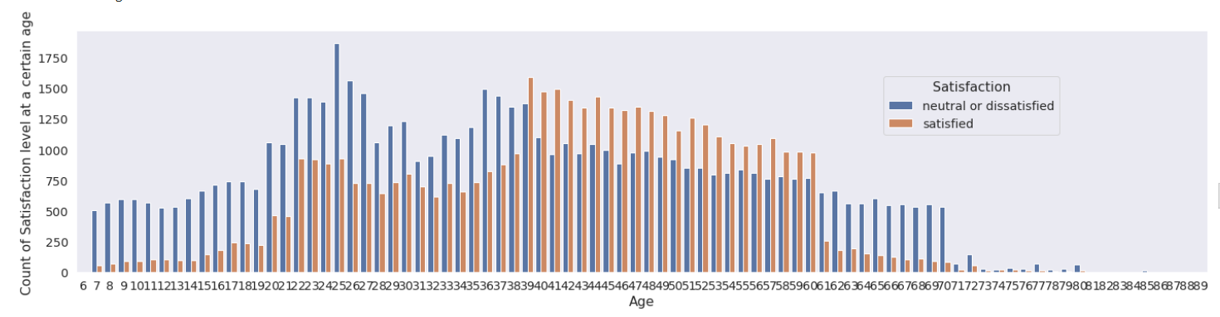
EDA – Age
We see that our early age passengers i.e. 8-38 are more neutral or dissatisfied as compared to satisfied. Passengers aged 39-60 have higher satisfaction level and then the trend for dissatisfied or neutral is again higher for the remaining higher age group.

Slide 5
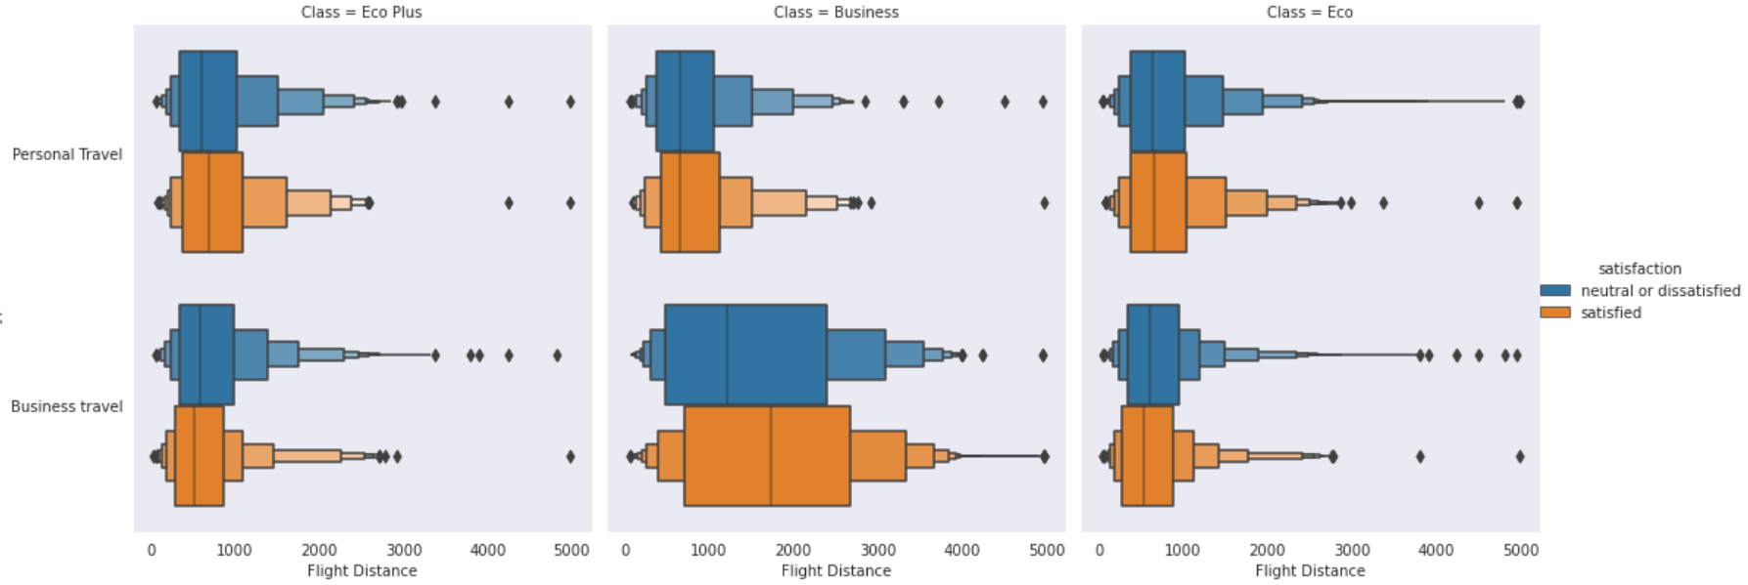
EDA – Travel Class of Passengers
For business travel in business class category, the number of satisfied passengers are quite on the higher side for longer flight distance. For other combinations, there is almost equal distribution of satisfied and dissatisfied passengers.

Slide 6
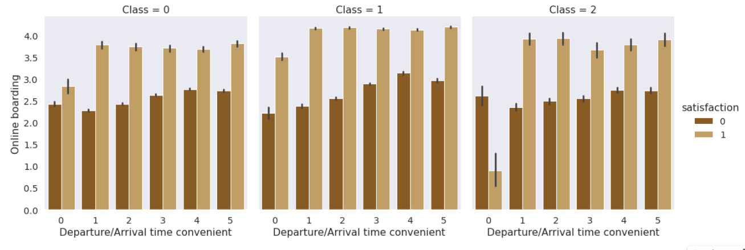
EDA – Ease of Online Boarding
For Eco Plus class, very inconvenient Departure/Arrival time (Departure/Arrival_time_convenient = 0) has really high no. of dissatisfied passengers, even when online boarding is done very well. For other combinations, no. of satisfied passengers are on the higher side compared to no. of dissatisfied passengers.

Slide 7
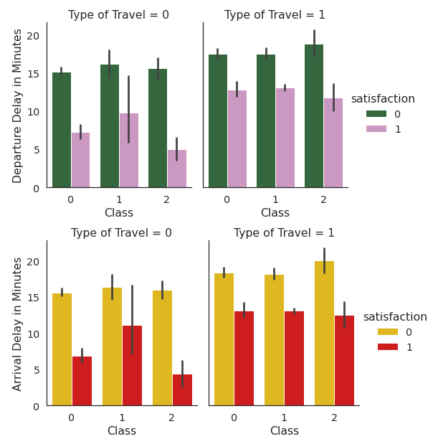
EDA – Departure/Arrival Delay
For personal travel (specially Eco Plus and Eco), the no. of dissatisfied passengers are really high when arrival delay in minutes is high. As observed the level of dissatisfied or neutral passengers is always more than the satisfied passengers whenever there's a delay in arrival or departure time.

Slide 8
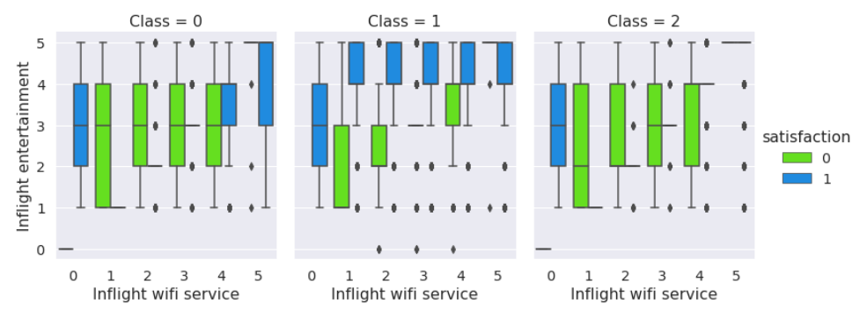
EDA – Inflight Wi-Fi Service
The Eco Plus passengers are mostly satisfied without in-flight Wi-Fi service (rating 0) and medium level of in-flight entertainment (rating 2 - 4). For Business class passengers, only highest level of in-flight entertainment (rating 5) can make them satisfied. For Eco passengers, high level of in-flight entertainment (rating 3 - 5) and very high Wi-Fi service availability (rating 5) can make them satisfied.

Slide 9
EDA – Other Predictors
Following are the interpretations from some of our important features –
As seat comfort increases, the customer satisfaction increases as well.
As cleanliness increases, the satisfaction level of passengers increases.
The maximum no. of satisfied passengers belong to the category of 4 and 5 rating givers for quality of food and drinks. Below the rating of 4, passengers are mostly dissatisfied.
For business class, it is observed that all gate locations have higher no. of dissatisfied passengers when baggage handling is not done perfectly well (rating <= 4). For Economy Plus, when the gate location is 1 and for Eco, when the gate location is 2, even when the baggage's are handled in a mediocre way (rating in range 2.0 - 4.0), passengers remained dissatisfied.

Slide 10
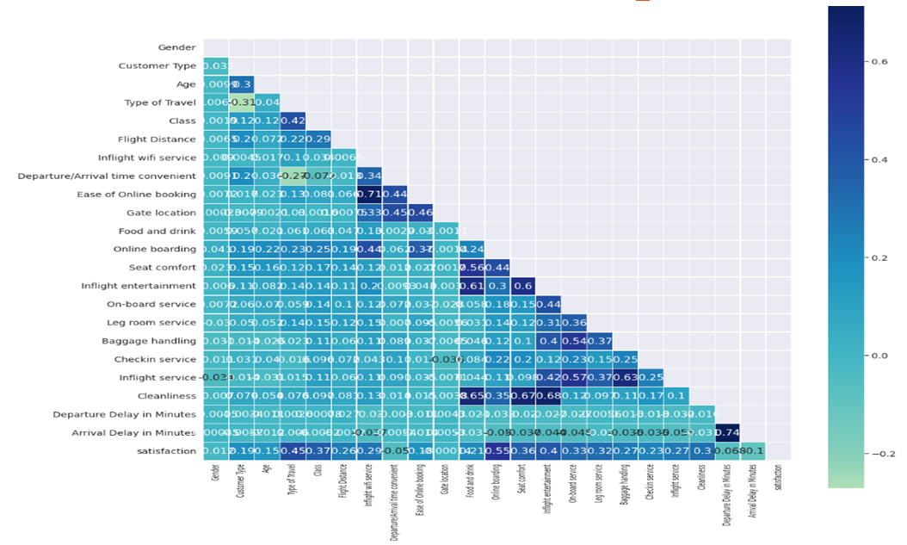
EDA – Correlation Heat map

Slide 11
EDA – Heat Map Interpretation
From the Correlation Heat map, we can observe that the factors affecting the passengers satisfaction the most are : Online Boarding, Type of travel, Inflight entertainment, Class, Seat comfort, On-board service, Leg room service, Cleanliness, Inflight Wi-Fi service and Baggage Handling.
The features which affect negatively on a passengers satisfaction are : Arrival Delay in minutes, Departure Delay in minutes, Departure/Arrival time convenient, Gender and Gate location.
Also from the above correlation plot we see that some of the features are correlated with one other i.e. multi-collinearity exists among the features. These pairs are - Arrival delay in minutes and Departure delay in minutes (0.74), Ease on online booking and Inflight Wi-Fi service (0.71), Cleanliness with Inflight entertainment(0.68), Cleanliness and Seat comfort (0.67), Cleanliness with Food and drink (0.65), Inflight service and baggage handling (0.63) and Inflight entertainment with Food and drink (0.61)

Slide 12
ML Classification Models
Logistic Regression -
Random Forests -

Slide 13
Comparison b/w ML Classification models -
Model | Training Accuracy (%) | Testing Accuracy (%)
Logistic Regression | 85.30 | 85.17
Decision Trees | 93.52 | 93.61
Random Forest | 93.47 | 92.89
KNN | 93.14 | 93.21
Ada Boost | 91.07 | 90.83
XG Boost | 94.88 | 94.23

