Slide 1
Fundamentals of Accelerated data science with rapids

Slide 2
Course goals
Learn the core tools to use RAPIDS for everyday data science
Understand RAPIDS’ scalability from workstation and cluster to cloud and HPC
Build the foundations for you to learn RAPIDS capabilities now and in the future

Slide 3
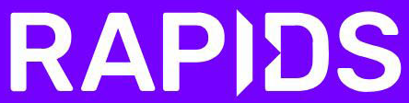
Fundamentals

Slide 4

Traditional model
APP B
Read data
APP B
APP A
GPU data
APP B
Copy & convert
CPU
Copy & convert
GPU
Copy & convert
GPU data
APP A
APP A
Load data

Slide 5
RAPIDS model
APP B
Read data
APP B
APP A
GPU data
CPU
Few or no copies to CPU
GPU w/ RAPIDS
GPU data
APP A
Load data

Slide 6

RAPIDS Platform
Dask
cuDF
Data Prep/Handling
cuML
Machine Learning
cuGraph
Graph Analytics
DL Frameworks
Deep Learning
cuXfilter
Visualization
GPU Memory
Specialized package examples
cuSpatial
Geospatial Analytics
cuSignal
Signal Processing
CLX
Cyber Analytics

Slide 7
Data science toolsets
 | CPU | GPU/RAPIDS
Data handling | pandas | cuDF
Machine learning | scikit-learn | cuML
Graph analytics | NetworkX | cuGraph
 | CPU | GPU/RAPIDS
Viz | Bokeh/ Datashader | cuXfilter
Geospatial | GeoPandas/ SciPy.spatial | cuSpatial
Signals | SciPy.signal | cuSignal
Cyber | cyberpandas | CLX

Slide 8


Requirements
Appropriate OS: Ubuntu 16.04/18.04, CentOS/RHEL 7, Windows with WSL (preview)
NVIDIA Pascal™ GPU architecture or newer
CUDA 10.1.2/10.2/11.0, drivers, etc. (see rapids.ai)
Open source/flexible mindset
Using v0.15 in this class
New versions released regularly
v1.0 TBD

Slide 9








Source code on GitHub
Containers on NGC & Docker Hub
Conda packages
https://github.com/rapidsai
https://ngc.nvidia.com
https://anaconda.org/rapidsai
rapids.ai
On-premises
In the cloud

Slide 10
Exercise data
Fused and simulated from several sources
Population data
Simulated from UK Census data on England and Wales, both from details (age, sex, given name, county) and aggregate statistics (geographic coordinates, employment)
Road network data
Nodes (endpoints/junctions) and edges of the entire road network of Great Britain
Epidemic data
Detailed hospital/clinic data from the UK National Health Service
Spread modeled on academic research on Ebolavirus risk factors

Slide 11
Section 1 01 - 04

Slide 12
RAPIDS Platform
Dask
cuDF
Data Prep/Handling
cuML
Machine Learning
cuGraph
Graph Analytics
DL Frameworks
Deep Learning
cuXfilter
Visualization
GPU Memory

Slide 13
cudf Dataframes
Pandas model: observations/records (rows) of features (columns)
Each feature/column has a single datatype
Simple, flexible interface to complex, performant datastructure
Special emphasis on columnar structure

Slide 14
RAPIDS Platform
Dask
cuDF
Data Prep/Handling
cuML
Machine Learning
cuGraph
Graph Analytics
DL Frameworks
Deep Learning
cuXfilter
Visualization
GPU Memory

Slide 15
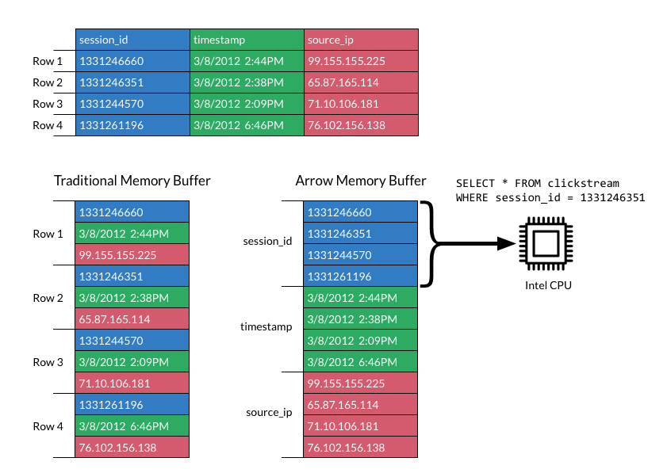

Apache Arrow
Columnar layout leverages GPU strengths
Emphasis on zero-copy and shallow-copy operations minimizes a key bottleneck
Consistency with CPU version simplifies development and conversion
gdf[‘session_id’]

Slide 16





APACHE ARROW
One format for interoperability and efficiency
cuDF
cuML
cuGraph
cuDNN

Slide 17


Interoperability
DLPack and __cuda_array_interface__
Deep Learning
Array Compute

Slide 18
Try notebooks 01 – 04 now
docs.rapids.ai/api

Slide 19
Section 1 05

Slide 20
Interoperating with cupy
CuPy:cuDF :: numpy:pandas
Not as fast as an optimized CUDA kernel, but very efficient for coding
Important to keep track of data type requirements (e.g. contiguity)

Slide 21
Coordinate systems
We will be using data that was provided in both ellipsoidal and grid coordinate formats
Grid coordinates make distance calculations more convenient within a specific area
Fusing geospatial datasets like this requires complex coordinate conversions—a perfect job for GPU acceleration!

Slide 22
Try notebook 05 now
docs.rapids.ai/api

Slide 23
Section 1 06

Slide 24
RAPIDS Platform
Dask
cuDF
Data Prep/Handling
cuML
Machine Learning
cuGraph
Graph Analytics
DL Frameworks
Deep Learning
cuXfilter
Visualization
GPU Memory

Slide 25
cugraph
node
Follows NetworkX convention for graph object
Key differences to take advantage of GPU power
Exercises
Now: steps to build a graph with from_cudf_edgelist
Later: traversing the graph with single-source shortest path
Not shown today: analyzing a graph for centralities, communities, link prediction…
0
1
2
2
1
2
edge
2
3

Slide 26
Building a graph
With from_cudf_edgelist
Undirected (Graph) vs directed (DiGraph)
Single vs Multi graphs
One source column, one destination column, one edge weight column

Slide 27
Try notebook 06 now
docs.rapids.ai/api

Slide 28
Section 1 07 - 08

Slide 29
RAPIDS Platform
Dask
cuDF
Data Prep/Handling
cuML
Machine Learning
cuGraph
Graph Analytics
DL Frameworks
Deep Learning
cuXfilter
Visualization
GPU Memory

Slide 30
Distributed Dataframes
Scaling seamlessly
Partition 0
Partition 1
Partition 2
Partition 3
Partition 4
DataFrame (pandas or cuDF)
Dask DataFrame
(same type)

Slide 31
Working with partitions
No intrinsic row ordering, so no .iloc row selection, and index is essential
Key methods operate on whole dataframe partitions
Remember distinction between multi-GPU and multi-node/multi-GPU algorithms
Rebalance across workers when necessary

Slide 32
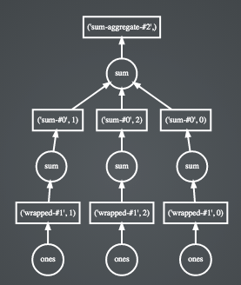
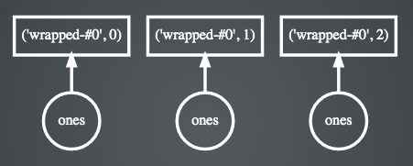
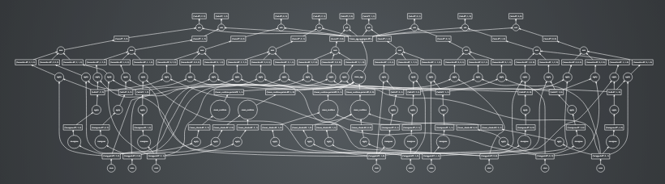
Task Scheduler
Enabling efficient compute
Compound operations
Simple operations
Complex DAG task chains
Notes:
Dask parallelizes PyData natively.
Dask.distributed is a centrally managed, distributed, dynamic task scheduler. The central dask-scheduler process coordinates the actions of several dask-worker processes spread across multiple machines and the concurrent requests of several clients.
The scheduler is asynchronous and event driven, simultaneously responding to requests for computation from multiple clients and tracking the progress of multiple workers. The event-driven and asynchronous nature makes it flexible to concurrently handle a variety of workloads coming from multiple users at the same time while also handling a fluid worker population with failures and additions. Workers communicate amongst each other for bulk data transfer over TCP.
Internally the scheduler tracks all work as a constantly changing directed acyclic graph of tasks. A task is a Python function operating on Python objects, which can be the results of other tasks. This graph of tasks grows as users submit more computations, fills out as workers complete tasks, and shrinks as users leave or become disinterested in previous results.

Slide 33
Working with the scheduler
Let Dask help you overcome your storage I/O barriers
Limit .compute (stay in Dask) until necessary
For exploratory and experimental data science, don’t be afraid to .persist
Remember that everything in a graph will be rerun without .persist/.compute— including random number generation

Slide 34
Try notebooks 07 - 08 now
docs.rapids.ai/api

