Slide 1

Capstone Presentation
Team 3:
Yeo Ping En Charmaine
MA Ka Kui

Slide 2
Project Design
Understanding, Framing Problems (News/ Article Popularity)
Problem Statement
Data Understanding & Pre-Processing
Data Cleaning, EDA, Data Viz.
ML Model (Classification)
Selections Based on Theory
Domain & Feature Knowledge
Perform CV (5-10 folds)
Testing, Refinement, Elimination
Check correlation, multicollinearity.
KNN, Random Forest, XGBoost Classification.
Recall— to correctly identify articles that are likely to do well.
Split Train-Test set 70%-30%.
Data Eng. for ML Model
Notes:
Check corr and heteroscedastic (consider PCA to reduce features)
List algorithms and metrics
Perform CV (k folds)
Do train test split

Slide 3
Domain Background
Mashable is an American digital multi-platform media company that explores topics like entertainment, culture, tech, science and social good.
Started as a simple Wordpress blog by Pete Cashmore in 2005, with Cashmore as sole author.
By Nov 2015, they’ve had 6,000,000 Twitter followers and 3,200,000 fans on Facebook.
Data was collected over few years on more than 40,000 articles.
Articles have varying levels of popularity.
There are different types of factors that may affect the popularity of the article: Article Technicalities, Type of Article, Metrics on Article.

Slide 4
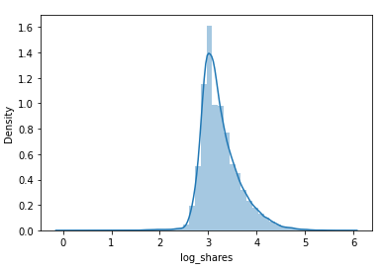
Problem Statement
Problem:
1. Will new articles be popular enough to justify spending more ad buys on them?
2. Which factors affect shares enough to continue with A/B testing?
Solution:
Supervised learning Classification model on features of articles to predict if new articles will attain a number of shares above the general median shares,
Models: K-Nearest Neighbours, Random Forest, XGBoost Classification.
Outcomes:
Shares predicted can be used to project revenue based on ads.
Ad money can be saved by prioritizing articles that are more likely to do well.
Notes:
Two objectives: predict shares and finding factors
Show distplot of log and no log
Justify choice of algorithms
Why regression? More shares = more $$$
Do regression and classification ?!?!??!

Slide 5
Datasets & Inputs
Dataset contains features about news articles published by Mashable within a period of two years.
15 Features + Target
Total: 39644 Entries
Target
shares: Number of shares
Features
n_tokens_content: Number of words in the content
n_unique_tokens: Rate of unique words in the content
num_hrefs: Number of links
num_self_hrefs: Number of links to other articles published by Mashable
num_imgs: Number of images
num_videos: Number of videos
data_channel_is_entertainment: Is data channel 'Entertainment’?
data_channel_is_bus: Is data channel 'Business’?
data_channel_is_tech: Is data channel 'Tech’?
is_weekend: Was the article published on the weekend?
global_subjectivity: Text subjectivity
global_sentiment_polarity: Text sentiment polarity
title_subjectivity: Title subjectivity
avg_positive_polarity: Avg. polarity of positive words
title_sentiment_polarity: Title polarity
Article Technicalities e.g. do more videos translate to more shares?
Type of Article e.g. Does entertainment produce more shares?
Metrics on Article e.g. positive sentiment > negative sentiment?
Notes:
1-6 data abt article (how they relate to shares)
7-9 kind of article
11-15
Intuition of how features relate to target

Slide 6
Understanding Data:
General Data Cleaning: Data’s rather clean!
There are no null values, no action required on that aspect.
97 Duplicates: To be dropped, won’t make much of a difference.
Based on heatmap, factors are not very correlated. However, VIF says there is multicollinearity present in 2 features.
Insights on the Distributions of Features
Article Technicalities:
Several features like n_tokens_content, num_hrefs, even shares are right-skewed.
Makes sense because it's easier for content production to have less content than more.
Type of Articles:
Boolean data types (no need to encode)
Metrics on article:
global_subjectivity, global_sentiment_polarity, and avg_positive_polarity all have a Gaussian Distribution, relatively unskewed.
Notes:
Check corr and heteroscedastic (consider PCA to reduce features)
List algorithms and metrics
Perform CV (k folds)
Do train test split

Slide 7
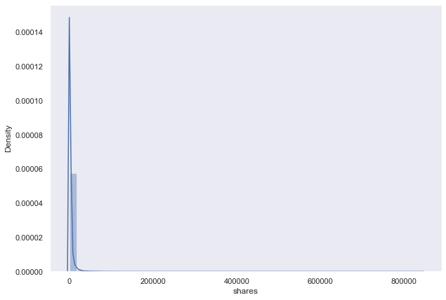
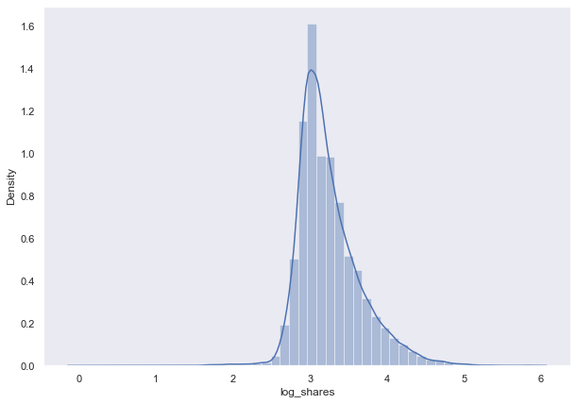
Understanding Data:
Shares
Log10 shares
Notes:
Check corr and heteroscedastic (consider PCA to reduce features)
List algorithms and metrics
Perform CV (k folds)
Do train test split

Slide 8
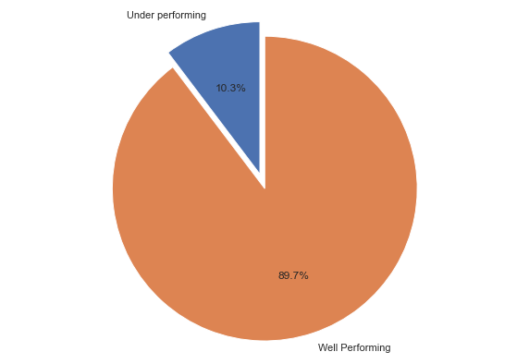
Understanding Data:
Before we drop the Outliers…
There is a higher percentage of well-performing articles than underperforming ones
….Good for you, Mashable!
Notes:
Check corr and heteroscedastic (consider PCA to reduce features)
List algorithms and metrics
Perform CV (k folds)
Do train test split

Slide 9
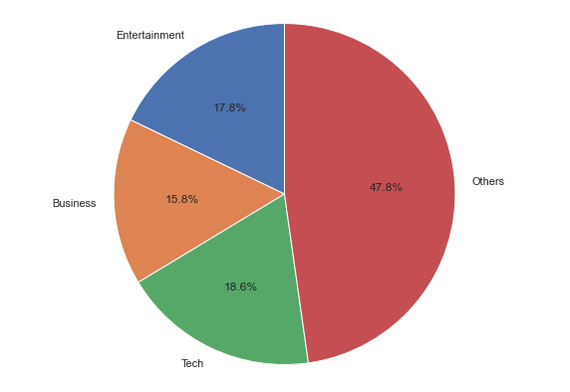
Understanding Data:
Types of Articles:
There are other “Hidden” categories of Articles.
One-Hot encoded, so we won’t know what the other categories are unless we find the original dataset or contact Mashable.
Notes:
Check corr and heteroscedastic (consider PCA to reduce features)
List algorithms and metrics
Perform CV (k folds)
Do train test split

Slide 10
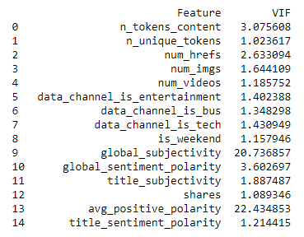
Understanding Data:
Checking for multi-collinearity
There are some pretty correlated features…
global_subjectivity: Text subjectivity
avg_positive_polarity: Avg. polarity of positive words
Suggests that Mashable articles might have a positive subjectivity to them, and that could be what makes Mashable’s Articles tick.
We could have done some feature engineering to these features, but the ML models perform better with features as is. Might be that classification models are more forgiving of high VIF than Regression Models
Notes:
Check corr and heteroscedastic (consider PCA to reduce features)
List algorithms and metrics
Perform CV (k folds)
Do train test split

Slide 11

Correlation
…we tried.

Slide 12
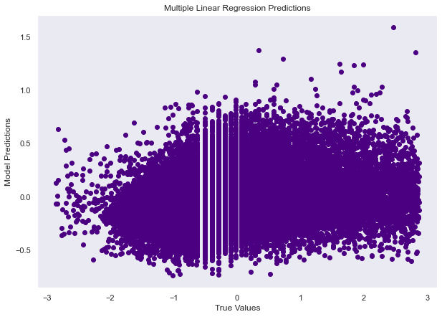
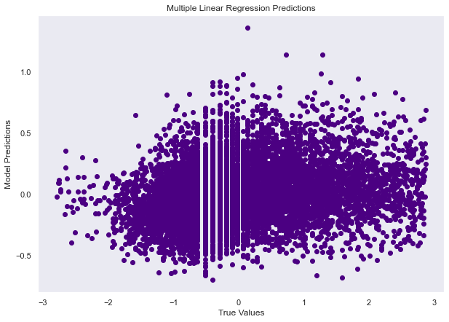
Model- Multiple Linear Regression
Train Set
R2: 0.06
RMSE: 0.97
Test Set
R2: 0.05
RMSE: 0.97
Notes:
Check corr and heteroscedastic (consider PCA to reduce features)
List algorithms and metrics
Perform CV (k folds)
Do train test split

Slide 13
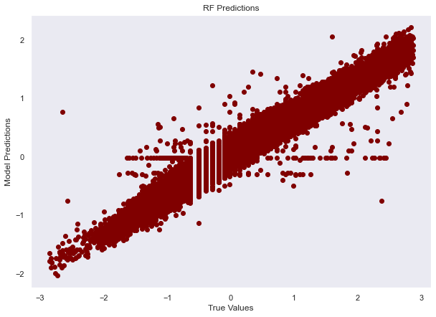
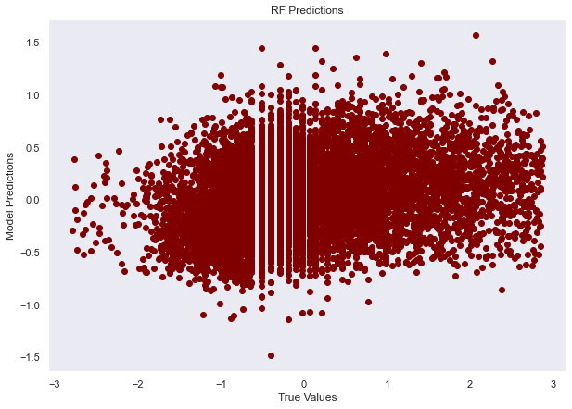
Model- Random Forest
Train Set
R2: 0.86
RMSE: 0.37
Test Set
R2: 0.07
RMSE: 0.96
Notes:
Check corr and heteroscedastic (consider PCA to reduce features)
List algorithms and metrics
Perform CV (k folds)
Do train test split

Slide 14
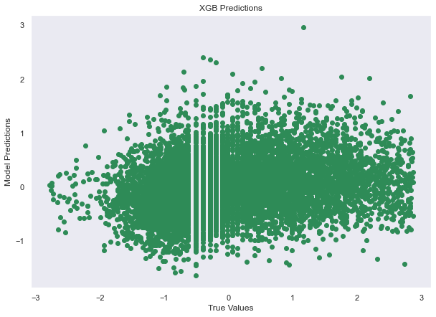
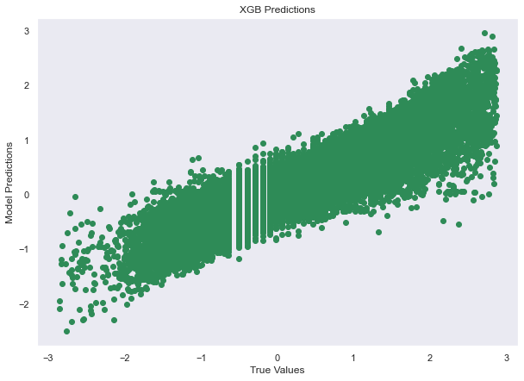
Model- XGBoost
Train Set
R2: 0.76
RMSE: 0.49
Test Set
R2: -0.03
RMSE: 1.01
Notes:
Check corr and heteroscedastic (consider PCA to reduce features)
List algorithms and metrics
Perform CV (k folds)
Do train test split

Slide 15

Classification
Now this is what we’re talking about

Slide 16
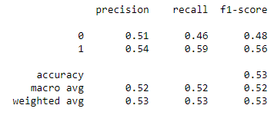
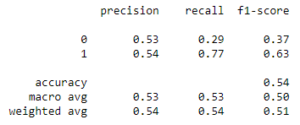
Model: K-Nearest Neighbours
❌
GridSearchCV
Recall: 0.59
✔️
GridSearchCV
Recall: 0.77
Improvement:
0.18
Notes:
Check corr and heteroscedastic (consider PCA to reduce features)
List algorithms and metrics
Perform CV (k folds)
Do train test split

Slide 17
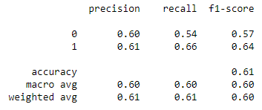
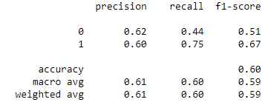
Model: Random Forest
❌
GridSearchCV
Recall: 0.66
✔️
GridSearchCV
Recall: 0.75
Improvement:
0.09
Notes:
Check corr and heteroscedastic (consider PCA to reduce features)
List algorithms and metrics
Perform CV (k folds)
Do train test split

Slide 18
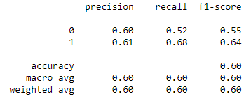
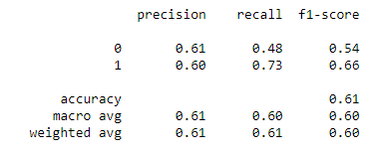
Model: XGBoost
❌
GridSearchCV
Recall: 0.68
✔️
GridSearchCV
Recall: 0.73
Improvement:
0.05
Notes:
Check corr and heteroscedastic (consider PCA to reduce features)
List algorithms and metrics
Perform CV (k folds)
Do train test split

Slide 19
Classification Models: Summary
Recall: Correctly predicted results
Why: We want to properly predict the articles that will do well, so as to prevent waste of money and effort on promoting articles that are not going to do well.
Model | Before GridSearchCV | After GridSearchCV | Improvement
KNN | 59% | 77% | 18%
Random Forest | 66% | 75% | 9%
XGBoost | 68% | 73% | 5%

Slide 20
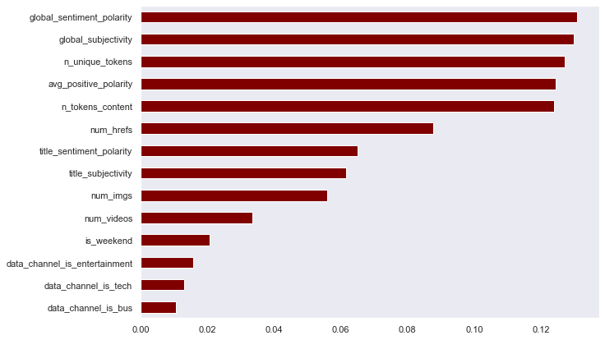
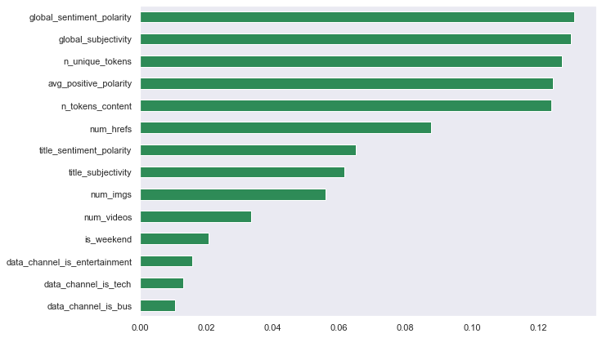
Feature Importance
Random Forest
XGBoost
Notes:
Check corr and heteroscedastic (consider PCA to reduce features)
List algorithms and metrics
Perform CV (k folds)
Do train test split

Slide 21
Feature Importance
⏳ Time to do some A/B testing!
Global_sentiment_polarity
Global_subjectivity
N_unique_tokens
Avg_positive_polarity
N_token_content
Text sentiment polarity
Text subjectivity
Rate of unique words in the content
Avg. polarity of positive words
Number of words in the content
First insights: People seem to share unique, positive content of a certain length!
Notes:
Multicollinearity – we know, but model performs better somehow
remo

Slide 22
Moving Forward:
Most likely to improve upon KNN model– showed the most potential.
Global_sentiment_polarity, Global_subjectivity, N_unique_tokens, Avg_positive_polarity, N_token_content are the features to examine and test further.
Further EDA can be done on these features.
Content team can look to starting with more positive, unique articles with differing lengths to see which readers respond to best.
There seems to be additional data available as suggested by the different types of articles (and lack thereof). Maybe Regression models can work if we get the full set of data.

