Slide 1
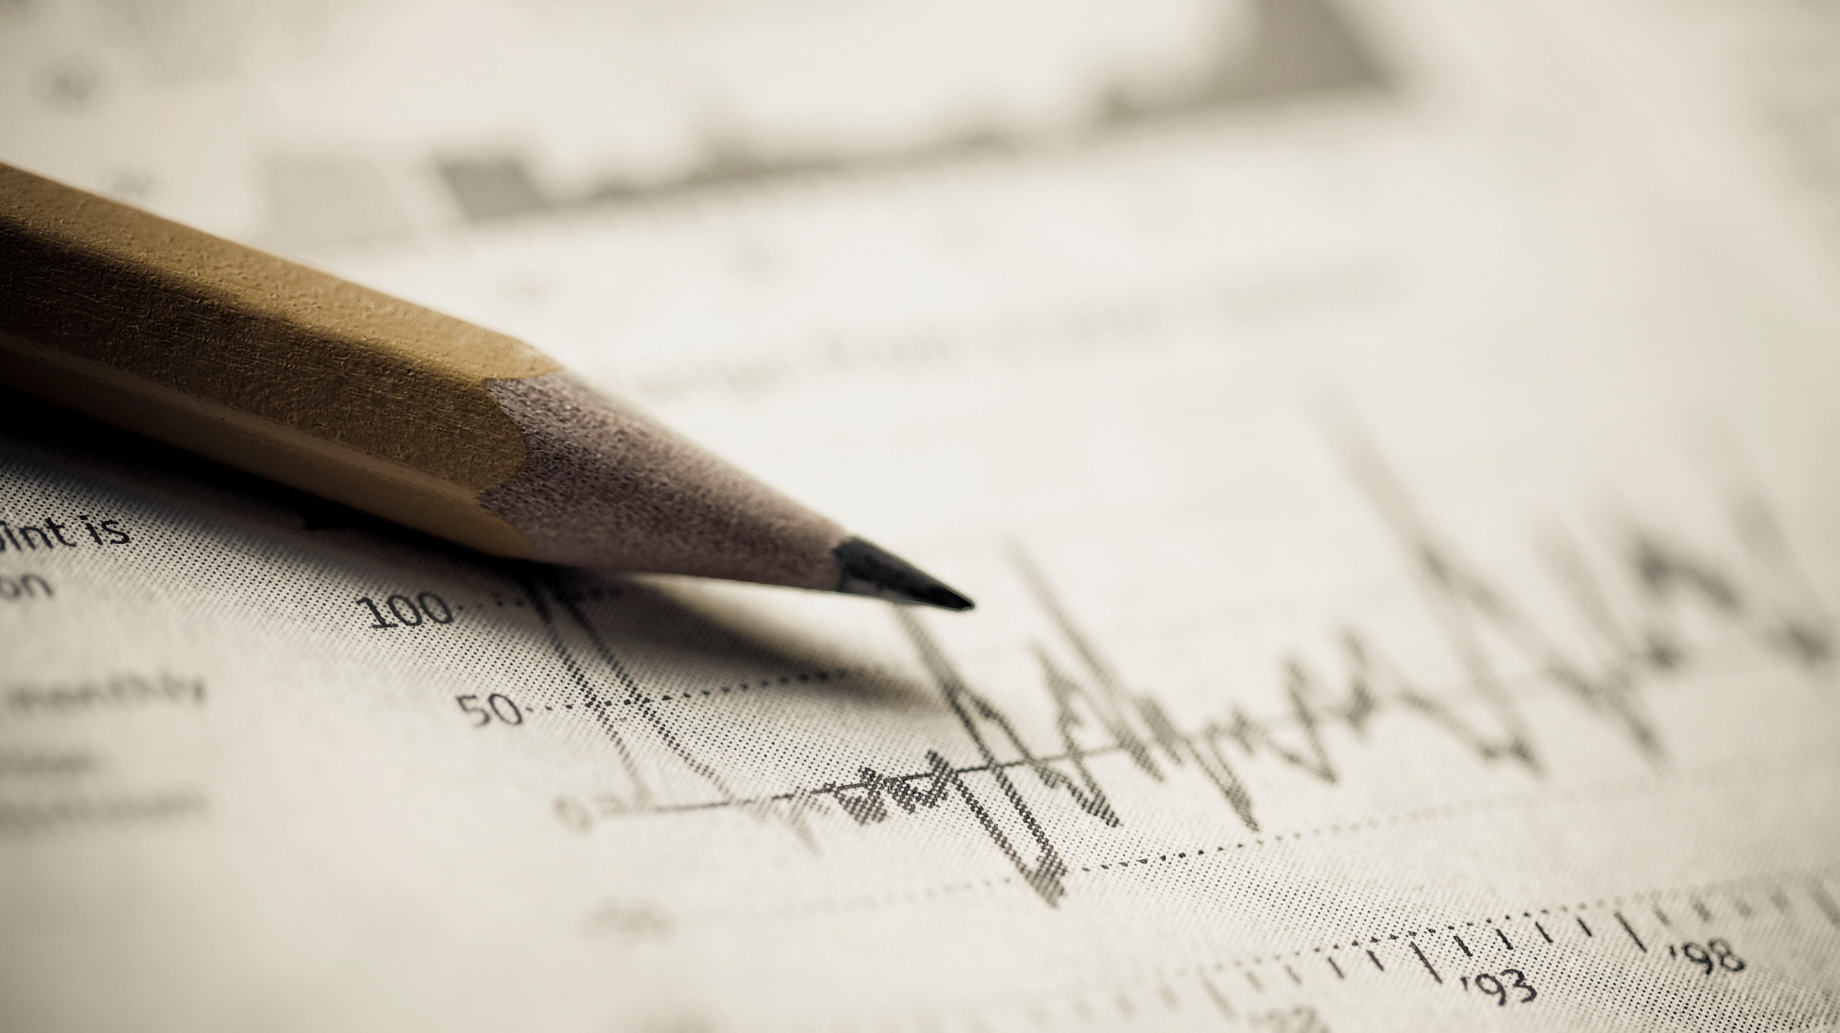
Supervised Machine Learning Final Project
Yeo Ping En Charmaine

Slide 2
Problem Statement:
As one of the leading banks in Europe, the Regional European Group of Banks (REG Banks) seeks to examine the worrying trend of increasing customer churn in recent years.
This study's main aim is to provide our marketing colleagues with better information to prevent customer churn by:
1) Identifying suitable ML models to predict customer churn.
2) Examining and appropriately selecting from the features listed below, to test and train a Machine Learning model to predict customer churn (Exited)
3) Suggest further refinement related to customer churn and further improve on the model(s).

Slide 3
Features
Independent factor: Exited feature
Dependent factors: CredRate, Geography, Gender, Age, Tenure, Prod Number, HasCrCard, Estimated Salary, ActMem features.
We have also identified the following models to examine:
Random Forest
XGBoost
K-Nearest Neighbours (KNN)

Slide 4
Data Pre-Processing
Data Cleaning
There are 10,000 rows and 12 columns,
Null Values
There are 14 rows with null values in the Age, Gender, and EstimatedSalary columns. By imputing the values with the median of Age values, the higher frequency of Gender (Male), and the mean of EstimatedSalary, we are able to manage all null values.
Duplicated Values
There are no duplicated values to manage.
Outliers
There are outliers in the CredRate, Age, and ProdNumber features. We could use the IQR method to remove the outliers. However, there are too many outliers, so we have to be careful while doing it.

Slide 5
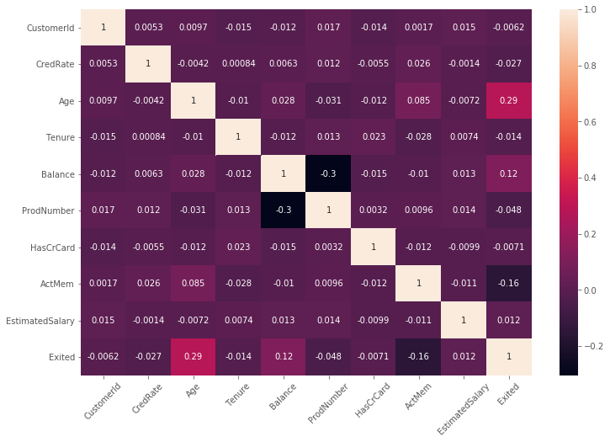
Basic EDA: Correlation
Checked correlation to get an overview of the features, and to check for multicollinearity. Features are all < 0.29 correlated, showing that they are not very correlated.

Slide 6
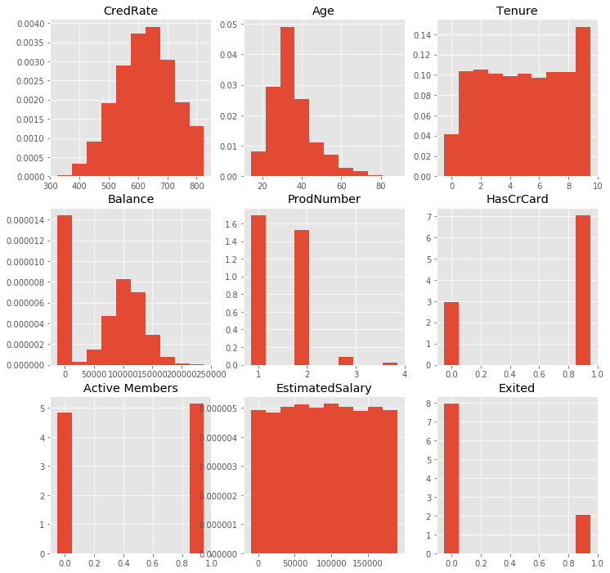
Basic EDA: Distribution
Summoned histograms of the different features to get a rough idea about the distribution of the different features.

Slide 7
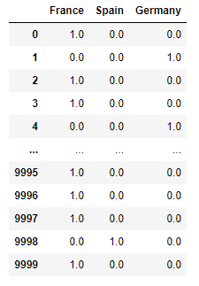
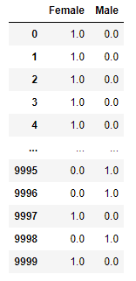
Feature Engineering
One-Hot Encoding
For Geography and Gender features, we need to encode them from categorical data into numeric data, and as there's no ranked country or gender, and not too many features already, we'll go with One-Hot Encoding.

Slide 8
Feature Engineering
Feature Selection
Forward Selection: For all 3 of the models experimented with, they turned up with the following features when put through a Forward Selection feature selection algorithm:
• RF (7) : CredRate, Age, Balance, ProdNumber, ActMem, Spain, Male
• XGB (9): CredRate, Age, Balance, ProdNumber, ActMem, France, Spain, Germany, Female
• KNN (7): Age, Balance, ProdNumber, ActMem, France, Spain, Germany
For these 3 models, the features Age, Balance, ProdNumber, ActMem, and Geography seem to be very important in maximizing the models.
CredRate and Gender were important for 2/3 models tested, suggesting that they are relatively important features as well.

Slide 9
Feature Engineering
Split Train-Test Data Sets
Split into 75% train data (7500 counts), 25% test data (2500 counts). The independent factor (Y) is Exited (whether customers remain with REG Banks).
Feature Scaling
Conducted standardization on the train data, in order to give it a mean of 0 and a standard deviation of 1, so the features can be measured on equal footing, less possibility of a feature being prioritized by the algorithm.

Slide 10



Model Selection
Classification
As we are developing a model to predict a “Yes/No” binary classification of whether a customer is going to churn, and less of a continuous number, we will be using Classification models instead of Regression ones.
Random Forest -- Harry
XGBoost-- Hermione
KNN-- Ron

Slide 11
Random Forest (RF)
Creates many different individual Decision Trees → Each individual tree in the does a prediction of the class.→ Harry will place the new value into the class with the most votes.
Why?
Can handle large datasets with higher more features to identify the most prudent variables.
Not sensitive to outliers.
Less likely to overfit if you give him the right parameters.

Slide 12
XGBoost (XGB)
Similar to Harry, but Hermione also uses gradient boosting (she places different weaker models together to help strengthen the overall result).
Creates final models based on a collection of weaker individual models the model to help lowering variance and leading to an improved result.
Selected for how how well she deals with different sizes of data, very quick scalable and quick it can be even on large datasets.
Brightest witch in her year! → Has won competitions!

Slide 13
KNN
Prefers to judge based on your closest neighbours.
Takes a look at you, and your k closest neighbours. If most of them have a white picket fence, then he will assume that you do, too.
Very often used in recommendation systems, guesses if you’re about to leave the bank just by looking at the people most similar and closest to you.
But very easily affected by outliers.

Slide 14
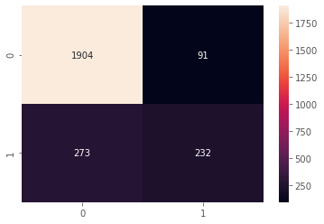

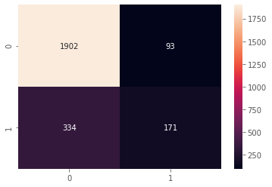
Evaluation Metrics:
Confusion Matrix: Charts out the actual target values with the predicted ones by the ML algorithm, and gives us an overview of how it is working and how much we need to improve on it.
.
RF:
XGBoost:
KNN

Slide 15
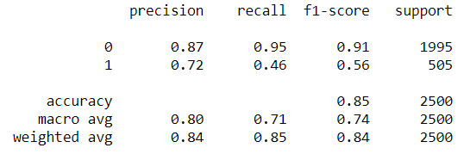
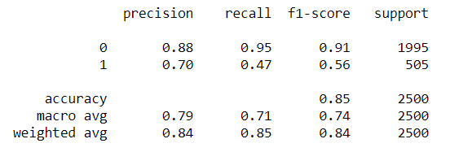
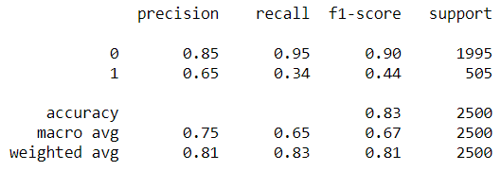
Evaluation Metrics:
Recall: used to calculate the proportion of True Positives to actual positives. We want to target people who are at risk of churning than wasting resources on people who are not.
.
RF:
XGBoost:
KNN

Slide 16
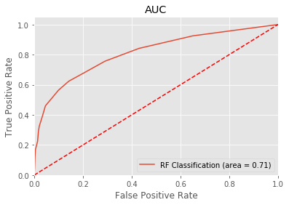
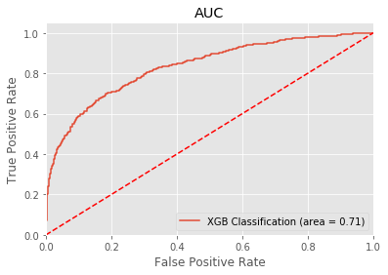
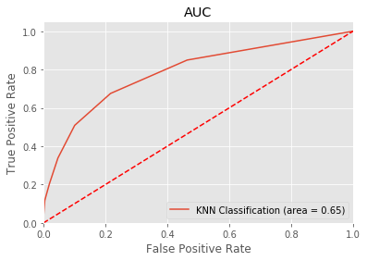
Evaluation Metrics:
Area Under Curve: measures the True Positive Rate (Sensitivity) against the False Positive Rate, of how well the predictions are ranked. Closer to 1, the better it is.
.
RF:
XGBoost:
KNN

Slide 17
Conclusion
☺
Answering the problem statement:
1) Identifying suitable ML models to predict customer churn.
Final verdict: RF and XGBoost show potential, XGBoost just slightly better than RF. By giving them more time, better parameters and less factors to draw their trees, they should be able to improve their performance.
Of the three, KNN performed the worst, as expected as there were outliers. For KNN to work well, we must be willing to drop some outliers—unless we can find a way to group those outliers together.
☹

Slide 18
Conclusion
2) Examining and appropriately selecting from the features listed below, to test and train a Machine Learning model to predict customer churn (Exited).
We have identified Age, Balance, ProdNumber, ActMem, and Geography to be important to all three of the models, and can continue to use them to test and train future data points. We’re also at about an average of 0.465 of recall for the top 2 performing algorithms, but accuracy, AUC, and precision are performing rather well, so those might be something to look into as well.
3) Suggest further refinement related to customer churn and further improve on the model(s).
With a rather lackluster recall score of even the top 2 performing models, there is an inclination that there might be overfitting, even though RF and XGBoost models are famous for mitigating that. Another possible cause might be that the decision trees in the RF and XGBoost models are growing too deep. Therefore, we might consider trying to optimize the prudent parameters in order to prune those trees.

Slide 19
Conclusion
Overall: It’s good to have a better idea of what features are more important in identifying whether or not a customer will churn. With a better understanding of the demographic and purchasing habits of our customers, we might even be able to conduct targeted studies about the psychology behind why our customers who do churn, and work to keep them. After all, it is important to understand how our customers think.
Furthermore, from a business point of view, it is cheaper to keep customers than to attract new ones.

